Slide 1
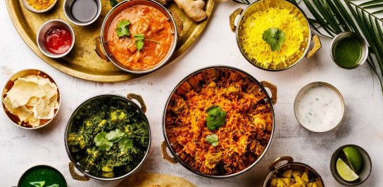
Meal Preparation Time
Created by: Charilaos Charalampopoulos

Slide 2

Agenda
Scope and problem definition
Assumptions and summary stats
Data cleansing
Answering question with data
Data analysis conclusions
Machine learning workflow
Models and evaluation metrics
Model development and results
If I had more time I would… Recommendations

Slide 3
Project Scope
Problem Definition
A food delivery company is committed to providing a delivery experience that delights their customers while still being incredibly efficient. Thus it is critical that they have the best possible model of how long it takes for a food order to be prepared. This allows them to ensure that a rider arrives at a restaurant to pick up an order exactly when the food is ready.
Perform exploratory data analysis
Present insights to the business through visualization
Build a machine learning model estimating the time that a meal needs to be prepared based on historic data
Provide recommendations regarding potential applications in production
Notes:
May require more than one slide

Slide 4

Summary statistics
Average order price
Maximum order price
Countries
26.5 GBP
711 GBP
Restaurants
4
No missing values!!
1697
Average number of items
Maximum number of items
Cities
4
38
22
Types of food
83
31 days
1st June – 1st July 2015
Average preparation time
Maximum preparation time
Assumptions
21.5 minutes
13.5 minutes
4258 minutes
4 countries at the same timezone
Same currency
Orders are not only placed for the delivery at the same day
People can order in the morning for their dinner so the this can explain very long preparation time
Types of food are not overlapping
Median preparation time

Slide 5
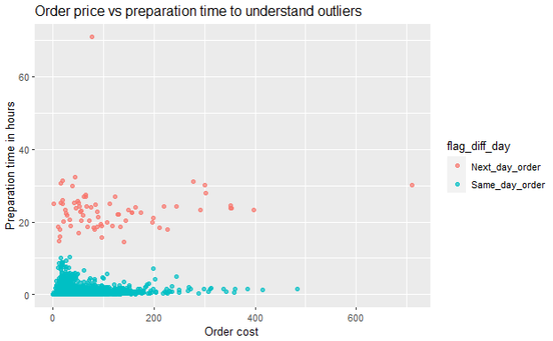
Extreme values
Business scenarios
An order can be placed to be delivered another day
An order can be made to be delivered at specific time in the same day, so the preparation can take long
The orders in 1st scenario will be called ‘next day orders’ and in the second scenario will be called ‘asap orders’
A model for each business scenario is created.
An order that took almost 3 days to be prepared and costed less than 100 GBP
The plot illustrates the relationship between order cost in GBP and preparation time in hours
Red points represent orders that were acknowledged different day compared to the date that the order got ready (74 out of around 32 thousands observations)
Extreme values can be called outliers
The business assumption we make for the analysis is that we are analysing the same day orders (the ones depicted as blue in the grah) – 1st BUSINESS SCENARIO

Slide 6
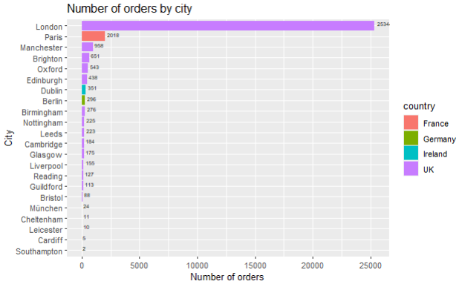
What is the city with the most orders?
The different colors show the country that the city belongs
London seems to have the vast majority with more than 2.5k
Paris is following with around 2k which is the only city from France
Ireland is only represented with Dublin and around 350 orders
Germany has restaurants in Munchen and Berlin

Slide 7
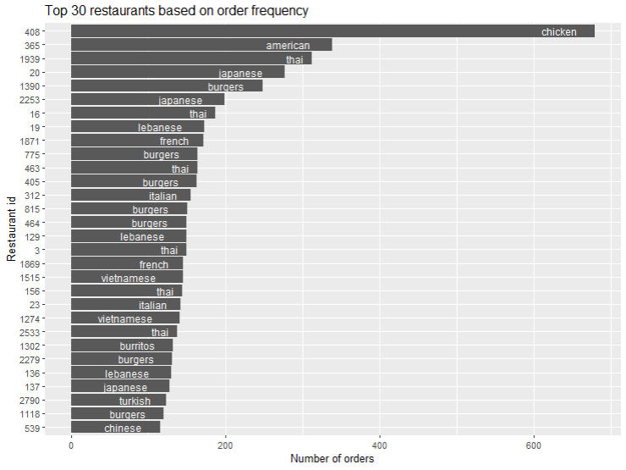
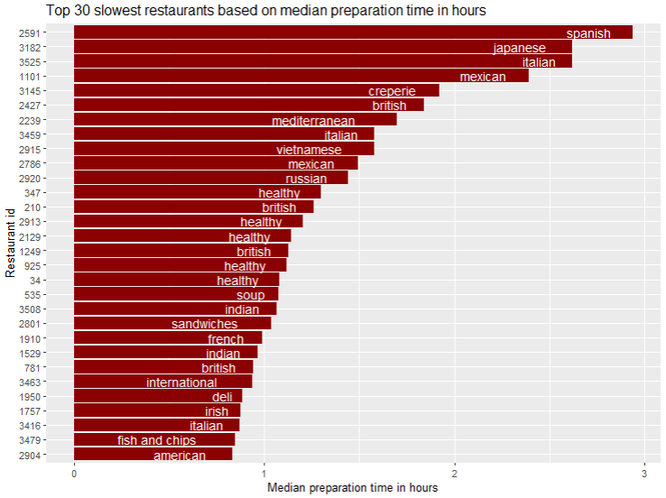
Famous restaurants / Slowest in preparation
Restaurant 408 has more than double orders in comparison with the second and has chicken as food type
The slowest in preparation restaurant is the one with id ‘2591’, has Spanish food and the median prep time is almost 3 hours

Slide 8
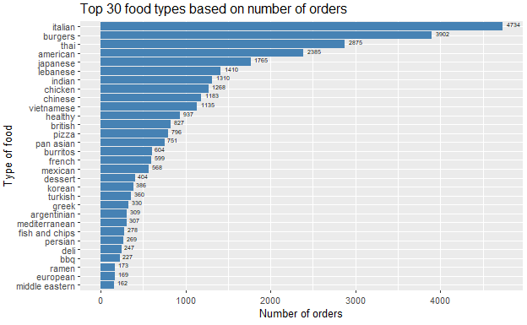
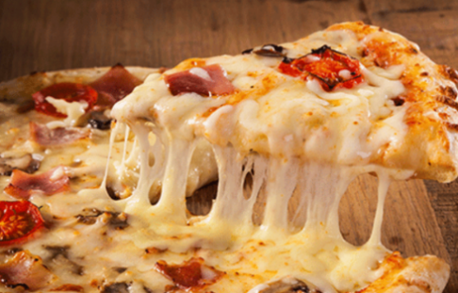
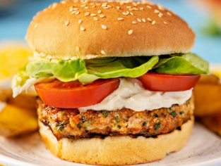
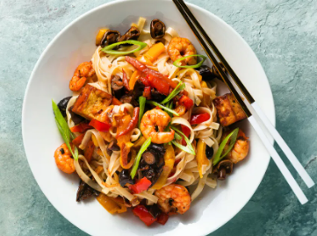
Most frequent type of food order?

Slide 9
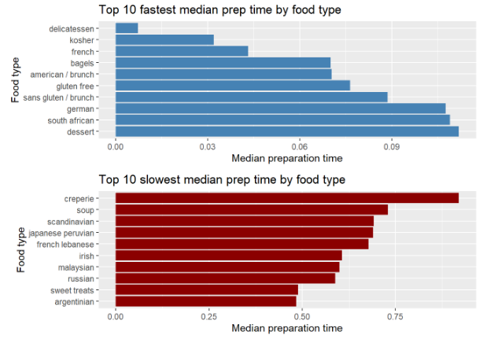
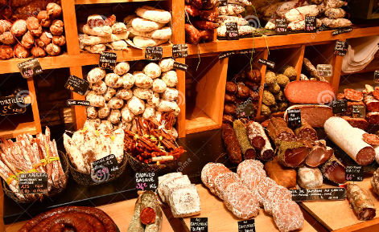
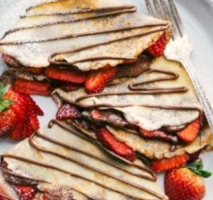
Fastest and slowest prep time in hours by food type?

Slide 10
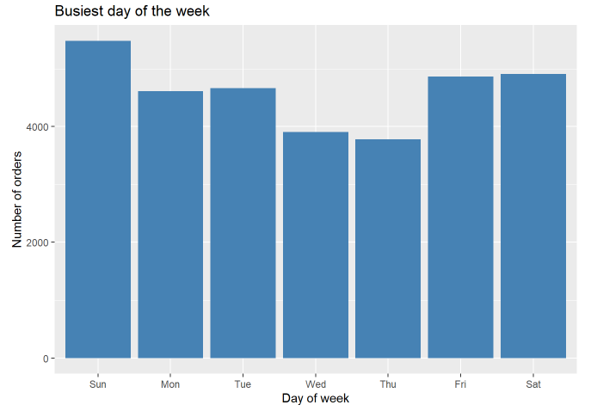
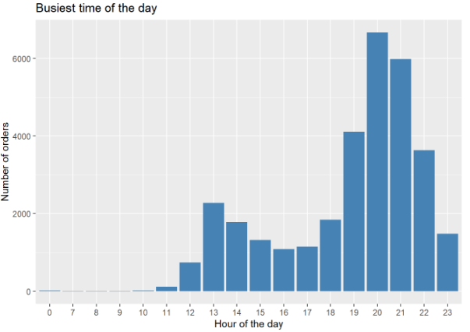
Busiest day of the week - Busiest time of the day?
The busiest time of the day seems to be from 7 to 11 pm while there are very little orders before 11 am
The busiest day of the week is Sunday and the most quiet is Thursday

Slide 11
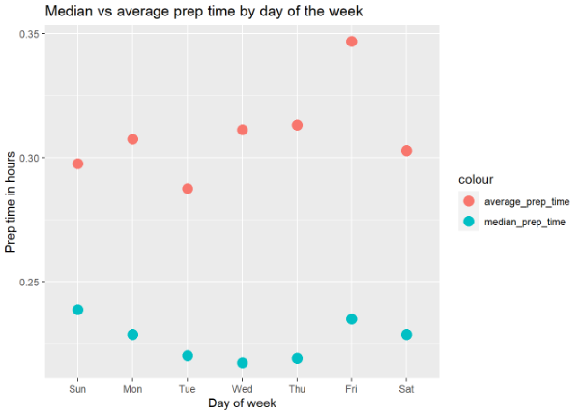
Preparation time by day of the week
Red points represent average prep time
Blue points represent median prep time
The busiest time of the day seems to be from 7 to 11 pm while the are very little orders before 11 am
The busiest day of the week is Sunday and the most quiet is Thursday

Slide 12
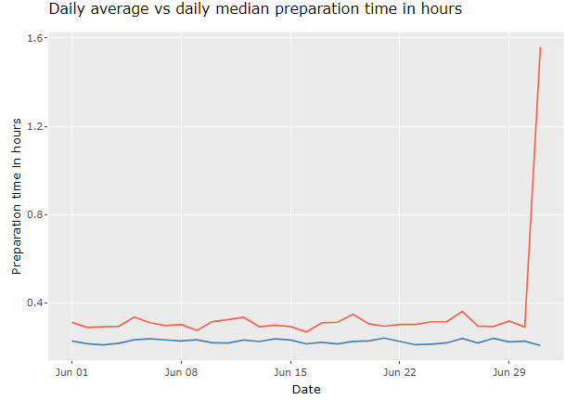
Preparation time over the days of the month
Red line indicates the mean daily preparation time in hours and the blue line the corresponding daily across the whole month
The median is consistently lower meaning that there are always cases with high values that affect the average
The average daily prep time (red line) ranges between 0.26 and 0.36 hours except for the last day that rockets up to 1,55 hours. The mean is steadily around 0.23 hours
The last day includes only 4 observations
In the report you can hover over the graph to check the daily values of the metrics interactively

Slide 13
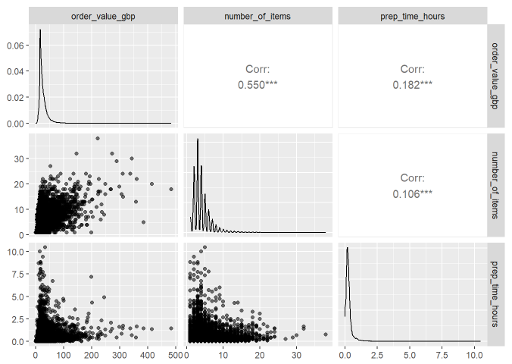
Distributions and correlations
Highly right skewed distributions indicating many little values and very sparse bad relatively huge values for all the three numeric variables
The point plots show the relationship between the variables by pairs
The corr on the three top right squares represent how strong the linear relationship between values is
Corr closer to zero implies no linear correlation while values closer to 1 indicate strong linear correlation

Slide 14
Conclusions of data analysis and exploration
Unknown if the outlier meant to be delivered next day, later in the day or ASAP so we created business scenarios
Without removing extreme values, the average prep time is 22 minutes with a median value to be 14 minutes
UK has more than 90% of the orders and the vast majority regard London
Restaurant ‘408’ has the most orders placed having ‘chicken’ as type of food
Italian food is the most popular option followed by burgers and thai
Crepes and soups seem to be the slowest in preparation
Delicatessen and kosher appear the fastest in preparation
The busiest time of the day seems to be from 7 to 11 pm while the are very little orders before 11 am
The busiest day of the week is Sunday and the most quiet is Thursday
Meals seem to get ready faster on Fridays and slower on Tuesdays
Higher number of items is not correlated with higher prep time
The higher the number of items the higher the price

Slide 15
Machine Learning Workflow
Data Cleansing
Fit machine learning models in the training data using different techniques.
Use cross validation using validation set and tune models’ parameters
In this case we trained linear regression and random forest models without parameter tuning
Feature Engineering
Identify and treat:
missing values
outliers
erroneous data
Identify appropriate performance metrics to evaluate how good the models are to predict new/ unseen data and decide what is the best model to proceed
Data partitioning
Create new predictors
Bring data to appropriate format
Transform distributions
Model development
Create and API or an application to showcase the model and the predictions at new data
Split data into:
Training
Testing
Validation
Model evaluation
Predictions

Slide 16
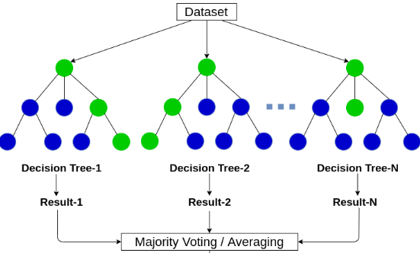
Develop two ml models
Evaluation metrics
We are dealing with a regression problem (the target is a continuous variable)
RMSE (Root mean squared error) is the metric we will consider to understand model’s performance
RMSE practically shows how far away the true values are from the model’s predictions
The lowest the RMSE the better in terms of mode’s performance
Random forest
A collection of decision trees
Average the results of the decision trees predictions creating more accurate predictions
Linear regression
Predicting the preparation time based on the linear combination of the predictors using a straight line

Slide 17
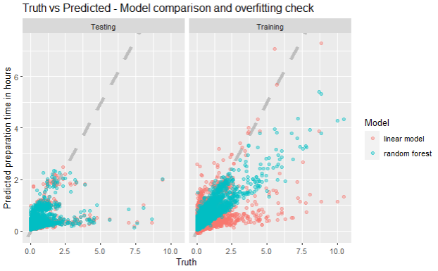
Models’ evaluation and comparison
We care about performance on test set
Models that predict accurately in the training data and not that well on the testing are ‘overfitting’ – learn too good the training data and do not generalise well
Red dots represent the linear model and the blue ones the random forest
The graph shows predictions on the vertical and true preparation times in the horizontal axis for the training (right) and test (left) data.
Points on the right hand side of the diagonal show that the model predict
The closest the points to the diagonal line the more accurate the prediction – prediction meets truth
Random forest seems to outperform linear model in the training predictions but not in the testing (left)
Non of the models can capture well the extreme values
BUSINESS SCENARIO : All orders of the same day
METRIC (RMSE) | Testing | Training
Linear model | 0.37 | 0.34
Random forest | 0.37 | 0.23
The actual value of this point is 10 hours (x-axis). The random forest estimates a little above 4 hours while the liner model estimates 1 hour (y-axis)

Slide 18
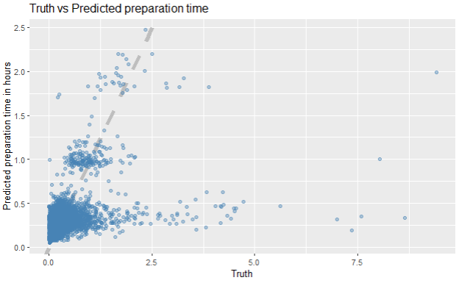
Linear regression model for all same day orders
BUSINESS SCENARIO : All orders of the same day
Does not overfit and generalizes well on unseen data. Same performance on training and testing data shows a trustworthy model
The vast majority of the points lies around the diagonal showing that predictions are close enough to the true values
Difficulty to correctly estimate extremely large values
Further improvement by penalizing non predictive variables or include interaction terms among the variables
How good our model is:
Error of 0.37 is close to zero but how close? A way to understand if the RMSE is good enough is to normalize it
RMSE / (max value – min value) = 0.37 / ( 9.41- 0) = 0.04 very close to zero indicating good performance for data that ranges between 0 and 10 hours
Test data
Error: 0.37
Very few cases that the model predicts more time needed than was actually needed
There are orders that in reality took many hours to be prepared and our model predicted that less than ¾ of an hour was needed

Slide 19
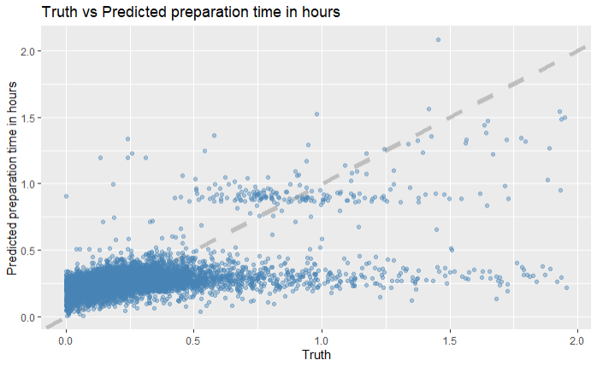
Linear regression model for ASAP orders
BUSINESS SCENARIO 2 : Only ASAP orders
METRIC (RMSE) | Testing | Training
Linear model | 0.20 | 0.18
Random forest | 0.20 | 0.13
Error: 0.20
Test data
Same logic and comparison has been made with the 1st business scenario in terms of model development
The difference is that we have removed around 400 observations that exceeded 2 hours of meal preparation considering them as outliers (statistical approach of how this cap is defined is described in the notebook)
The model has drastically improved performance as the testing RMSE is 0.2 compared to 0.37 – the lower the better
Orders that in reality take more than an hour to prepare and we predict it took less than half an hour

Slide 20
If I had more time I would:
Perform outlier analysis
Build more predictors for the model (example: count how many concurrent orders are there for the restaurant,
clustering restaurants using k-means and use the group as a factor based on restaurant similarities)
Try more modelling techniques
Perform hyperparameter tuning to improve model’s performance
Examine feature importance and indicate drivers of estimation
Create a shiny app to showcase my model
Recommendations
Create an app which takes as input the data of a new order and outputs the estimated time
Application development and usage of the model as a service in a production system
Put the model to production and enable live streaming data processing
Using cloud and computational power this model can be retrained and adjusted constantly with the latest data
Build outlier detection machine to ensure data quality
If there is an app that the store inputs (flagging) whether a particular order is to be delivered ASAP or at a specific time in the future

Slide 21
Thank you!
Questions?

