Slide 1
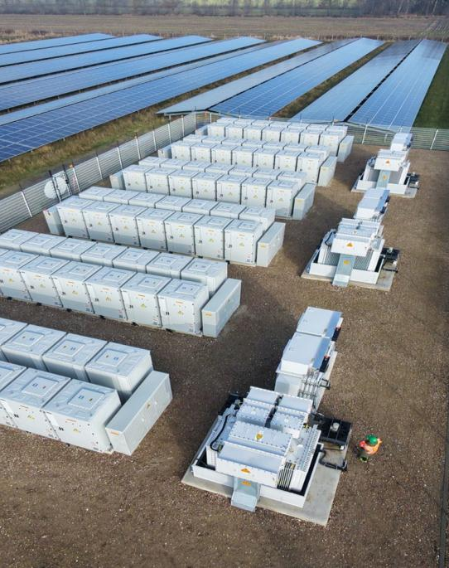

YOUR ENERGY
INFRASTRUCTURE
SHOULD PROTECT
YOUR BUSINESS.
Not compete with it for capital.
Lower energy cost, stronger resilience and the right funding route—built around your actual operation.
START MY ENERGY SNAPSHOT →
No obligation • Practical options • Clear next step
Notes:
[Sources]
- User-supplied ChariotPower - Commercial Deck.pdf.
- Chariot Power website: https://chariotpower.co.za/

Slide 2





THE PRESSURE IS ALREADY INSIDE THE BUSINESS
YOUR ENERGY RISK IS
BIGGER THAN THE BILL.
The real cost appears in margins, downtime, diesel use and delayed investment.
RISING
TARIFFS
UNPLANNED
DOWNTIME
EXPENSIVE
BACKUP
CAPITAL
PRESSURE
Operating costs climb while margins tighten.
Production and service stop when power fails.
Diesel and emergency power protect uptime—at a price.
Buying the wrong system can drain cash unnecessarily.
THE ANSWER IS NOT “MORE SOLAR”. IT IS THE RIGHT ENERGY AND FINANCE STRUCTURE.
CAPITAL. TECHNOLOGY. EXECUTION.
Notes:
[Sources]
- Pain-point framing derived from the supplied Chariot commercial proposition and official South African bank renewable-energy finance pages.

Slide 3
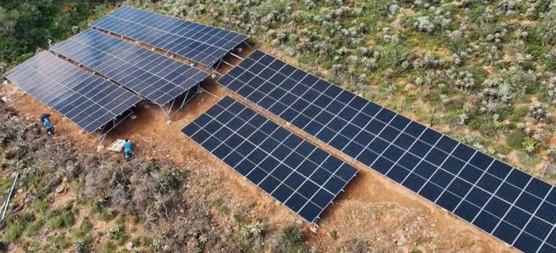
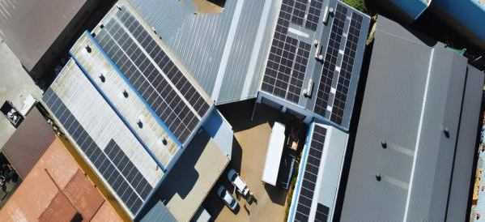
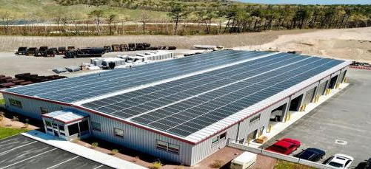
BUILT FOR WORKING OPERATIONS
YOUR LOAD PROFILE
DRIVES THE SOLUTION.
Different operations use power differently. The design must reflect that.
FARMING & AGRICULTURE
COMMERCIAL
INDUSTRIAL & MINING
Irrigation • cold rooms • packhouses • mills
Offices • retail • hospitality • portfolios
Factories • processing • heavy operations
Use daytime solar and protect essential loads.
Control operating costs across one or many sites.
Support uptime, peak demand and critical production.
CAPITAL. TECHNOLOGY. EXECUTION.
Notes:
[Sources]
- Sector imagery and sector descriptions from the user-supplied Chariot commercial materials.

Slide 4
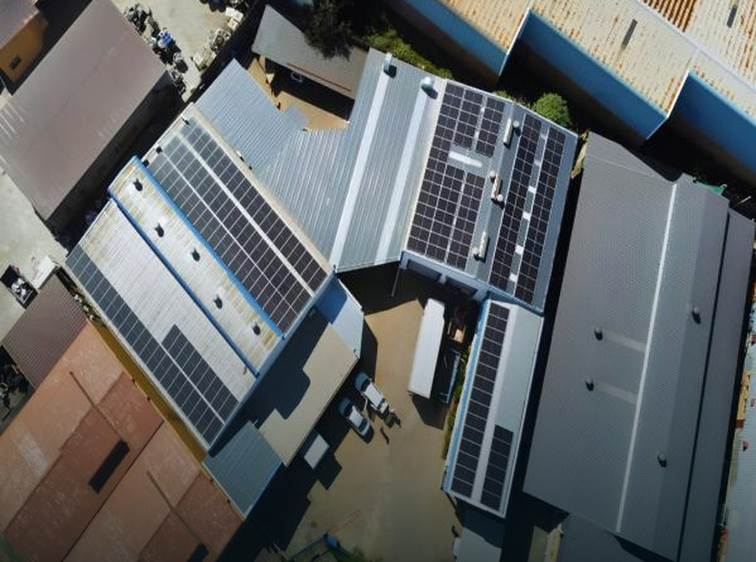
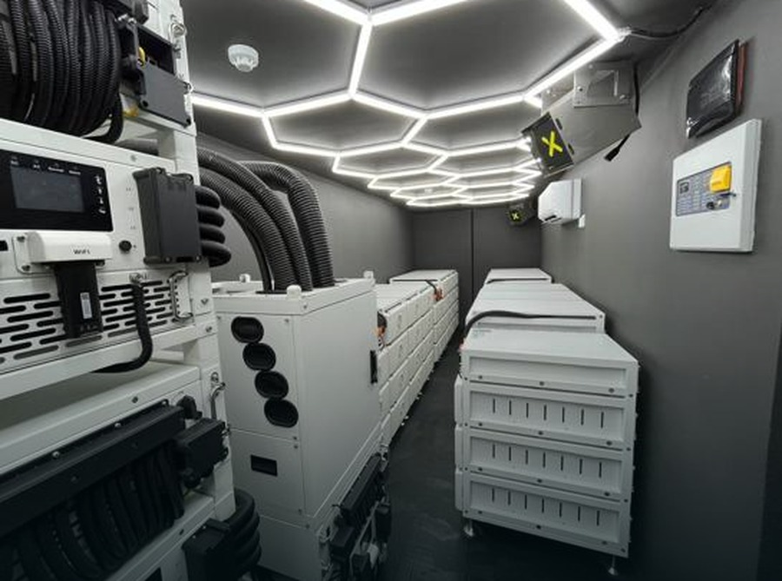
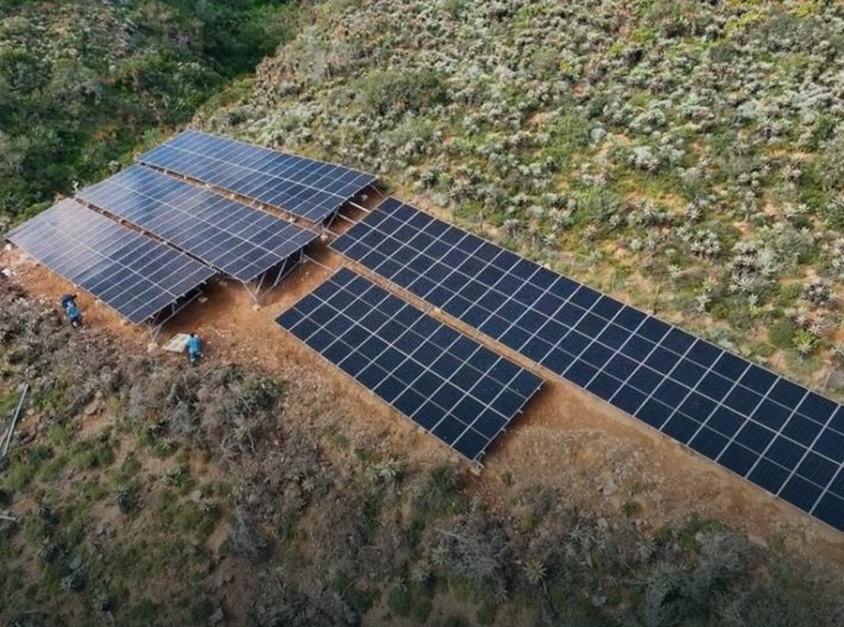
THE RIGHT SYSTEM FOR THE JOB
CHOOSE THE OUTCOME.
WE ENGINEER THE SYSTEM.
No technology theatre. The solution follows your operating priority.
GRID-TIED
HYBRID
OFF-GRID
SAVE
SAVE + PROTECT
OPERATE ANYWHERE
Best when cost reduction is the priority.
Best when outages disrupt the operation.
Best where grid supply is absent or unreliable.
Solar reduces daytime grid purchases.
Solar and storage support critical loads.
Generation, storage and controls work together.
Every system remains subject to site, load, grid, technical and commercial assessment.
CAPITAL. TECHNOLOGY. EXECUTION.
Notes:
[Sources]
- System categories derived from the supplied Chariot commercial deck.

Slide 5



FUNDING THE RIGHT WAY
THE CHEAPEST RATE IS NOT ALWAYS
THE BEST ENERGY DEAL.
Compare cash required, monthly cost, ownership and long-term spend—not interest alone.
PPA
NO UPFRONT CASH
Pay only for the power you use.
Best for cash flow
RENT-TO-OWN
LOW UPFRONT CASH
Fixed monthly payment; you own it later.
Best for eventual ownership
BANK / ASSET FINANCE
PARTIAL UPFRONT CASH
Financed through your bank or a funder.
Best for banking relationships
OUTRIGHT PURCHASE
FULL UPFRONT CASH
Own the asset outright from day one.
Best for long-term value
Bank and asset-finance terms vary by provider, credit profile and project. Chariot compares the complete commercial outcome.
CAPITAL. TECHNOLOGY. EXECUTION.
Notes:
[Sources]
- User-supplied ChariotPower - Commercial Deck.pdf, financing slides.
- Absa business solar finance: https://www.absa.co.za/business/sector-solutions/renewable-energy/solar-energy/
- FNB Alternative Energy Solutions: https://www.fnb.co.za/business-banking/industry-expertise/alternative-energy-solutions/index.html
- Nedbank renewable-energy asset finance: https://cib.nedbank.co.za/insights/articles/asset-based-finance.html
- Standard Bank Business Solar Financing: https://www.standardbank.co.za/southafrica/business/products-and-services/borrow-for-your-needs/business-loans/business_solar_financing
- All funding routes are indicative and subject to technical, credit, legal, commercial and funder approval.

Slide 6
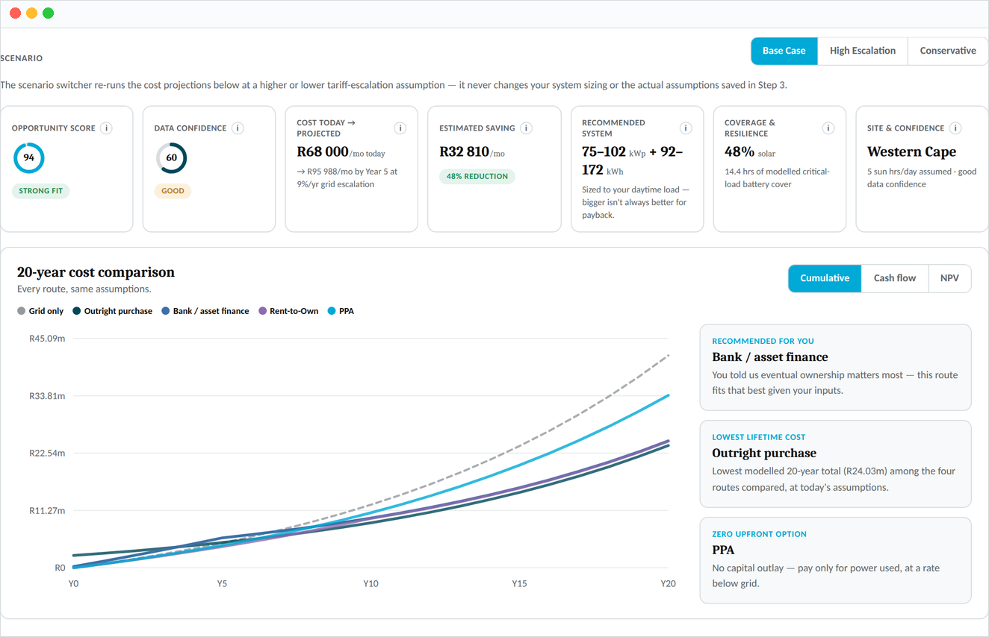
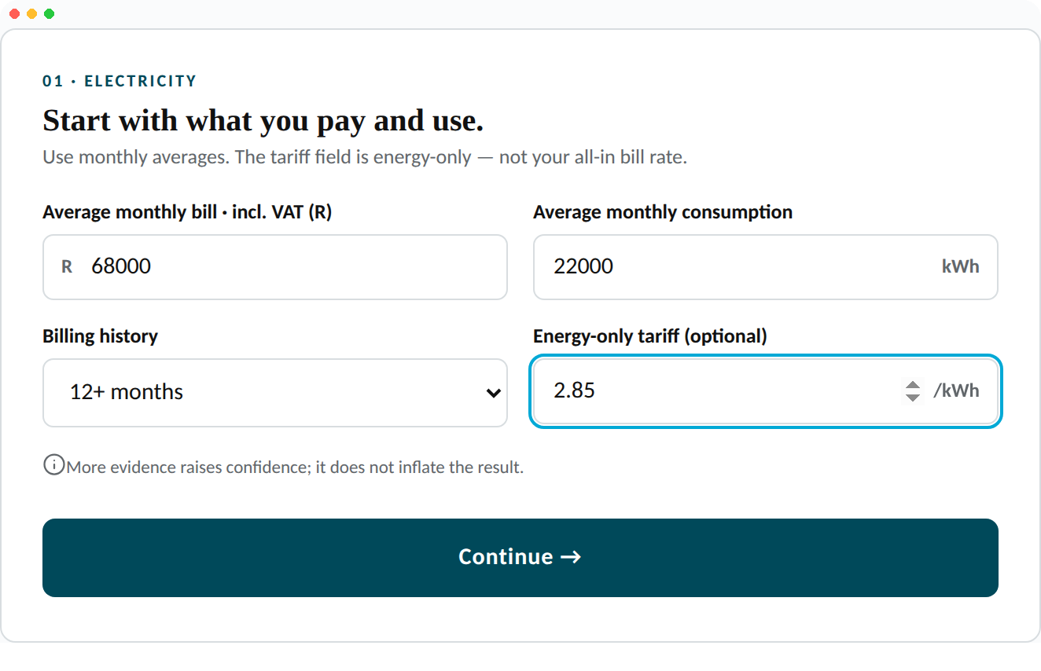
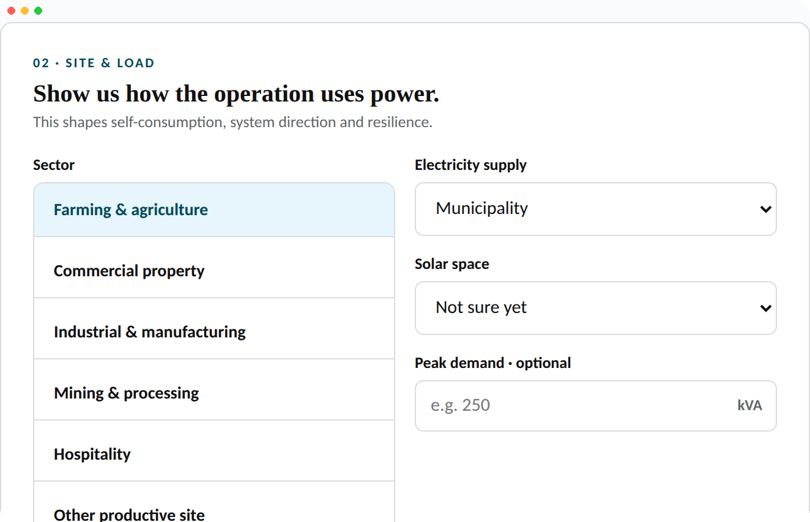
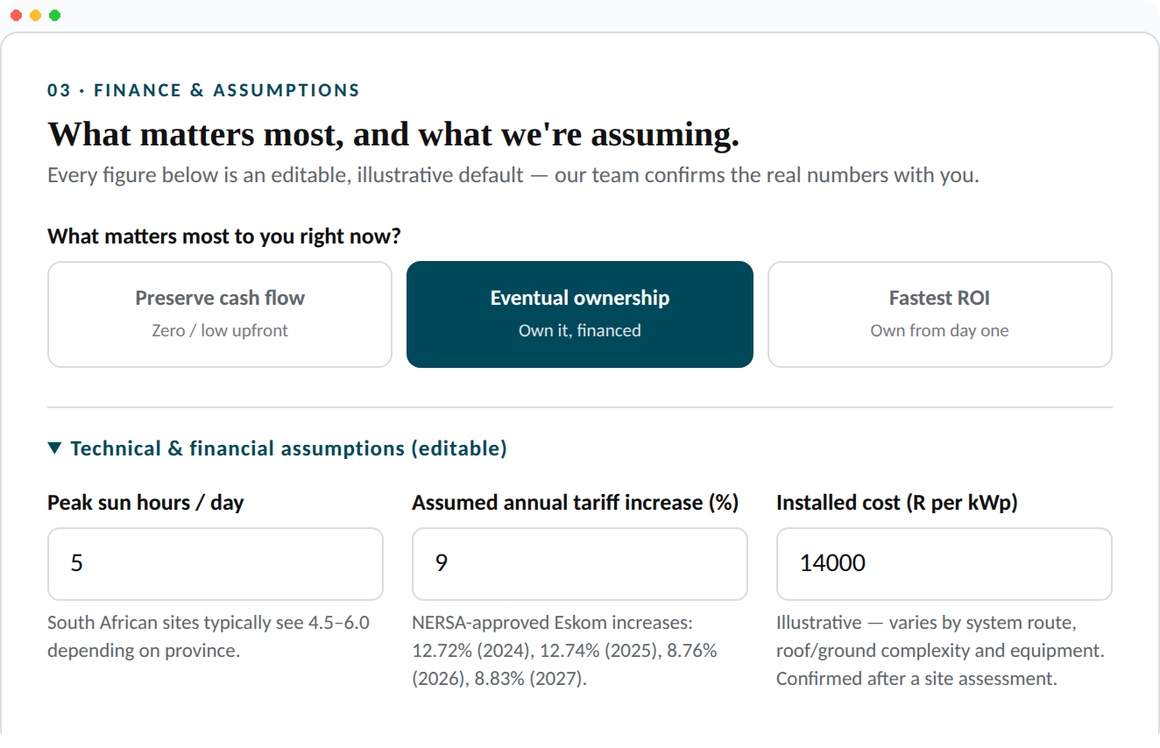
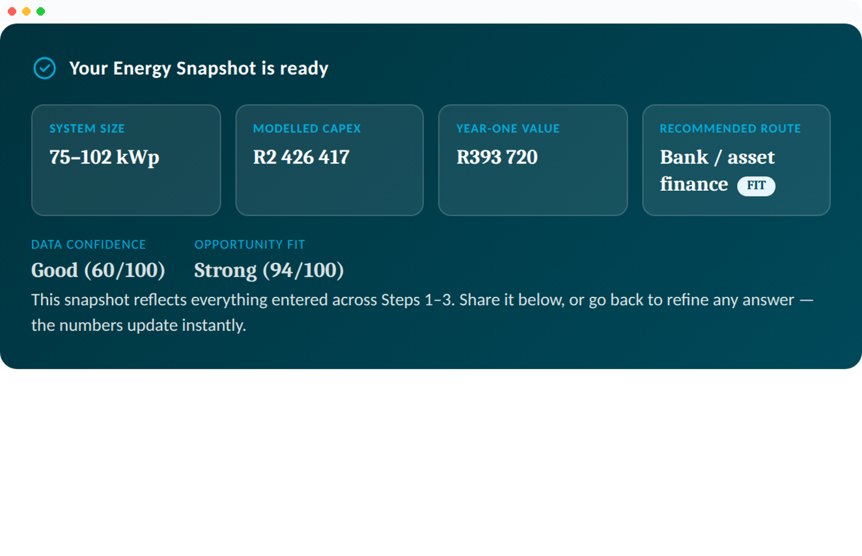
YOUR FIRST DECISION TOOL
START WITH FACTS.
NOT A GENERIC SOLAR QUOTE.
We use your real energy data to show which route deserves deeper work.
1
2
3
4
5
YOUR BILL
YOUR LOAD
YOUR SITE
YOUR OPTIONS
YOUR DECISION
Cost, tariff and usage
Daytime and critical demand
Roof, land and grid reality
System and funding routes
Proceed, refine or stop
YOUR ENERGY SNAPSHOT: A CLEAR FIRST VIEW—NOT A SALES ESTIMATE.
OPEN YOUR ENERGY SNAPSHOT →
CAPITAL. TECHNOLOGY. EXECUTION.
Notes:
[Sources]
- Energy Snapshot concept developed from the user-approved Chariot sales workflow.
- Snapshot outputs are indicative and require validation before proposal or investment decisions.

Slide 7
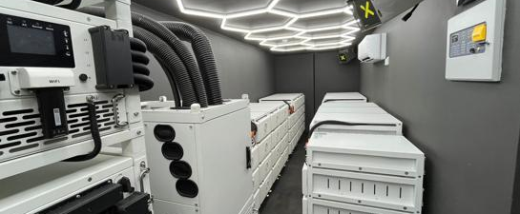
FROM FIRST VISIT TO LONG-TERM SUPPORT
FROM YOUR ELECTRICITY BILL
TO AN OPERATING ASSET.
Chariot coordinates the commercial, technical and delivery journey.
01
02
03
04
05
ASSESS
DESIGN
STRUCTURE
DELIVER
SUPPORT
Bills, site and objectives
Solar, storage and controls
Commercial and funding route
Procure, install and commission
Monitor, maintain and optimise
You keep one clear point of accountability while specialist partners perform defined project roles.
CAPITAL. TECHNOLOGY. EXECUTION.
Notes:
[Sources]
- User-supplied ChariotPower - Commercial Deck.pdf, execution process.
- Final contracting roles and responsibilities are confirmed for each project.

Slide 8
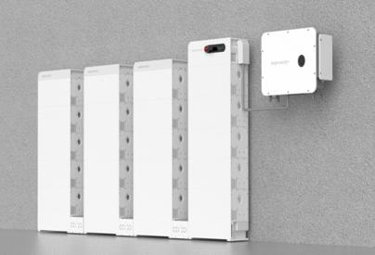
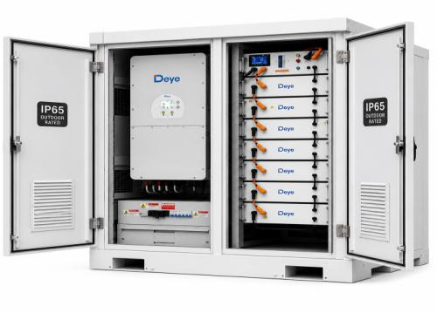
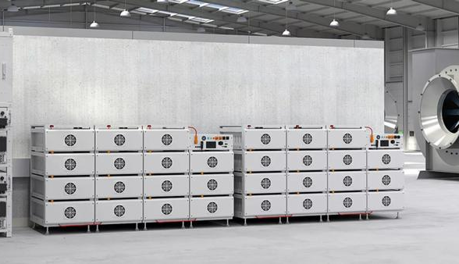
BANKABLE TECHNOLOGY
SELECTED FOR YOUR SITE.
SUPPORTED FOR THE LONG TERM.
Technology is chosen for performance, warranty, serviceability and project bankability.
MODULAR
SERVICEABLE
SCALABLE
Open architecture allows the design to follow the project—not a preferred product catalogue.
CAPITAL. TECHNOLOGY. EXECUTION.
Notes:
[Sources]
- Technology images and product references supplied in the Chariot commercial deck.
- Final products and specifications are project dependent.

Slide 9
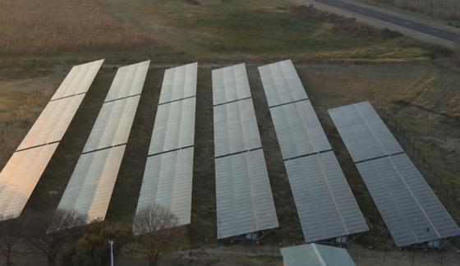
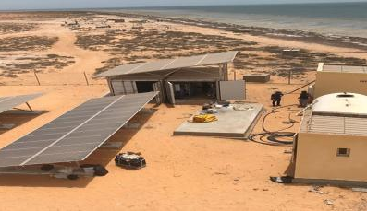
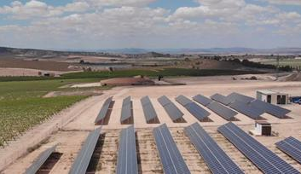
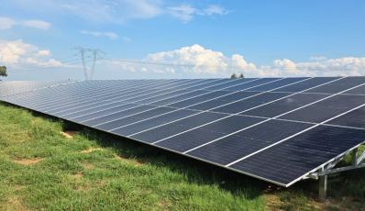
EXPERIENCE THAT TRANSLATES INTO DELIVERY
REAL OPERATIONS.
REAL ENERGY REQUIREMENTS.
Selected experience across Chariot, its team and delivery network.
3.5 MW
1 MW
1.2 MW
750 kW
Industrial foundry • South Africa
Remote hospitality • Angola
Commercial mill • South Africa
Industrial steel mill • Tanzania
250+ MW REPORTED COMBINED EXPERIENCE ACROSS THE TEAM AND DELIVERY NETWORK
CAPITAL. TECHNOLOGY. EXECUTION.
Notes:
[Sources]
- User-supplied ChariotPower - Commercial Deck.pdf, selected experience.
- Project role, completion status, client permission and reference availability must be confirmed before external circulation.

Slide 10
CHARIOT ENERGY SNAPSHOT
SEE THE TRUE COST
OF EVERY ROUTE.
One comparison using your bill, your tariff, your site and the finance quotes available to you.
COMPARE
Grid-only • cash • bank loan • asset finance • rent-to-own • PPA
MEASURE
Upfront cash • monthly payment • escalation • cumulative spend
DECIDE
Savings • ownership • payback • resilience • next-best action
ILLUSTRATIVE OUTPUT — NOT A QUOTE
The live Snapshot recalculates from client inputs and verified quotes.
CAPITAL. TECHNOLOGY. EXECUTION.
Notes:
[Sources]
- Illustrative indexed chart; not a customer quote or forecast. Actual outputs must be calculated from the client’s bills, tariff, load profile, system proposal and finance terms.
- Official product categories verified from Absa, FNB, Nedbank and Standard Bank business solar-finance pages accessed 30 August 2026.

Slide 11

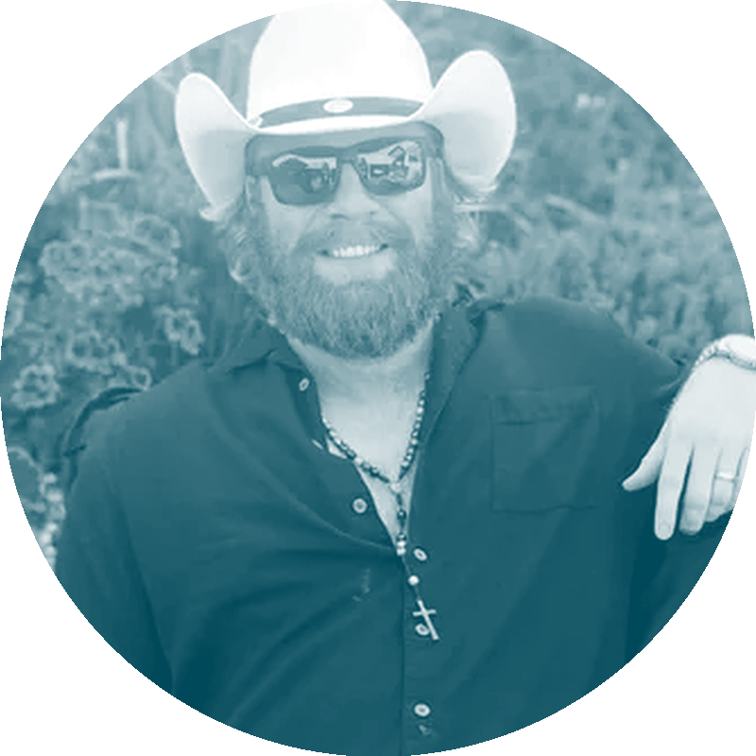



WHY CHARIOT
BIG ENOUGH TO STRUCTURE IT.
CLOSE ENOUGH TO SHOW UP.
A relationship-led South African team supported by aligned technical and funding partners.
WE LISTEN FIRST
The solution begins with your operation.
WE SHOW THE OPTIONS
Compare funding and ownership clearly.
WE STAY ACCOUNTABLE
One route through design and delivery.
JAMES
TAYLOR
WE THINK LONG TERM
14+
Support continues after commissioning.
YEARS IN SOLAR, SINCE DAY ONE
Founded by James & Taylor Blasczyk • Powered by a South African team that shows up
CAPITAL. TECHNOLOGY. EXECUTION.
Notes:
[Sources]
- Founder and positioning information supplied in the user-approved Chariot deck materials.

Slide 12
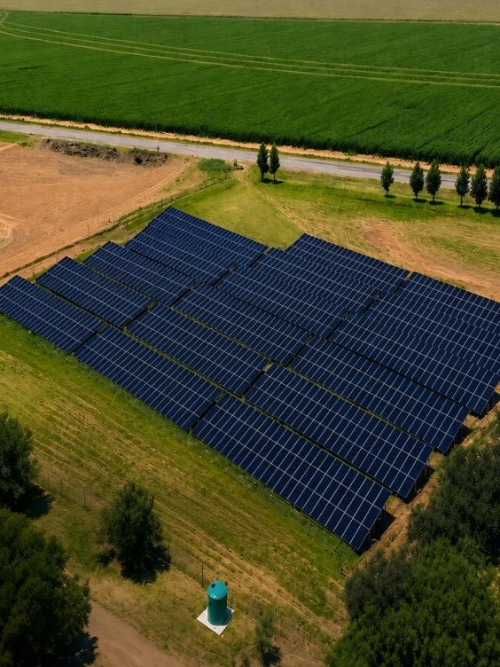
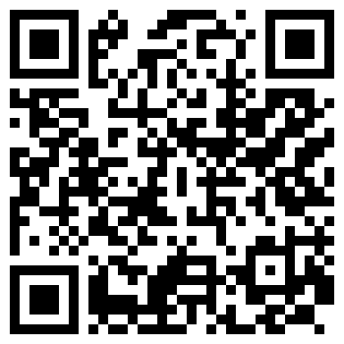
CHARIOT ENERGY SNAPSHOT
BRING US YOUR
ELECTRICITY BILL.
WE’LL SHOW YOU
THE OPTIONS.
Compare your real energy and finance options in one clear view.
GET MY ENERGY SNAPSHOT →
⏱ TAKES ABOUT 3 MINUTES
SCAN TO OPEN →
+27 66 110 5578
No obligation. Indicative assessment only. Final solutions remain subject to technical, commercial, credit, legal and funder approval.
CAPITAL. TECHNOLOGY. EXECUTION.
Notes:
[Sources]
- Chariot Energy Snapshot: https://chariot-energy-snapshot.kwoodroffe22.chatgpt.site
- Chariot Power website: https://chariotpower.co.za/
- Contact number supplied in the Chariot Power materials.

