Slide 1
Konkani Speech-to-Text
Speak in Konkani. Get Devanagari and Roman text.
Rakshita Chari - 2636
Saisha Prabhu - 2642

Slide 2
Introduction
Konkani is spoken along the west coast: Goa, coastal Karnataka, Maharashtra and Kerala.
Many scripts
Devanagari, Roman (Romi), Kannada, Malayalam
It is one of India's 22 scheduled languages, but it has far fewer digital tools than Hindi or Marathi.
Many dialects
Speech-to-text turns spoken words into written text. Our project does this for Konkani.
Goan, Mangalorean, Karwari, Malvani and more
Our output
Devanagari first, Roman as a second option
Konkani Speech-to-Text · 2

Slide 3
Problem statement
A Konkani speaker, from Goa or from Mangalore, should be able to talk to the computer and see the words written down.
Typing Konkani is slow, and people use different scripts
Common dictation tools do not handle Konkani well
Dialects like Mangalorean have little public speech data
Konkani Speech-to-Text · 3

Slide 4
Competitive analysis
Alternative | What it is | Gap for a Konkani user
Whisper, fine-tuned (ICON 2023) | Research model on about 100 hours of Konkani speech | A paper, not a ready app
SraVaani (ARTPARK-IISc) | One model for 63 Indian languages, Konkani included | For developers; no interface
AI4Bharat IndicConformer | Open models for 22 languages | What we build on; still no app
Bhashini (Govt. of India) | Public speech and translation platform | Needs internet and API access
Cloud APIs (Google, Microsoft) | Paid cloud speech services | Audio leaves the laptop; Konkani support not confirmed

Slide 5
Where our project fits
A finished app
Runs locally
Two scripts
Free parts only
Press a button, talk, read the text. Most options are only models or APIs.
After one model download, no internet and no audio sent anywhere.
Devanagari and Roman together, so the user picks what they need.
Open-source libraries and a free model. Cost is zero.
We are not claiming better accuracy than the model underneath. We make it easy to use and we are honest about where it struggles.
Konkani Speech-to-Text · 5

Slide 6
How it works
Java client
FastAPI server
IndicConformer
Text
Microphone
→
→
→
→
Speech in Konkani
Records, makes a WAV
Gets the file over HTTP
Language code kok
Devanagari + Roman
Two separate programs on one laptop, talking over 127.0.0.1:8000. Java handles the screen and the mic. Python handles the model, because the ML libraries live there.
Konkani Speech-to-Text · 6

Slide 7
The model and the audio pipeline
Java records 44.1 kHz, 16-bit mono audio
Server reads the WAV and averages to mono
TorchAudio resamples it to 16 kHz
IndicConformer decodes it (CTC) into Devanagari
Why IndicConformer
AI4Bharat, 600M parameters, Conformer encoder (convolution plus attention)
Supports Konkani, runs on CPU, about 2.5 GB
We use it as is. No training from our side.
Konkani Speech-to-Text · 7

Slide 8
Java client
Swing window: two buttons, a status line, two read-only boxes
TargetDataLine records on a background thread
Audio saved as a temporary WAV file
Multipart upload built by hand with HttpClient (HTTP/1.1)
SwingWorker keeps the window responsive while it waits
Small JSON parser reads the two fields back
Konkani Speech-to-Text · 8

Slide 9
Python server and Roman text
POST /transcribe takes the WAV and returns devanagari and roman as JSON.
Devanagari | Roman
कमल | kamal
बरें | baren
कितें | kiten
म्हजें | mhajen
The model loads once at start-up, not on every request.
Roman text comes from our own rule table: consonants, vowel signs, virama, and dropping the final a.
Konkani Speech-to-Text · 9

Slide 10
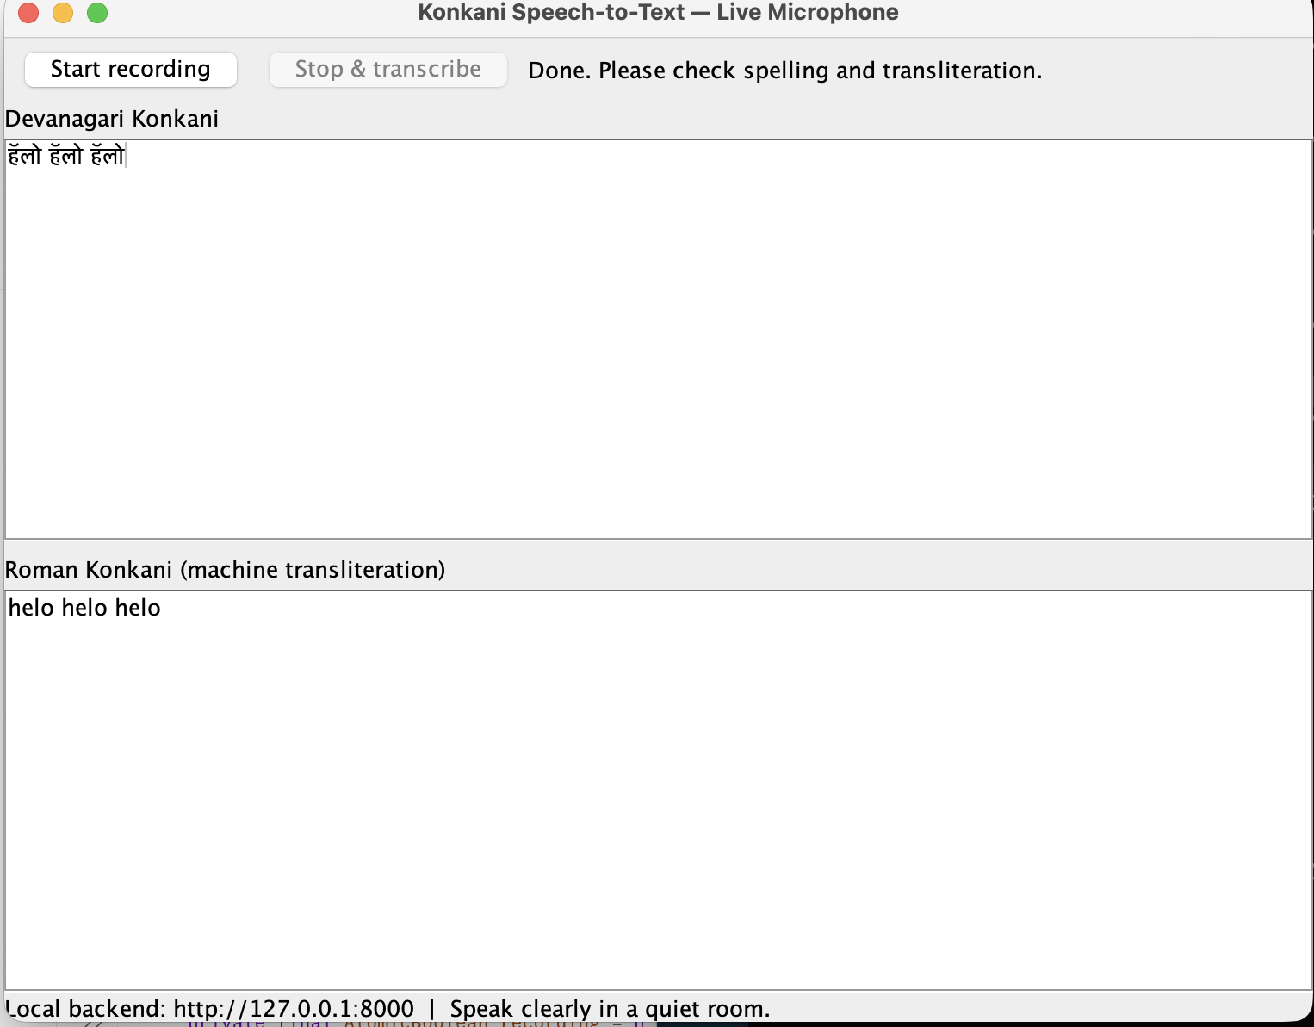
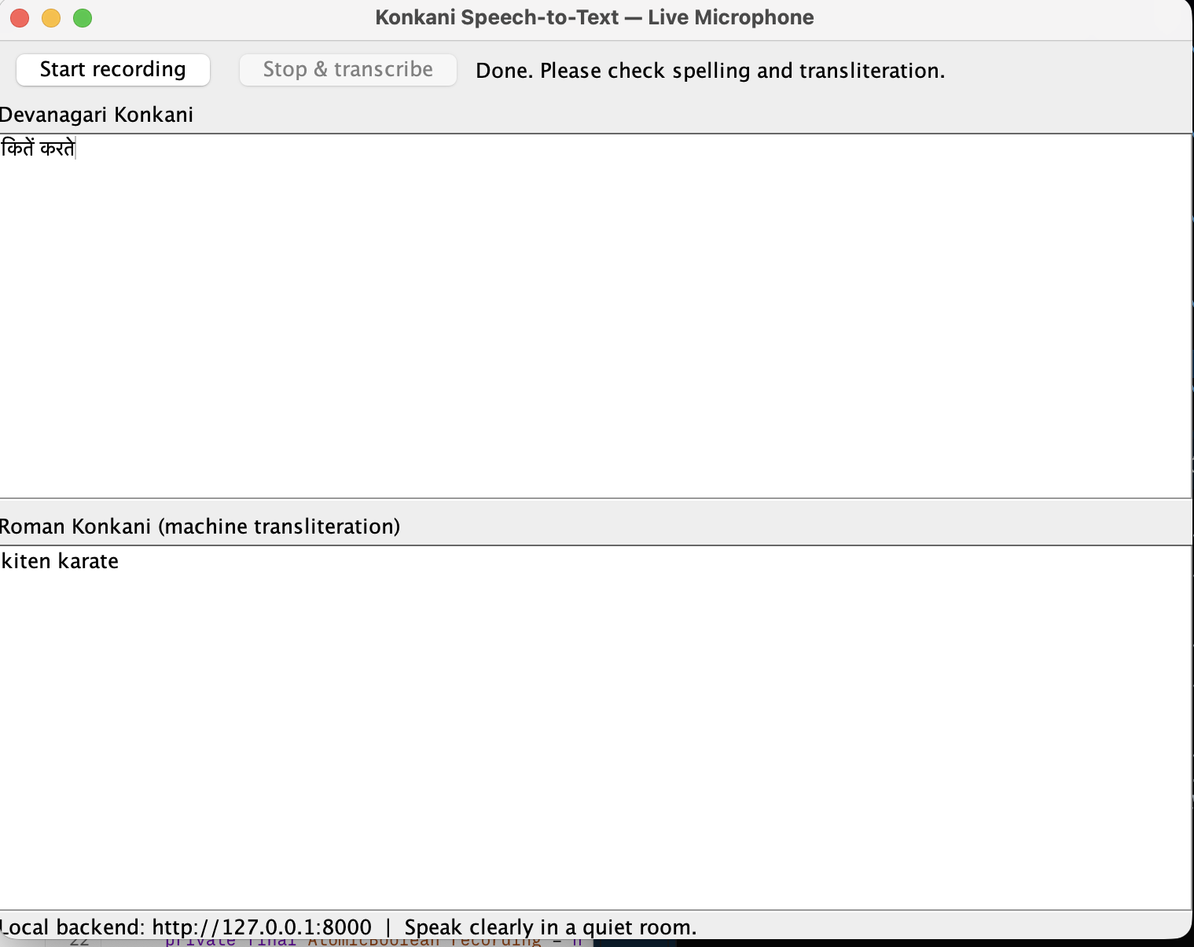
Live output from our tests
Test 1
Test 2
हेलो हेलो हेलो
कितें करते
helo helo helo
kiten karate
Konkani Speech-to-Text · 10

Slide 11
Problems we hit and fixed
Problem | Fix
Model locked on Hugging Face (401, then 403) | Access request on the right account, plus a token
Libraries failed on Python 3.13 | Moved to Python 3.12
ONNX error: path escapes model directory | Keep the model in a normal folder, no symlinks
HTTP 422, audio field missing | Forced HTTP/1.1 in the Java client
Java crash: out of memory | Restart, close big apps, then start again
Konkani Speech-to-Text · 11

Slide 12
Future benefits
For speakers
For writers and media
For culture
For research
Dictate messages and notes in Konkani instead of typing. Helpful for people who find typing in Konkani hard.
Help transcribe and archive oral histories, folk songs and sermons that exist only as audio.
A base to collect Mangalorean speech, fine-tune the model, and plug an Android or web app into the same API.
Turn interviews and radio talks into text faster, in the script the publication uses.
Konkani Speech-to-Text · 12

Slide 13
Limits, next steps, thank you
Limits
Next
Mangalorean accuracy is likely lower. A published test of this model on a Konkani community set reported 46.5% word error.
Fine-tune on Mangalorean recordings.
Streaming recognition.
Android front end on the same API.
Roman has no single spelling standard.
Smarter Roman spelling.
Not real-time, and a 2.5 GB download.
Thank you. Questions?
13

