Slide 1
An Apple A Day
Or is it a Nap? Charisa Amorie Geyer (22894551)

Slide 2
Health is Wealth
Taking care of one’s health is crucial because it impacts overall well-being, including physical, mental, and emotional health, which in turn affects daily life, productivity, and longevity.
Good health allows individuals to function optimally, cope with stress, and enjoy a higher quality of life.

Slide 3
What is BMR?
Basal metabolic rate is the speed at which your body performs basic metabolic functions.
It the rate at which your body burns calories while at rest, performing essential functions like breathing and circulation.
It represents the minimum number of calories needed to keep your body functioning at a basic level.
Essentially, it’s the energy your body uses just to stay alive when you’re not actively doing anything.

Slide 4
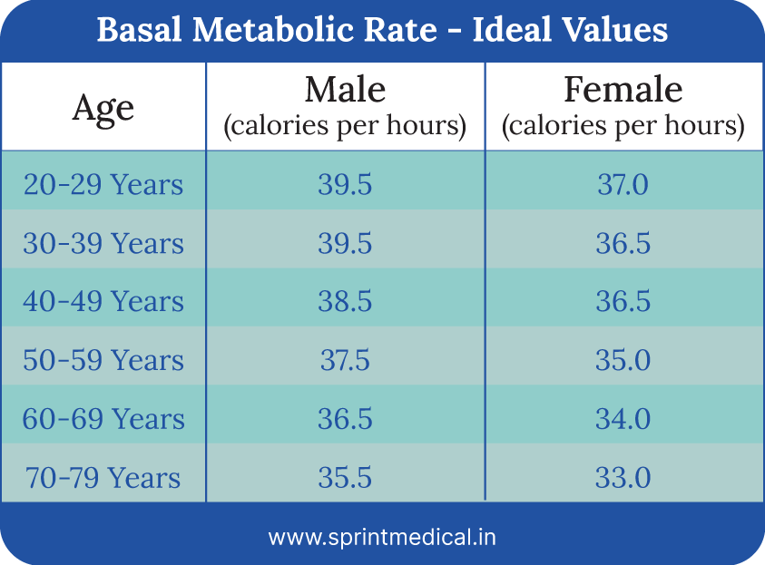
A healthy BMR threshold
The Ideal BMR by gender and age

Slide 5
Determinants of BMR
Age
Muscle mass
Body size
Gender
Physical Activity
Diet

Slide 6
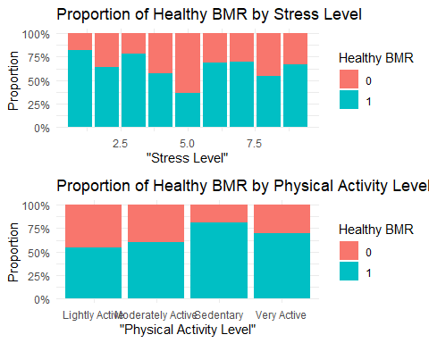
Who is healthy?

Slide 7
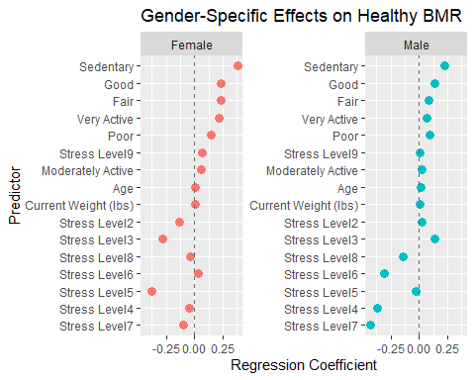
Let’s look at the stats

Slide 8
What’s next?
Sleep more
Exercise less
Stop stressing about your stress levels!

Slide 9
Thanks for listening!

