Slide 1

Note: The data and information in this document is reflective of a hypothetical situation and client. This document is to be used for KPMG Virtual Internship purposes only.
"Data-Driven Customer Targeting for Value Enhancement at Sprocket Central Pty Ltd"
Data analytics approach
Charis Chuks – Data Aunalyst Virtual Intern
13th,August 2023.

Slide 2
Note: The data and information in this document is reflective of a hypothetical situation and client. This document is to be used for KPMG Virtual Internship purposes only.
Agenda
Introduction
Project Overview
Project Goals
Scope and Phases
Data Exploration phase
Model Development phase
Interpretation phase
Expected Outcomes
Conclusion and Next Steps

Slide 3
Note: The data and information in this document is reflective of a hypothetical situation and client. This document is to be used for KPMG Virtual Internship purposes only.
Introduction
Client Profile:
Sprocket Central Pty Ltd, a respected KPMG client.
Specializes in premium bikes and cycling accessories.
Client's Goal:
Propel business growth through data-driven insights.
Focus on customer trends and behavior analysis.
Value in Data:
Existing customer datasets hold untapped potential.
Key resource for informed decision-making.
Mission:
Transform data into actionable strategies.
Maximize value and drive sustained growth.

Slide 4
Note: The data and information in this document is reflective of a hypothetical situation and client. This document is to be used for KPMG Virtual Internship purposes only.
Project Overview
Project Purpose:
Recommend targeted strategies for business growth.
Leverage customer insights as a catalyst.
Data Utilization:
Harness three vital datasets:
Customer Demographic
Customer Address
Transactions
Empowering Decisions:
Informed choices drive:
Elevated customer engagement
Enhanced revenue streams
Outcome:
Unveil untapped potential within data.

Slide 5
Note: The data and information in this document is reflective of a hypothetical situation and client. This document is to be used for KPMG Virtual Internship purposes only.
Project Goals
Goal 1: Identify Customer Trends and Behaviors
Unearth patterns shaping customer interactions.
Illuminate preferences, buying habits, and interactions.
Goal 2: Determine High-Value Customer Segments
Segregate segments with optimal potential.
Target marketing efforts for maximum impact.
Goal 3: Provide Actionable Business Insights
Translate data into strategies.
Strengthen decision-making for sustainable growth.

Slide 6
Note: The data and information in this document is reflective of a hypothetical situation and client. This document is to be used for KPMG Virtual Internship purposes only.
Scope and Phases
Project Scope: A 3-Week Engagement
Duration: 3 weeks
Aim: Deliver actionable insights efficiently
Phase 1: Data Exploration (1 Week)
Objective: Uncover data intricacies
Activities: Dive into datasets, assess quality, discern patterns and relationships
Phase 2: Model Development (1 Week)
Objective: Predict high-value segments
Activities: Create predictive models using key attributes
Phase 3: Interpretation (1 Week)
Objective: Transform models into strategies
Activities: Derive actionable recommendations for targeted approaches

Slide 7
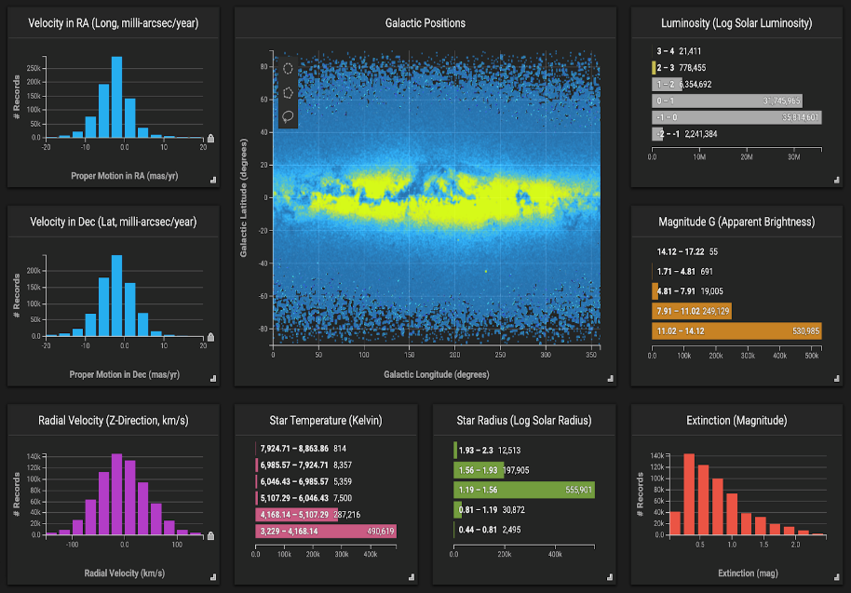
Note: The data and information in this document is reflective of a hypothetical situation and client. This document is to be used for KPMG Virtual Internship purposes only.
Data Exploration
Data Exploration Phase: Activities
Assess Data Quality and Consistency:
Evaluate completeness and accuracy.
Identify inconsistencies in data formatting.
Ensure reliable data foundation.
Address Missing Values:
Detect and handle missing entries.
Mitigate potential bias in analysis.
Ensure Consistency:
Standardize formats across attributes.
Enhance data reliability.
Analyze Customer Demographics:
Uncover insights into customer characteristics.
Identify trends based on gender, age, and more.
Analyze Addresses:
Understand geographic distribution.
Inform targeted marketing strategies
.
Analyze Transactional Patterns:
Detect purchasing behaviors and frequencies.
Identify high-value transaction patterns.
Identify Correlations and Trends:
Unearth relationships between variables.
Spot initial trends for further exploration
Place any supporting images, graphs, data or extra text here.

Slide 8
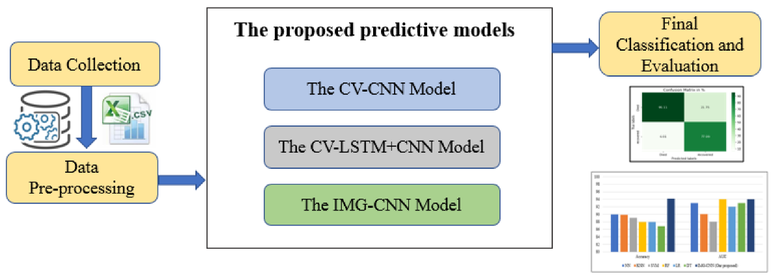
Note: The data and information in this document is reflective of a hypothetical situation and client. This document is to be used for KPMG Virtual Internship purposes only.
Model Development
Predictive Modeling: Significance
Harnesses the power of data-driven insights.
Forecasts customer behavior for strategic decisions.
High-Value Customer Segments:
Utilizes machine learning techniques.
Predicts segments with maximum potential.
Key Variables for Prediction:
Past Purchases: Identify valuable customer history.
Tenure: Gauge loyalty and engagement.
Demographics: Understand customer profiles.
Data Preprocessing:
Vital step for accurate modeling.
Cleansing, transforming, and normalizing data.
Model Training:
Ensures model learns from patterns.
Refines accuracy through iterative training.
Results:
Pinpoint high-value customers for targeted strategies.
Elevate marketing precision and effectiveness.
Place any supporting images, graphs, data or extra text here.

Slide 9
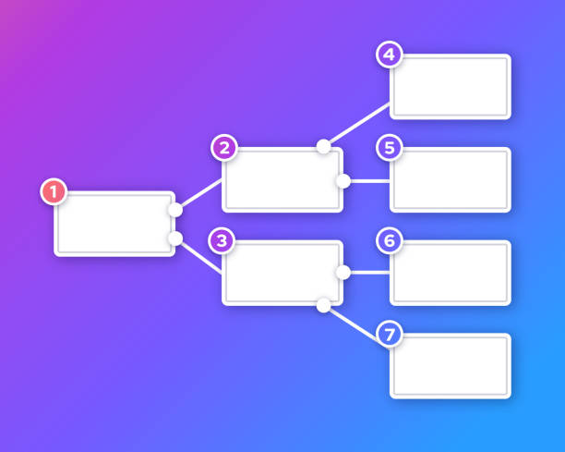
Note: The data and information in this document is reflective of a hypothetical situation and client. This document is to be used for KPMG Virtual Internship purposes only.
Interpretation
Interpretation Phase: Objectives
Extract Meaningful Insights:
Decode the model's predictions and findings.
Uncover underlying trends and patterns.
Translate into Actionable Recommendations:
Transform insights into tangible strategies.
Craft targeted marketing approaches.
Enhance Decision-Making:
Provide clear guidance for implementation.
Empower data-driven business choices.
Strengthen Marketing Strategies:
Tailor campaigns to high-value segments.
Optimize engagement and revenue potential.
Place any supporting images, graphs, data or extra text here.

Slide 10
Note: The data and information in this document is reflective of a hypothetical situation and client. This document is to be used for KPMG Virtual Internship purposes only.
Expected Outcomes
Identification of High-Value Customer Segments
Precision in pinpointing customer groups with maximum potential.
Insights into specific demographics, behaviors, and purchase patterns.
Personalized Strategies for Targeted Marketing Campaigns
Tailored approaches for each high-value segment.
Crafting messages that resonate with customer interests and preferences.
Enhanced Customer Engagement and Revenue Growth
Elevated engagement due to more relevant interactions.
Increased revenue through strategic targeting and improved customer experiences.

Slide 11
Conclusion and Next Steps
Project Summary:
Goals: Identify trends, target segments, enhance strategies.
Approach: Data Exploration, Model Development, Interpretation.
Phases: Each phase contributes to actionable insights.
The Power of Data-Driven Decision-Making:
Data insights: Catalyst for business success.
Informed strategies lead to tangible outcomes.
Timeline and Client Collaboration:
Data Exploration: 1 week
Model Development: 1 week
Interpretation: 1 week
Client's active involvement vital for effective results.
Next Steps:
Begin Data Exploration phase promptly.
Collaborate closely for optimal outcomes.

Slide 12
THANK YOU

