Slide 1


Slide 2
Agenda
Problem Statement 03
Data Mining - 01 04
Data Mining - 02 05
Exploratory Data Analysis (EDA) 06
Data Visualization 07
Algorithms Used 08
Analysis of Results 09
Conclusion & Future Work 10

Slide 3
Problem Statement
Online payment transaction is one of the important aspects of the present world .
Online payment fraud refers to unauthorized or fraudulent transactions conducted using stolen credit card information, compromised account credentials, or other malicious activities.
This dataset contains historical information about online payment transactions consists of 10 variables namely step ,type ,amount ,nameOrig ,oldbalanceOrg ,newbalanceOrig, nameDest ,oldbalanceDest ,newbalanceDest ,isFraud.
In this project , we aim to develop an accurate and efficient model that can identify fraudulent online payment transactions

Slide 4
Data Mining - 01
Firstly we load the dataset and find the different types of data available in the given dataset .In my dataset there are 3 types of data namely int64 ,float64 ,object.
The shape of the dataset is 63,62,620 rows,11 columns.
The Ratio proportion of the dataset is imbalanced with 773.7:1.As the dataset is large I applied ‘pandasql’ library to filter and manipulate data by selecting a range of 0.01.
Now the shape of dataset is 71839 rows ,11 columns.
There are duplicate values in my data set so these can be removed by using drop_duplicates() function.
There are no null values in my dataset which is found by using isnull() function.

Slide 5
Data Mining - 02
Use info() function to get the information about the dataset.
All categorical data is converted into numerical data by labelEncoder.
There are 3 attributes namely nameOrig ,nameDest ,isFlaggedFraud which does not effect the target variable so they were deleted by using drop() function.
After finding independent and dependent variables splitting of data is done.
Finally scaling technique were used to Normalize the data.

Slide 6
Exploratory Data Analysis (EDA)
In the dataset the target variable is “isFraud”.
And all the remaining variables are independent variables.
After identifying the necessary differentiating target and other variables splitting of data is done by using train_test_split() method from sklearn module.
After obtaining the train and test data , it is normalized by fit_transform() method from MinMaxScaler.

Slide 7
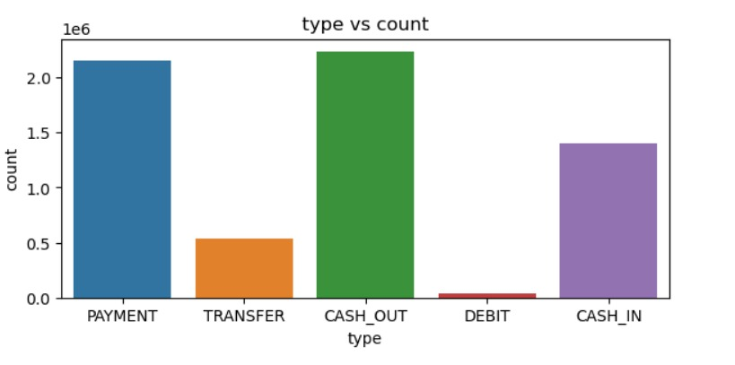
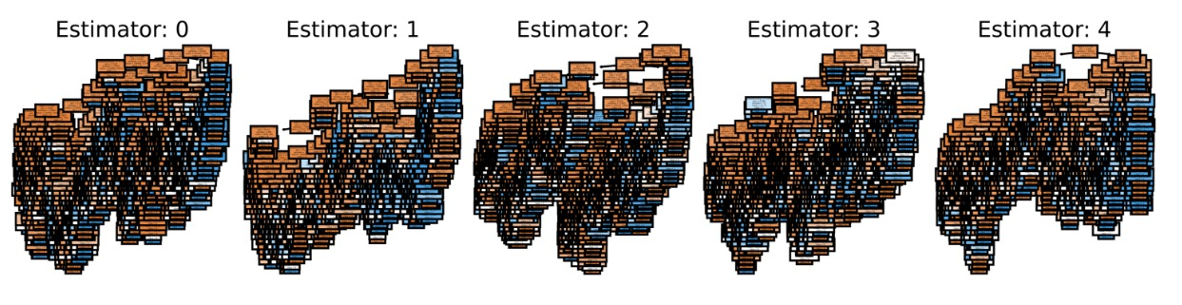
Data Visualization

Slide 8
Algorithms Used
My problem is a classification problem.
Algorithms the are applied in the classification problem is :
Logistic Regression
Decision Tree Classification
Random Forest
Extra Trees Classification
KNN Algorithm
SVM Algorithm

Slide 9
Analysis of Results
From KNN Algorithm k=3 gives the best Accuracy about 97.6%.
From SVM Algorithm kernel is polynomial that is kernel = “poly”.
From KNN and SVM by comparing all the algorithms ExtraTreeClassifier Algorithm is found to give best accuracy of all.
Best Algorithm is ExtraTreeClassifier and the Accuracy is 97.6%.

Slide 10
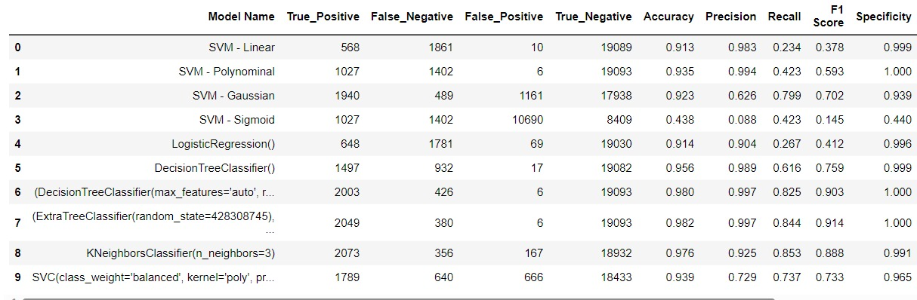
Conclusion and Future Work
After evaluating various algorithms, by observation ExtraTreeClassifier Algorithm is found to be the best and produced highest accuracy among all.
Therefore we will utilize the ExtraTreeClassifier to fraud detection.

Slide 11
Thank You
Q & A
Student Name : Rongali charishma
Regd Number : 21B91A05R3
SRKR Engineering College
Mobile:+917993008269
Email: 21b91a05r3@srkrec.ac.in
Bhimavaram - India

