Slide 1
How does public news become a market price?
INDEPENDENT STUDY · RESULTS UPDATE
Pre-declared tests, the 2015–2026 extensions and the forecast-dispersion result (H3)
Charishma, Giancarlo, Shivesh
October 7, 2026
Notes:
Follow-up to the September 30 results brief. Since then we worked through the professor's next steps: a pre-declared short-horizon measure for Q1, the macro arm extended back to 2015, matched control afternoons for every FOMC meeting, a much larger unscheduled sample, and the H3 forecast-dispersion test using Bloomberg survey data. Arc: what is new, the updated scorecard, then each result, then next steps.

Slide 2
What changed since September 30
OVERVIEW
437
90
107
425
release mornings, 2015–2026
FOMC meetings vs control afternoons
unscheduled arrivals
release mornings with survey data
Macro arm back to 2015 (was 77, all in 2024–25), with 112 control mornings
Matched 2:00 p.m. controls for 2015–2026, not only the 12 recent meetings
Price-identified jumps in ES, NQ, ZN with 373 control windows
Bloomberg forecast ranges make H3 testable for the first time
Frozen before the data were run. The short-horizon quote-revision measure (Q1) was frozen on 5 October, before any 2015–2023 window was processed. The H3 dispersion test was frozen on 7 October and run once.
Notes:
Four extensions. The macro arm grew from 77 releases, all 2024-25, to 437 releases from 2015. Every FOMC meeting now has control afternoons. The unscheduled test moved from five hand-picked corporate stories to 107 price-identified arrivals in the same three futures. And H3, which was not identified last time for lack of vintage forecast data, is now tested with Bloomberg survey ranges. Two of these were pre-declared and frozen before the data were run. Every Databento request was cost-checked and quoted at $0.00.

Slide 3
Where each hypothesis stands now
RESULTS
Hypothesis | Sept 30 | Now | Key number
H1 · numeric news priced in the first quote (>70%) | Rejected | Rejected | Arrival share median 0.32; above 0.70 in 27 of 212 releases
H2 · narrative news first-quote share <40% | Supported in sample | Half right | Statements −0.25 vs own placebo (Holm 0.003); press conference ≈ ordinary trading
H3 · slower discovery when forecasters disagree | Not identified | Rejected | β = +0.033 per sd; 95% CI −0.009 to +0.075 excludes −0.05
H4 · depth withdraws before scheduled news | Partly supported | Supported | ES −0.26, ZN −0.51 vs control mornings; none before 107 unscheduled arrivals
H5 · bigger surprise, slower pricing | More testing due | Not supported | No equity cell survives Holm; ES+NQ ρ = −0.12, p = 0.28
H6 · hawkish surprises priced slower | Not supported | Not supported | No test survives Holm at 12 or 93 meetings
Notes:
One-slide summary. H3 moves from not identified to rejected under the pre-declared rule. H4 is now a cleaner result: withdrawal before scheduled news, against control mornings and afternoons across 2015-2026, and none before unscheduled arrivals. H2 is only half right once the new measure is used: statements are trade-driven, but so are numeric releases, so the taxonomy contrast is weak. H5 and H6 are unchanged.

Slide 4
A measure anchored on the market's own arrival
METHODOLOGY · Q1
Scheduled clock
Market arrival
100 ms window
Attribute each tick
8:30:00 or 2:00:00 p.m., exchange timestamps
Median 1.05–1.3 s after the clock, not at it
Largest net midpoint move in the first 10 s
Trade (book update with a trade's timestamp) or quote revision
S = quote-attributed move ÷ (quote + trade), over the 100 ms arrival window
PLACEBOS
FREEZE
The same statistic on a pseudo clock two minutes earlier, and on matched control days. Ordinary trading sits near S = 0.50.
Frozen 5 Oct 2026 with hashes of the measure code, script and registry, after the 2024–25 development sample and before any 2015–2023 window was run.
Notes:
The market does not react at the scheduled second. After CPI and PPI the move starts a median 1.05 to 1.09 seconds after 8:30:00. A fixed window on the clock would measure noise, so the measure is anchored on the arrival: the 100 millisecond window with the largest net midpoint move in the first ten seconds. Every midpoint change in that window is attributed either to a trade, meaning the book update carrying a trade's timestamp, or to a quote revision. S is the quote share. Each event has its own placebo, the same statistic two minutes earlier, plus matched control days. On ordinary trading S sits around 0.5.

Slide 5
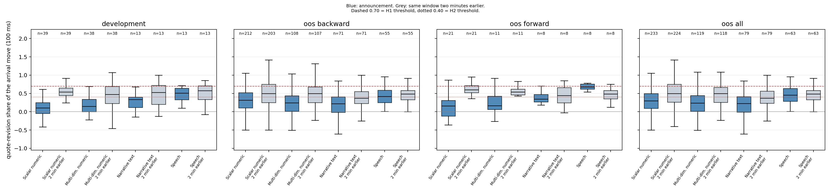
Announcements are absorbed more by trades than usual
RESULTS · Q1
Quote-revision share of the arrival move (100 ms). Blue: announcement; grey: same window two minutes earlier. Dashed 0.70 = H1 threshold, dotted 0.40 = H2 threshold.
0.32 vs 0.50
−0.25
0.42
median S for CPI and PPI releases, 2015–2023, against control days
FOMC statement minus its own pseudo clock, out of sample (n = 71, Holm 0.003)
press conference: no arrival, no difference from its placebo (p = 0.31)
Notes:
Blue boxes are announcements, grey the same window two minutes earlier. In every sample the scalar, multi-dimensional and statement boxes sit below their own placebos. The press conference does not: it has no arrival. Its largest 100 ms move in the first ten seconds is a median 1.3 bp against 5.4 bp for the statement, and its split looks like the window two minutes earlier.

Slide 6
Placebo contrasts replicate; the taxonomy does not
RESULTS · H1 AND H2
Contrast (difference in S) | Development 2024–25 | Out of sample 2015–2023 | Replicated?
CPI and PPI minus own pseudo clock | −0.38 (n = 39, Holm 0.0002) | −0.17 (n = 202, Holm < 0.0001) | Yes
Jobs report minus own pseudo clock | −0.31 (n = 38, Holm 0.004) | −0.21 (n = 107, Holm 0.001) | Yes
FOMC statement minus own pseudo clock | −0.22 (n = 13, Holm 0.65) | −0.25 (n = 71, Holm 0.003) | Yes, now significant
Press conference minus own pseudo clock | −0.17 (n = 13, n.s.) | −0.03 (n = 55, p = 0.31) | No difference in either
Statement minus press conference, same meeting | −0.05 (n = 13, Holm 0.11) | −0.20 (n = 55, Holm 0.003) | Yes
Scalar minus narrative | −0.23 (n.s.) | +0.10 (Holm 0.014) | Sign differs
Scalar minus multi-dimensional | −0.04 (n.s.) | +0.08 (Holm 0.029) | Sign differs
Reading: an announcement with a clock is absorbed mostly by trades, for a single number as well as for a statement. The scalar-over-narrative gap is small and unstable, so H1 and H2 as written do not hold.
Notes:
Development is 2024-01 to 2025-09, which was inspected before the freeze. Out of sample is 2015 to 2023, run once afterwards. The event-minus-placebo contrasts all replicate, and the statement result becomes significant with 71 meetings. The scalar-versus-narrative ordering, which is what H1 and H2 were meant to carry, changes sign. Without the vendor-flagged September 2025 meeting, the development statement figure is -0.23 and the conclusions are unchanged.

Slide 7
Releases arrive a second late and are absorbed faster
RESULTS · MACRO 2015–2026
Medians, 2015–2026 | ES | NQ | ZN
Arrival after 8:30:00 | 1.31 s | 1.35 s | 1.27 s
|Move| after 5 s / 60 s / 5 min, bp | 5.2 / 9.0 / 11.7 | 6.4 / 10.3 / 14.3 | 7.9 / 9.2 / 10.3
Time to half / 90% of the 5-min move | 6.8 s / 31 s | 7.4 s / 38 s | 1.5 s / 10 s
First-quote share of the 5-min move | 0.000 | 0.000 | 0.000
Releases with that share above 70% | 0.9% | 2.3% | 0.0%
S at arrival / at pseudo clock | 0.19 / 0.50 | 0.29 / 0.66 | 0.15 / 0.50
ABSORPTION GOT FASTER
13.8 s → 1.3 s
ES time to half of the five-minute move, 2015–2019 vs 2024–2026
437 / 112
release mornings / control mornings; vendor-degraded days excluded from every test
Notes:
437 release mornings: every CPI, PPI and Employment Situation release from January 2015 on the official BLS schedule, plus the 2024-25 retail sales releases. The first-quote share of H1 as written is zero in every contract. Absorption has sped up a lot: ES reached half of its five-minute move in a median 13.8 seconds in 2015-2019 and 1.3 seconds in 2024-2026.

Slide 8
Before 8:30, ES and ZN pull depth; NQ widens its spread
RESULTS · H4 · MACRO
93 / 112
months with lower ES depth on release mornings: −0.26 (95% CI −0.31, −0.20)
105 / 112
months with lower ZN depth: −0.51 (95% CI −0.55, −0.46)
+2.41 ticks
NQ spread change vs control mornings (95% CI 1.99, 2.86)
Notes:
A control morning is the same 8:30 window on a day of the same month without a release. Depth ratio is the final minute against the prior three minutes, time-weighted from tick data, paired by month. ES and ZN withdraw clearly against controls. NQ depth does not move, but its spread widens by about 2.4 ticks more than on control mornings. 25 of the rule-based controls turned out to have an 8:30 volume spike, probably a Census or BEA release; dropping them leaves ES at -0.27 and ZN at -0.54.

Slide 9
FOMC withdrawal holds against 2015–2026 control days
RESULTS · H4 · FOMC
2015–2026, 90 MEETINGS
0.28
ES: depth relative to control days in the final minute
0.66
NQ: depth relative to control days in the final minute
0.08
ZN: depth relative to control days in the final minute
Within-event, without controls: 92 of 92 statement windows have a depth ratio below 1 (sign p = 2e-28).
Notes:
Last time the 93-meeting H4 test was within-event only, without controls. Now every meeting from 2015 has matched control afternoons at the same clock. The final-minute depth ratio relative to control days is 0.28 in ES and 0.08 in ZN, in every period. NQ is the exception again, at 0.66, and fading over time; the next slide explains why.

Slide 10
NQ withdraws through its spread, not its depth
RESULTS · H4 · WHY NQ
FOMC, final 60 s vs control days | ES | NQ | ZN
Normal spread, ticks | 1.01 | 1.73 | 1.00
Time at a one-tick spread | 99% | 42% | 100%
Depth ratio | 0.28 | 0.66 | 0.08
Spread ratio | 1.36 | 2.57 | 1.19
Depth per tick of spread | 0.20 | 0.26 | 0.07
ρ = −0.72 across meetings between NQ's normal one-tick share and how much of its withdrawal shows up as depth
Notes:
ES and ZN trade at a one-tick spread almost all the time, so showing less can only mean less size at the touch. NQ's normal spread is wider than a tick, so the same decision shows up as a wider quote. Depth per tick of spread puts NQ at 0.26, close to ES at 0.20. As the index rose, one NQ tick fell from 0.52 bp of price to 0.11 bp, time at one tick fell from 80% to 8%, and the depth withdrawal faded in step while the combined measure stayed between 0.18 and 0.35. Across meetings, NQ's normal one-tick share predicts how much of the withdrawal shows up as depth, rho -0.72. A direct check needs MBP-10 for about a dozen meetings.

Slide 11
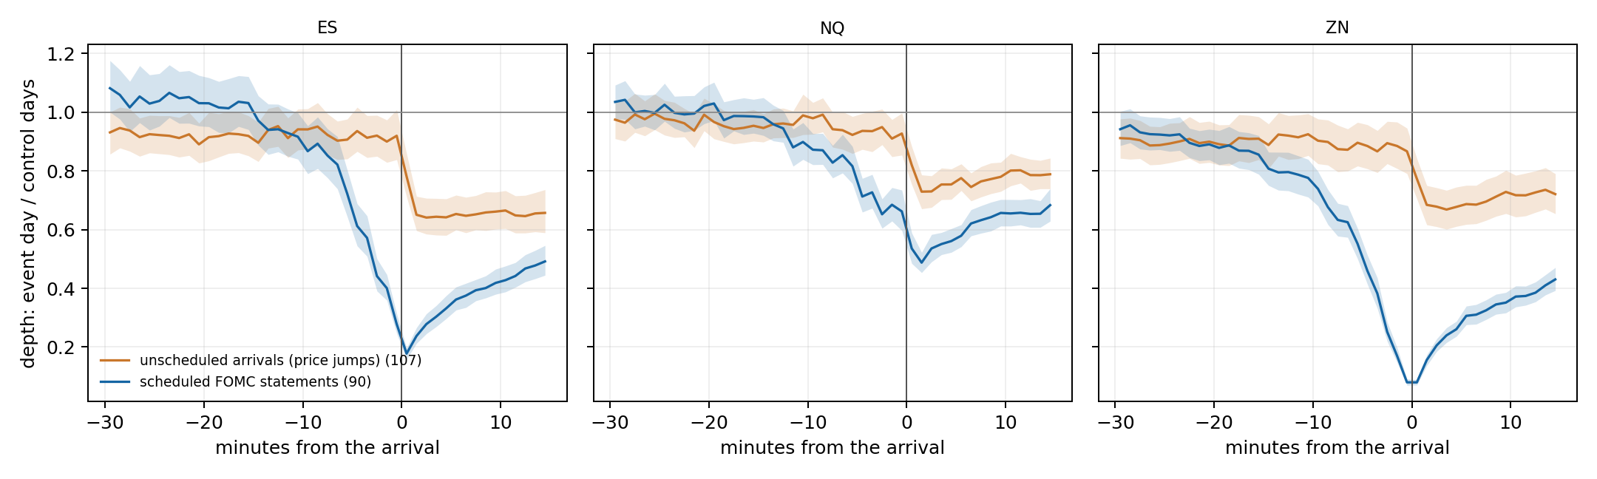
No withdrawal before unscheduled news; a shock after it
RESULTS · H4 · UNSCHEDULED
0.92
ES depth vs control days in the final minute before an unscheduled arrival (0.84–1.01)
0.99
change from 30–10 min before to the final minute (p = 0.41): no run-down
Depth, event day ÷ control days, minute by minute. Orange: 107 unscheduled arrivals; blue: 90 FOMC statements.
0.65
ES depth 1–5 minutes after the arrival: the post-event liquidity shock
Caveat: arrivals are price-identified jumps, not verified news. They should be labelled against headlines before any single event is quoted.
Notes:
Arrivals are one-minute moves of at least 8 local standard deviations, off every scheduled clock, first in the hour: 107 arrivals with two to four control days each. Before an unscheduled arrival, depth is where it was half an hour earlier. After it, depth falls to about two thirds of control levels within a minute and stays there for at least 15 minutes. This is the proposal's 'no pre-event withdrawal but a sharp post-event liquidity shock'. Scheduled against unscheduled, p below 0.0001 in all three contracts. Results hold dropping arrivals near scheduled releases and dropping the 19 control windows that are an hour off because of daylight saving.

Slide 12
H3 was pre-declared before the survey data were joined
METHODOLOGY · H3
S = β·D + γ·|u| + δ·log n + release, contract and period effects + ε
S
quote-revision share at the arrival (step 1 measure), one row per morning and contract
DECISION RULE, FIXED IN ADVANCE
D
survey high minus low, standardized within series over 2015–2026
Supported
β < 0, p < 0.05, and negative with and without period effects
|u|
absolute surprise: actual minus survey median, scaled by the series' typical surprise
log n
number of forecasters; standard errors clustered by release day
Rejected
95% interval excludes −0.05 (smallest effect of interest)
425 release mornings (134 CPI, 135 PPI, 139 jobs, 17 retail sales), 1,255 morning-contract rows, 2015–2026
Inconclusive
neither
Notes:
H3 says the order-flow share rises with ex-ante forecast dispersion. On the step 1 measure that means S should fall when economists disagree more. Bloomberg returned survey high and low but no standard deviation, so dispersion is the range, standardized within series. The decision rule and the smallest effect of interest, -0.05 in S per standard deviation, were fixed in advance. -0.05 is about a quarter of the gap between CPI and PPI arrivals and the no-news level.

Slide 13
Disagreement does not make releases more trade-driven
RESULTS · H3
H3 · REJECTED
Primary
+0.033
Placebo: pseudo-clock S
No period effects
change in S per sd of dispersion (p = 0.13): the opposite sign to H3
Year effects
Robust standardization (post-freeze)
0 of 9
Log range in place of z-score
Drop March–July 2020
secondary tests survive Holm (by release, composite, CPI core, within-day, speed)
ES only
NQ only
−2.8 s
ZN only
−0.10
−0.05
0.00
+0.05
+0.10
+0.15
speed outcome: more disagreement, if anything faster (p = 0.17)
β on dispersion, change in S per sd, with 95% interval. Shaded: effects of −0.05 or larger.
Notes:
The primary coefficient is +0.033 per standard deviation of dispersion, standard error 0.022, p 0.13. The interval runs from -0.009 to +0.075, so it excludes -0.05 and the pre-declared rule reads rejected. The sign is the opposite of the hypothesis. The pseudo-clock placebo is flat, as it should be. Every robustness run keeps a positive point estimate. NQ alone is significant, +0.068, unadjusted, and NQ is again the contract whose spread leaves S free to move. Nothing in the nine-test secondary family survives Holm.

Slide 14
What the H3 result does and does not show
RESULTS · H3
PAYROLL SCALE
CPI QUANTIZATION
NO HELD-OUT SAMPLE
2020 ranges set the scale; outside 2020 the payroll z-score barely varies (sd ≈ 0.02). Median/MAD standardization, logged post-freeze: β = +0.015, p = 0.19.
CPI survey ranges move in steps of 0.1, so D takes a handful of values. ECOS forecast standard deviations will be used as a calibration check.
2015–2026 was used in one pass, as pre-declared. This is a single test; the forward sample will become the replication.
Reading: forecaster disagreement does not push absorption toward trades at the arrival. If anything, high-dispersion CPI and PPI releases are slightly more quote-driven, and only in NQ, the contract with room for S to move (+0.068, p = 0.004 unadjusted).
Notes:
The reading: disagreement among forecasters does not make a release more trade-driven at the arrival. The mechanism in the proposal, that people who disagree must trade to learn what the number means, is not visible there. Three limits were seen after the run. Payroll dispersion barely varies outside 2020, so a post-freeze robust standardization was added and logged; it gives +0.015. CPI ranges are quantized to 0.1. And the whole period was used in one pass, so this is one test, not a replication.

Slide 15
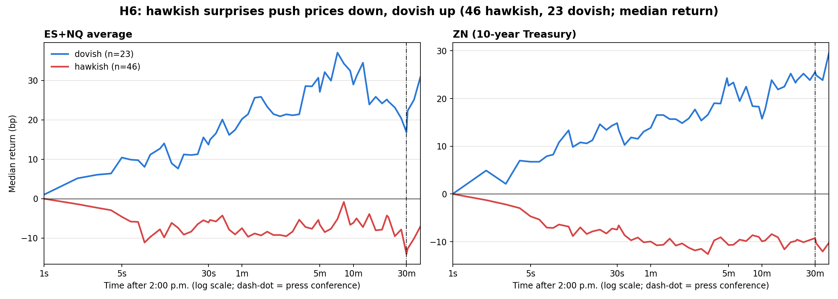
Price paths separate by direction, not by speed
RESULTS · H5 AND H6
Test: β_hawk = β_dove per bp of surprise. p = 0.05–0.85 across horizons, none significant after Holm. H5: no equity cell survives Holm either.
Notes:
Median paths from the shared one-second book, 69 FOMC statements with a USMPD surprise, 46 hawkish and 23 dovish, smallest quarter of surprises dropped. Hawkish surprises push equities and Treasury futures down and dovish ones up, as expected. The test of equal slopes per basis point of surprise gives p between 0.05 and 0.85 across horizons and nothing survives correction. So direction matters for the sign of the move, not for how fast it is priced.

Slide 16
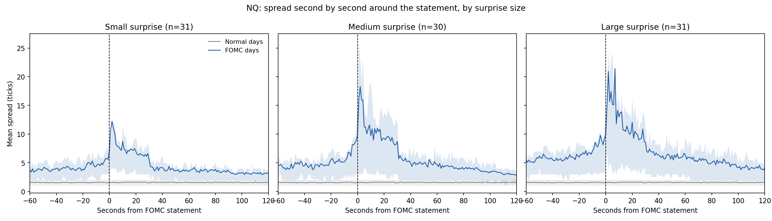
NQ's spread spikes at the release, more for big surprises
RESULTS · SPREAD
≈1.7 ticks
≈12 → 21
≈30 s
NQ spread on normal days at the same clock
peak mean spread in ticks, small vs large surprises (read from the figure)
for the spread to fall back toward its pre-release level
Notes:
Second-by-second mean spread in NQ ticks around the statement, split into terciles of the absolute USMPD surprise. The normal-day spread is flat at about 1.7 ticks. On FOMC days the spread is already wider before the clock, which is the withdrawal through the spread from the H4 slides, and it spikes at the release, higher for larger surprises, then decays over about 30 seconds.

Slide 17
Which contract moves first depends on the release
EXPLORATORY · Q3
JOBS REPORT, 2020–2026
FOMC STATEMENT, 2015–2019
CPI AND PPI
33 of 43
12 of 12
No order
untied cases where ZN moves before ES; median lead 19 ms (Holm p = 0.014)
untied cases where ES moves before ZN; median lead 71 ms (p = 0.0005)
no consistent leader between ES, NQ and ZN in any period
Caveat: exploratory; p-values are unadjusted except where Holm is shown. The lead is in milliseconds, so the result depends on exchange timestamps, which are used throughout.
Notes:
Exploratory, not pre-declared. After jobs reports since 2020, ZN moves before ES in 33 of 43 untied cases, median 19 milliseconds, sign test p 0.0006, 0.014 after Holm across the 24 tests in that table. There is no consistent order for CPI or PPI. FOMC statements went the other way in 2015-2019: ES first in all 12 untied cases, median 71 milliseconds. Arrivals are counted only when both contracts move within half a second.

Slide 18
Check the mechanism directly, then replicate
NEXT STEPS
01
MBP-10 for about a dozen FOMC meetings to test the NQ tick-constraint explanation
Top-of-book size cannot show liquidity moving to wider prices; ten levels can
02
03
04
Label unscheduled arrivals
Calibrate H3 dispersion
Replicate H3 forward
Match the 107 price jumps to headlines before quoting single events
ECOS forecast standard deviations as a check on the survey range
Use 2026–27 releases as the held-out sample
05
06
07
Screen macro controls
Unify FOMC control sets
Rebuild the paper
Census and BEA calendars, in place of the volume-spike proxy
One screened set of control afternoons for every pipeline
Add steps 1, 5, 8 and H3 to the draft and the PDF
Notes:
The tick-constraint explanation for NQ is the most interesting new claim and it has a direct test: ten-level data for about a dozen meetings should show NQ liquidity moving to wider prices rather than disappearing. Then label the unscheduled arrivals against news, finish the H3 calibration with ECOS, and close the two data-hygiene items. The paper PDF needs rebuilding with all of this.

Slide 19
Data, clocks and selection checks
APPENDIX

Slide 20
1,701 Databento files, every request quoted at $0.00
APPENDIX · DATA
Schema | Files | Size | What
MBP-1, every book update and trade | 818 | 5.76 GB | 437 release mornings, 112 control mornings, 93 FOMC meetings, 176 control afternoons
BBO, one second | 774 | 0.28 GB | 269 FOMC and control afternoons; 505 unscheduled arrival and control windows
One-minute bars | 16 | 0.17 GB | ES, NQ, ZN 2015–2026: unscheduled scan and control-morning volume screen
Trades | 93 | 0.55 GB | FOMC afternoons; volume columns of the one-second panel only
Excluded everywhere: vendor-degraded days (2024-09-18 and 2025-09-17 FOMC, 2026-04-10 CPI, two 2019 PPI dates, two control afternoons), except the step 1 development sample, which includes 17 Sept 2025.
Notes:
All GLBX.MDP3, continuous front contracts ES.v.0, NQ.v.0 and ZN.v.0. 254 MBP-1 files were already on hand; the rest were downloaded on 5 October 2026. Seven FOMC windows exceeded the 250 MB size guard and were fetched with an explicit per-run override. The raw files are not in the repository; they are shared inside the team as steps_1_5_8_data.zip, and reports/data_files_steps_1_5_8.csv lists every file with its SHA-256.

Slide 21
A trade often comes before the first quote revision
APPENDIX · SELECTION
2015–2023, ES / NQ / ZN | Event | Pseudo clock | Control day
Scalar (CPI, PPI) | 32% / 36% / 24% | 57% / 42% / 4% | 30% / 17% / 13%
Jobs report | 30% / 31% / 34% | 53% / 46% / 6% | same control days
FOMC statement | 42% / 52% / 41% | 28% / 30% / 8% | 22% / 12% / 18%
Press conference | 15% / 15% / 13% | 11% / 15% / 7% | same control days
CLOCKS
FEED FORMAT
Exchange timestamps (ts_event) throughout. The receive clock ran exactly 1 s ahead in 31 files (May–Aug 2018) and is corrected file by file.
Millisecond stamps to Nov 2015; trade and book update 15–40 µs apart to May 2017; same timestamp after. Handled by the attribution rule.
Notes:
This is the selection question the professor raised: how often a trade intervenes before the first quote revision. For FOMC statements a trade comes first two to four times as often as on control afternoons. 8:28:00 is itself a busy second for ES and NQ because of algorithmic orders on the minute, which inflates the pseudo-clock rate for macro releases.

