Slide 1
ELEVATOR MANAGEMENT SYSTEM PYTHON PROGRAMMING(23I209) DONE BY: A GESFETHA(23I201) CHARISHMA T R(23I209) LAVANYA G(23I232) DATE OF PRESENTATION:18.06.2024

Slide 2
INTRODUCTION Brief Overview of the Project: Developing a graphical user interface (GUI)for controlling elevator movements. Importance and Relevance of the Project in the Real World: Crucial for vertical transportation in buildings.

Slide 3
PROBLEM STATEMENT Description of the Problem Being Solved: Allowing users to manage elevator operations such as movingelevators ,opening and closing doors,viewing elevator status. Objectives of the Project: - Create a user-friendly GUI using Python and Tkinter. - Implement functionalities to move elevators to specified floors. - Enable opening and closing of elevator doors. - Display the current status of the elevator system to the user.

Slide 4
SYSTEM OVERVIEW AND DESIGN High-Level Description of the System: - A Python-based GUI - User inputs control the elevator System Components:GUI(Graphical UseInter face): - Built using Tkinter library. Controller: - Manages elevator operations - Handles requests to move elevators Diagram: - System architecture diagram - Workflow

Slide 5
TECHNOLOGIES USED Technologies: Python, Tkinter, Messagebox. Justification for the Choice of Each Technology: Python: -Widely used and versatile programming language. - Provides easy integration with various libraries and tools. Tkinter: - Standard Python library for creating GUIs. - Simple and effective for building desktop applications. Messagebox: - Convenient for showing user feedback and error messages. - Enhances user experience by providing clear instructions and alerts.

Slide 6
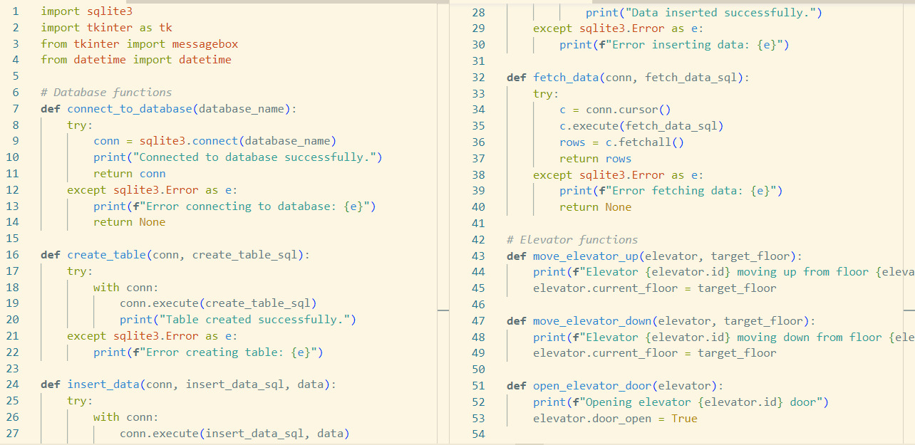
IMPLEMENTATION DETAILS Code:

Slide 7
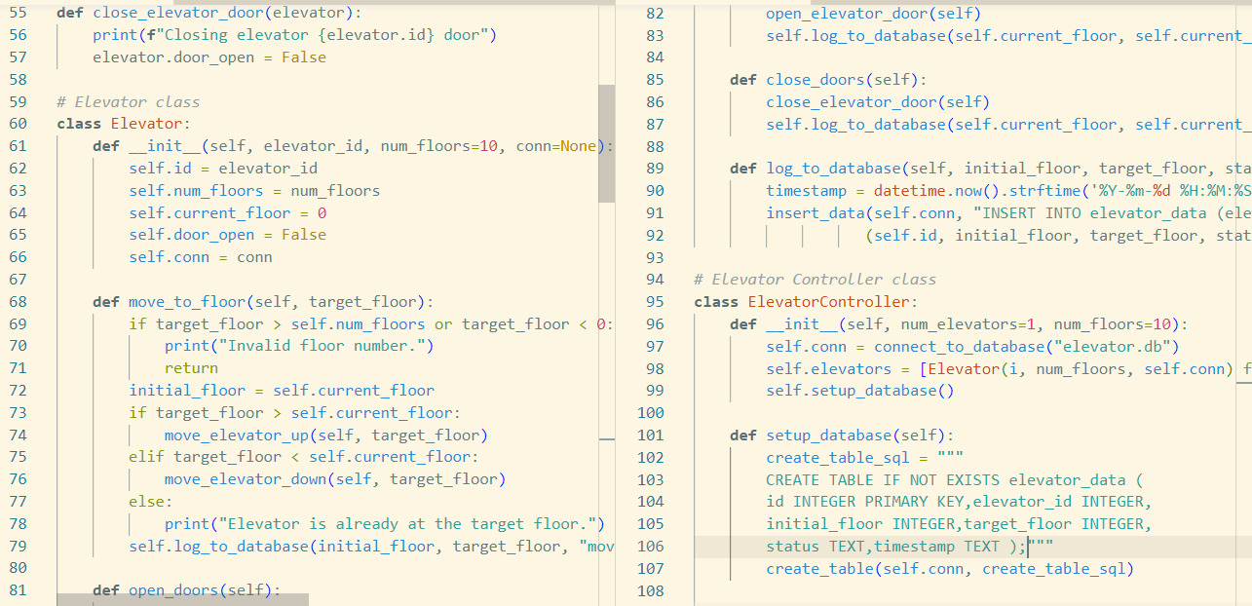

Slide 8
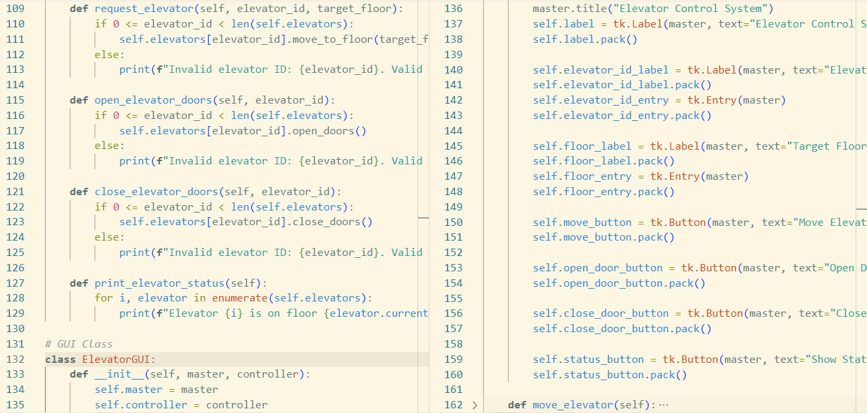

Slide 9
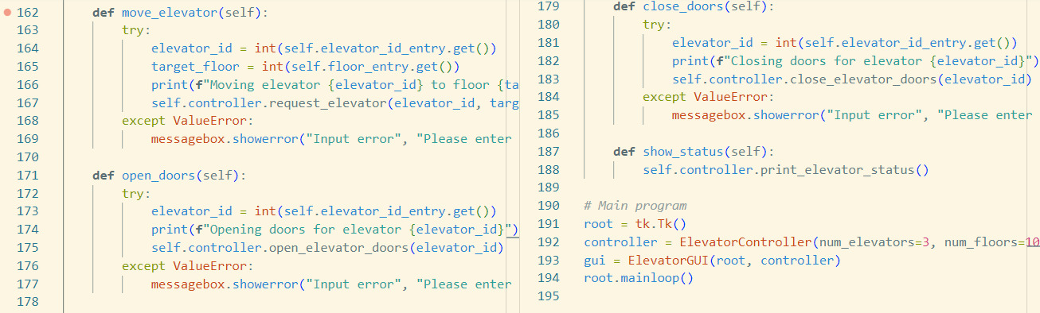

Slide 10
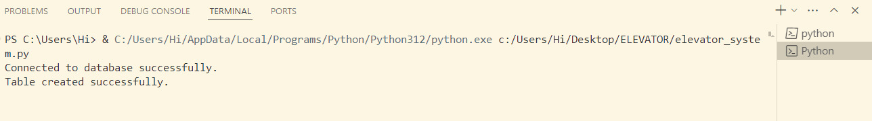
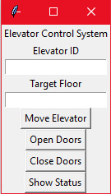
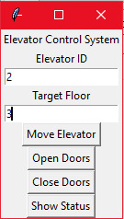
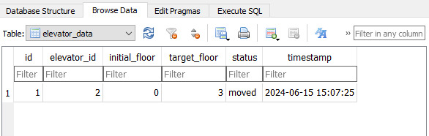
OUTPUT

Slide 11
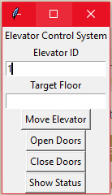
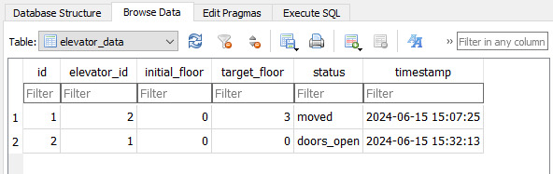
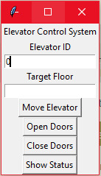
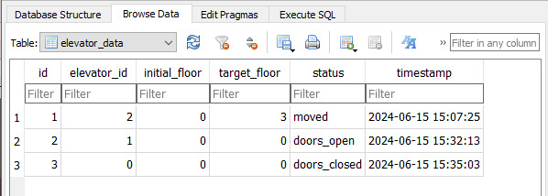

Slide 12
RESULTS AND DISCUSSION Outcomes of the Project: - Successfully created a functional elevator control system with a user-friendly GUI. Challenges and Solutions: - Challenge: Handling invalid user inputs. - Solution: Implemented error handling using try- except blocks and messagebox dialogs.

Slide 13
CONCLUSION Summary of the Project: Developed a Python-based GUI for an elevator control system, enabling users to manage elevator operations effectively. Key Takeaways: - Importance of user-friendly interfaces for system control. - Robust error handling to enhance user experience. Future Enhancements or Improvements: - Adding more advanced features such as scheduling and multi- elevator management. - Integrating with real-world elevator hardware for practical applications.

Slide 14
REFERENCES List of all references and resources used during the project: - Tkinter Documentation - Python Official Documentation - Stack Overflow for troubleshooting and additional tips

Slide 15
TIME FOR QUESTIONS THANKYOU

