Slide 1



Project
View in Power BI
Last data refresh:
5/19/2023 6:50:24 PM UTC
Downloaded at:
5/19/2023 6:51:19 PM UTC

Slide 2
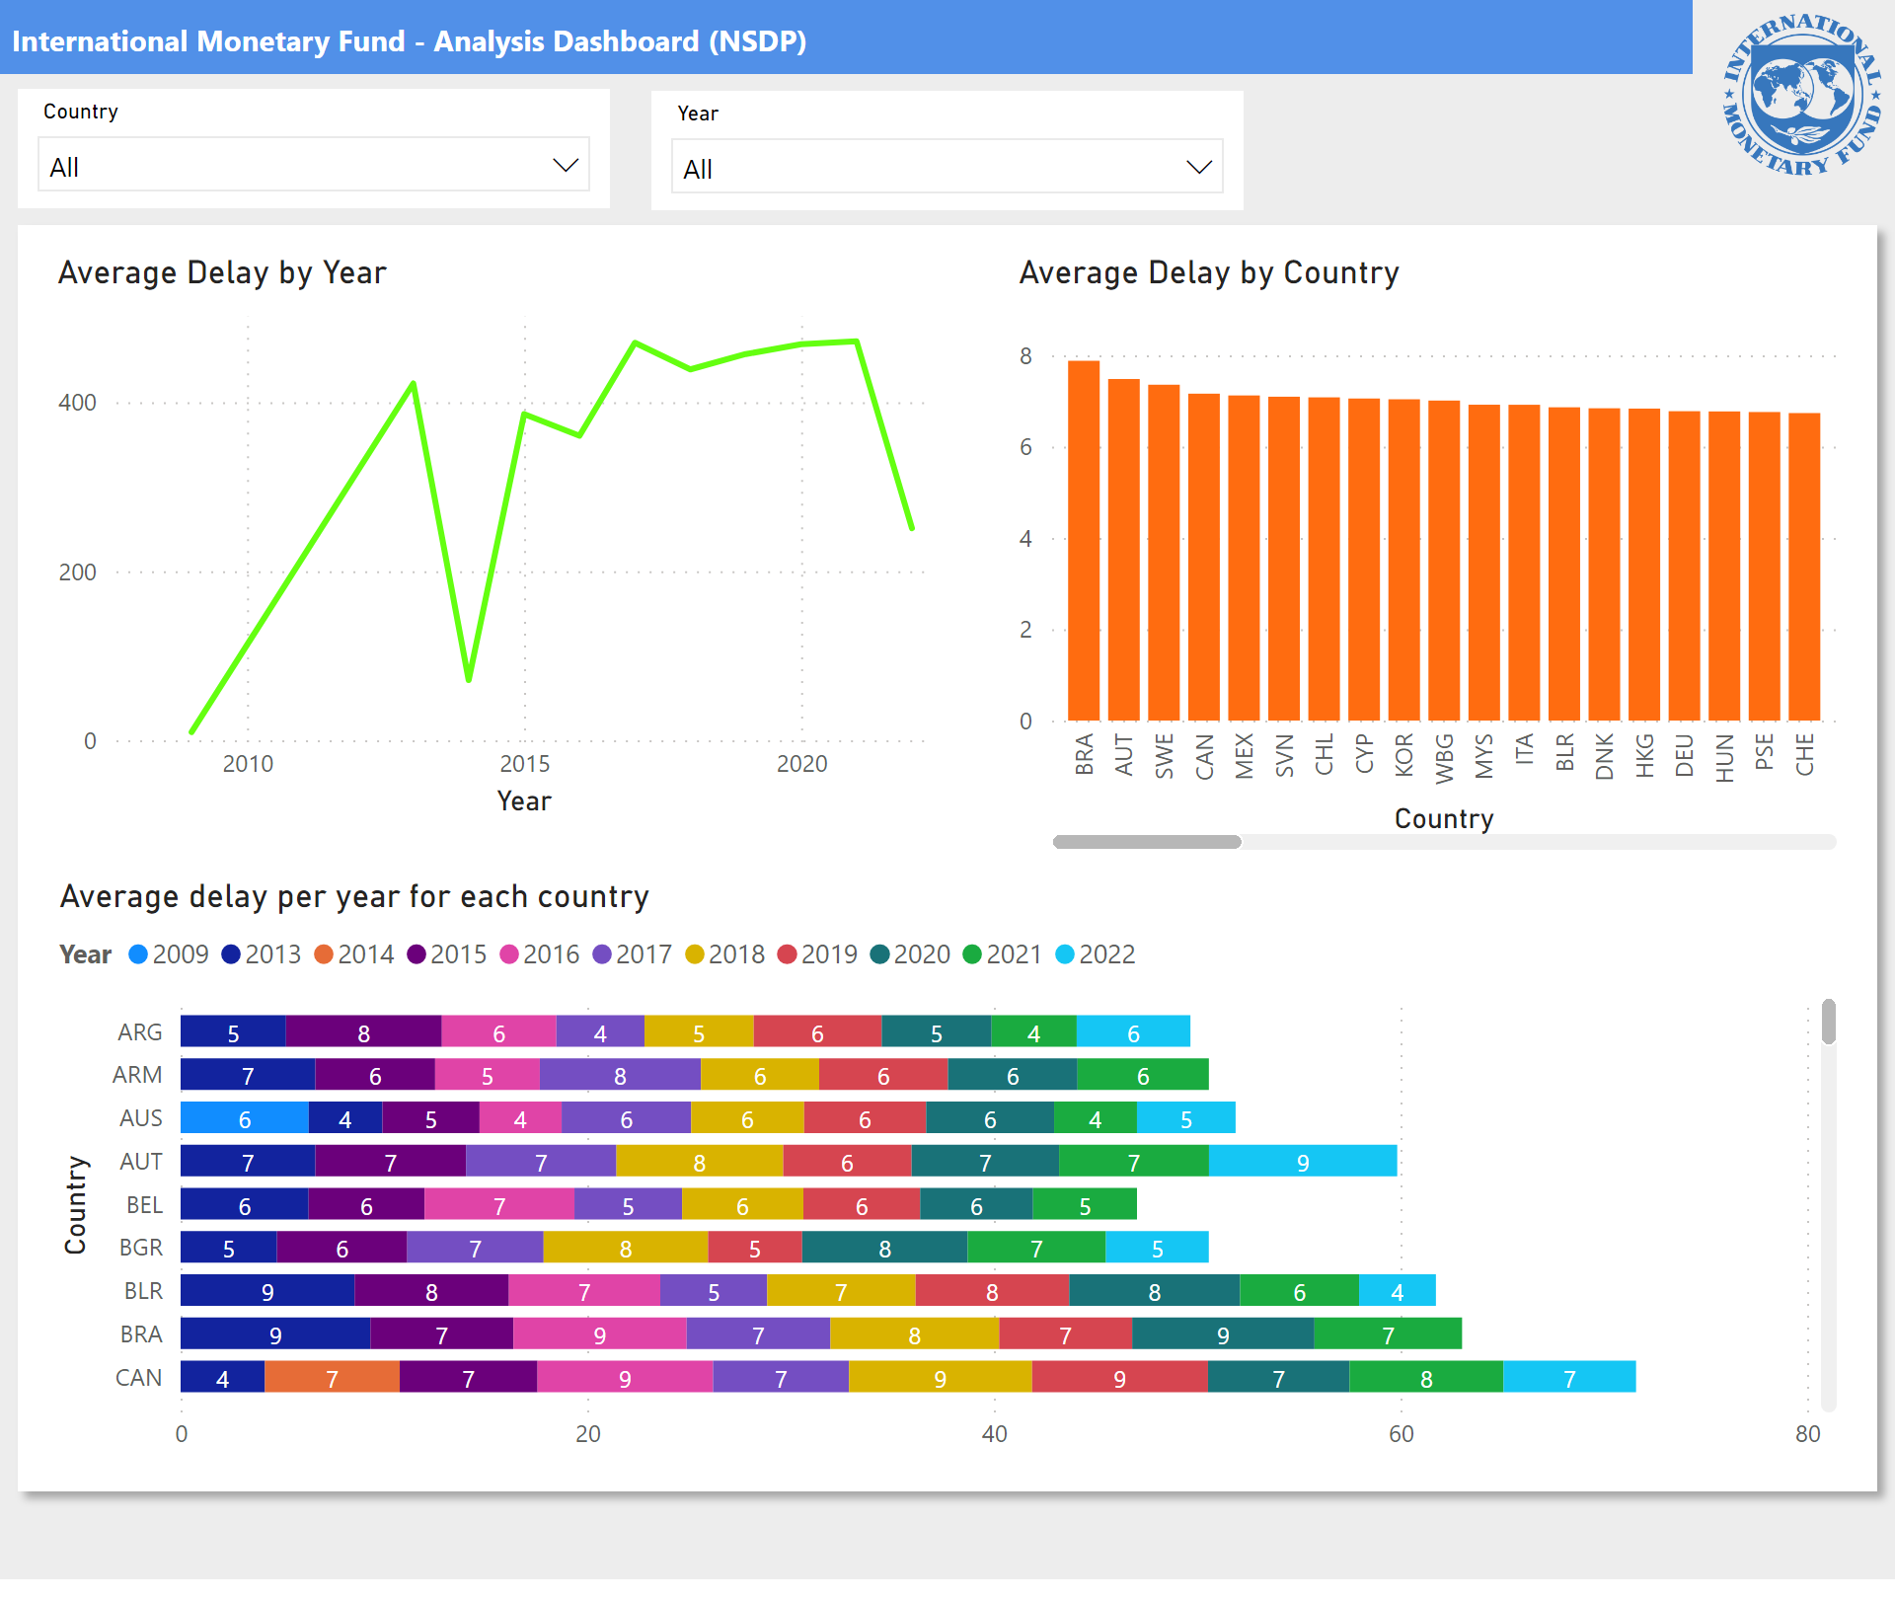
Page 1
Notes:
shape
No alt text provided
lineChart
No alt text provided
shape
No alt text provided
Average delay per year for each country
No alt text provided
clusteredColumnChart
No alt text provided
actionButton
No alt text provided
image
No alt text provided
slicer
No alt text provided
slicer
No alt text provided

