Slide 1
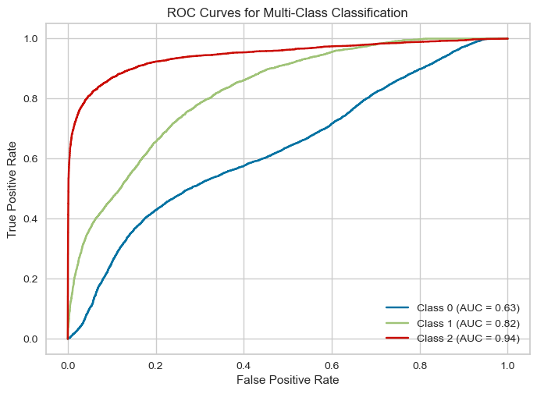
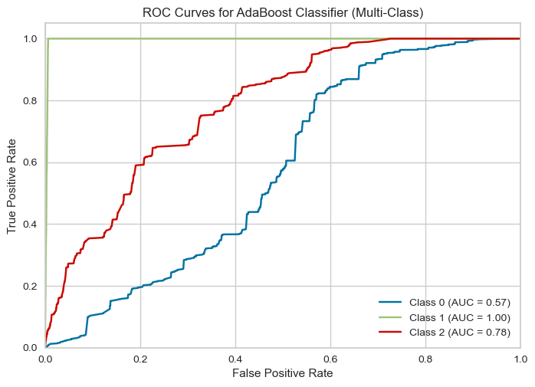
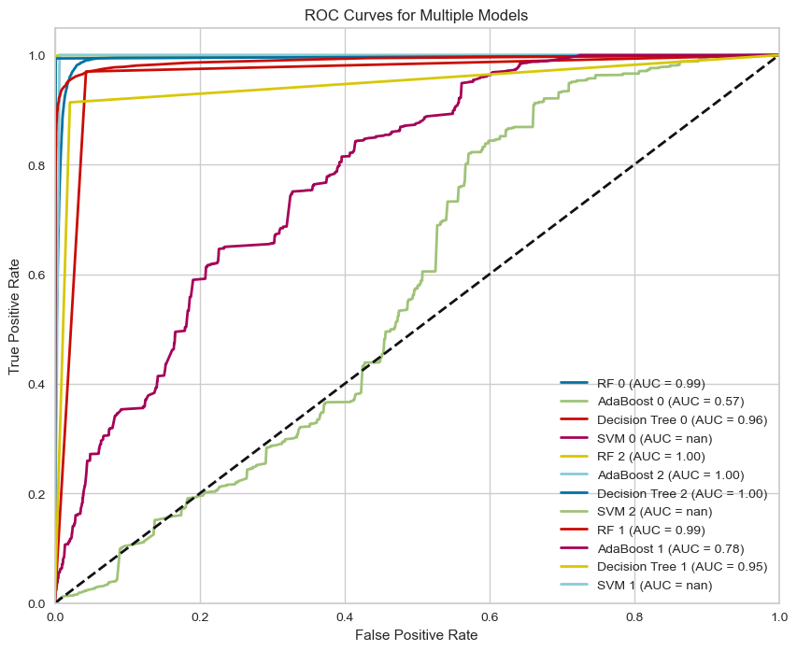
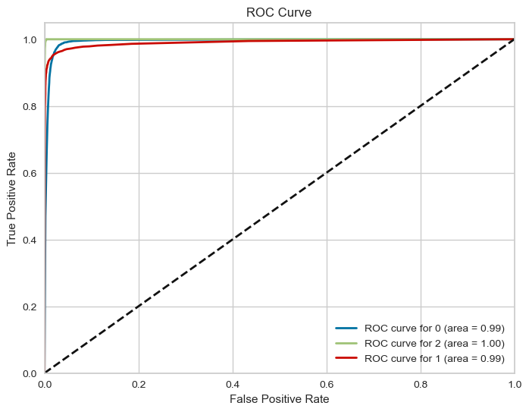
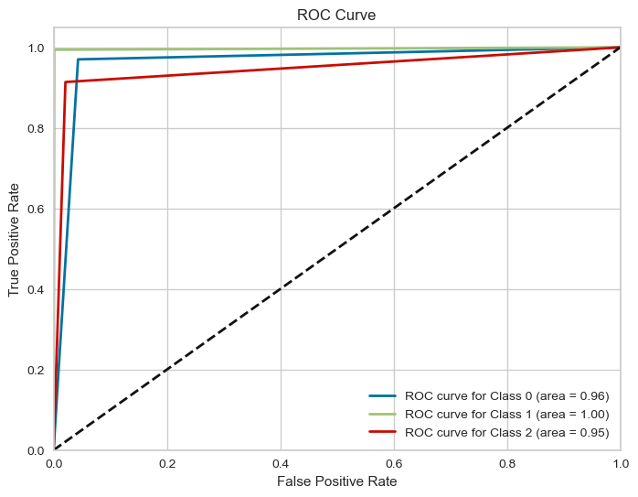
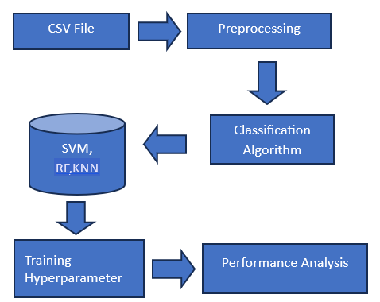
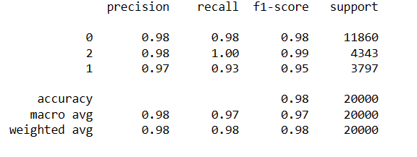
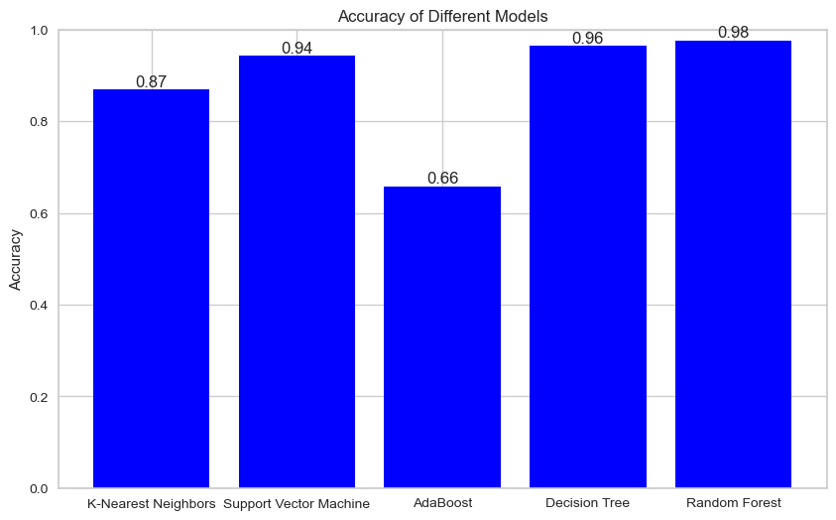
Stellar Enlightenment on Enhancing Star Categorization for Astronomical Insights
SR University
Ch. Srijanya: 2003A52105 M.Charishma:2003A52081 T. Bhavana : 2003A2068 D.Phaninder:2003A52L02 D. Jayadeep Reddy:2003A52024 Guide: Maratha. Sheshikala
INTRODUCTION
RESULTS
The main pillar of astronomy is the classification system that includes galaxies, quasars, stars. Stellar categorization extends well beyond the mere identification of celestial objects. It is essential to comprehending the prdynamics and evolution of galaxies. Understanding the star populations in various galaxies offers vital insights into the complex ocesses regulating galactic formations. This project combines the power of the machine learning algorithms to improve the classification through the unique stars enhancing the stars classification into their class.
OOBJECTIVES
Understand the physical properties of stars, such as their temperature, mass, radius, luminosity, and chemical composition,Study the evolution of stars and their life cycles.
identifing the Three target variables based on the wavelength, UV rays, cam col and main features containg 18 features. This classification system helps astronomers gain a better understanding of the different stages of stellar evolution, the underlying physical processes governing stars, and the relationships between various types of stars. It also aids in identifying patterns and trends in stellar populations, which in turn contributes to our broader understanding of the cosmos and the fundamental principles that govern it.
EXISTING METHOD VS PROPOSED METHOD
The Harvard system is based on the star’s surface temperature, which is estimated from its spectrum. The system uses the letters O, B, A, F, G, K, and M to classify stars, with O being the hottest and M being the coolest.
Differwntiation: Our plan focuses on the classification of stars whether they belong the class of the respective classification and this mainly focuses on the redshift alpha and delta values of the stars on separating from the spectrum classification.
Russell system: This is a graphical representation of stars based on their luminosity and temperature.
Differentiation:: Considering the brightness and the uv rays of the overall multiclass attributes it is possible to find the clusters that are repositioned or inactive stars are categorized.
CONCLUSIONS
Model is a strong candidate for stellar classification tasks, especially when dealing with multi-class problems and when seeking consistent and reliable performance across different classes of stars The Random Forest model which have good accuracy 98% to classify the stars present in dataset.

