Slide 1
Remote Controlled Armed Car
100060004 謝宜君
100060007 邱名彰
100060008 孫晨瑄

Slide 2
OUTLINE
Abstract
Overview
Block Diagram
Functionality

Slide 3
OUTLINE
Abstract
Overview
Block Diagram
Functionality

Slide 4
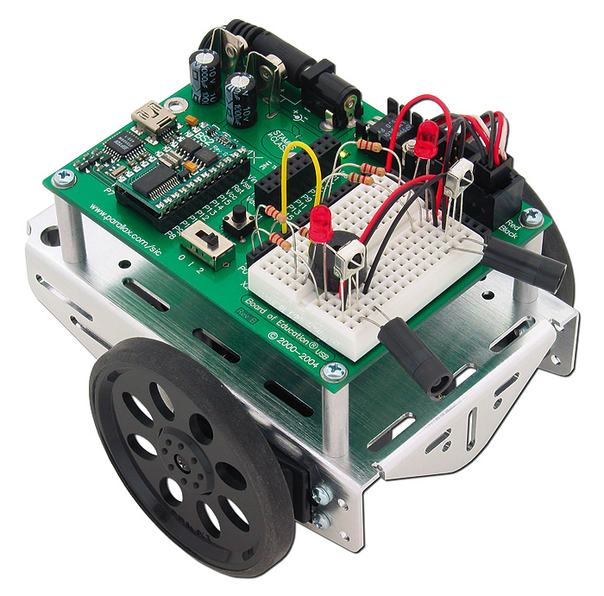
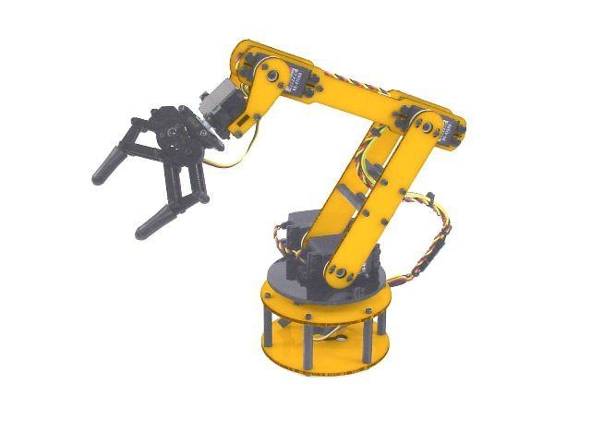
Abstract
remote control car
+
machine arm

Slide 5
OUTLINE
Abstract
Overview
Block Diagram
Functionality

Slide 6
Overview
A machine arm
A remote control car
Hand-gesture sensors
APP --- perform service routines

Slide 7
OUTLINE
Abstract
Overview
Block Diagram
Functionality

Slide 8
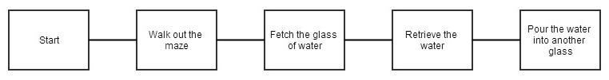
Block Diagram
APP
Service Routines

Slide 9
OUTLINE
Abstract
Overview
Block Diagram
Functionality

Slide 10
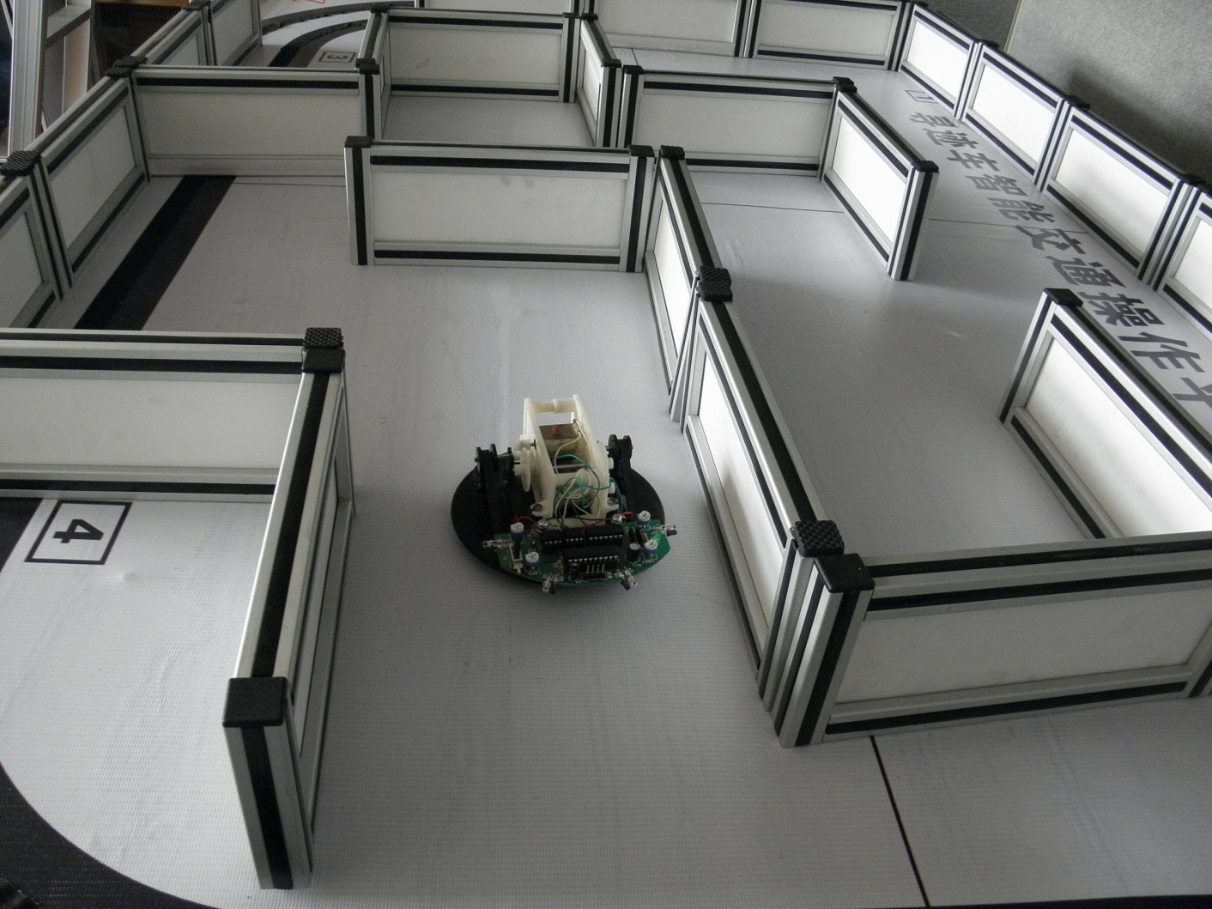

Functionality
Walk out a maze by using obstacle detector
Use hand gestures to fetch and pour the water
Use APP to perform certain routines

Slide 11
THE END

