Slide 1
Influence of Self-Service Technology in North America
For Retailers and Job Market

Slide 2
Agenda
Introduction to SST
Both sides of implementing SST for retailers
Why people do or do not use SST
Factors that will affect the employment rate
Factors that have influences on company’s revenue
Analysis on statistics
Discussion
Notes:
Explain why discuss these topics

Slide 3
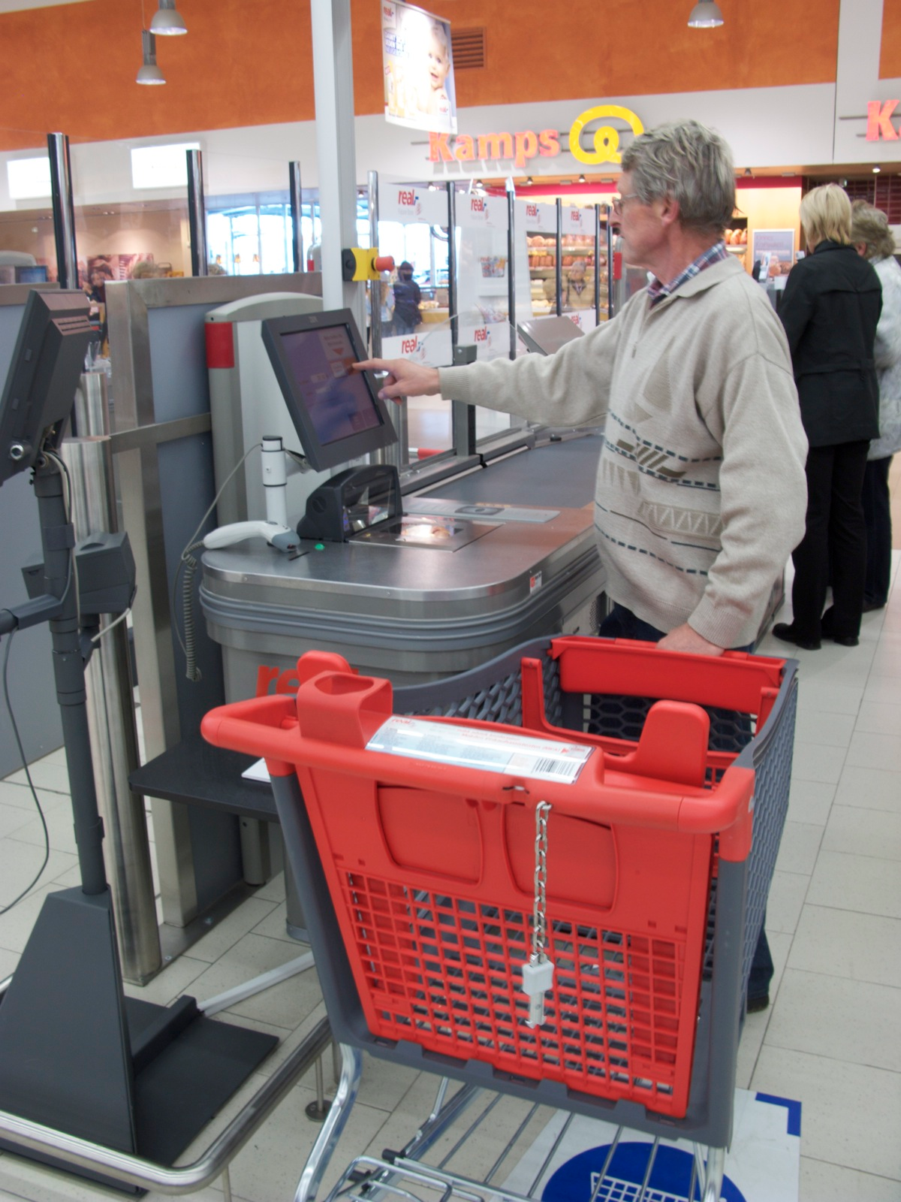
Introduction to Self-Service Technology(SST)
Goal: skip human involvement
Direct online connections and Internet-based interfaces:
The ATM, self-checkout machine(SCM)
Notes:
Decades ago

Slide 4
Both sides of implementing SST for retailers
Benefits:
Cost-saving: reduce expense of human resources
Good experience: people will come back
Disadvantages:
Stability
Notes:
Every year, trillions of dollars are invested in installing SST

Slide 5
Why people do or do not use SST
Convenience: accessibility
Functionality: ease to use
Security/Privacy
Notes:
Customers cares most about their convenience.

Slide 6
Factors that will affect the employment rate
Mismatch between the skills of the workers and skills needed for job market : Structural unemployment
SST could cause job vacancies to reduce in service market.
Big environment: Cyclical unemployment
In recession, people are involuntarily unemployed

Slide 7
Factors that have influences on company’s revenue
Every inner decision or policy counts:
Pricing, Return policy, Discount policy
Giant companies sell multiple products
Big environment

Slide 8
Statistics
Growth rate of revenues of retailers who use SST:
average growth rate = 2.04%
For SCM manufacturers:
NCR: 6.2% (SST-focused)
IBM: -3.4%
Fujitsu: -9.5%
Avg growth rate of number of workers(job markets):
Cashiers: 1.22%
SST-related workers: 1.27%

Slide 9
Discussion
No strongly direct relationship observed
But, no obvious damage to job market because of the SST
Possible reasons:
Amount of investment is not comparable to giant companies’ revenue
Time scale: understanding of SST, long-term observation
World is too complex to analyze

Slide 10
Thank You

