Slide 1
Autonomous Robotic Convoy
Introduction
CSCI 5551 Final Project
Team members:
Ming-Chang Chiu (Computer Science)
Wenbo Dong (Department?)
Joel Runnels (Aerospace Engineering)
Venkat Ram Subramanian (Electrical Engineering)

Slide 2
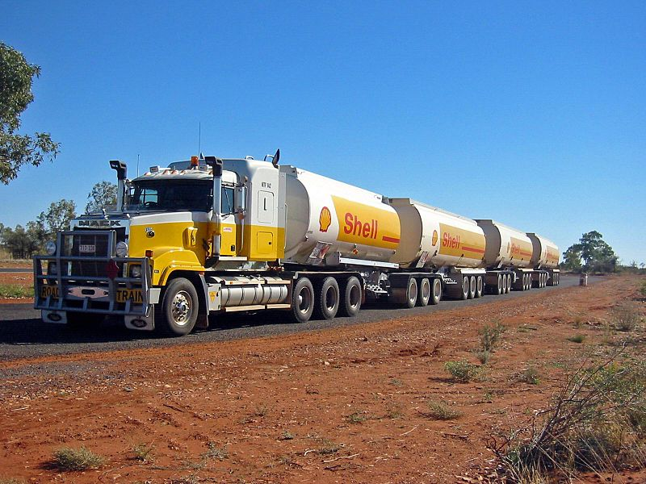
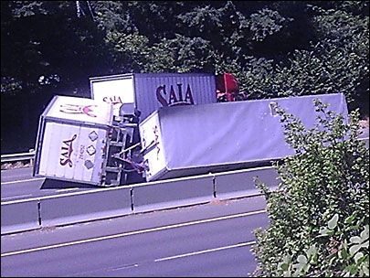
Autonomous Robotic Convoy
Motivation
“Road trains” are a series of freight trailers pulled by a single tractor.
Advantages:
Decreased drag leads to higher efficiency
Only one driver required to move several truck-loads of freight
Disadvantages:
Difficult to maneuver
Accident prone
Limited to use on low-traffic routes

Slide 3
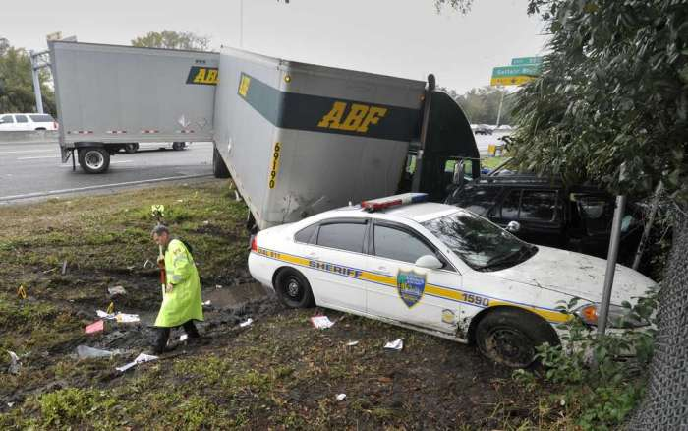
Autonomous Robotic Convoy
Motivation
Most problems caused by the dynamic coupling between multiple vehicles
Each additional car introduces another degree of freedom
More degrees of freedom leads to a more chaotic system
Each additional car makes the system harder to control in sub-optimal conditions

Slide 4
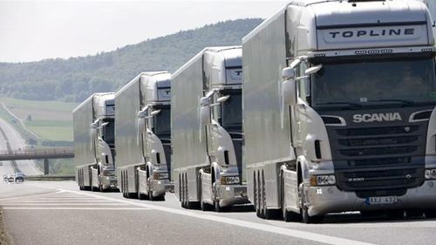
Autonomous Robotic Convoy
Motivation
Robotic convoys avoid these problems
Robotic convoys rely on sensors to follow the next car in the train
No mechanic coupling between cars means no complex dynamics
Each unit in convoy would be able to detect dangerous situations and avoid halt maneuvers which could lead to accidents

Slide 5
Autonomous Robotic Convoy
Assumption
Initial range of leader is known
Initial distance to the is also known
Only one person is moving at first

Slide 6
Autonomous Robotic Convoy
Previous Work
INSERT LITERATURE REVIEW HERE!

Slide 7
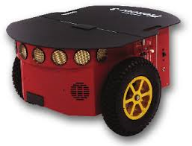
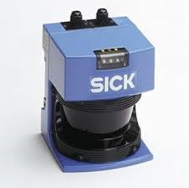
Autonomous Robotic Convoy
Problem Description
Problem Statement: Develop a prototype robotic convoy system
Assumptions:
Each unit in the robotic convoy will follow a “leader” on an arbitrary path
Workspace of robot convoy is not “clean,” i.e. the robots must be able to discern between leader and other obstacles (stationary or moving)
Workspace assumed to be flat, i.e. no obstacles or “pot holes” in workspace that are undetectable by robots
Equipment:
Pioneer 3 Robots by Adept MobileRobots
SICK laser scanner

Slide 8
Autonomous Robotic Convoy
Methodology
Robotic Convoy: Two main tasks
Object Detection
Path Planning

Slide 9
Autonomous Robotic Convoy
Methodology
Workflow:
Identify Leader
Detect Objects
Plan Path
Execute Path

Slide 10
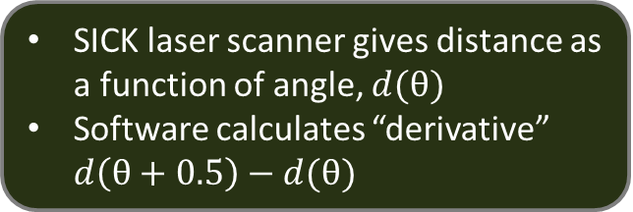
Autonomous Robotic Convoy
Methodology
Object Detection
SICK laser scanner gives distance as a function of angle, $d(θ)$
Software calculates “derivative” $d\left(θ+0.5\right)−d(θ)$
INSERT PLOTS FROM SICK LASER SCANNER HERE!

Slide 11
Autonomous Robotic Convoy
Methodology
Object Detection
Objects identified by signature peaks in “derivative”
Software identifies object “center” angle and distance
INSERT PLOTS FROM SICK LASER SCANNER HERE!

Slide 12
Autonomous Robotic Convoy
Methodology
Object Velocity Measurement
Two data-sets taken, separated by specified time (0.1 seconds)
Object B
(t)
Object B
(t + 0.1)
Object C
(t)
Object C
(t + 0.1)
Object A
(t)
Object A
(t + 0.1)
Robot

Slide 13
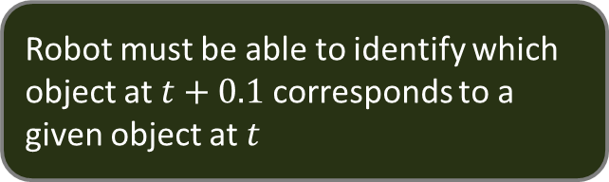
Autonomous Robotic Convoy
Methodology
Object Velocity Measurement
Robot must be able to identify which object at $t+0.1$corresponds to a given object at $t$
Object ?
(t)
Object C
(t)
Object ?
(t + 0.1)
Object ?
(t + 0.1)
Object ?
(t + 0.1)
Object ?
(t)
Robot

Slide 14



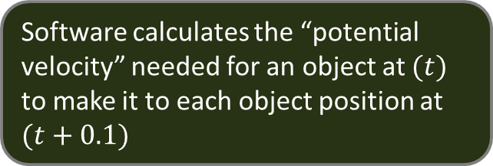
Autonomous Robotic Convoy
Methodology
Object Velocity Measurement
Software calculates the “potential velocity” needed for an object at $(t)$ to make it to each object position at $(t+0.1)$
$$v(i⟶j_{1})$$
$$v(i⟶j_{2})$$
Object ?
(t + 0.1)
Object ?
(t + 0.1)
$$v(i ⟶ j_{3})$$
Object ?
(t + 0.1)
Object ?
(t)
Robot

Slide 15

Autonomous Robotic Convoy
Methodology
Object Velocity Measurement
Software assumes that lowest “potential velocity” is the correct velocity.
$$v(i⟶j_{1})$$
$$v(i⟶j_{2})$$
Object ?
(t + 0.1)
Object ?
(t + 0.1)
$$v(i ⟶ j_{3})$$
Object ?
(t + 0.1)
Object ?
(t)
Robot

Slide 16
Autonomous Robotic Convoy
Methodology
Path Planning
Following
Turning
Give a tolerance degree(theta),
If object exceeds the theta, then check if the robot still can see the object, if it can, then just follow, else turn

Slide 17
Autonomous Robotic Convoy
Results
INSERT RESULTS SLIDES HERE!

Slide 18
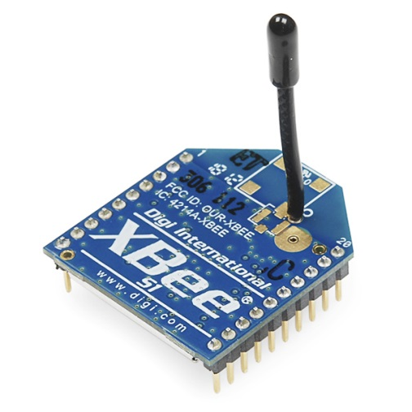
Autonomous Robotic Convoy
Future Work
Immediate Future Work:
Continue development and implementation of path-planning and execution
Develop more robust obstacle avoidance methods
Test software in varied environments
Long-Term Future Work:
Implement inter-robot communication using wireless transmitters
Implement additional sensors which can detect more subtle obstacles
Implement absolute location measurement (GPS)

Slide 19
Autonomous Robotic Convoy
Conclusion
Algorithms for robotic convoy under continual development
Object detection algorithms have been tested and implemented on Pioneer 3 units
Path planning algorithms still under development and continual testing

Slide 20
Autonomous Robotic Convoy
Conclusion
Thank You!

