Slide 1


CMPE 280 Web UI Design and Development September 4 Class Meeting
Department of Computer Engineering San Jose State University Fall 2018 Instructor: Ron Mak
www.cs.sjsu.edu/~mak

Slide 2
HTML and CSS
HTML
content
organization
semantics
Cascading Style Sheet (CSS)
layout
formatting

Slide 3
Formatting Text
Format text by setting font properties:
family
style
weight
size
line height
color
spacing and indentation
alignment
transformations and variants

Slide 4
Font Family
Example:
Surround multi-word names with quotes.
Generic font families:
serif
sans-serif
cursive
body {
font-family: Geneva;
}
h1,
h2 {
font-family: "Gill Sans";
}
fantasy
monospace

Slide 5
Font Family, cont’d
Specify alternate font families.
In case a browser lacks a font family.
Example:
Default font families shared by Microsoft Windows and Mac OS X:
Arial
Comic Sans MS
Courier New
h1 {
font-family: "Gill Sans", "Gill Sans MT", Calibri, sans-serif;
}
New Times Roman
Verdana

Slide 6
Font Style
Font styles are normal, italic, or oblique (faux italic).
Not all font families have true italic.
Example:
h1: {
font-style: oblique;
}
p: {
font-style: italic;
}

Slide 7
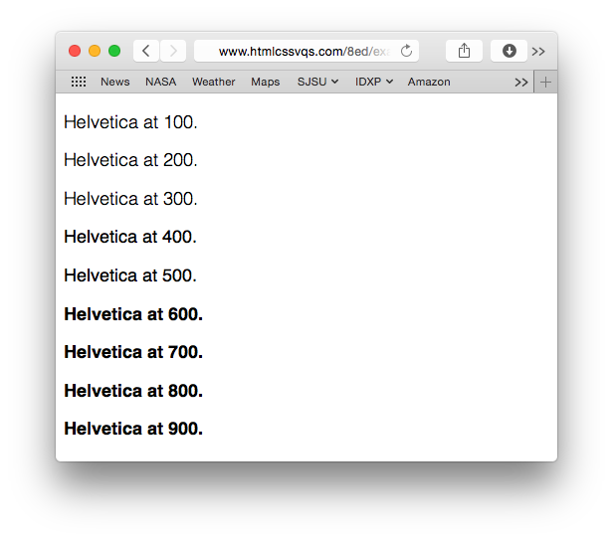
Font Weight
Font weights are normal, bold, bolder, or lighter.
Example:
Also: 100, 200, 300, 400, 500, 600, 700, 800, or 900
.special {
font-weight: bold;
}

Slide 8
Font Size
Default sizes:
xx-small
x-small
small
Specify font size with absolute or relative units.
Absolute units in pixels (px) or points (pt)
Example:
There is no space between the number and px or pt.
medium
large
x-large
xx-large
smaller
larger
h1 {
font-size: 35px;
}
Use points
for printing.

Slide 9
Font Size, cont’d
Relative units
By percentage of the default size (usually 16px).
By ratio of the parent element’s font size (em units).
Examples:
body {
font-size: 100%; /* 16px */
}
h1 {
font-size: 2.1875em; /* 35px/16px */
}
h2 {
font-size: 1.75em; /* 28px/16px */
}
Establish the
baseline size.
In traditional typesetting,
an em unit is the width
of the letter m.

Slide 10
Line Height
Specify line height:
as a multiple of the font size
as a percentage of the font size
in em, px, or pt units
Example:
p {
line-height: 1.65; /* 15px x 1.65 = 24.75px */
}

Slide 11
Points, Pixels, and Em
Conversion chart for points, pixels, and em:
https://websemantics.uk/articles/font-size-conversion/

Slide 12

Font Variants
Font variants are normal or small-caps.
Example:
h2 {
font-variant: small-caps;
}

Slide 13
Combining Font Values
Use the font property to combine font values.
Size, families, weight, variant, line height
List the values separated by blanks.
You must specify the font size and font families.
Size before families, only a blank after the size.
Specify line height immediately after the font size, separated by a slash.
Example:
p {
font: italic small-caps bold .85em/1.2 Palatino, serif;
}

Slide 14

Line and Letter Spacing
Specify line spacing and letter spacing with absolute px units or relative em units.
Example:
h2 {
font-family: "Gill Sans", "Gill Sans MT", Calibri, sans-serif;
font-weight: normal;
letter-spacing: 7px
}

Slide 15
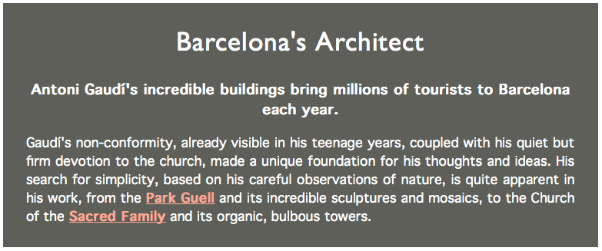
Text Alignment
Text alignments are left, right, center, or justify.
Example:
h1
{
text-align: center;
}
p {
text-align: justify;
}
.intro .subhead {
text-align: center;
}

Slide 16
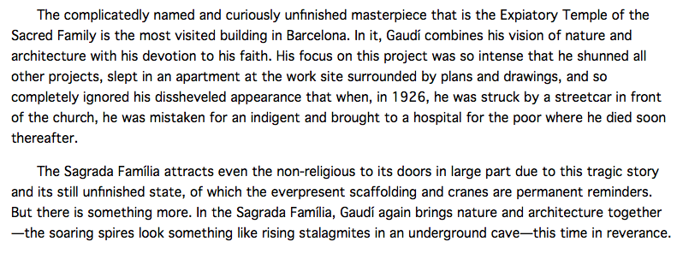
Text Indentation
Specify paragraph indentation with absolute px units or relative em units.
Example:
p {
text-indent: 2em;
}

Slide 17

Text Transformation
Text transformations are none, capitalize, uppercase, or lowercase.
Example:
h1 {
text-transform: uppercase;
}

Slide 18
Controlling the Display of Elements
Each HTML element has a default display property setting.
Example: Paragraphs are display: block and emphasized text are display: inline
CSS rules can override the default display.
Example:
em {
display: block;
}
The following is some
emphasized
text that displays as a block.

Slide 19
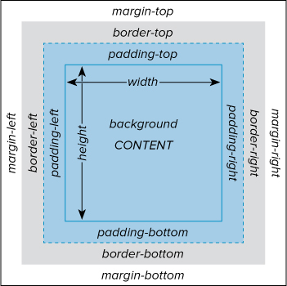
The Box Model
CSS treats every HTML element as if it were enclosed in an invisible box:
content width
content height
padding
borders
margins
Use absolute or relative units, or auto.

Slide 20
Borders
Set the values of each border individually:
border-top, border-bottom, border-left, border-right
Or just border to set the values of all four borders.
Also:
border-color
border-width
border-style
none, dotted, dashed, solid, double, groove, ridge, inset, outset
.about img {
border: 5px solid gray;
}
.nav-main {
border-top: 5px solid red;
border-bottom: 1px solid red;
}

Slide 21
Padding
Set the size of the padding on each side:
padding-top, padding-bottom, padding-left, padding-right
Padding color is the background-color.

Slide 22
Padding, cont’d
Also:
padding: size Applies to all sides
padding: size_{tb}, size_{rl} size_{tb} applies to the top and bottom and size_{rl} applies to the right and left
padding: size_{t}, size_{rl}, size_{b} size_{t} applies to the top, size_{b} applies to the bottom, and size_{rl} applies to the right and left
padding: size_{t}, size_{r}, size_{b}, size_{l} in clockwise order
.about {
background-color: white;
padding: .3em .6em .3em;
}

Slide 23
Margins
Set margin sizes (similar to padding sizes):
margin-top, margin-bottom, margin-left, margin-right
Also:
margin: size margin: size_{tb}, size_{rl} margin: size_{t}, size_{rl}, size_{b} margin: size_{t}, size_{r}, size_{b}, size_{l}
h1: {
margin-bottom: .4em;
}

Slide 24
HTML and CSS
HTML
content
organization
semantics
Cascading Style Sheet (CSS)
layout
formatting

Slide 25
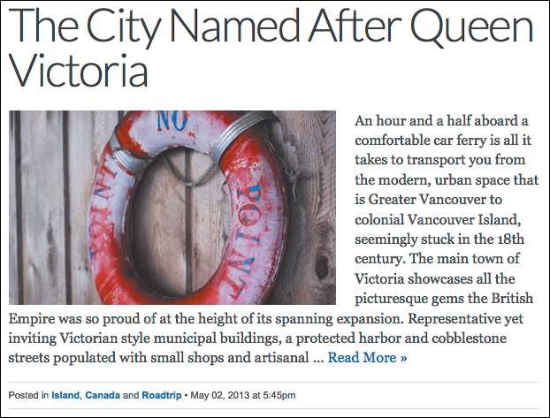
Floating Elements
An element can float among text or other elements by making that other content flow around it.
float: left Put the element to the left of the other content.
float: right
float: none
.post-photo {
float: left;
margin-bottom: 2px;
margin-right: 22px;
}

Slide 26
Relative Positioning
Position an element relative to its natural location.
position: relative;
Add any top, right, bottom, or left offsets.
Relative positioning does not affect any surrounding elements.

Slide 27
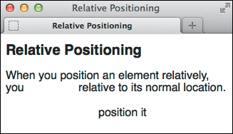
Relative Positioning, cont’d
Example:
<h1>Relative Positioning</h1>
<p>When you position an element relatively, you
<span class="example">position it</span>
relative to its normal location.</p>
.example {
position: relative;
top: 35px;
left: 100px;
}

Slide 28
Absolute Positioning
Position an element absolutely by specifying its position with respect to the page body or to its nearest positioned ancestor element.
position: absolute
Add any top, right, bottom, or left positions in px, em, or percentage of the ancestor.
If elements overlap, specify a z-index value.
Elements with higher z-index values overlap elements with lower values.
Compare the z-index values only for elements in the same container.

Slide 29
Vertical Alignment
Use vertical-align to align an element:
baseline Align the element’s baseline with its parent’s baseline.
middle Align the middle of the element slightly above the parent’s baseline.
sub Position the element as a subscript of the parent’s baseline.
super Position the element as a superscript of the parent’s baseline.

Slide 30
HTML Container Elements
Semantic containers
<header> … </header>
<footer> … </footer>
<main> … </main>
<aside> … </aside>
<nav> … </nav>
<article> … </article>
<section> … </section>
Generic containers
<div> … </div>
<span> … </span>
Have meanings relative
to page organization.
No inherent meanings. Used to apply styling.
Contain a block of content.
Contain a word or phrase.

Slide 31
ARIA Landmark Roles
WAI-ARIA
Web Accessibility Initiative Accessible Rich Internet Application
Add ARIA roles to HTML elements to guide HTML screen readers for the visually impaired.
Example:
Encloses a major block of navigation links.
Tip to screen readers.
<nav role="navigation"> … </nav>

Slide 32
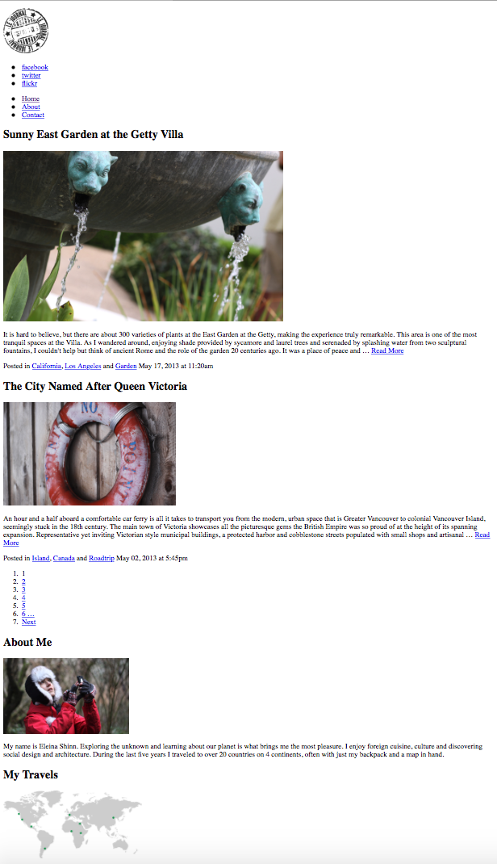
Page with No Styles
http://www.htmlcssvqs.com/8ed/examples/chapter-11/no-styles.html

Slide 33
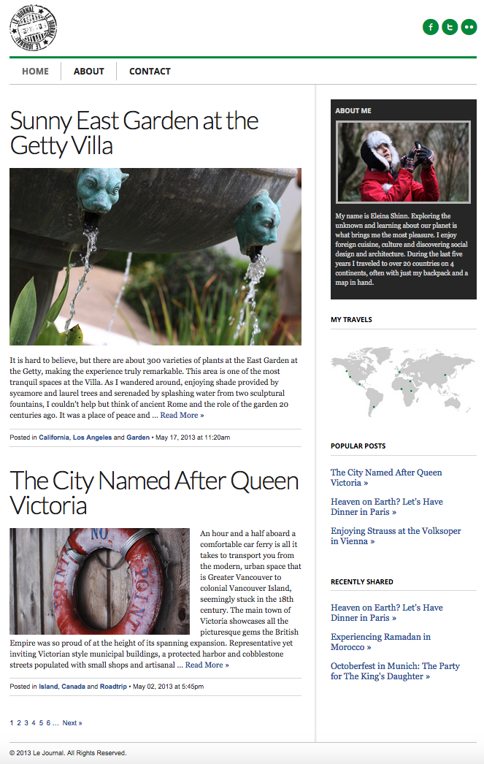
Styled Page
Header
http://www.htmlcssvqs.com/8ed/examples/chapter-11/finished-page.html
Main
Sidebar
Footer

