Slide 1



FRESHMAN -15

Slide 2


EXAMINING THE WEIGHT GAIN IN FIRST SEMESTER STUDENTS
GROUP –2
CHARITHA NALLAKA
RAJAMANOHAR VADREVU

Slide 3
Is it true that students tend to gain weight during their first year in college?
Cornell Professor of Nutrition David Levitsky recruited students from two large sections of an introductory health course. Although they were volunteers, they appeared to match the rest of the freshman class in terms of demographic variables such as sex and ethnicity. The students were weighed during the first week of the semester, then again 12 weeks later. Based on Professor Levitsky’s data and comment on the 'freshman 15.' (Weights are in pounds.)

Slide 4

CONTENTS
1.Problem statement
2.Observation Study
3.Data Overview
4.Hypothesis
5.Assumptions for T-test
6.Non parametric Test
7.Wilcoxon Signed Rank
8.Conclusion
9.References

Slide 5

OBSERVATION STUDY
In Professor David Levitsky's study on freshman weight gain, an observational approach was adopted to understand the phenomenon without intervening in participants' behaviors. This study, typical of observational research, involved tracking weight changes among college freshmen over a 12-week period. Data collection occurred through initial weigh-ins at the beginning of the semester and subsequent measurements at the end of the observation period. Unlike experimental studies where researchers actively manipulate variables, observational studies passively observe natural behaviors. While observational studies offer valuable insights into real-life trends and behaviors, they inherently lack the ability to establish causation between variables. Levitsky's study sheds light on the natural progression of weight gain among freshmen, contributing to our understanding of this common phenomenon in college settings.

Slide 6
DATA OVERVIEW
Number of Samples: 68
Variables: Initial Weight and Terminal Weight
Each sample includes data on the initial weight (at the beginning of the semester) and terminal weight (12 weeks later).

Slide 7
HYPOTHESIS
Null Hypothesis (H0): There is no significant difference in the mean weight of first-semester freshmen between the beginning and end of the semester.
H0 : mean difference = 0
H0 : µend - µ beginning = 0
Alternative Hypothesis (H1): There is a significant increase in the mean weight of first-semester freshmen between the beginning and end of the semester.
Ha : mean difference > 0
Ha: µ end- µbeginning > 0

Slide 8
ASSUMPTIONS FOR T-TEST
RANDOMNESS
INDEPENDENCE
HOMOGENEITY OF VARIANCE
NORMALITY

Slide 9
RANDOMNESS AND INDEPENDENCE ASSUMPTIONS
Randomness: Professor Levitsky recruited students from two large sections of an introductory health course, and if the selection process within these sections was random, then the random assumption would likely be met
Independence: The weight change of one student does not influence the weight change of another student so the independence is met.

Slide 10
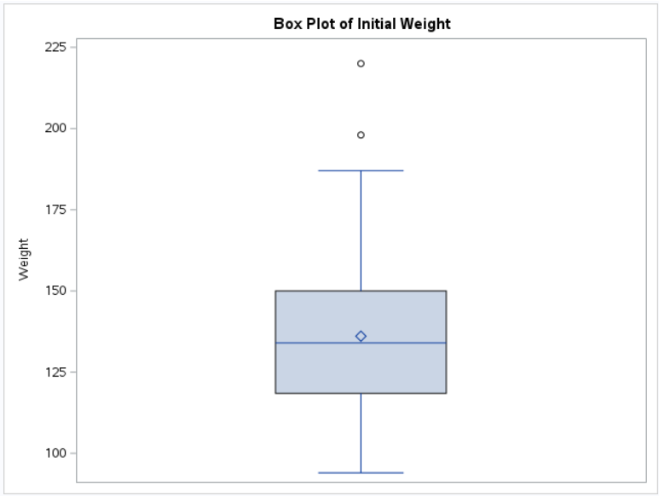
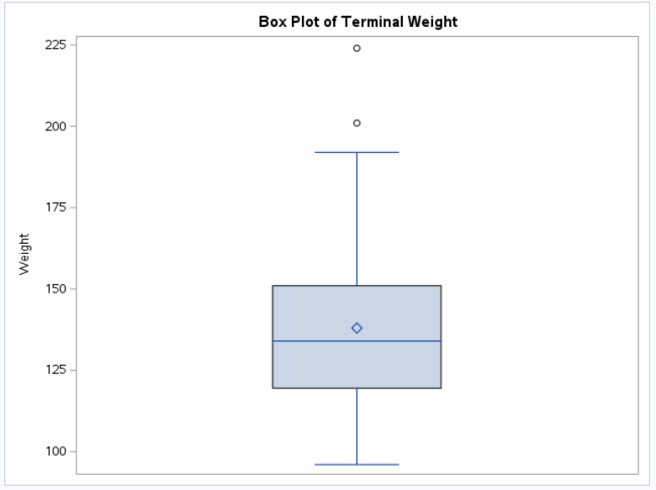
HOMOGENEITY OF VARIANCE ASSUMPTION

Slide 11
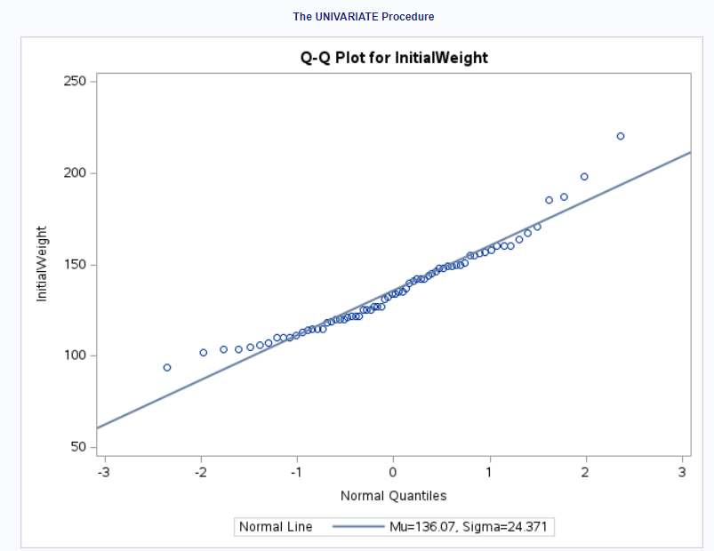
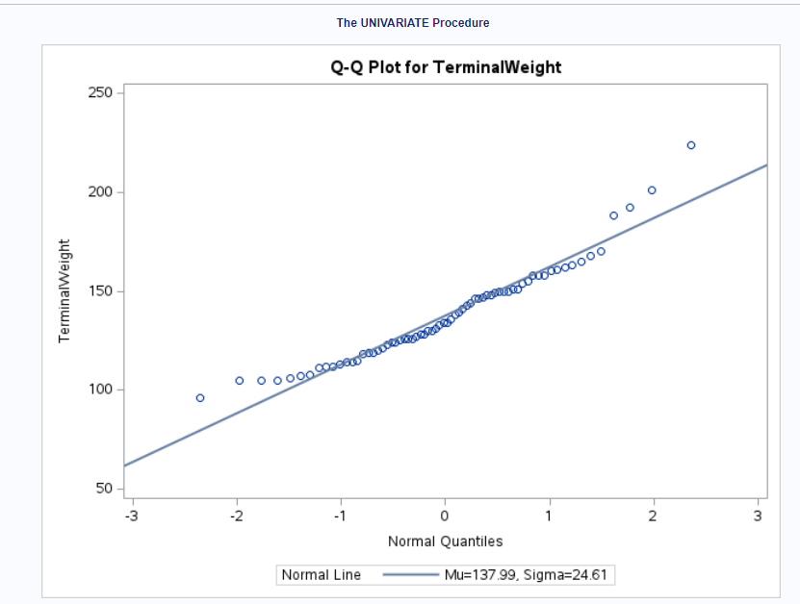
NORMALITY ASSUMPTION CHECK

Slide 12
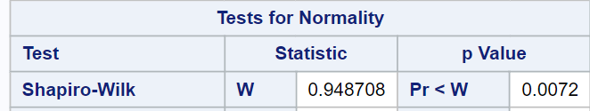
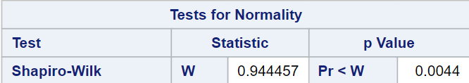
NORMALITY ASSUMPTION CHECK: SHAPIRO-WILK TEST
INITIAL WEIGHT
TERMINAL WEIGHT

Slide 13
NON PARAMETRIC TESTS
Wilcoxon signed-rank
Mann-Whitney U
Kruskal-Wallis
Friedman tests
A non-parametric test is a statistical method used to analyze data when the assumptions of parametric tests are violated or when the data is not normally distributed.

Slide 14
WILCOXON SIGNED RANK TEST
The Wilcoxon signed-rank test is a non-parametric statistical test used to determine if there is a significant difference between two related groups based on the ranks of their paired differences.
When to Use:
Paired Data: It is used when data is paired, meaning each observation in one group is related to a corresponding observation in the other group (e.g., before and after measurements on the same subjects).
Non-Normal Data: It's appropriate when the data does not meet the assumptions of parametric tests, such as the normal distribution of the differences.
Ordinal Data: Suitable for ordinal data or data that can be ranked but not necessarily measured on a continuous scale.

Slide 15
ASUMPTIONS OF WILCOXON SIGNED RANK TEST
Dependent samples
Independence within the pairs
Distribution of difference is symmetric
Ordinal level of measurement
Scale compatibility

Slide 16
DEPENDENT SAMPLE AND INDEPENDENCE WITHIN THE PAIRS ASSUMPTIOMS
Dependent Samples: The weights of the students are measured before and after a specific period (12 weeks), making them dependent samples.
Independence within the Pairs: Since the students are matched based on demographic variables and are weighed individually, the observations within each pair are likely to be independent of each other. As weight of one student would not affect others so, this assumption is met.

Slide 17
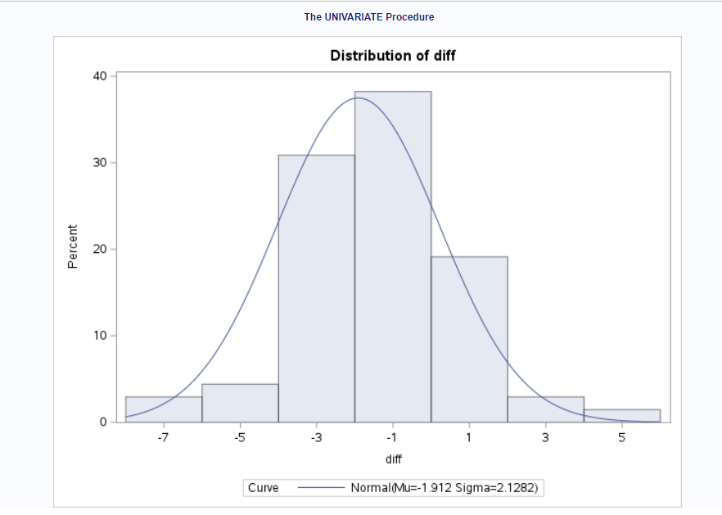
DISTRIBUTION OF DIFFERENCE IN SYMMETRIC ASSUMPTIOM
This assumption requires that the differences between paired observations (weight gain or loss) are symmetrically distributed around the median difference. This can be checked visually using a histogram or quantitatively using skewness or a formal test for symmetry.

Slide 18
STEPS FOR CONDUCTING WILCOXON SIGNED RANK TEST
Calculate Differences
01
Calculate Absolute Differences
02
Rank the Absolute Differences
03
Sum Ranks
04
Test Statistic (W)
05
Critical Value and Decision

Slide 19
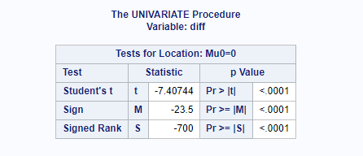
WILCOXON SINGNED RANK TEST USING SAS
We can perform Wilcoxon signed-rank using PROC UNIVARIATE IN SAS
PROC UNIVARIATE doesn't offer a direct method for one-sided tests.
To conduct a one-sided test, we need to derive it manually from the two-sided p-value obtained.

Slide 20
ONE SIDED P-VALUE OF UPPER TAIL
The p-value reported for the signed rank test is "<.0001", which is 0.0001
P(one-sided) = p(two-tailed) / 2
P(one-sided) = 0.0001 / 2 = 0.00005
So, the one-sided p-value for the upper tail is 0.00005.

Slide 21
INTERPRETATIONS
Student’s t-test | Sign Test | Wilcoxon Signed Rank Test
Test Statistic (t): -7.40744 p-value: 0.00005 Interpretation: The t-test compares the mean difference between paired observations to a reference value (in this case, zero). Since the p-value is less than your chosen significance level (typically 0.05), we reject the null hypothesis. Conclusion: There is a statistically significant difference between the paired observations. | Test Statistic (M): -23.5 p-value: 0.00005 Interpretation: The sign test evaluates whether the median difference between paired observations differs from zero. Again, the p-value is less than your significance level, leading to rejection of the null hypothesis. Conclusion: There is a statistically significant difference . | Test Statistic (S): -700 p-value: 0.00005 Interpretation: The Wilcoxon signed rank test assesses the median difference between paired observations. As expected, the p-value is less than your significance level, indicating a significant difference. Conclusion: The paired observations exhibit a meaningful change.

Slide 22
CONCLUSIONS
Statistical Significance: The p-value obtained from the test is 0.00005, which is significantly lower than the significance level of 0.05 commonly used in hypothesis testing.
Rejection of Null Hypothesis: With such a low p-value, we reject the null hypothesis. This indicates that there is strong evidence to suggest that there is mean weight gain in first-semester freshmen between the beginning and end of the semester.
Implications: The significant difference in mean weight implies that there is likely weight gain occurring among first-semester freshmen during their initial semester at college. This finding aligns with the popular notion of the "freshman 15," which suggests that students may experience a substantial weight gain of around 15 pounds during their first year at college.

Slide 23
REFERENCES
Freshman_15 | DASL (datadescription.com)
https://blogs.sas.com/content/iml/2023/07/19/wilcoxon-signed-rank.html

Slide 24
THANK YOU

