Slide 1

GLOBAL LIFE EXPECTANCY PROJECTIONS
GROUP-1
Charitha Nallaka
King, Joshua Taylor
Chilukuru, Kushwanth Kumar
Abedalkanee, Ahamed Mohamed

Slide 2
This project aims to create a model that predicts how long people might live in different countries based on factors like health, wealth, and social status. The goal is to understand what influences life expectancy and use that knowledge to make better decisions about public health and social policies. Ultimately, we hope to contribute to improving people's lives worldwide.​
​

Slide 3
OVERVIEW OF THE DATASET
Consists data of 193 countries from 2000 to 2015
There are 2938 Rows
22 Columns which covers health, social and economic factors of each county.

Slide 4
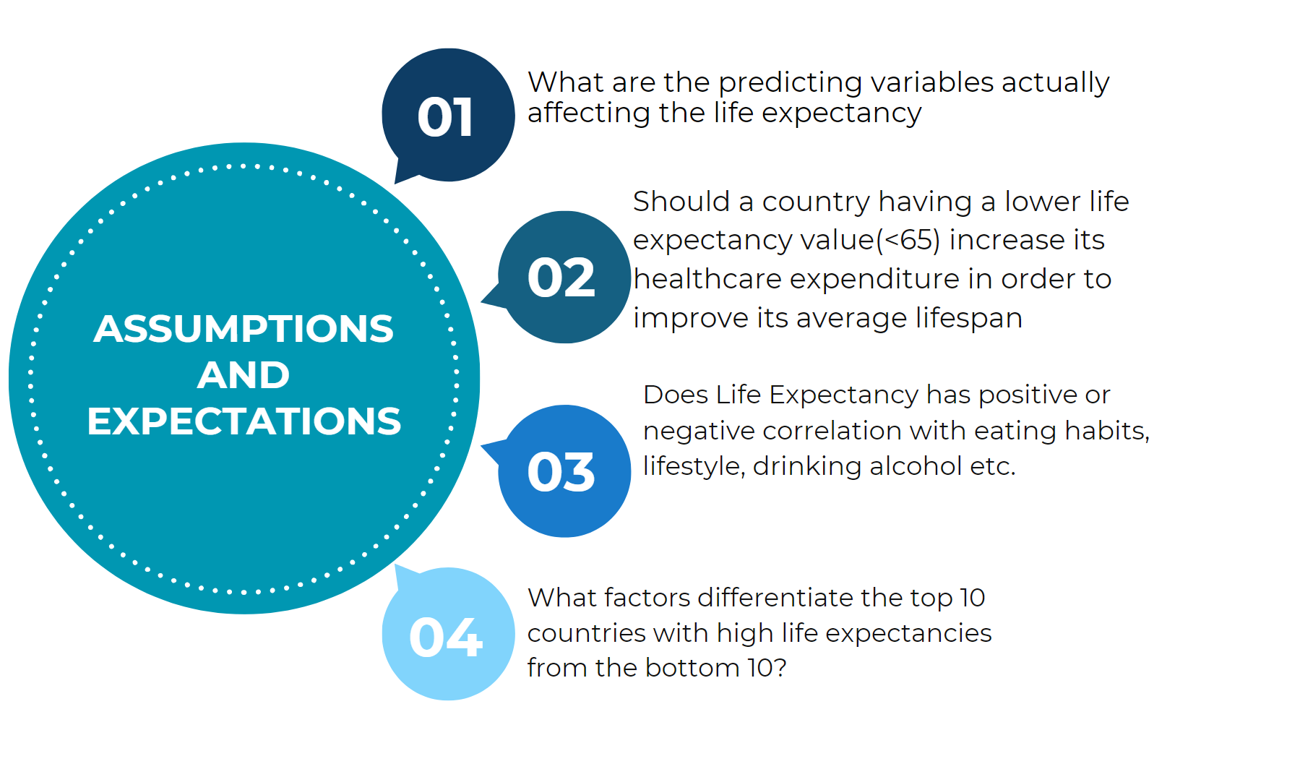

Slide 5
DATA
PREPROCESSING

Slide 6
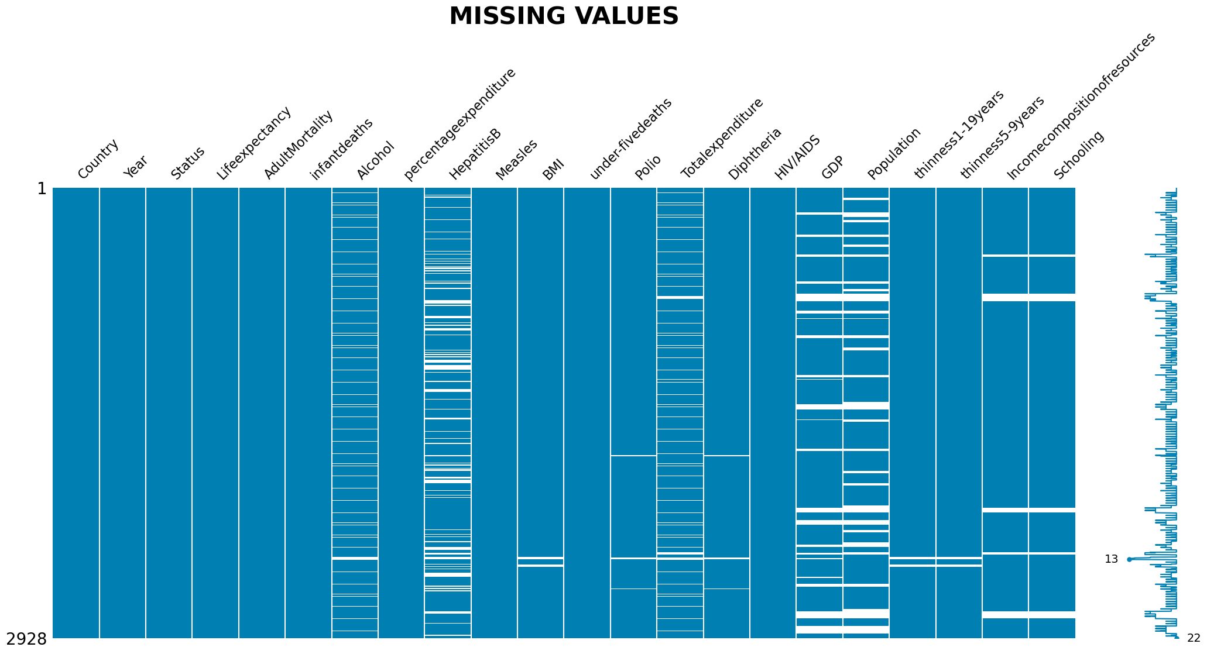

Slide 7
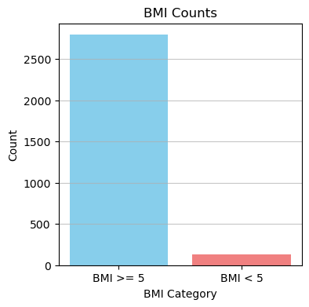
DATA ERRORS
COUNTRIES WITH ONLY ONE YEAR OF DATA
Cook Islands
Marshall Islands
Monaco
Palau
Niue
San Marino
Nauru
Saint Kitts and Nevis
Dominica
ABNORMAL BMI

Slide 8
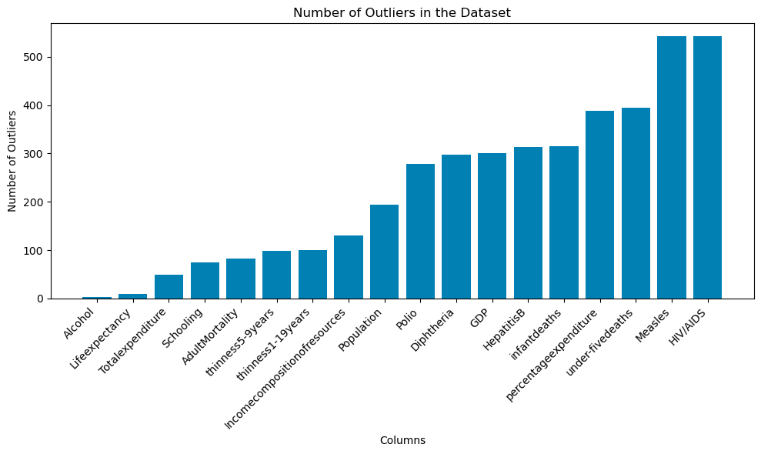
OUTLIERS

Slide 9
EXPLARATORY DATA ANALYSIS

Slide 10
UNIVARIATE ANALYSIS

Slide 11
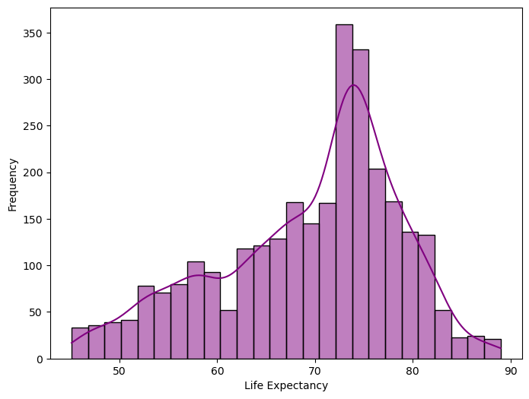
DISTRIBUTION OF LIFE EXPECTANCY
The histogram shows a bell-shaped distribution suggesting a common life expectancy values.
The peak represents the mode which means most of them live around 70 to 80 of life expectancy.

Slide 12
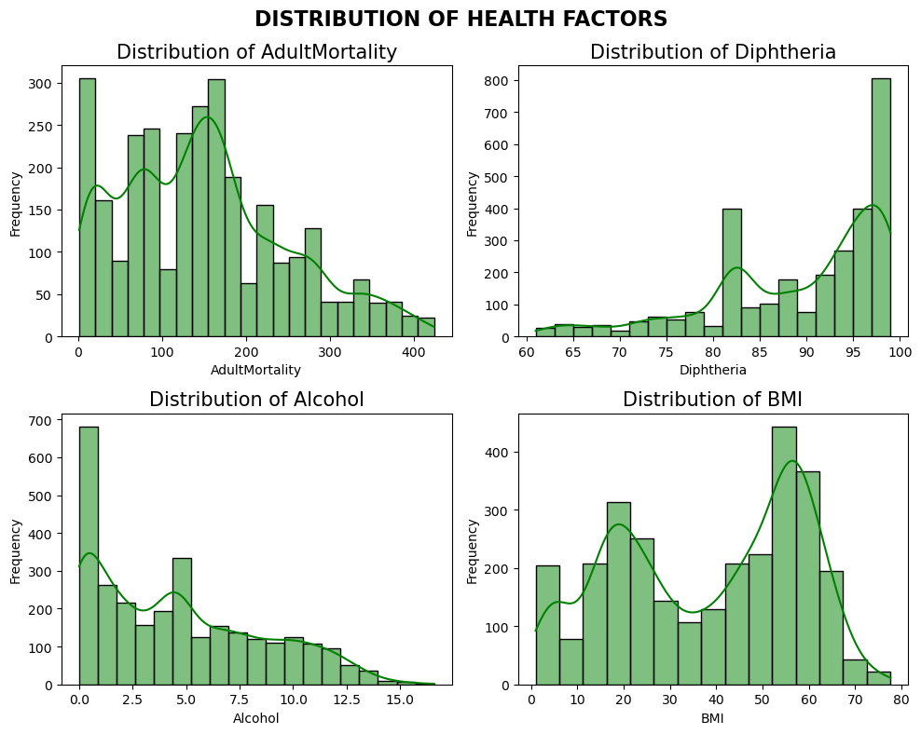
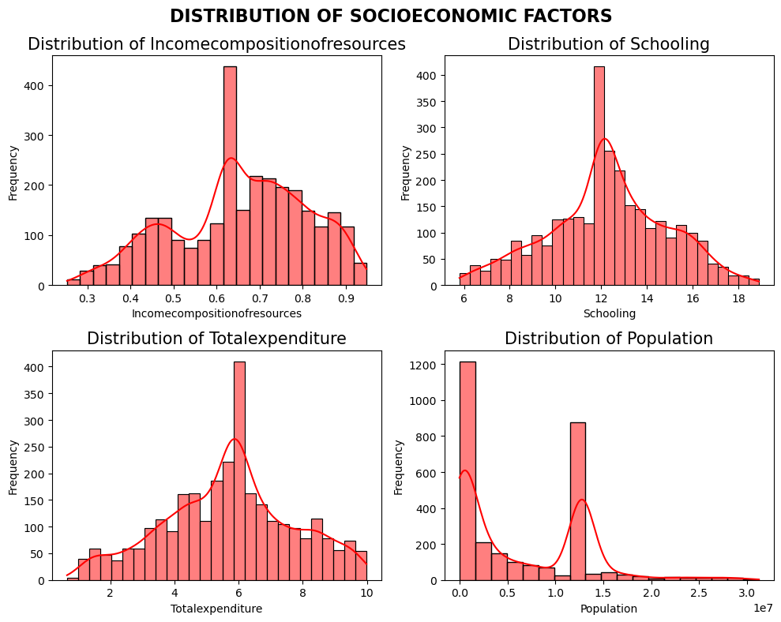
HISTOGRAMS

Slide 13
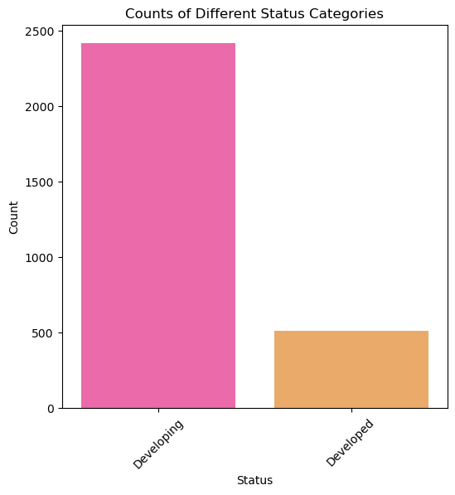
IMBALANCED DATA

Slide 14
BIVARIATE ANALYSIS

Slide 15
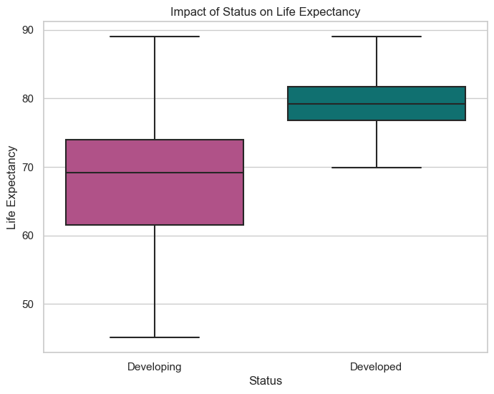
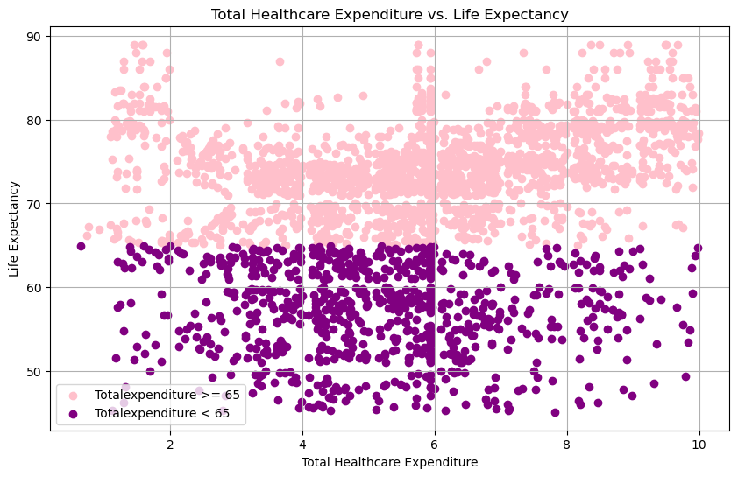
IMPACTS OF STATUS AND HEALTH EXPENDITURE ON LIFE EXPECTANCY

Slide 16
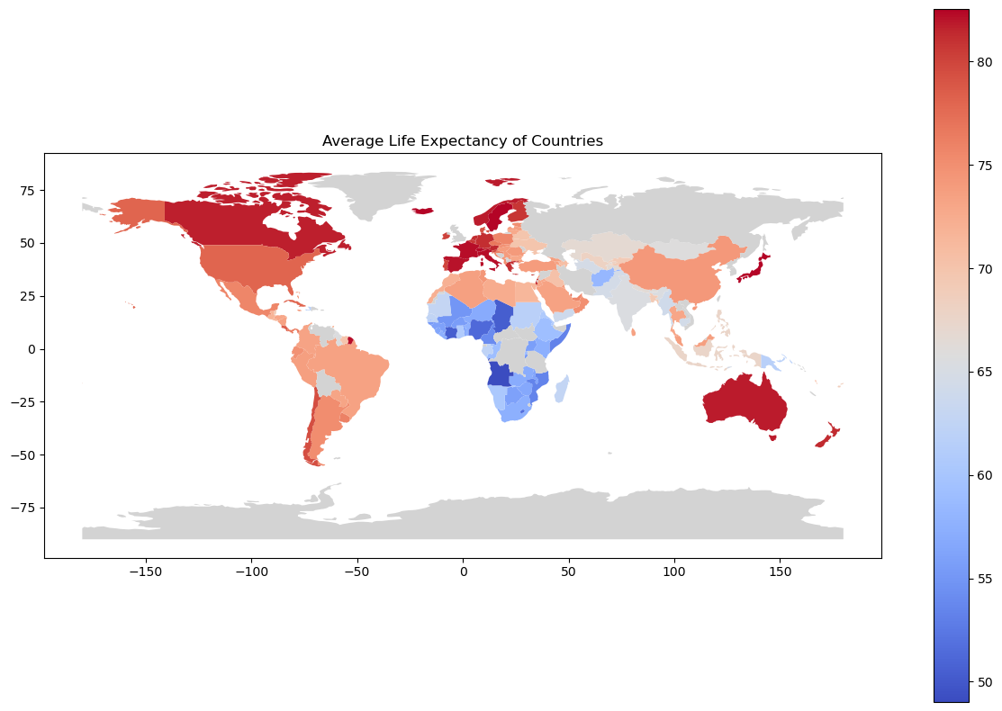
LIFE EXCPECTANCY ACROSS THE WORLD

Slide 17
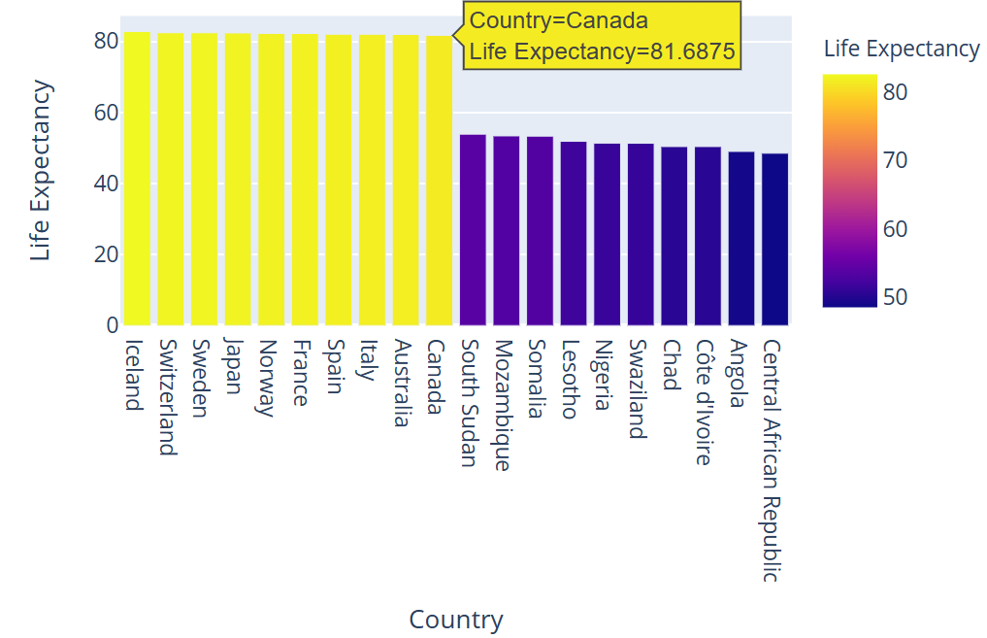
TOP 10 AND BOTTOM 10 COUNTIRES BY LIFE EXPECTANCY

Slide 18
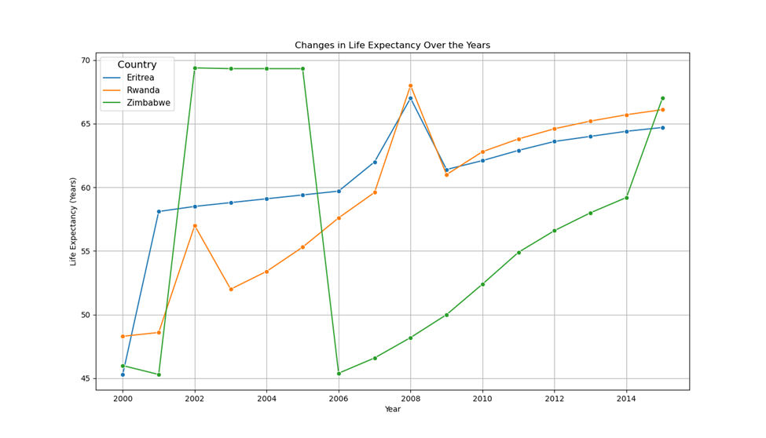
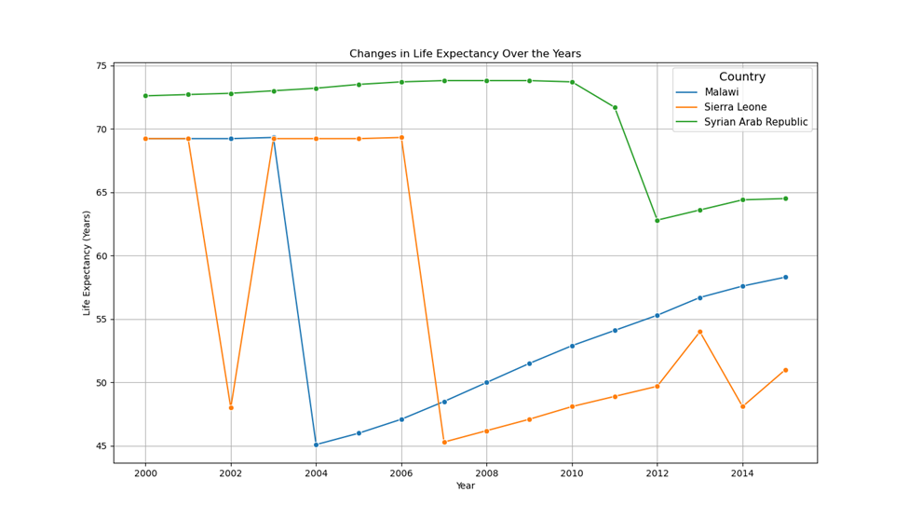
AVERAGE YEARLY PERCENTAGE CHANGE
TOP THREE COUNTRIES WITH THE GREATEST PERCENT CHANGE
BOTTOM THREE CONTRIES WITH THE LOWEST PERCENT CHANGE

Slide 19
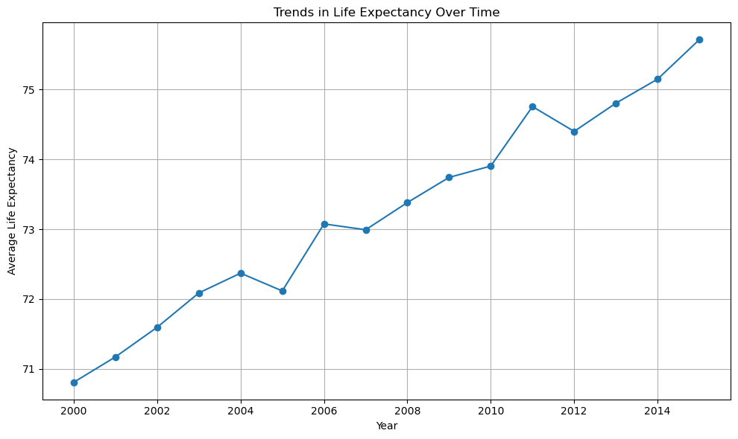

Slide 20
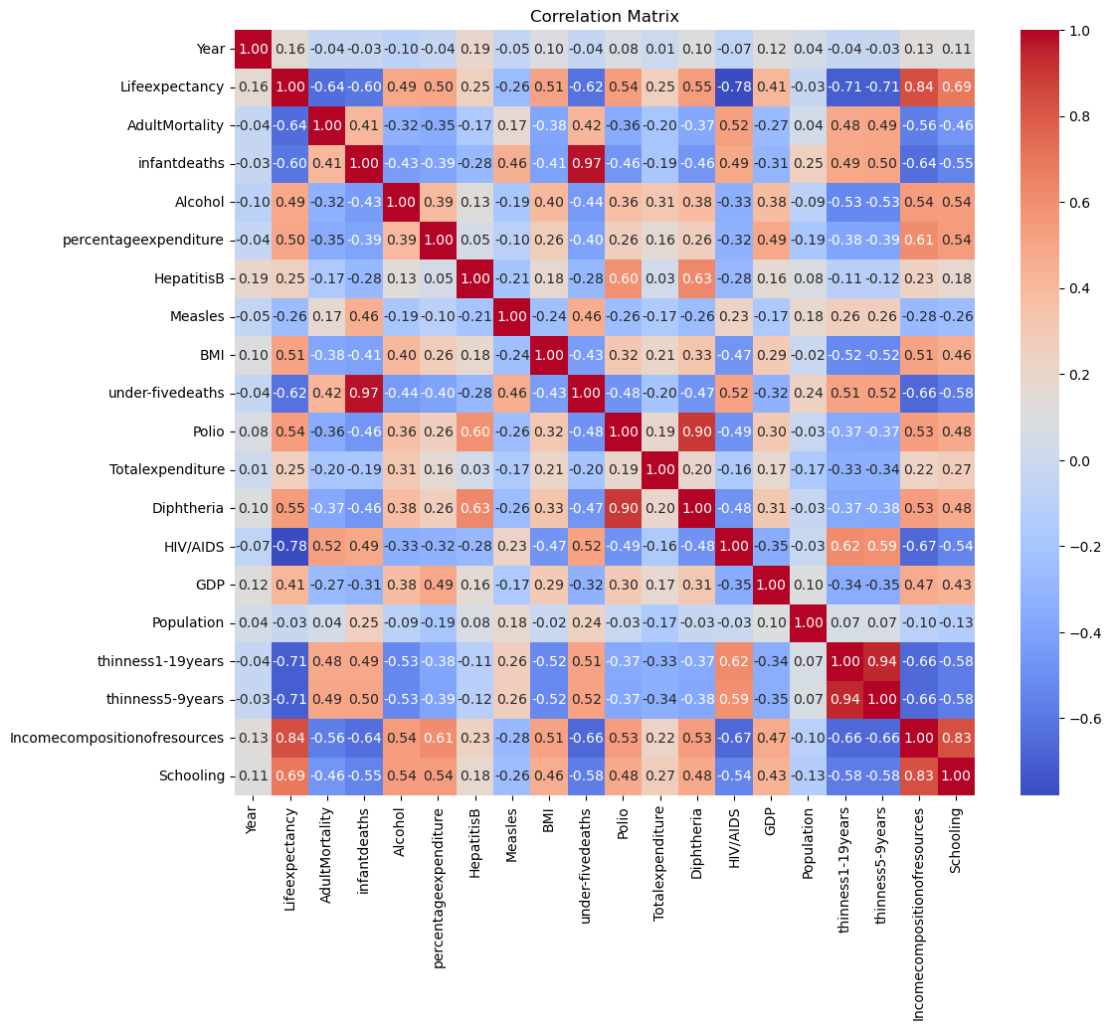
HEATMAP
Multicollinearity is an issue which arises when predictor variables in a regression model are highly correlated, leading to unstable coefficient estimates.
Correlations:
Thinness1-19years and Thinness5-9years: 0.92
Infant Deaths and Under-five Deaths: 0.97
Implications:
High correlations between variables may lead to inflated standard errors and difficulty in interpreting the individual effects of predictors.
Addressing multicollinearity is crucial for ensuring the reliability of regression analyses.

Slide 21
MULTIPLE LINEAR REGRESSION MODEL

Slide 22
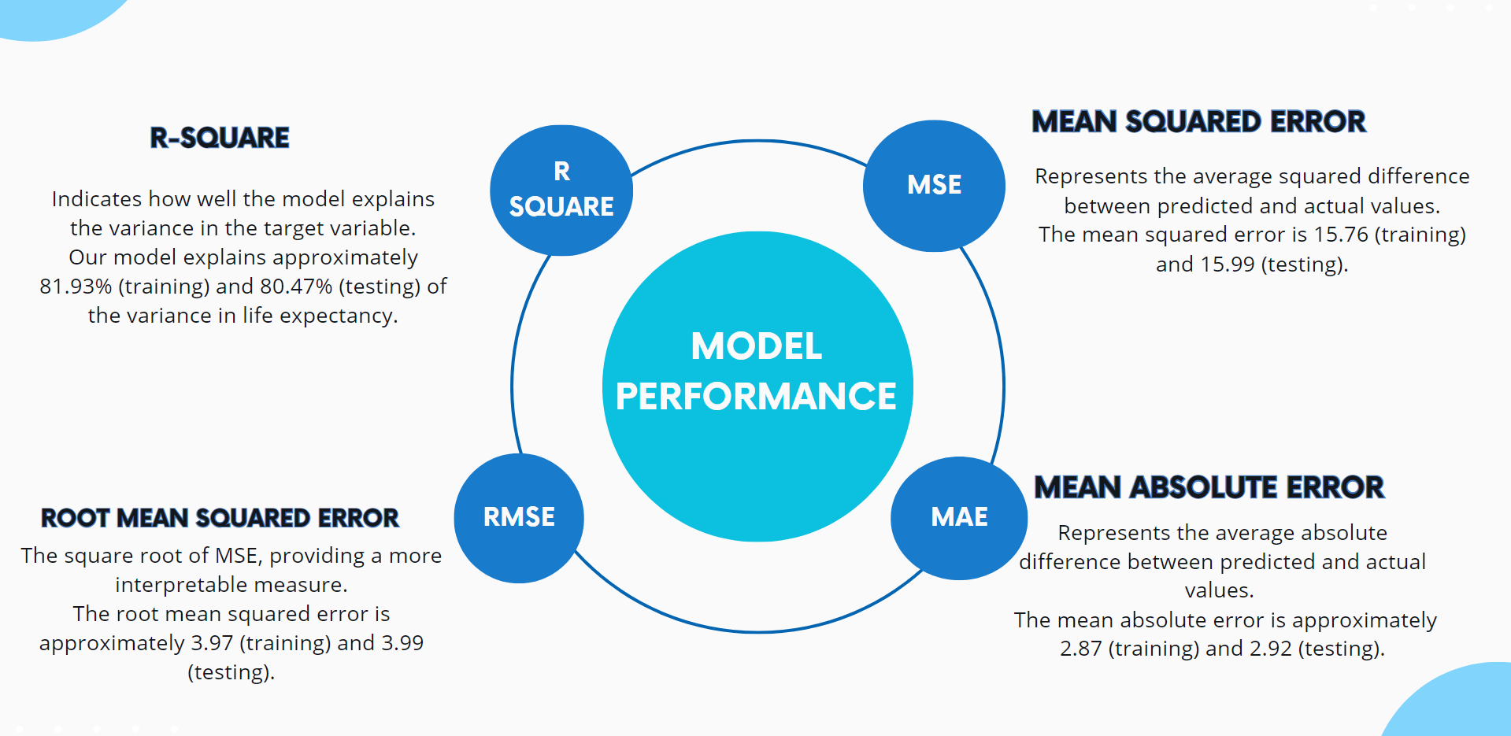

Slide 23
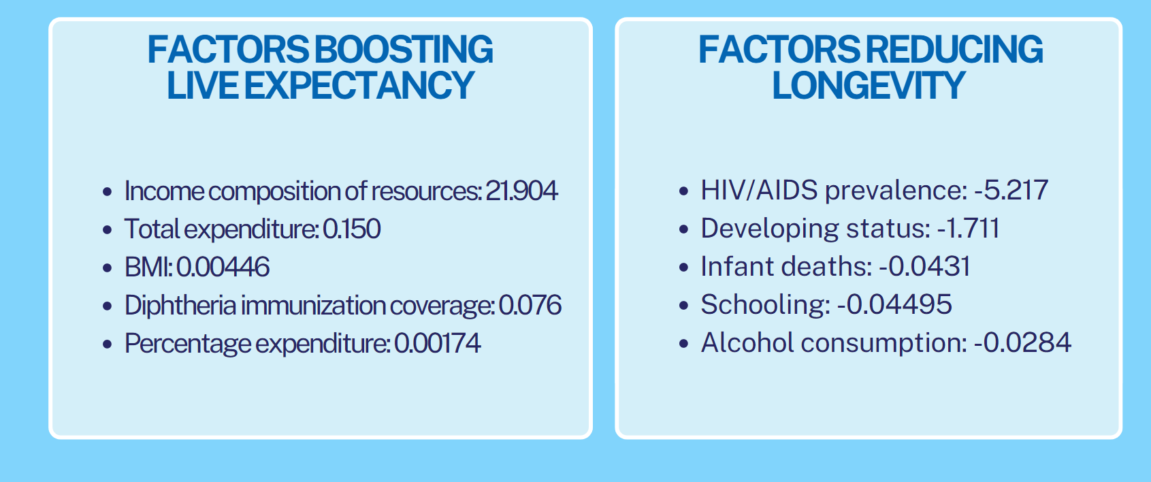
SIGNIFICANT VARIABLES AND THEIR IMPACTS ON LIFE EXPECTANCY

Slide 24
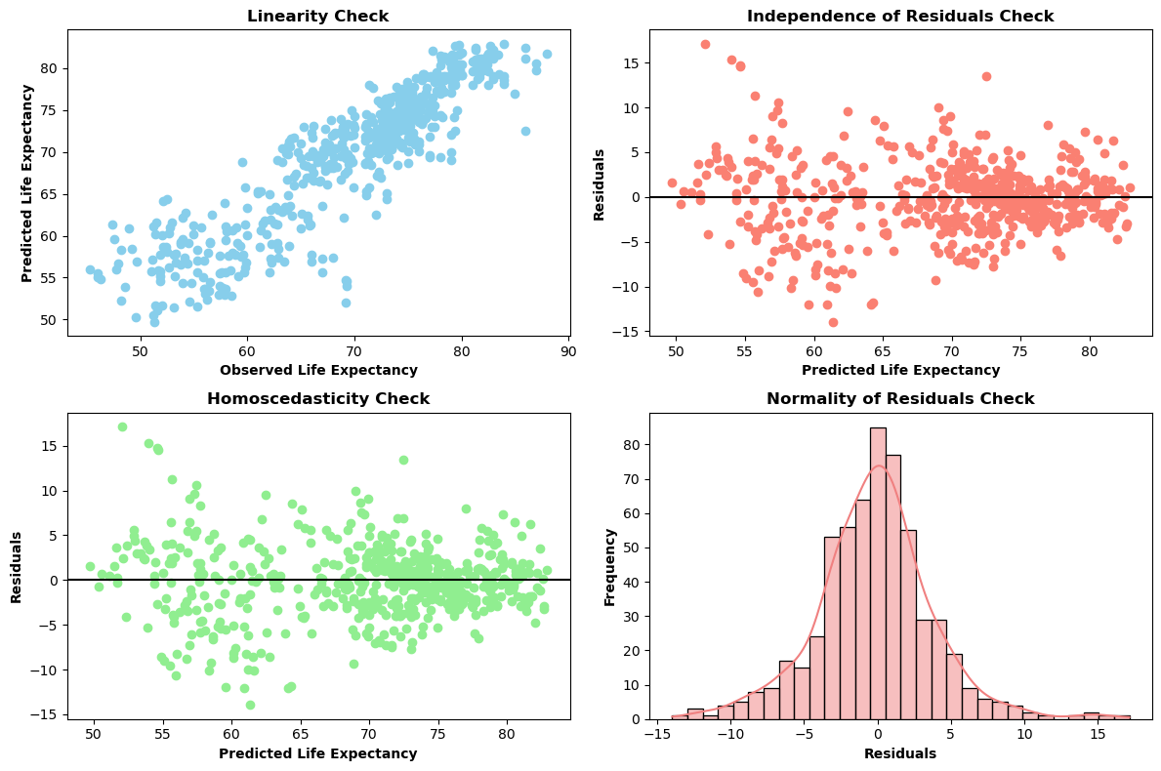
ASSUMPTIOS CHECK FOR LINEAR REGRESSION MODEL

Slide 25
CONCLUSIONS
Higher healthcare spending may improve life expectancy in countries with low averages.
Factors like diet, lifestyle, and alcohol intake impact life expectancy.
Education positively affects lifespan, while densely populated areas may see lower life expectancies.
Immunization boosts life expectancy.
Top 10 countries have higher income, education, immunization, GDP, and lower disease rates compared to bottom 10.

Slide 26

MODEL IMPROVEMENTS
FEATURE ENGINEERING:
Explore transformations and combinations of features to improve linearity.
Consider techniques like logarithmic or square root transformations.
MODEL SELECTION:
Experiment with different types of models beyond linear regression.
Try complex models like decision trees, random forests, or neural networks.
HYPERPARAMETER TUNING:
Tune hyperparameters using techniques like grid search or random search.
Find the best combination of hyperparameters for improved performance.
ENSEMBLE METHODS:
Combine multiple models using techniques like bagging or boosting.
Create a more robust and accurate predictor by leveraging ensemble methods.

Slide 27
REFERENCE
https://www.kaggle.com/datasets/kumarajarshi/life-expectancy-who

Slide 28

THANK YOU

Slide 29
QUESTIONS?

