Slide 1
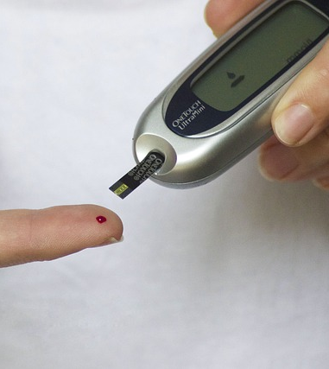
PIMA INDIAN WOMEN DIABETIC STUDY
GROUP – 19
CHARITHA NALLAKA
RAJAMANOHAR VADREVU

Slide 2
CONTENTS
INTRODUCTION
DATA OVERVIEW
FEATURES
KEY ASSUMPTIONS
DATA PREPROCESSING
EXPLORATORY DATA ANALYSIS
LOGISTIC REGRESSION MODEL
REFERENCES
CONCLUSIONS

Slide 3
INTRODUCTION
DATASOURCE AND BACKGROUND: This dataset was obtained from the National Institute of Diabetes and Digestive and Kidney Diseases. It was selected to predict the onset of diabetes in individuals based on certain diagnostic measurements. The data specifically focuses on females at least 21 years old of Pima Indian heritage.
PROBLEM STATEMENT: Develop a predictive model to identify the likelihood of diabetes onset in Pima Indian women based on medical predictor variables such as pregnancies, BMI, insulin levels, and age.

Slide 4
OUTCOMES EXPECTED FROM THE MODEL
EARLY INTERVENTION: The predictive model enables early identification of individuals at risk of diabetes, allowing for timely intervention and preventive measures.
PERSONALIZED HEALTHCARE: By tailoring interventions based on individual risk profiles, healthcare resources can be allocated more efficiently, leading to improved patient outcomes.
REDUCED HEALTHCARE COST: Proactive management of diabetes risk can help mitigate the economic burden associated with diabetes-related complications, hospitalizations, and treatments
EMPOWERING PATIENTS: Providing individuals with personalized risk assessments empowers them to make informed lifestyle choices and engage in proactive health management.

Slide 5
DATASET OVERVIEW
768 samples
9 Features

Slide 6
FEATURES
NUMERICALS
PREGNANCIES
GLUCOSE LEVELS
BLOOD PRESSURE LEVELS
SKINTHICKNESS
INSULIN
CATEGORICALS
OUTCOME
BMI
DIABETES PEDIGREE FUNCTION
AGE

Slide 7

KEY ASSUMPTIONS
What are the key predictors that significantly influence the chance of getting diabetes?
How does skinthickness affects the diabetes
Are women with the highest number of pregnancies more likely to have higher glucose levels that cause diabetes?
Do women with higher insulin levels tend to have higher glucose levels, which cause diabetes?
Do aged people tend to get diabetes ?

Slide 8
DATA PREPROCESSING

Slide 9
MISSING VALUES AND DUPLICATES
NO MISSING VALUES
NO DUPLICATES

Slide 10
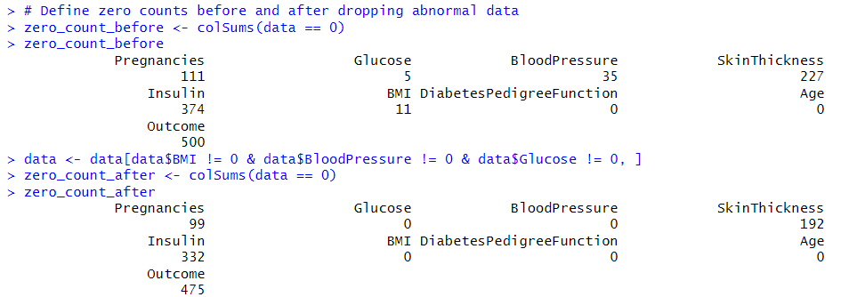
DATA ERRORS
Abnormal data:
A Person cannot have BMI, Blood Pressure, Glucose levels as zero.
So dropped all those rows that has zeros in BMI, Blood Pressure and Glucose.

Slide 11
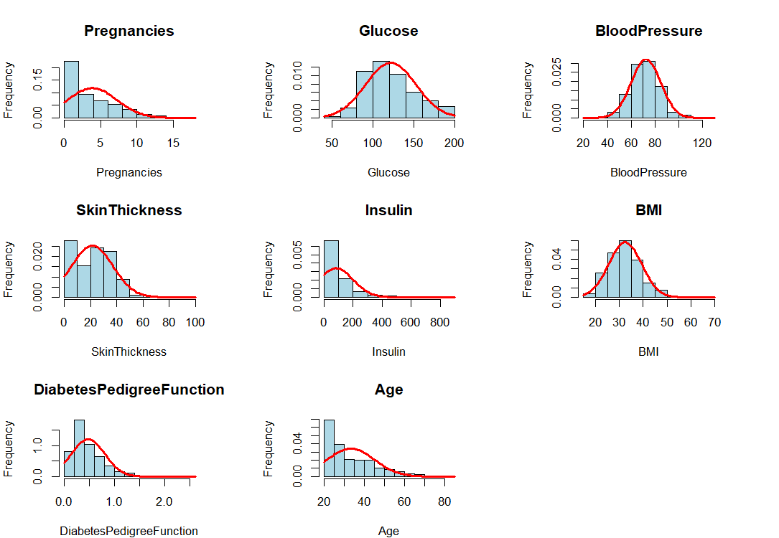
DITSRIBUTIONS OF VARIABLES

Slide 12
DISTRIBUTION OF VARIABLES
1. Pregnancies: Mostly fewer, peak at 0-2, with some having higher counts.
2. Glucose: Normal distribution, centered at 100-120 mg/dL, some outliers.
3. Blood Pressure: Bimodal, peaks at 70-80 and 110-120mm Hg.
4. BMI: Right-skewed, most in normal range, few outliers.
5. Age: Positively skewed, peak at 20-40 years, tail for older ages.
6. Skin Thickness: Right-skewed, mostly thin, with some outliers.
7. Insulin: right-skewed with some high outliers.
8. Diabetes Pedigree Function: Skewed, but vital for genetic risk assessment.

Slide 13
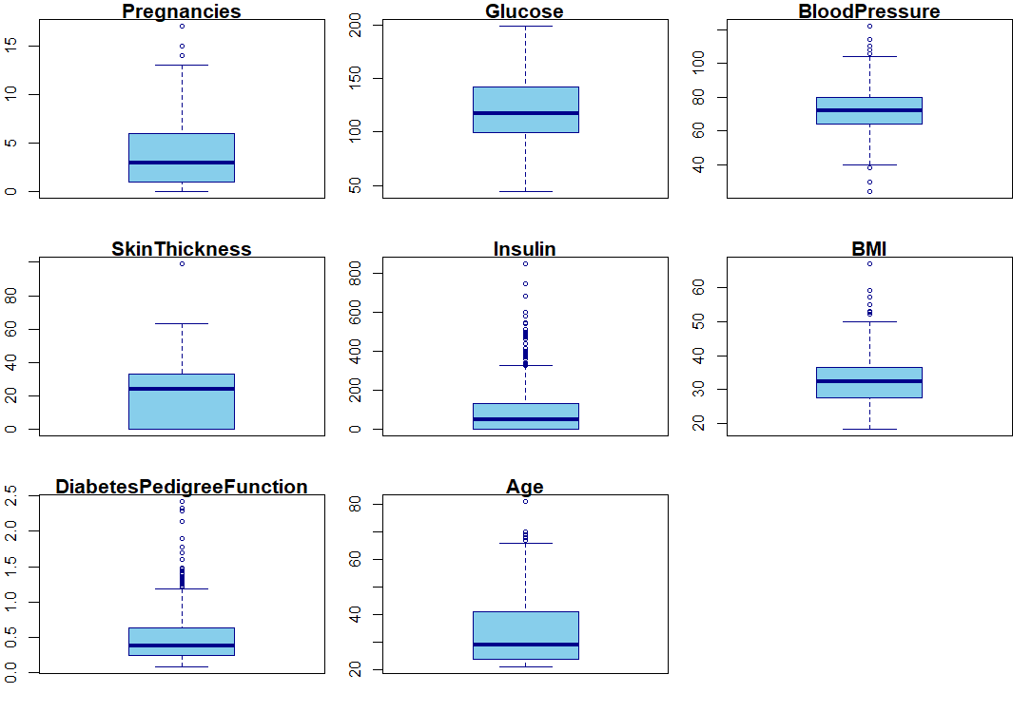
OUTLIERS

Slide 14
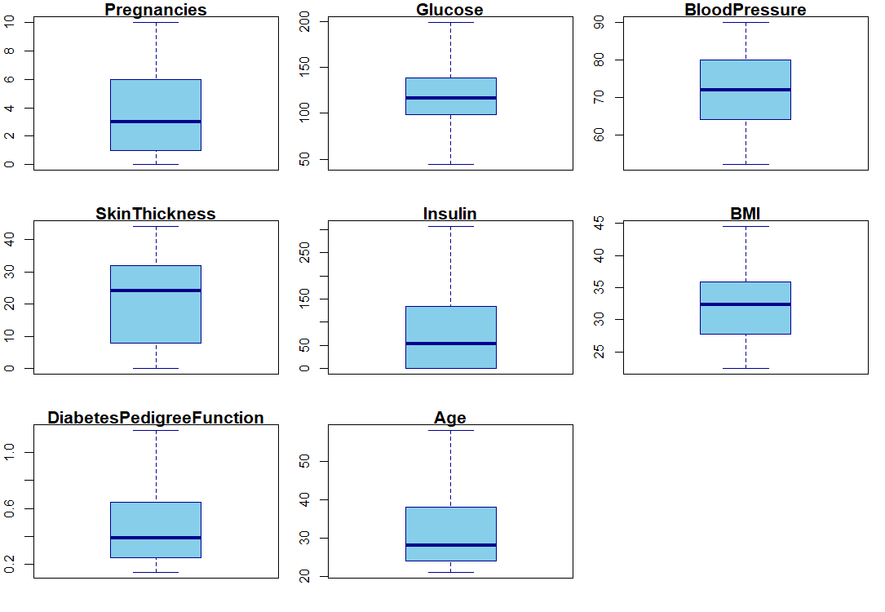
OUTLIER REMOVAL
As there are a smaller number of outliers in Pregnancies, Skin Thickness , age and BMI so dropped those outlies
For Insulin, Diabetic Pedigree Function and Blood Pressure used capping method to remove outliers.
As most of the data is skewed which is evident from the distributions do used caping method for the variables that has more outliers.

Slide 15
EXPLORATORY DATA ANALYSIS

Slide 16
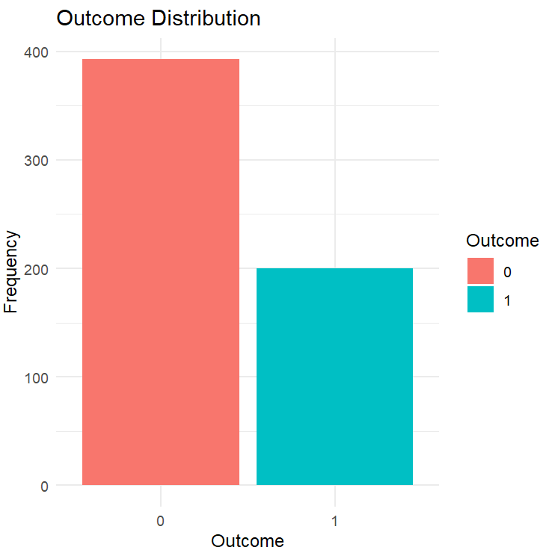
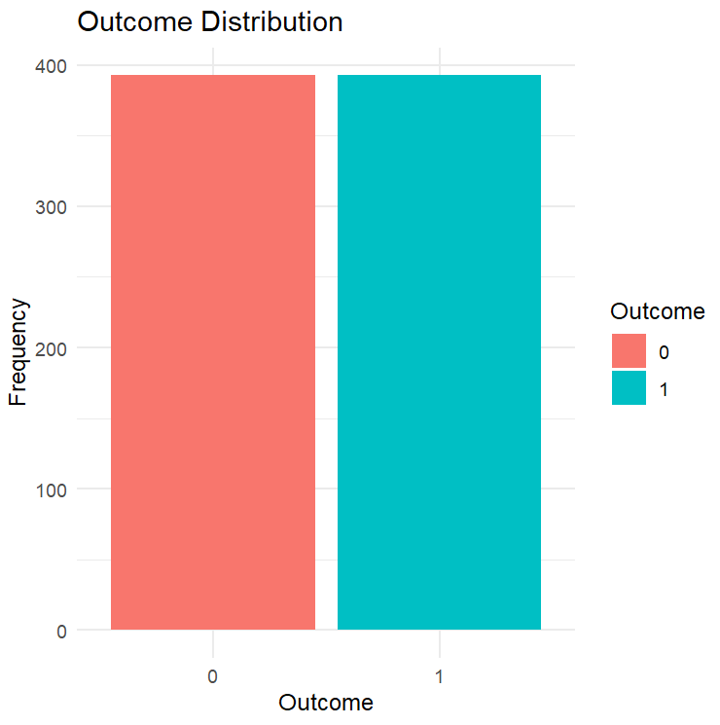
IMBALANCE DATA
BEFORE RESAMPLING
We first separated the majority class and the minority class .
Then, we randomly sampled (with replacement) from the minority class to match the number of samples in the majority class. This process of randomly sampling with replacement from the minority class to increase its size is known as random oversampling.
AFTER RESAMPLING

Slide 17
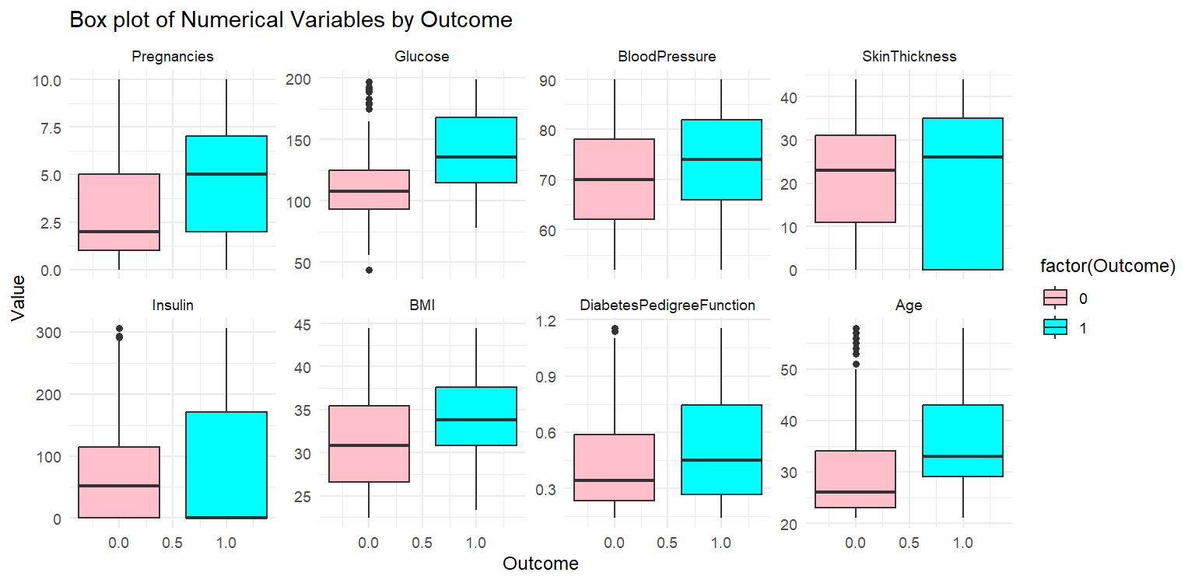
RELATIONSHIP BETWEEN OUTCOME AND INDEPENDENT VARIABLES

Slide 18
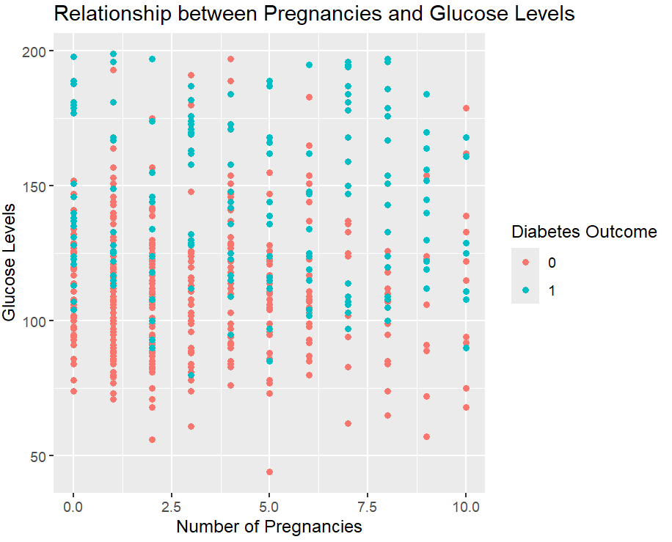
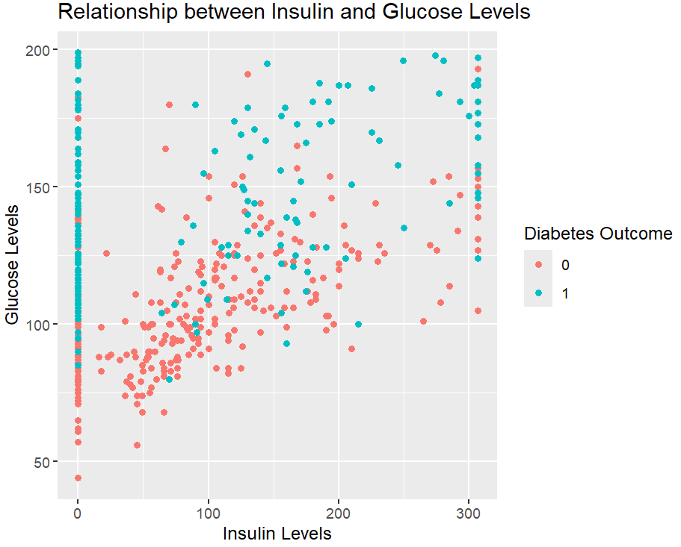
ANALYSING RELATIONS BETWEEN VARIABLES

Slide 19
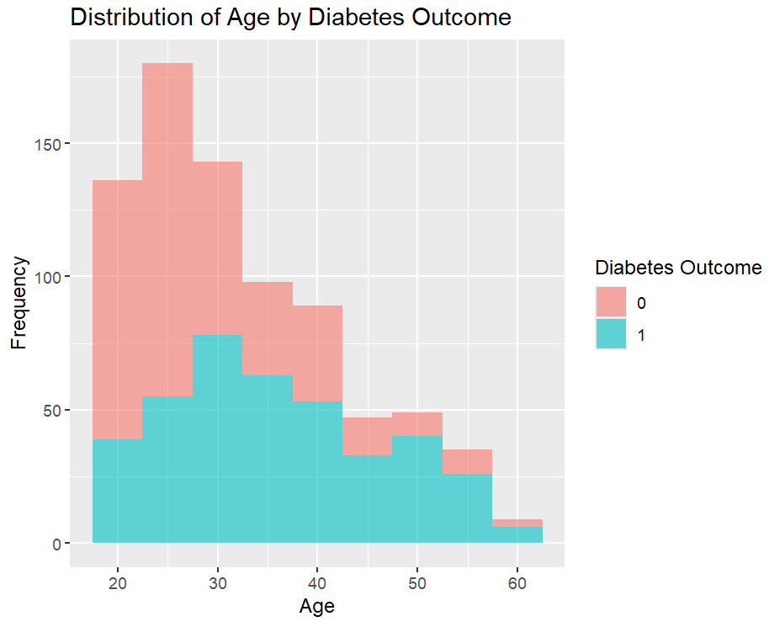
RELATIONSHIP BETWEEN AGE AND DIABETES

Slide 20
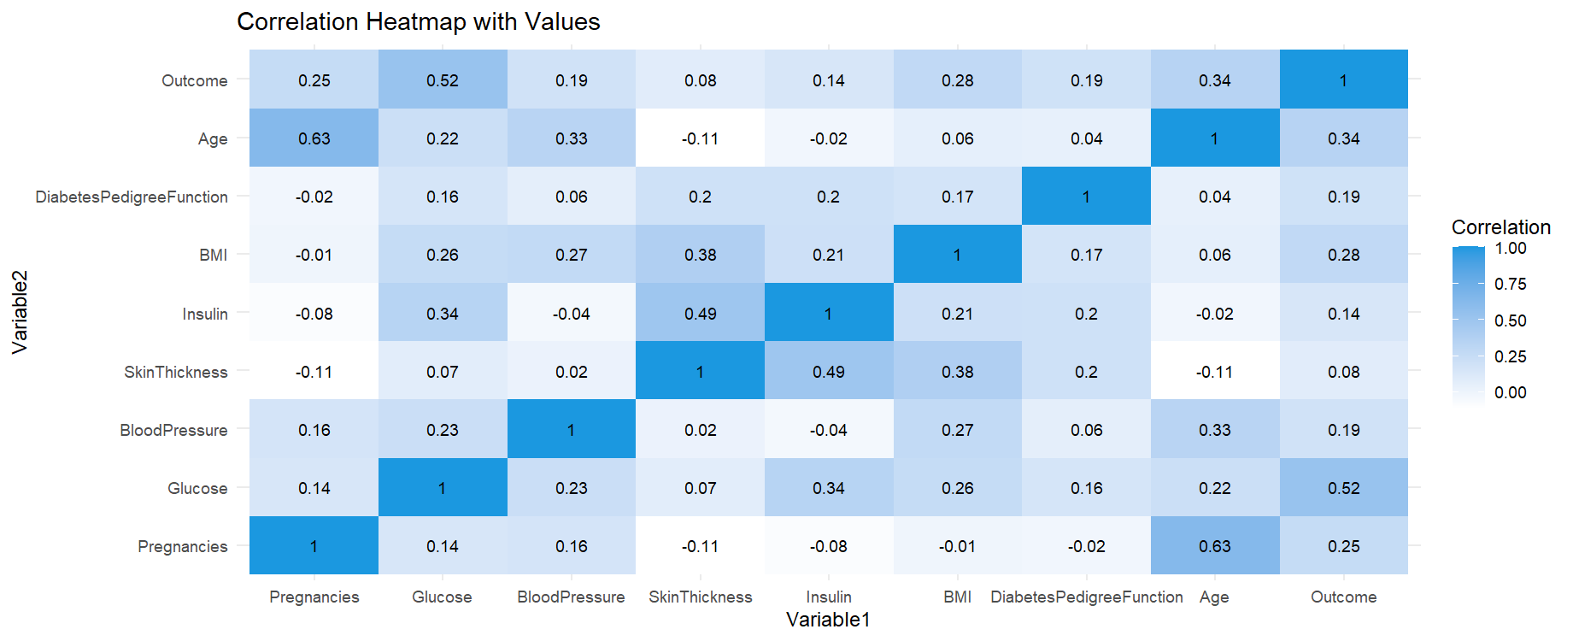
CORRELATION MATRIX
From the heat map it is evident that there no multicollinearity

Slide 21
LOGISTIC REGRESSION

Slide 22
DATA PREPARATION
Scaling
Feature Scaling
Ensures features are comparable in scale.
Prevents bias towards certain features.
Methods: MIN – MAX Scaling
Splitting
Data Splitting : Crucial for effective model assessment.
Divides data into:
Training Set(70%)
Testing Set(30%)

Slide 23
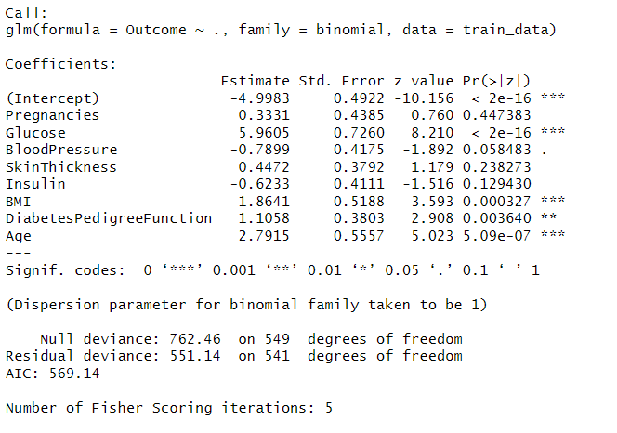
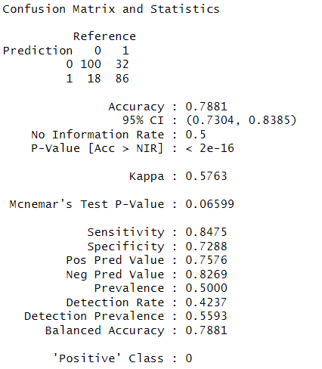
MODEL WITH ALL VARIABLES

Slide 24
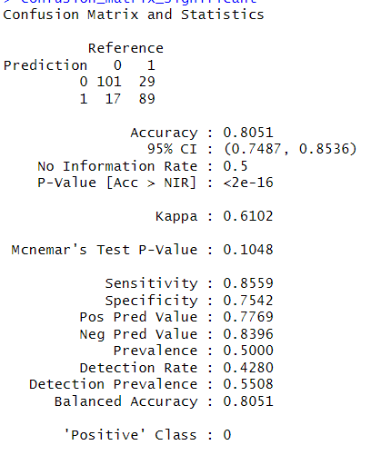
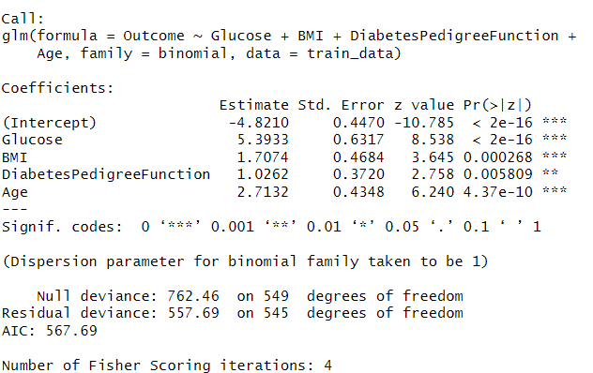
MODEL WITH SIGNIFICANT VARIABLES

Slide 25
MODEL COMPARISONS
Comparing these metrics, we observe that the model with only significant variables generally performs slightly better in terms of accuracy, sensitivity, and specificity compared to the model with all variables. Additionally, the positive predictive value (precision) is slightly higher for the model with significant variables.
Therefore, based on these metrics, the model with only significant variables appears to be better in terms of predictive performance on the test data.
For the model with all variables:
Accuracy: 78.81%
Sensitivity (True Positive Rate): 84.75%
Specificity (True Negative Rate): 72.88%
Positive Predictive Value (Precision): 75.76%
Negative Predictive Value: 82.69%
For the model with only significant variables:
Accuracy: 80.51%
Sensitivity: 85.59%
Specificity: 75.42%
Positive Predictive Value: 77.69%
Negative Predictive Value: 83.96%

Slide 26
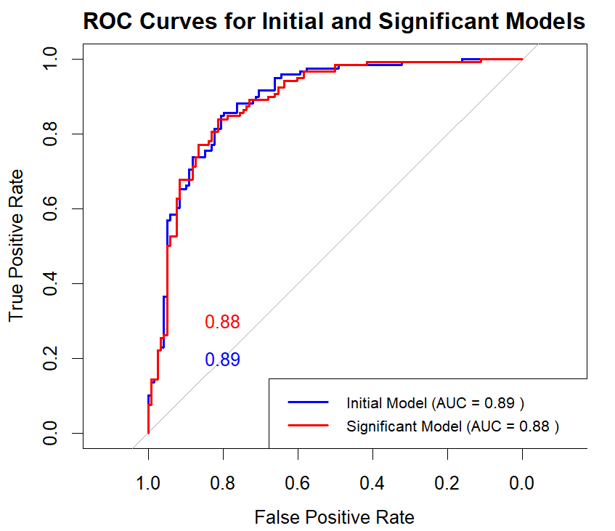
ROC CURVES OF MODELS
The ROC curve visually depicts how effectively a binary classifier distinguishes between positive and negative cases by plotting the True Positive Rate (TPR) against the False Positive Rate (FPR) at various threshold values. A perfect classifier would have an ROC curve that hugs the top-left corner, indicating optimal performance.
In our case, the ROC curve suggests that our model performs better, as it leans towards the top-left corner. The Area Under the Curve (AUC) quantifies overall performance, ranging from 0.5 (random guessing) to 1 (perfect classification). Our initial model has an AUC of 0.89, and the improved model has an AUC of 0.88, both close to 1, indicating good performance.

Slide 27
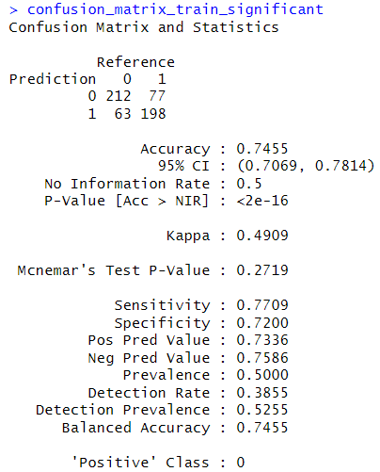
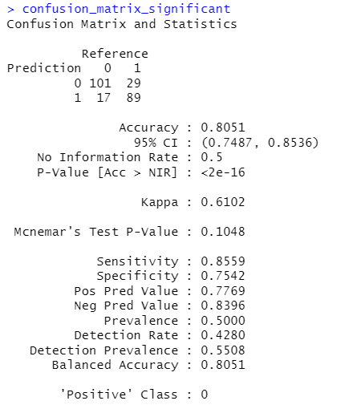
ACESSING OVERFITTING OR UNDERFITTING
1. Training data: Accuracy 0.7455, Sensitivity 0.7709, Specificity 0.72, Positive class prevalence 0.5.
2. Testing data: Accuracy 0.8093, Sensitivity 0.8475, Specificity 0.7712, Positive class prevalence 0.5.
Underfitting: Model may not capture underlying patterns well, leading to subpar performance on both training and testing data.
Overfitting: Model may perform exceptionally well on training data but generalize poorly to unseen data due to capturing noise or random fluctuations.
Model: Demonstrates reasonable performance with a slight advantage on testing data, suggesting effective learning without significant overfitting.
TESTING DATA
TRAINING DATA

Slide 28
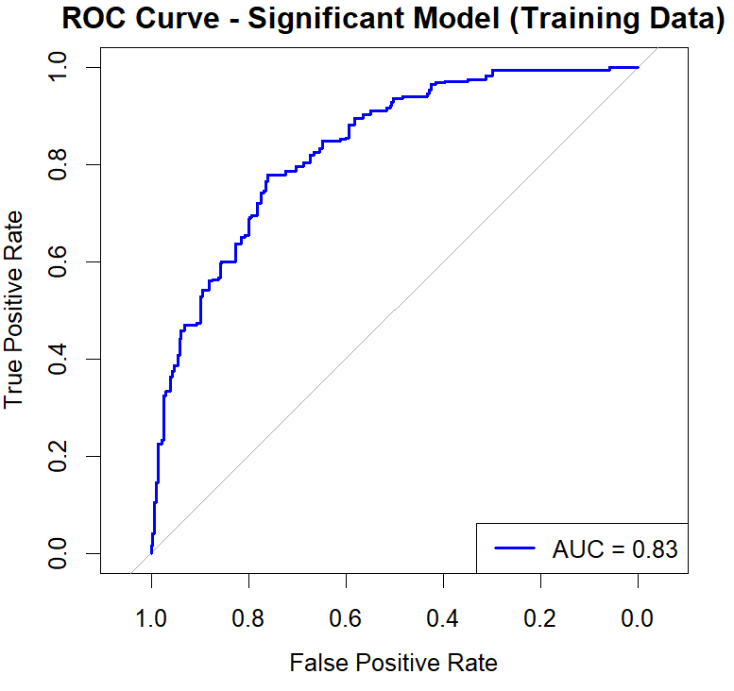
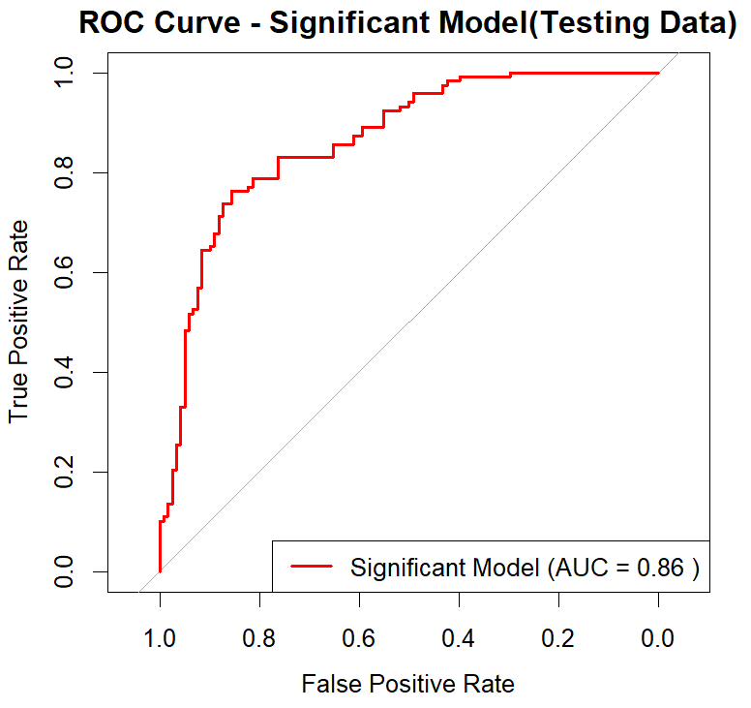
ROC CURVE OF TRAINING AND TESTING DATA
TRAINING CURVE
TESTING CURVE

Slide 29
CONCLUSIONS
1. Strong Predictors: Glucose levels and BMI emerge as robust predictors of diabetes, with higher levels of these variables correlating strongly with an increased likelihood of diabetes. Age and the degree of the pedigree function also contribute significantly to predicting diabetes risk.
2. Weak Predictors: In contrast, factors such as insulin levels, pregnancy status, skin thickness, and blood pressure are identified as poor predictors of diabetes. These variables do not significantly impact the likelihood of developing the condition.
3. Overall Accuracy: The logistic regression model achieves an impressive 80% accuracy in predicting diabetes status. This indicates that the combination of predictors utilized in the model yields reliable results, with 80% of predictions being correct.
4. Accuracy by Diabetic Status: The model demonstrates a slightly higher accuracy in predicting non-diabetic cases, with an accuracy of 85.5%. This suggests that the model is particularly adept at identifying individuals who do not have diabetes. However, its accuracy in predicting diabetic cases remains strong at 75.42%, albeit slightly lower than the accuracy for non-diabetic cases.
5. Model Performance: The overall performance of the logistic regression model indicates its effectiveness in distinguishing between diabetic and non-diabetic individuals. While there is a marginally higher accuracy in predicting non-diabetic cases, the model still exhibits a commendable ability to identify individuals with diabetes.

Slide 30
MODEL IMPROVEMENTS
1. INCREASE MODEL COMPLEXITY: Make the model more intricate by adding more data or using a more complex architecture.
2. FEATURE ENGINEERING: Enhance feature quality or create new ones to better represent underlying relationships in the data.
3. REGULARIZATION: Apply techniques like L1/Lasso or L2/Ridge regularization to prevent oversimplification and encourage a balance between fitting the training data and generalization.
4. ENSEMBLE METHODS: Utilize ensemble methods such as Random Forest or Gradient Boosting to combine multiple models and capture more complex patterns in the data.

Slide 31
REFERENCE
https://www.kaggle.com/datasets/uciml/pima-indians-diabetes-database

Slide 32
THANK YOU

