Slide 1
Stock Market Insights Using
Network Science
Phase - 2
Panel Review - 1
Tag 5 - Data Science / Data Analytics
Guide: Dr. (Col.) Kumar P. N.
Co-Guide: Dayanand V.
SL NO. | Name | Roll No
1 | Avantika Balaji | CB.EN.U4CSE20309
2 | Charitha Uppalapati | CB.EN.U4CSE20311
3 | Kanumilli Pavan Sai | CB.EN.U4CSE20324
4 | Kausalyaa Sri | CB.EN.U4CSE20326

Slide 2
Abstract
This paper introduces a dynamic stock market analysis system leveraging advanced network science techniques for comprehensive exploration across diverse sectors, with a primary emphasis on enhancing portfolio management strategies. Our approach involves constructing time-series complex networks, a methodology that unveils concealed relationships and patterns within the data while maintaining strict statistical rigor to separate genuine correlations from the noise inherent in financial data. Utilizing time series analysis and feature extraction, we construct a correlation matrix and extract edge weights based on a specified threshold. Subsequently, community detection techniques unveil distinctive groupings within the stock network. After identifying communities within the stock network, we further analyze the dynamics by computing the beta measure and range of volatility between each community. Based on these metrics, we classify the communities into baskets, facilitating more effective portfolio management strategies. Our project adopts an interdisciplinary approach, drawing from the fields of finance, data analysis, and network science, to provide a holistic understanding of stock market dynamics. By combining these domains, we aim to bridge the gap between theoretical insights and practical applications, ultimately contributing to a more informed and agile financial ecosystem.

Slide 3
Problem Statement
To develop a dynamic stock market analysis system using network science techniques across diverse sectors with a focus on portfolio management.

Slide 4
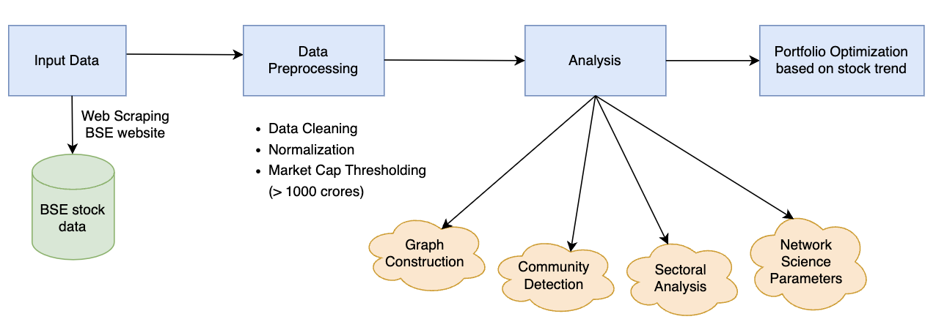
Architecture Diagram

Slide 5
Work done in Phase - 1
1. Data Preprocessing: Initial cleaning and quality assurance.
2. Filtering Companies: Focus on stable entities with market capitalization ≥ 1000 crores.
3. Time Series Analysis: Calculation of moving averages and gradients.
4. Feature Extraction: Utilization of six feature vectors.
5. Correlation Matrix: Computation using cosine similarity.
6. Edge Weight Extraction: Based on specified threshold (0.99) for short-term and long-term periods.
7. Community Detection: Implementation of Louvain, Label Propagation, and Greedy Modularity algorithms.
8. Network Science Parameters: Calculation of centrality measures and clustering coefficient.
9. Modularity Analysis: Plotting modularity against threshold for community structure.
10. Lead-Lag Relationship Analysis: Exploration of temporal dynamics and sub-community identification.

Slide 6
Comments/Feedback
Why the market cap filtering (>1000 crore)
Ensures focus on more stable entities
Larger market cap = greater stability, liquidity, and established market presence.
How it aligns with stock stability: Reduces exposure to smaller, riskier stocks prone to higher volatility and market fluctuations.
2. How do we suggest companies for portfolio
Community detection
Volatility Analysis
Risk Mitigation during basket creation
Diversification

Slide 7
Comments/Feedback
3. Comparison between conventional portfolio method and proposed automated portfolio management
Conventional: Manual, subjective, limited.
Proposed Automated: Data-driven, objective, comprehensive.
Result: Improved performance and risk management.

Slide 8
Phase 2 - Approach
Objectives:
Expand communities for finer distinctions.
Measure community volatility using beta.
Construct portfolios within communities using heuristics.
Backtest portfolios for performance evaluation.
Compare heuristic results with traditional models.
Optimize portfolios for enhanced risk-adjusted returns.

Slide 9
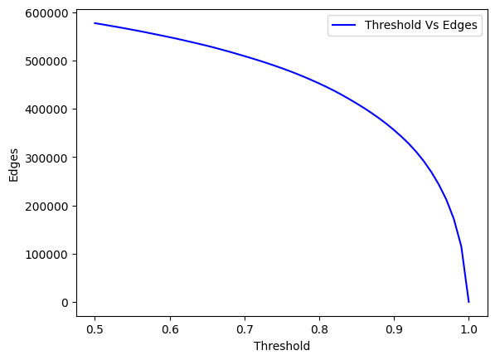
Experimentation
The graph demonstrates how the number of edges in the correlation matrix decreases as the threshold value increases from 0.5 to 1.0.
At a certain point, known as the "elbow" or foot of the curve, the rate of decrease slows down significantly, indicating a balance between retaining meaningful connections and filtering out noise.
Selected threshold = 0.98

Slide 10
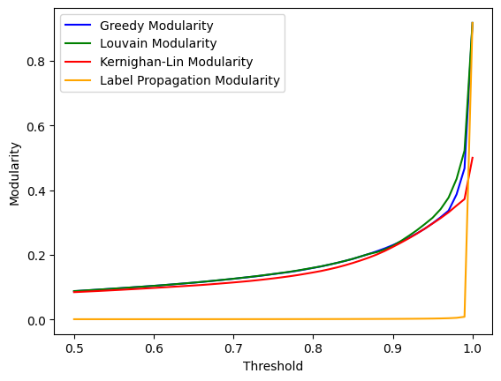
Experimentation
1. Threshold Variation:
Experimented with different thresholds to increase community diversity
Evaluated the impact on the number of communities
2. Exploring Community Detection Algorithms:
Tested various community detection algorithms
Explored Louvain, Label Propagation, and Greedy Modularity algorithms.
3. Finalization: Louvain Algorithm:
Better results for maximizing modularity.
Offers optimal partitioning of the network into distinct communities.
Provides valuable insights into the modular structure of the stock network.

Slide 11
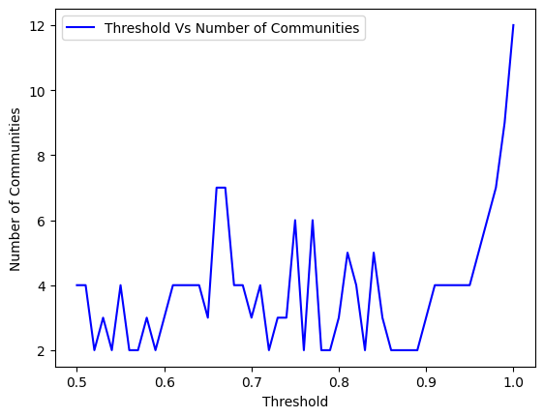
Experimentation
The threshold vs number of communities graph shows how adjusting the threshold affects the granularity of detected communities in the stock market network.
It helps in selecting an optimal threshold for balanced insights into the market structure.

Slide 12
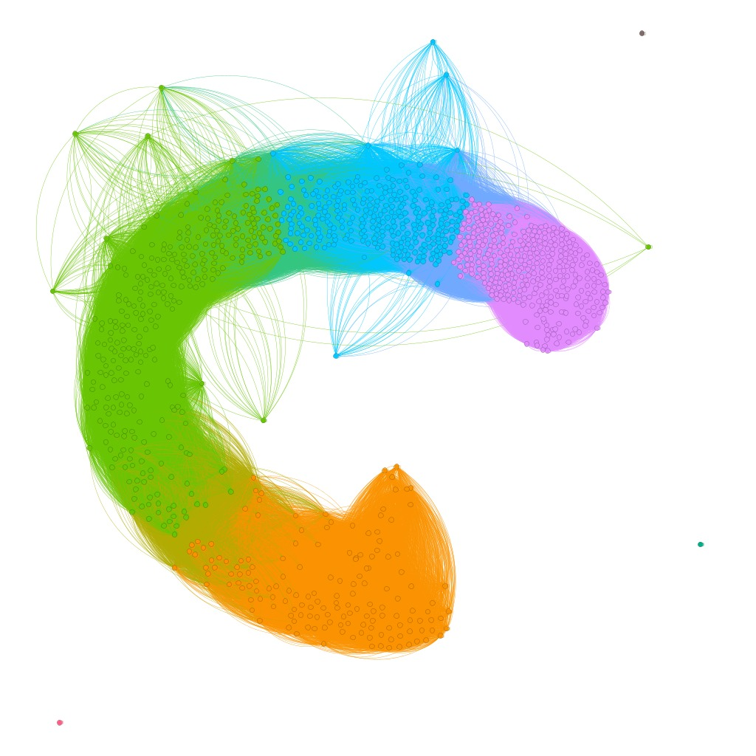
Network Graph
Four distinct communities are evident in the network graph.
Three additional communities are isolated and distant from the main network.
Our analysis prioritizes the four interconnected communities over the isolated ones.
Isolated communities containing only one stock each are excluded from consideration.
Graph with 7 communities

Slide 13
Community Analysis
The ‘louvain_fuzzy’ function helps determine which community each company belongs to by assigning membership scores to each node for each community.
These membership scores indicate the degree of association of a node to each community.
Example result:
Community 1 :
Node: Medplus Health Services Limited
Membership Scores: {0: 1, 1: 0, 2: 0, 3: 0}

Slide 14
Overlapping Communities
No overlapping communities were detected during our analysis.
In order to identify potential overlapping communities, we systematically iterated through the communities that were detected.
For each node within the network, we checked to determine if it belonged to more than one community.

Slide 15
Why Beta Measure?
The beta measure is utilized here because it provides insights into the volatility of a stock or portfolio relative to the overall market.
By comparing the price movements of an asset to those of a benchmark index, such as the market index, beta helps investors assess the risk associated with the investment.
This metric is valuable for understanding the risk-return profile of assets and is therefore instrumental in portfolio management and risk assessment strategies.
Beta is calculated by regressing the returns of a stock or portfolio against the returns of a benchmark index, typically the market index such as the S&P 500.

Slide 16
Beta Measure Statistics
Beta range for Community1: (-0.088, 0.053)
Beta range for Community 2: (-0.098, 0.072)
Beta range for Community 3: (-0.106, 0.093)
Beta range for Community 4: (-0.089, 0.06)
Beta range for Community 5: (0.022, 0.022)
Beta range for Community 6: (-0.031, -0.031)
Beta range for Community 7: (-0.021, -0.021)
Community 1 Beta Range: 0.142
Community 2 Beta Range: 0.17
Community 3 Beta Range: 0.199
Community 4 Beta Range: 0.15
Community 5 Beta Range: 0
Community 6 Beta Range: 0
Community 7 Beta Range: 0
Overall Beta range for all Communities: (-0.106, 0.093)

Slide 17
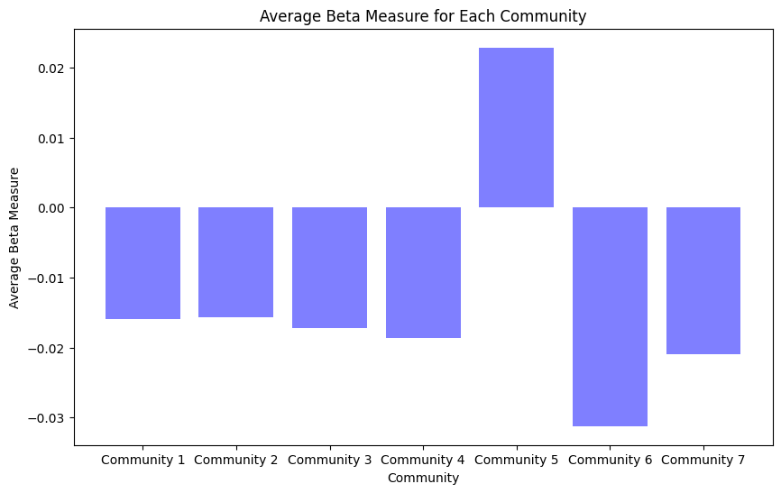
Beta Measure

Slide 18
Exploration of Models
1. Segment the stock market into distinct communities using community detection algorithms.
2. Apply the Markowitz Mean-Variance Model independently to each community.
3. Evaluate portfolio performance within each community by comparing predicted and actual returns and risks.
4. Analyze risk-return tradeoff for each community's portfolio.
5. Compare model performance across different communities.
6. Conduct sensitivity analysis to assess parameter impact on portfolio allocation.
7. Test model robustness under various market conditions and time periods.

Slide 19
Exploration of Models
To select stocks within each community, we compute the average of three centrality measures—Closeness Centrality, Betweenness Centrality, and Eigenvector Centrality—for each stock. The stocks with the highest average centrality scores are chosen, and their average returns serve as the model's return.
In each community, the objective function incorporates the centrality measures and the return of each node. The node resulting from this objective function, with the highest value, is selected as the superior node.

Slide 20
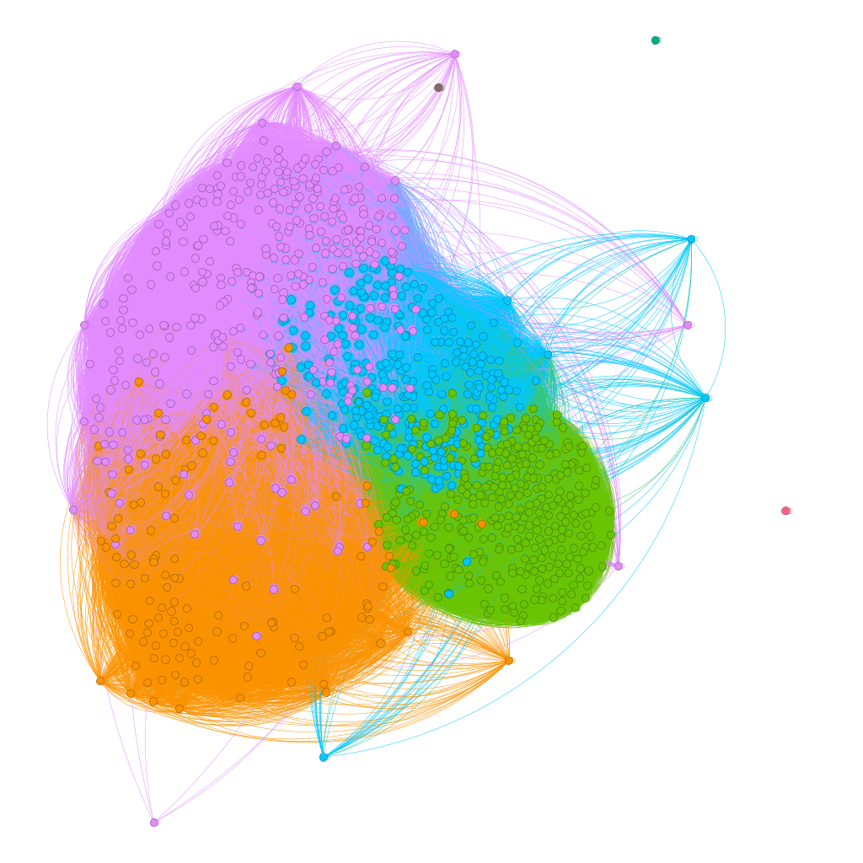
Results
7 communities detected so far
Community 1: 342
Community 2: 377
Community 3: 273
Community 4: 137
Community 5: 1
Community 6: 1
Community 7: 1
Stock in communities:
5 - Elpro International Ltd.
6 - PNB Gilts Ltd
7 - Rashtriya Chemicals & Fertilizers Limited

Slide 21
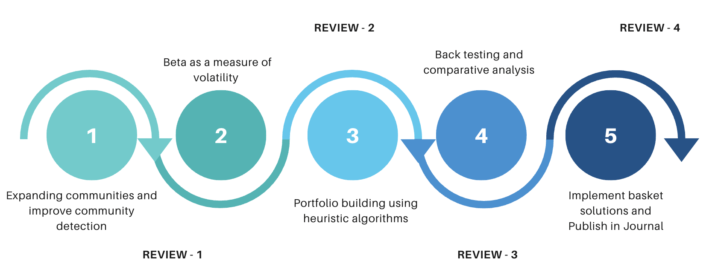
Phase 2 - Work Plan

Slide 22
Work Split
Student | Contribution
Avantika Balaji [CB.EN.U4CSE20309] | Community Detection Algorithms, Model Exploration
Charitha Uppalapati [CB.EN.U4CSE20311] | Beta Volatility Measure, Model Exploration
Kanumilli Pavan Sai [CB.EN.U4CSE20324] | Beta Volatility Measure, Overlapping Communities
Kausalyaa Sri [CB.EN.U4CSE20326] | Community Detection Algorithms, Community Analysis

