Slide 1
Big Data Analytics in Health Care
Student’s Name’s
Charitha Kammari
UCID: ck369
Ratna Deepika Cheedarla
UCID: rc645
Varunkumar Nachu
UCID:vn293
Institution Affiliate
New Jersey Institute Of Technology
Course Name
Introduction of Big Data

Slide 2
Abstract
The Big Data term is a controversial topic that many writers and authors have been part of the argument depending on the application that is used in defining and differentiating the data and its analysis.
This term has been authored preferably been an extensive data heave that would not have been handled through the traditional method of data handling or techniques.
The big data field has been able to play an indispensable role in different fields where agriculture, data mining, education, finance and marketing.
Analytics of Big data is a method where one would be able to look at the data and find a hidden pattern, relationship within the data and other data with importance in trying to enhance decision in relation to the data.
With continued interest that is expanding due to the technological developments and many fields trying to use data increasing the data continuity and usage.

Slide 3
INTRODUCTION
The term "Big Data" has lately become popular to describe a new paradigm for data exploitation.
In the world of information technology, these new innovations frequently make their debut and receive a lot of media attention; yet, it may take some time to notice their unique selling feature. Volume (too vast), velocity (rapid arrival), unpredictability (quick changes), veracity (much turmoil), and variety (diversity) are only a few of the unique characteristics of big data, or BD.
Large and diverse datasets share several distinct and significant characteristics that are similar to "Big Data."
It is difficult to manage big datasets using the conventional frameworks for information preparation.
Additionally, the "Big Data" highlights a number of uphill issues related to data storage, data movement, data visualization, data penetration, analysis of data, information protection, privacy of data breaches, and sharing.
It is reasonable to consider the Big Data as a way to possibly grasp more knowledge sets, highlighting the limitations of habitual data structures.
The Big Data model appears when data compute is either in motion or in take it easy mode; it compels data management to become a key component of the system engineering architecture.

Slide 4
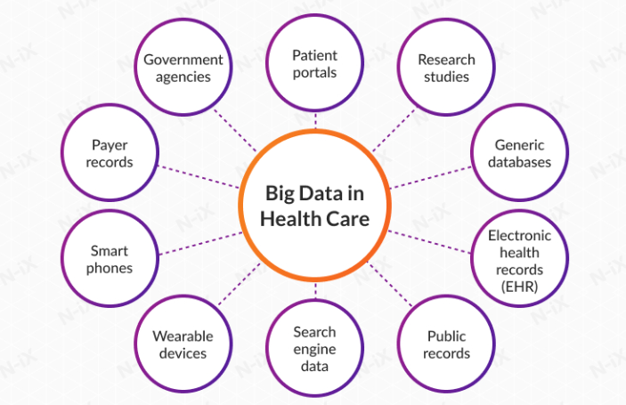
INTRODUCTION

Slide 5
DATA ANALYTICS
Massive data sets with a variety of information types may be analyzed using the big data analytics technique.
For instance, massive data sets can be used to uncover hidden relationships, advertising drift, customer preferences, and other useful business information.
These measurable results might lead to effective marketing, additional revenue opportunities, more customer satisfaction, improved operational proficiency, an advantage over competing associations, and different business repayment.
Big Data has become a central subject in many endeavors, research projects, educational initiatives, and society at large.
This is due to the fact that the ability to produce, compile, transmit, prepare, and analyze extraordinary amounts of disparate information has practically broad applications and fundamentally alters how companies operate, how research ought to be conducted, and how people use and live with modern technology.
Specialized businesses, such as automobile, finance, social insurance, or assembly, might greatly benefit from improved and expedited information research

Slide 6
DATA ANALYTICS
Big Data invention and study in information-driven research methodologies becomes increasingly commonplace, for example in the geosciences, cosmology, and biological sciences.
Customers who use PDAs, web-based social networks, and online resources spend a growing amount of time and energy on the internet, generate enormous amounts of information,
They are the target audience for tailored services, offers, and notifications.
While many of the potential advances associated with large amounts of data remain in their early stages.
There is tremendous promise provided that the many application-specific and mechanical challenges associated with managing and using big data are adequately addressed.

Slide 7
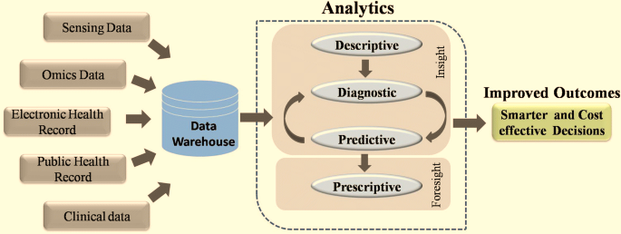
DATA ANALYTICS

Slide 8
Big Data Analytics in Health Informatics
The application of computer programming is the primary distinction between big-data health analytics and classical health analysis.
Under the old structure, big data analysis in the healthcare sector was dependent upon other industries.
Because information technology produces useful results—its operating systems are operational and it can process data into standardized forms—many healthcare stockholders have faith in it.
Managing the quickly expanding large healthcare data is a difficulty facing the healthcare sector today.
Big data analytics is a developing topic that might offer the healthcare system insightful information.
The vast majority of the enormous volumes of data produced by this system are kept in hard copies, as was already mentioned, and must thereafter be digitized.
Big data may enable enhanced patient care, enhance medical outcomes, cut costs, and prevent wasteful spending all while enhancing healthcare delivery.

Slide 9
Big Data Analytics in Health Informatics
The healthcare informatics industry is facing challenges in developing data processing algorithms due to the heterogeneous origins and formats of big data.
Techniques that merge disparate data sources are in high demand.
Large volumes of data from various datasets may be recognized for anomalies using a variety of conceptual techniques.
The following frameworks are available for the analysis of medical data:
Healthcare and Predictive Analytics: Although statistical analysis has been widely acknowledged as a prominent business intelligence technique for the past two years, its practical implications go much beyond the realm of business
Machine Learning Applications in Health Care: Data Mining and Machine Learning have a similar notion in that they both scan data to find patterns.
Electronic Health Records: EHRs are the most popular use of big data in healthcare applications.

Slide 10
The Four V’s of Big Data in Healthcare
The Four attributes that are necessary and related to the big data are the following; Volume, Velocity, Variety and veracity.
Volume; This are the volume of data collected which is of huge data.
Velocity: Velocity, or the rate at which data is gathered, is the main cause of the exponential increase of data.
Variety: in data relates to its format, including text, audio, video, medical images, unstructured or structured data, and sensor data
Veracity: The degree of certainty that the interpretation of the data is consistent is known as the veracity of the data.

Slide 11
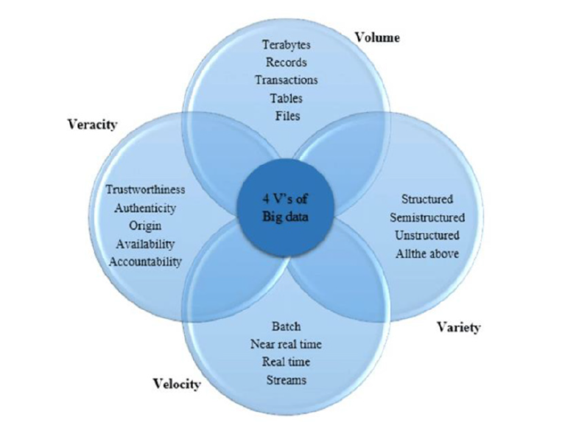
The Four V’s of Big Data in Healthcare

Slide 12
Big Data-Related problems
Utilizing medical data to its maximum potential is hampered by several issues.
First off, data are frequently divided or compartmentalized in many healthcare organizations, particularly hospitals.
The teams responsible for financial and operational oversight maintain and utilize administrative data, including cost data, reimbursements requests, and claims.
The administrative functions of the health care industry use this information, but patient treatment and care procedures are typically not informed by it.

Slide 13
Big Data-Related problems
Data Analytics
Only by merging these datasets can data analytics pertaining to the best possible use of the hospital's resources and bettering patient outcomes be accomplished, fulfilling the second part of Gartner's definition
Privacy
Safeguarding patient privacy is a second major obstacle to fully utilizing big data in healthcare.
Computation
The fact that analysis is frequently an additional use of the information is a significant barrier in healthcare information analytics that has to be recognized.
Unstructured Data
The quantity of unstructured data presents perhaps the biggest obstacle to gathering and interpreting large amounts of health care data.

Slide 14
Solutions towards Application Problem
Many of these issues inside and across providers may be resolved with full information and data governance procedures.
Regulations governing data format, proper usage of data sources, and data fields are all part of a data governance program.
Strict data governance guidelines assist the technical elements of mapping and merging data from several sources while ensuring that the subject matter or format of information is consistent.
Programs for information governance deal with data processing, analysis, and protection.
Information governance regulations will help data users decide what amount of information may be disclosed without jeopardizing the identification of patients, as well as whether or not another use of the information is appropriate.
For the team understanding it is important to improve the technology use which would be more convenient in the respect of data security and essentials.
Keeping the prospects and storage position more permanent and secure would be a resolver of all the issues that comes with the data analytics in medical essence comparing technology advancements and updates.

Slide 15
Conclusion
Big data plays a major role in the field of healthcare informatics and has a considerable impact on the healthcare system particularly its four Vs in healthcare.
In this report, we have presented an in-depth definition and a quick review of big information in general and in the healthcare system.
Additionally, we suggested using a conceptual architecture to solve big data-driven healthcare problems using Hadoop-based terminologies.
This would entail using big data produced by various medical data levels and developing techniques for analyzing the data and coming up with answers to medical queries.

Slide 16
References
Chugh, S., Kumaram, S., & Sharma, D. K. (2021). Application of tools and techniques of big data analytics for healthcare system. Applications of Big Data in Healthcare, 69-84. https://doi.org/10.1016/b978-0-12-820203-6.00010-2
Isakki Alias Devi P. (2022). Big data, data mining, and data analytics in IoT-based healthcare applications. Research Anthology on Big Data Analytics, Architectures, and Applications, 1035-1053. https://doi.org/10.4018/978-1-6684-3662-2.ch049
Iyamu, T. (2022). A framework for selecting healthcare big data analytics tools. Advancing Big Data Analytics for Healthcare Service Delivery, 58-73. https://doi.org/10.4324/9781003251064-5
Kumar, S., & Singh, M. (2019). Big data analytics for healthcare industry: Impact, applications, and tools. Big Data Mining and Analytics, 2(1), 48-57. https://doi.org/10.26599/bdma.2018.9020031
Varatharajan, A., C., S., & Varatharajan, V. (2020). Big data analytics in the healthcare industry. Big Data Analytics for Sustainable Computing, 160-178. https://doi.org/10.4018/978-1-5225-9750-6.ch010

