Slide 1



Group 14
Project Proposal Presentation
IS 3013/SCS 3117
Date – 31.03.2016

Slide 2
Overview of the Presentation
Introduction to the Project
Goals & Objectives
Scope
  Users and Functionalities
Main Deliverables of the System
Project Plan

Slide 3

To Whom?
External Degree Center (EDC), University of Colombo School of Computing

Slide 4
Why ?
In order to achieve efficiency and effectiveness of the EDC processes. Which can be divided in
      1.) Calling for Applications
      2.) Registration Process
      3.) Examination Preparation Process

Slide 5
What ?
Implementing a web based automated information system
To filter and manage application forms
To register candidates
To register students for semester exams
To generate student IDs and admission cards for exams
Allocating students and other staff for examination centers
Summarize the examination process at each examination center

Slide 6
Tentative Problem Definition
Current system,
  Data entry and evaluations of the applications are carried out manually.
  Registration process operations are handled manually.
  Examination coordination operations are more complex and time consuming.
  Not providing a platform to communicate with students and administration.

Slide 7
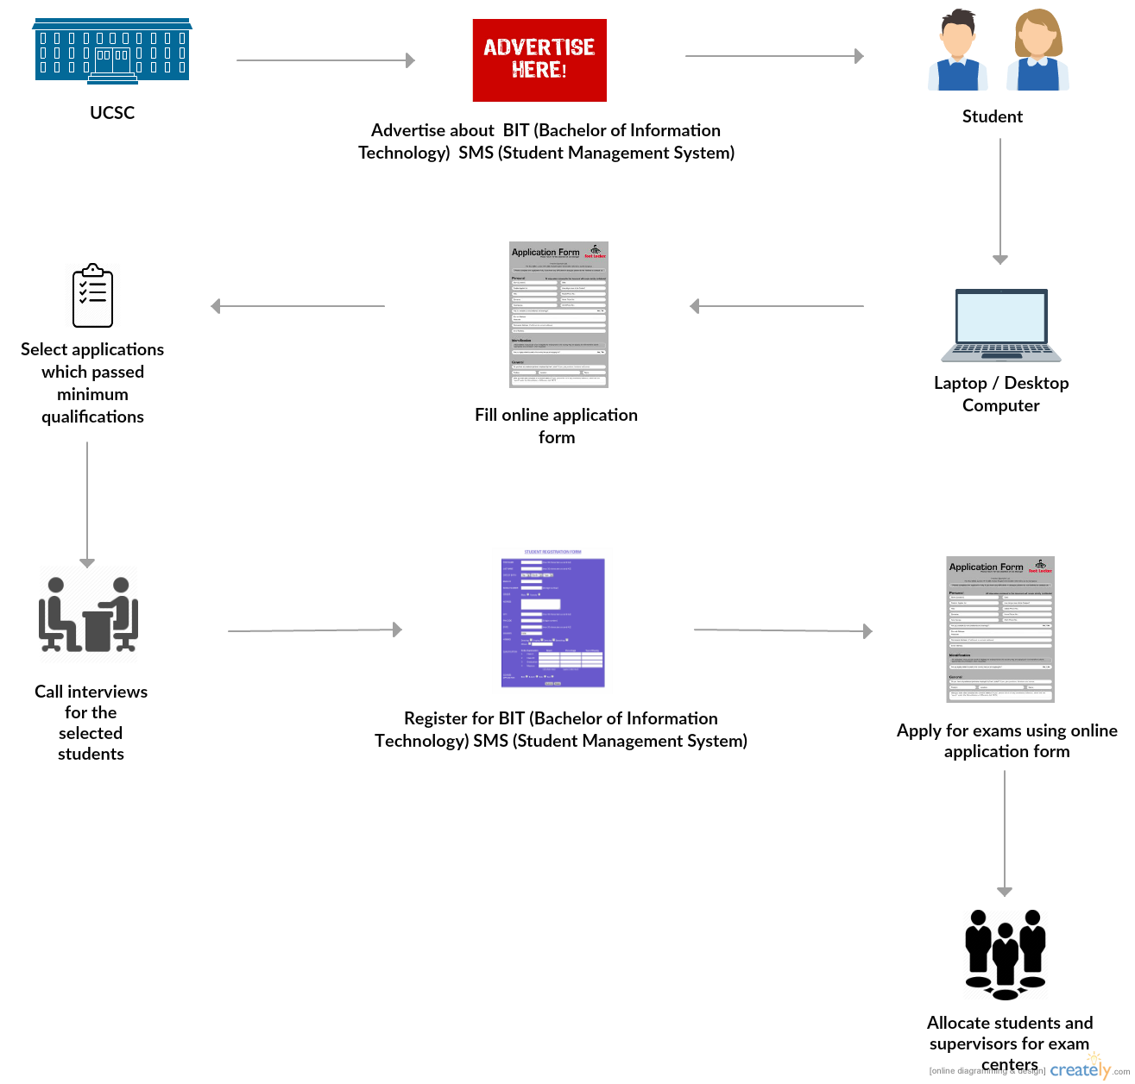
How?

Slide 8

Our Goal is to,
Minimize the complications of handling student management process in order to have an effective and efficient management system.

Slide 9
  Objectives –
Automate the application calling process.
Automate the student selection process.
Automate the process of calling the candidates for the registration.

Slide 10
  Objectives –
Automate the examination process.
Increase the consistency of data entry through a standardized format.
Improve the communication between the BIT center and students by providing accessibility to both parties.

Slide 11

Users of the system
User level 1
  •Administrator
User level 2
  Director
  Department Head
User level 3
  •Coordinator
  Senior Assistant Registrar

Slide 12
Scope of the Project
User level 4
•Operational Staff
User level 5
  •Registered Student
  User level 6
  Unregistered Students

Slide 13
Student Registration Process
  Gathering student details
  Filtering student details and call applicants according to them
  Scheduling the interview
  Registering the students according to interview results
  Generating Student IDs
  Editing student details if required

Slide 14
Examination Process
  Publishing Exam details and applications
  Applying and registering for exams
  Entering Exam center details
  Allocating students and staff for exam centers
  Generating Admission cards and exam documents needed
  View Exam results

Slide 15
  Administrative Process
    Create users and change privileges
    Publishing notices
    Publishing exam results

Slide 16

Give a solution to keep and manage student’s data
Enhanced way to manage exams and Assignments
Give a solution to generate reports easy.
System documentation.

Slide 17
Resources
Technologies
Supporting Tools
Java EE
HTML 5
CSS 3
JQuery
Ajax
MySQL
NetBeans
SourceTree
Xampp
Photoshop

Slide 18

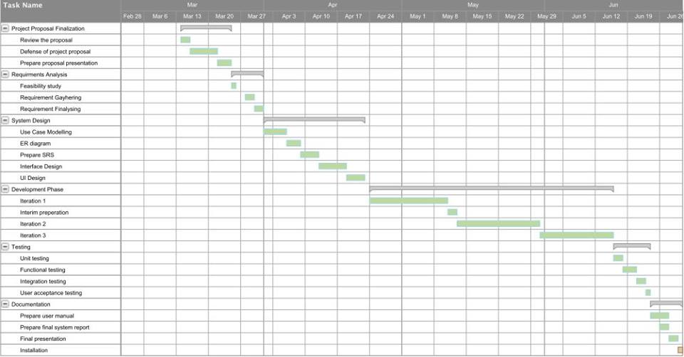

Slide 19
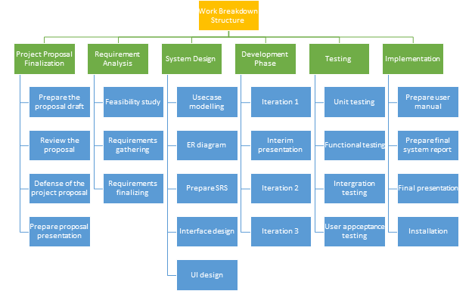

Slide 20
Thank You

Slide 21
Q & A

