Slide 1
BWT HACKATHON · TEAM 4
02 EXPLANATION
Turnin
01
Create
Teachers create assignments with title, description, deadline and maximum marks.
02
Track
Students see each assignment as not submitted, submitted, late, overdue or graded.
Assignment Submission Portal
03
Submit
One file per assignment; students can resubmit until it is graded.
01 PROBLEM STATEMENT
Teachers and students often exchange assignments through WhatsApp, e-mail or paper. This causes lost files, missed deadlines, unclear submission status and delayed marks.
04
Auto late-check
The submission time is compared with the deadline automatically.
05
Grade
Teachers view and download submissions, then give marks with feedback.
THE TASK
06
Dashboards
Role-based dashboards show progress, pending work and deadlines, with filters and search.
Build a secure backend web application where teachers publish assignments, students submit files before the deadline, and teachers grade the work with feedback.
07
Secure
Only logged-in users reach data, and each role uses only its own features.
TEAM A. Sai Charitha (Lead) · G. Sathvika · G. Ganesh · D. Sai Kumar MENTOR Mrs. V. Nikitha Reddy

Slide 2
TURNIN · ASSIGNMENT SUBMISSION PORTAL
02 / 07
02 · OBJECTIVES & APPROACH
What we set out to build
OBJECTIVES
PROPOSED APPROACH
01
Secure access
Registration and login with hashed passwords and JWT sessions.
Architecture
Single-page frontend (HTML, CSS, vanilla JS) with student and teacher dashboards, calling a REST API built with Express.
Database
SQLite (better-sqlite3) with three tables: users, assignments, submissions.
02
Role-based access
Student / teacher roles with ownership checks on every route.
Authentication
bcrypt password hashing; JWT in an httpOnly cookie (7-day expiry).
03
Validated input
File-type whitelist, 10 MB limit and marks range checked.
Authorization
requireAuth and requireRole middleware; teachers reach only their own assignments.
File handling
multer saves uploads with random names; served only to the owner student or owning teacher.
04
Clean data
SQLite relations; one submission per student per assignment.
Security
helmet headers, login rate limiting and parameterized SQL queries.
BWT Hackathon · Department of Data Science · Malla Reddy Technical Campus

Slide 3
TURNIN · ASSIGNMENT SUBMISSION PORTAL
03 / 07
03 · TECH STACK
Tools we used, and why
Node.js
Express
SQLite
JWT + cookie
RUNTIME
WEB FRAMEWORK
DATABASE · better-sqlite3
SESSIONS
WHY JavaScript on the server: one language for frontend and backend, with non-blocking I/O for uploads.
WHY Simple routing and middleware to build the REST API and the role checks.
WHY Zero-setup file database with relations and constraints. Ideal for a small portal.
WHY Stateless login. The httpOnly cookie keeps the token away from page scripts.
bcrypt
multer
helmet
HTML · CSS · JS
PASSWORDS
FILE UPLOADS
SECURITY · RATE LIMITING
FRONTEND · VS CODE
WHY Stores only salted hashes, so real passwords are never saved.
WHY Handles multipart uploads with size limit, type whitelist and random file names.
WHY Safe HTTP headers and login throttling against brute-force attempts.
WHY Light single-page UI with no framework to learn; built and tested in VS Code.
BWT Hackathon · Department of Data Science · Malla Reddy Technical Campus

Slide 4
TURNIN · ASSIGNMENT SUBMISSION PORTAL
04 / 07
04 · USER FLOW
From login to graded marks
No: error, retry
Register / Login
Valid?
JWT cookie issued
Role?
Start
Yes
TEACHER
STUDENT
1
Create assignment: title, deadline, max marks
1
View assignments with their status
2
View submissions of own assignment
2
Upload one file: type and 10 MB check
3
Download the submitted file (owner check)
3
Deadline check: on time or marked late
4
Grade 0 to max marks, add feedback
4
Resubmit until graded, then see marks
BWT Hackathon · Department of Data Science · Malla Reddy Technical Campus

Slide 5
TURNIN · ASSIGNMENT SUBMISSION PORTAL
05 / 07
05 · REQUEST FLOW & SECURITY
How every request is checked
1
Request
API call from the browser
2
requireAuth
verify the JWT cookie
3
requireRole
student or teacher?
4
Ownership
is it your data?
5
Validate
input, file type, 10 MB, marks
6
SQL
parameterized query
7
Response
JSON result
FAIL
401
Please log in / session expired
403
Only that role can do this
404
Not found (not your data)
400 / 409
Invalid input, or graded and locked
Each failed check stops the request with an error.
JS routes/assignments.js late detection and resubmit lock
SUBMIT RULES
1
2
3
4
5
6
7
const late = now > new Date(a.deadline) ? 1 : 0;
if (existing && existing.marks !== null) {
discard();
return res.status(409).json({
error: 'This submission is already graded and locked.'
});
}
multer checks file type and size
is_late set by comparing with the deadline
Resubmit replaces the old file
Graded work is locked
BWT Hackathon · Department of Data Science · Malla Reddy Technical Campus

Slide 6
TURNIN · ASSIGNMENT SUBMISSION PORTAL
06 / 07
06 · DATABASE & API
Three tables, one REST API
users
submissions
API ROUTES
student_id
POST
/api/auth/register · /login · /logout
Public
id PK
name
email
password_hash
role student/teacher
id PK
assignment_id FK
student_id FK
file_path
original_name
note
submitted_at
is_late
marks
feedback
graded_at
UNIQUE (assignment_id,
student_id)
GET
/api/auth/me
Logged in
GET
/api/assignments
Logged in (role-specific data)
teacher_id
POST PUT DEL
/api/assignments[/:id]
Teacher (owner)
assignments
GET
/api/assignments/:id/submissions
Teacher (owner)
id PK
teacher_id FK
title
description
deadline
max_marks
POST
/api/assignments/:id/submit
Student
assignment_id
GET
/api/submissions/:id/file
Owner student / owning teacher
PUT
/api/submissions/:id/grade
Owning teacher
BWT Hackathon · Department of Data Science · Malla Reddy Technical Campus

Slide 7
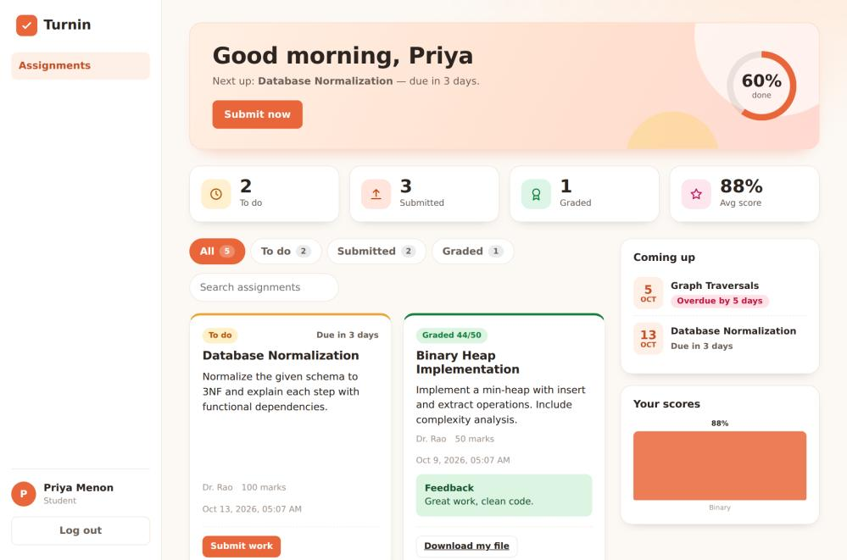
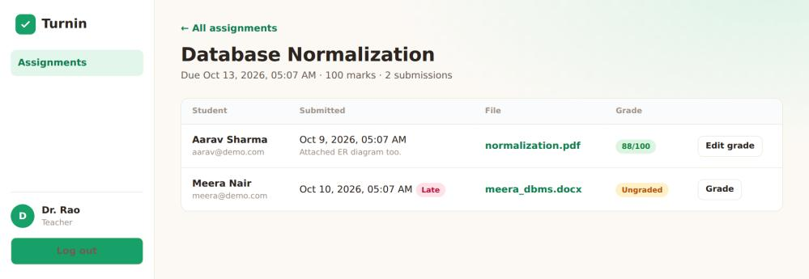
TURNIN · ASSIGNMENT SUBMISSION PORTAL
07 / 07
07 · RESULTS & CONCLUSION
What Turnin delivers
RESULTS
Student dashboard shows a progress ring, summary counts and filters (All / To do / Submitted / Graded), with a status tag on each assignment.
Teachers see every submission with its late tag, file link and grade status.
Handled safely: wrong password, duplicate email, bad teacher code, disallowed file type, file over 10 MB, marks out of range, resubmitting after grading, opening another user’s file.
CONCLUSION Turnin gives a secure, role-based way to publish, submit and grade assignments in one place.
STUDENT DASHBOARD
FUTURE SCOPE
E-mail deadline reminders
Multiple file uploads
Course-wise grouping
Grade export to CSV
TEACHER GRADING VIEW
Thank you
BWT Hackathon · Department of Data Science · Malla Reddy Technical Campus

