Slide 1

JAVA PROGRAMMING
M.Charitha Sree

Slide 2
Library Management System with Java Collection Framework
The library management system comprises several key components. The Book class represents individual library items with attributes such as title, author, ISBN, and publication year. The Library class manages the collection of books, providing methods to add, remove, search, and display books.

Slide 3
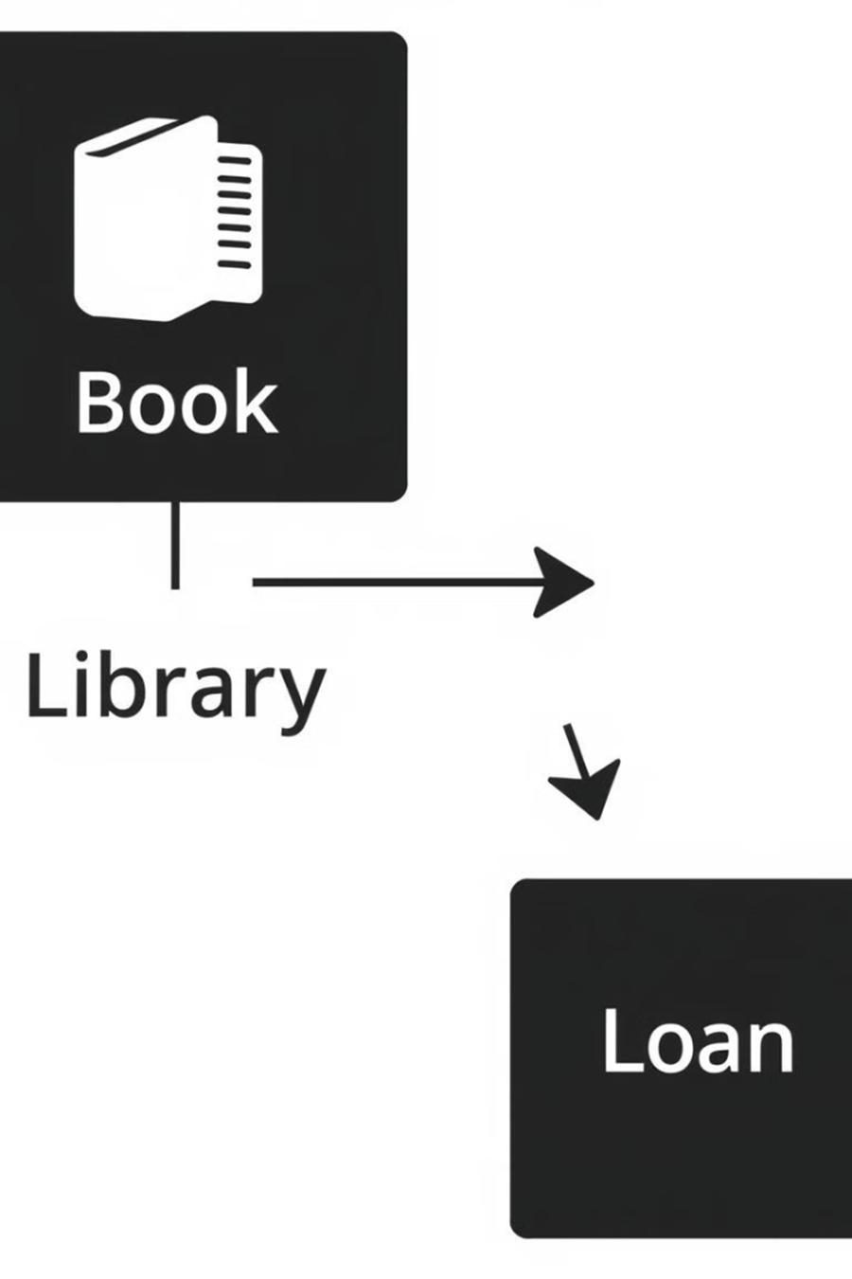
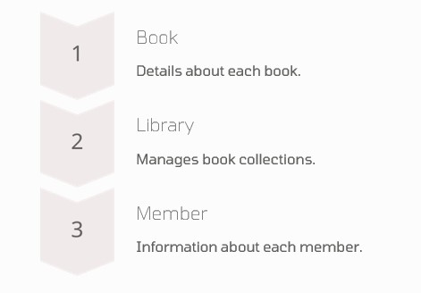
The Member class represents library members with attributes like member ID, name, and contact information. The system also includes classes for managing borrowing and returning books, ensuring accurate tracking of book availability and due dates.

Slide 4

Choosing the Right Collection
Selecting the appropriate collection type is crucial for optimal system performance. We'll use the ArrayList for dynamic storage and retrieval of books, ensuring efficient management of large book collections. HashMap will be used for quick book retrieval by ISBN, providing fast access to book details.
These selections help enhance the efficiency of managing library resources.
Consider using HashSet to efficiently manage unique member IDs and prevent duplicates. By choosing the right collection for each data type, we optimize performance and ensure data integrity within the library management system.

Slide 5
Adding Books to the Library
Adding books to the library involves creating a new Book object and adding it to the ArrayList in the Library class. The addBook() method performs this operation, ensuring that each book is properly stored within the system. Error handling can be implemented to prevent duplicate entries or invalid book details.
Consider implementing a unique ISBN check to prevent duplicate book entries. Proper validation of book details ensures data integrity and prevents errors within the system. These steps are vital for maintaining an accurate and reliable library catalog.

Slide 6
Searching for Books
Searching for books can be implemented using the HashMap for ISBN-based retrieval or by iterating through the ArrayList for title or author-based searches. The searchBook() method provides efficient access to book details based on specified criteria. The search functionality enhances the user experience by enabling quick and accurate retrieval of library resources.
Consider implementing indexed searching to improve search performance for large book collections. Allowing users to search by multiple criteria (e.g., title, author, ISBN) provides greater flexibility. Adding fuzzy search functionality can improve user satisfaction by finding close matches even with minor typos.

Slide 7
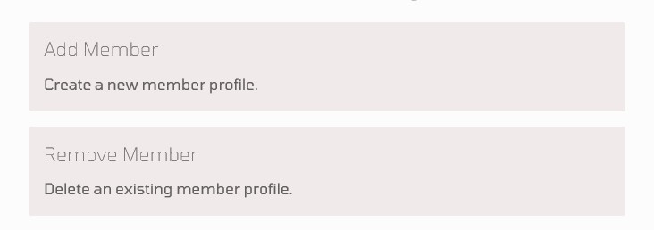
Managing Members
Managing members involves creating a Member class to store member details and using a HashSet to ensure unique member IDs. The addMember() and removeMember() methods handle member management operations, providing a robust system for tracking library members.
Consider implementing a membership validation process to ensure accurate member information. Integrating with a database can provide persistent storage of member details. Implementing role-based access control can provide differentiated access levels for administrators and regular members.

Slide 8
Borrowing and Returning Books
Implementing borrowing and returning functionalities requires careful tracking of book availability and due dates. The system should update the book status when a member borrows or returns a book, ensuring accurate record-keeping. Use the Date class to manage due dates.
Consider implementing late fee calculations for overdue books. Sending automated email reminders to members about approaching due dates can reduce late returns. Integrate with a payment gateway for online late fee payments.
Displaying Book Information
The displayBookInfo() method provides a user-friendly way to view book details, including title, author, ISBN, and availability. Clear and concise presentation of book information enhances the user experience and facilitates easy access to library resources. Proper formatting and presentation of data are crucial for usability.

Slide 9
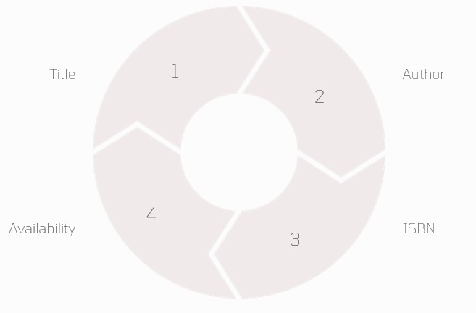
Consider implementing a graphical user interface (GUI) to improve the display of book information. Adding features like book cover images and user reviews can enhance the visual appeal and user engagement. Providing options to sort and filter books can improve navigation and usability.
Error Handling
Robust error handling is essential for maintaining system stability. Implement try-catch blocks to handle exceptions such as BookNotFoundException or InvalidMemberIDException. Proper error handling prevents system crashes and ensures a smooth user experience.

Slide 10
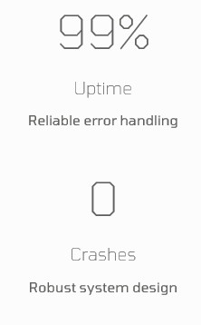
Consider implementing detailed logging of errors for debugging and troubleshooting. Providing user-friendly error messages can help users understand and resolve issues. Adding input validation to prevent invalid data from being entered into the system can reduce the occurrence of errors.
JAVA CODE :
import java.util.*;
class Book {
private String title;
private String author;
private int id;

Slide 11
public Book(int id, String title, String author) {
this.id = id;
this.title = title;
this.author = author;
}
public int getId() {
return id;
}
public String getTitle() {
return title;
}
public String getAuthor() {
return author;
}
@Override
public String toString() {
return "Book ID: " + id + ", Title: " + title + ", Author: " + author;
}
}

Slide 12
class Library {
private List<Book> books = new ArrayList<>();
public void addBook(Book book) {
books.add(book);
System.out.println("Book added successfully!");
}
public void removeBook(int id) {
books.removeIf(book -> book.getId() == id);
System.out.println("Book removed successfully!");
}
public void displayBooks() {
if (books.isEmpty()) {
System.out.println("No books available in the library.");
} else {
for (Book book : books) {
System.out.println(book);
}
}
}

Slide 13
public void searchBook(String title) {
for (Book book : books) {
if (book.getTitle().equalsIgnoreCase(title)) {
System.out.println("Book Found: " + book);
return;
}
}
System.out.println("Book not found.");
}
}
public class LibraryManagementSystem {
public static void main(String[] args) {
Scanner scanner = new Scanner(System.in);
Library library = new Library();
while (true) {
System.out.println("\nLibrary Management System");
System.out.println("1. Add Book");
System.out.println("2. Remove Book");
System.out.println("3. Search Book");
System.out.println("4. Display Books");
System.out.println("5. Exit");
System.out.print("Enter your choice: ");

Slide 14
int choice = scanner.nextInt();
scanner.nextLine();
switch (choice) {
case 1:
System.out.print("Enter Book ID: ");
int id = scanner.nextInt();
scanner.nextLine();
System.out.print("Enter Book Title: ");
String title = scanner.nextLine();
System.out.print("Enter Book Author: ");
String author = scanner.nextLine();
library.addBook(new Book(id, title, author));
break;
case 2:
System.out.print("Enter Book ID to remove: ");
int removeId = scanner.nextInt();
library.removeBook(removeId);
break;

Slide 15
case 3:
System.out.print("Enter Book Title to search: ");
String searchTitle = scanner.nextLine();
library.searchBook(searchTitle);
break;
case 4:
library.displayBooks();
break;
case 5:
System.out.println("Exiting the system...");
scanner.close();
return;
default:
System.out.println("Invalid choice! Please try again.");
}
}
}
}

Slide 16


