Slide 1


Slide 2
METHOD OVERLOADING

Slide 3
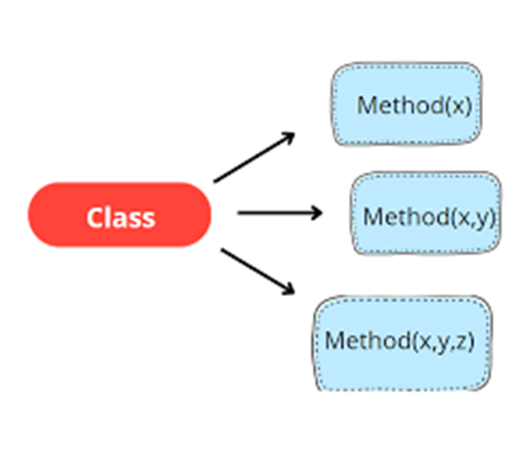
METHOD OVERLOADING :
Method overloading is concept of object-oriented programming where you can define multiple methods with the same name in a class, but with different parameter lists(different number or type of parameters). Overloading allows you to perform the same action in different ways depending on the arguments passed to the method.

Slide 4
In method overloading :
The method name remains the same, but the number, type, or order of parameters must be different.
Overloaded methods can have different return types, but the return type alone cannot distinguish them—the parameters must differ.

Slide 5
Advantages of Method Overloading :
Code Reusability: Developers can use the same method name for different types or
numbers of parameters, reducing code duplication and improving maintainability.
Readability and Clarity: Overloaded methods make code cleaner and more
readable since similar operations share the same method name, making the code easier to understand.
Increased Flexibility: Users can call the same method with different arguments
depending on their needs.
For example, a print() method may print an integer, float, or string, depending on its overloaded version.
Compile-Time Polymorphism: Method overloading is an example of static or
compile-time polymorphism, which allows the compiler to determine which method version to
call at compile time, improving performance.

Slide 6
Better Maintenance: Changes in logic can be made to overloaded method without affecting other parts of the code. Developers can focus on modifying only the specific
overloaded method.
Enhanced Productivity: Overloaded methods reduce development time by
allowing multiple functionalities under a single method name.
Consistency Across APIs: Method overloading is widely used in standard libraries
(like Java's System.out.println() and constructors), making APIs more consistent and predictable.
Improved User Experience: Provides convenience to developers and
users by supporting variations in parameters while performing similar actions.

Slide 7
Different Ways of Method Overloading in Java :
1) Changing the Number of Parameters :
Method overloading can be achieved by changing the number of parameters while passing to different methods.
2) Changing Data Types of the Arguments :
In many cases, methods can be considered Overloaded if they have the same name but have different parameter types, methods are considered to be overloaded.
3) Changing the Order of the Parameters of Methods :
Method overloading can also be implemented by rearranging the parameters of two or more overloaded methods.

Slide 8
Code:
public class ShapeAreaCalculator {
public static double
calculateArea(double side) {
return side * side;
}
public static double
calculateArea(double length, double width)
{
return length * width;
}
public static double calculateArea(double radius, boolean isCircle)
{
if (isCircle) {
return Math.PI * radius * radius;
}

Slide 9
return 0;
}
public static void main(String[] args)
{
double squareArea = calculateArea(5);
double rectangleArea = calculateArea(4, 6);
double circleArea = calculateArea(3, true);
System.out.println("Area of square: " + squareArea);
System.out.println("Area of rectangle: " + rectangleArea);
System.out.println("Area of circle: " + circleArea);
}
}

Slide 10
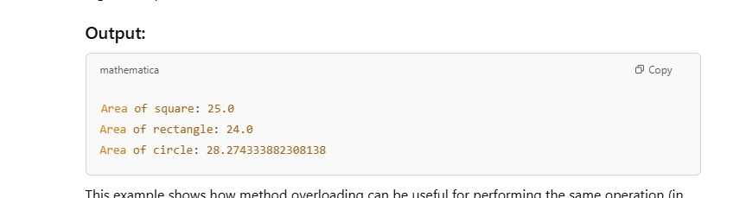
Expected Output:

Slide 11
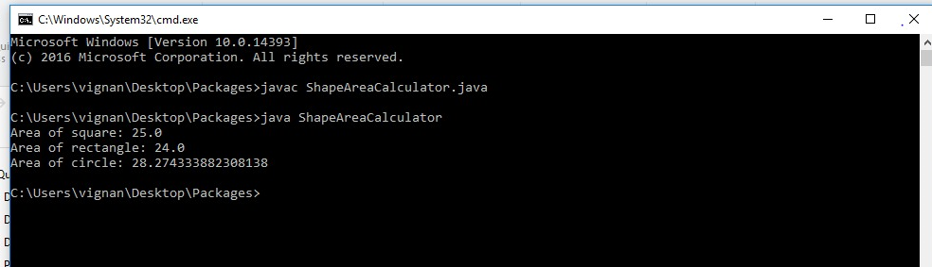
Output :

Slide 12


