Slide 1



cv
hAIoThon-2021
Department of Computer Science
&
Engineering
WELCOME YOU ALL
FOR 48 hrs HACKTHON
Department of Computer Science & Engineering, DSCE

Slide 2
Outline
Outline
Challenges associated with Ultrasound image acquisition
How AI can assist with image acquisition
Problem Statement 1
Problem Statement 2
Advantages of Ultrasound imaging
Challenges associated with Ultrasound image acquisition
How AI can assist with image acquisition
Portable point-of-care Ultrasound systems
Future Direction

Slide 3
cv
Advantages of Ultrasound Imaging
Low cost and widely accessible
Portability
Variety of clinical applications
Ultrasound could be an attractive modality for AI/ML space both for image acquisition and post processing.
Department of Computer Science & Engineering, DSCE

Slide 4
cv
Challenges linked with ultrasound image acquisition
Operator/user dependent
Variability across different manufacturer
Challenges
Many presets
Noise/ artifacts
Department of Computer Science & Engineering, DSCE

Slide 5
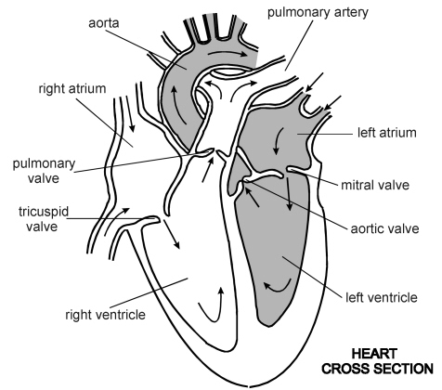
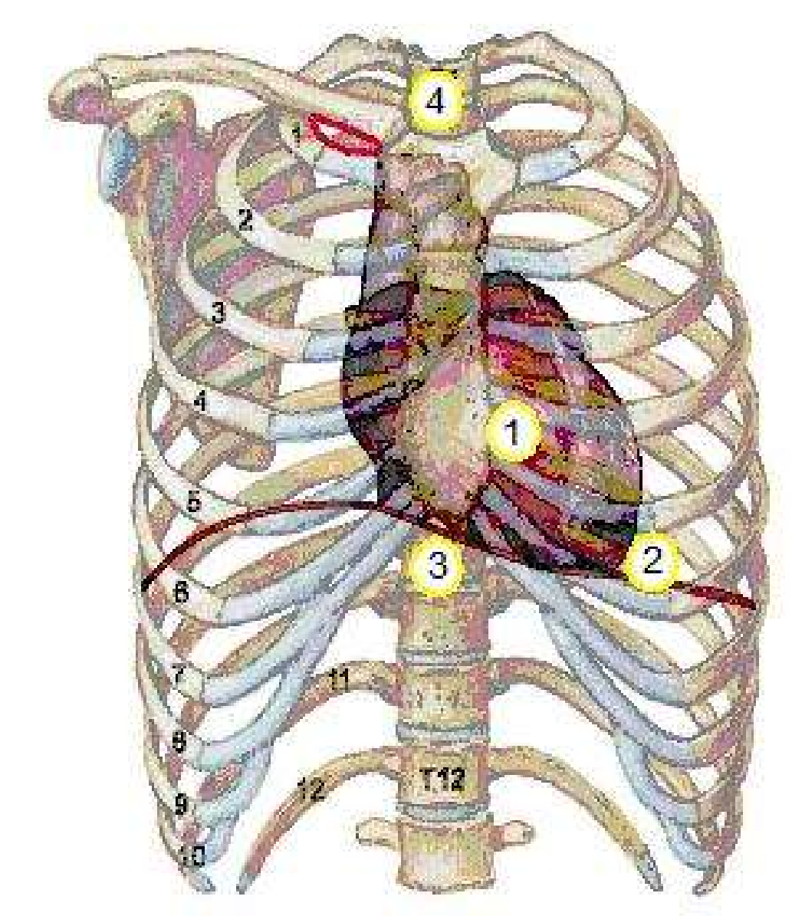
Heart – its position and chambers
The heart has four chambers called left ventricle (LV), right ventricle, left atrium and right atrium. The LV is the main chamber that pumps blood into all parts of the body.

Slide 6
Problem statement 1
Detection of blood chambers in all frames of an echo video, given the contour of the chamber in the first frame.
An echo of heart is a video consisting of multiple frames of a beating heart. The video shows one full cycle of a beating heart from diastole (fully expanded) to systole (fully contracted) to diastole again.
The heart has four chambers but only 2, 3 or 4 chambers may be visible in one video. We want to identify one of the chambers automatically.
The boundary (contour) of the chamber in the first frame is given. The boundary lies at the point of maximum intensity change (perpendicular to the boundary) around the chamber.
As the heart expands and contracts, the boundary also should grow and shrink so that points on the contour lie at the point of maximum intensity change. It should also maintain smoothness of the boundary (it should not be zig-zag.
The problem is to adjust the boundary, given in the first frame, for all subsequent frames in the video by satisfying the criteria given above.
The expected result is to show the video with the frames superimposed in all the frames.

Slide 7
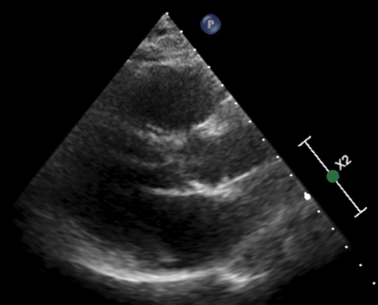
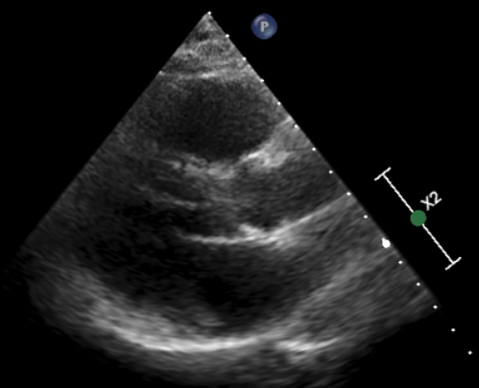
Example images
Automatic tracking and detection contouring of heart in Ultra sound video sequence
Department of Computer Science & Engineering, DSCE

Slide 8
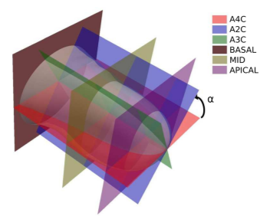
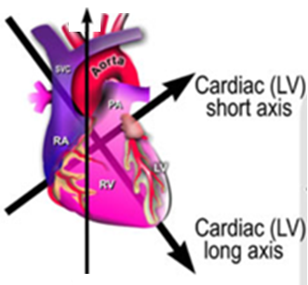
The Imaging planes and axes
Y-axis
X-axis
Z-axis
The red plane called A4C (Apical 4 chamber), is in the X-Z plane
The blue plane called A2C (Apical 2 chamber), is in the Y-Z plane
The brown (basal), green (mid-cavity) and purple (apical) planes called SAX

Slide 9
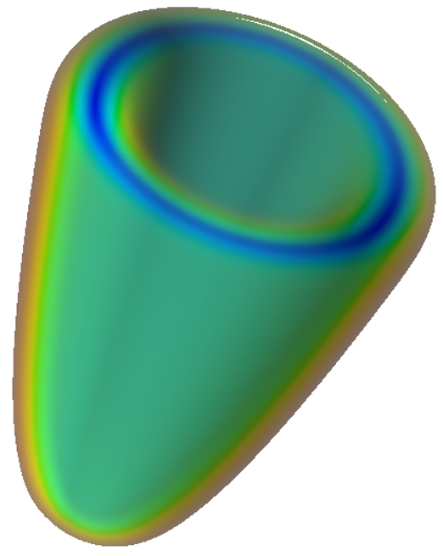
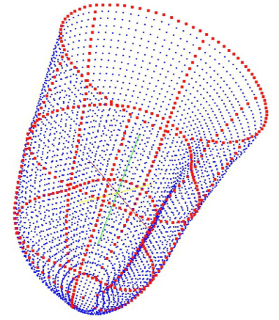
cv
Problem Statement 2
Construction of 3D model of heart using the 2D images given in different planes
The heart is like a hollow cone made of muscles (called myocardium) and filled with blood inside, as shown on the RHS.
An echo image of the heart is available on three different planes, as defined below –
Three SAX images (basal, mid-cavity and apical) in the X-Y plane
A4C in the X-Z plane
A2C in the Y-Z plane
An example of a real image on the three planes are shown in the next slide.
Their contours are given in all the images and they are like projections of an object in the front, top and side view.
The problem is to combine the 5 contours in the five images (3 SAX and 2 LAX) to create a 3D model of the heart, as shown on RHS.
also called long axis or LAX
Department of Computer Science & Engineering, DSCE

Slide 10
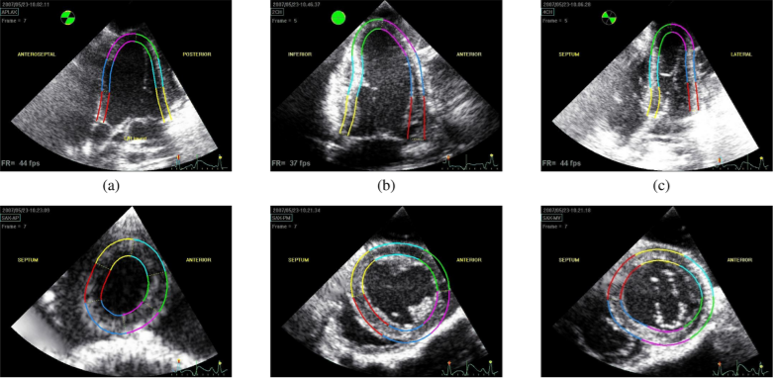
Example images
Take the inner contour only, ignore the outer contour

Slide 11
cv
THANK YOU
Department of Computer Science & Engineering, DSCE

