Slide 1

Code Refactoring and Bug Fixing
On
Note TakingApplication
Prepared by - Madamanchi Charith Prabhu

Slide 2
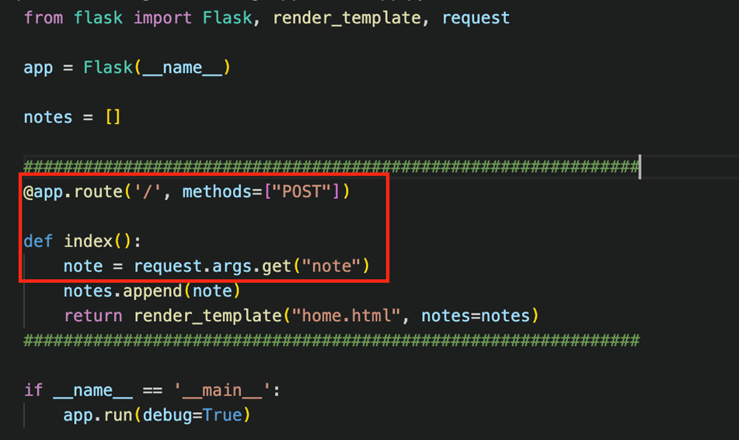
Project Description
The Flask Note Taking App is a straightforward web application built using Flask and HTML, designed to provide users with a simple yet effective platform for creating and viewing notes. The application follows a minimalistic approach, focusing on ease of use and quick access to notes.
Bug Identification :
The Flask application is only designed to handle post request from the frontend and note variable is trying to retrieve the data using request.args.get(“note”)

Slide 3
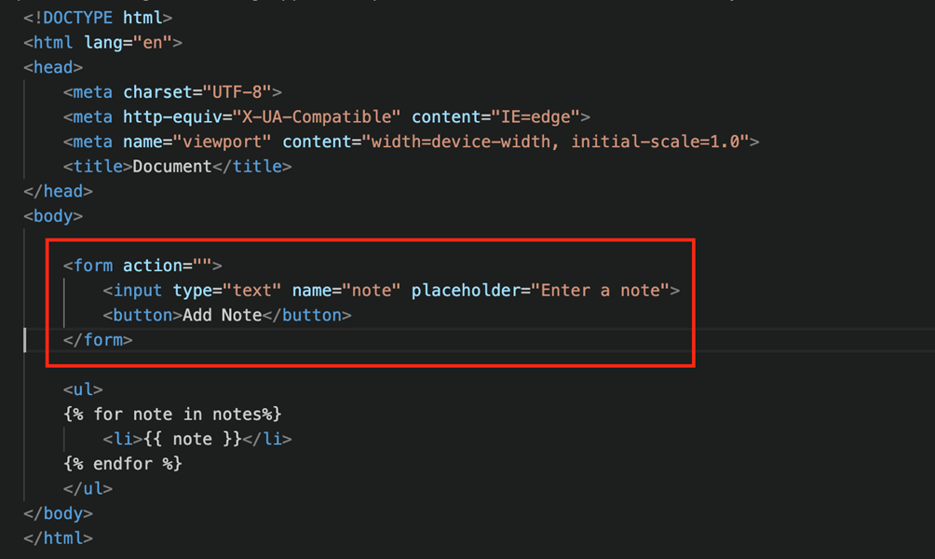
Backend :

Slide 4
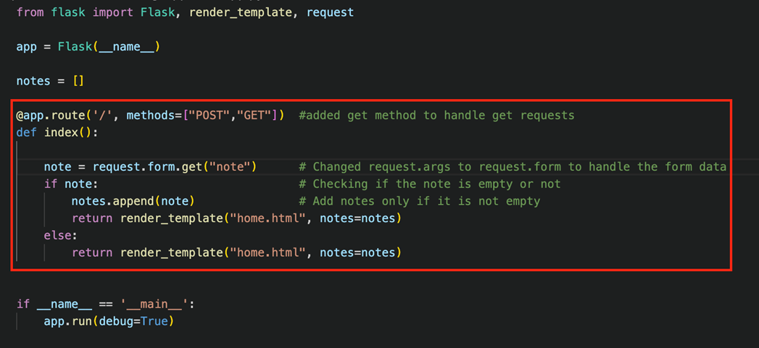
Frontend :
Form doesn’t any have methods mentioned, by default form sends a “get” request and action is redirecting to anywhere. Button doesn’t have any type mentioned with it
Bug Fixing :
Backend :
Added “get” method for handle both
get method and post method,
for read the form data, replace
‘request.args.get(“note”) to
request.form.get(“note”) added
one more condition to check if the input
is empty, notes will note be added.

Slide 5
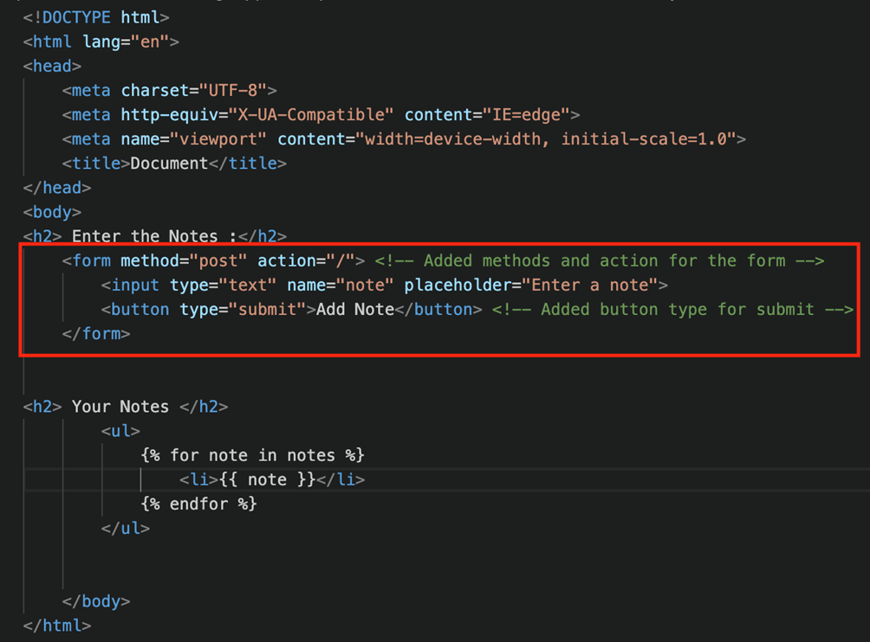
Frontend :
Added form method and action will redirect to the home page, and also added button type “submit” to send request for the form.

Slide 6
Conclusion :
By adding the flask route to handle both the get and post request and also adjusting the logic to retrieve the post form data for the backend. And for the front end we added form action, http method and button type we were able to solve the identified bugs and the application is working successfully

