Slide 1
ESP32-Based Universal PLC Protocol Bridge
Charith Sai Sathvik Ale
EE 697 Graduate Project
M.S In Electrical and Computer Engineering
Dr. Leon Jololian
Chair and Professor, Department of ECE
University of Alabama at Birmingham
12/10/2025

Slide 2
PROBLEM IDENTIFICATION
Legacy PLCs rely on outdated fieldbus protocols (RS-232/Modbus RTU) that don’t integrate with modern IT/OT platforms.
Lack of interoperability blocks Industry 4.0 adoption — analytics, dashboards, cloud systems cannot read PLC data natively.
Commercial protocol bridges are expensive, closed-source, and rarely customizable for safety-critical workflows.
Small/medium plants cannot modernize without costly hardware replacements.
There is a clear need for a low-cost, deterministic, and secure PLC-to-MQTT gateway for legacy automation systems.

Slide 3
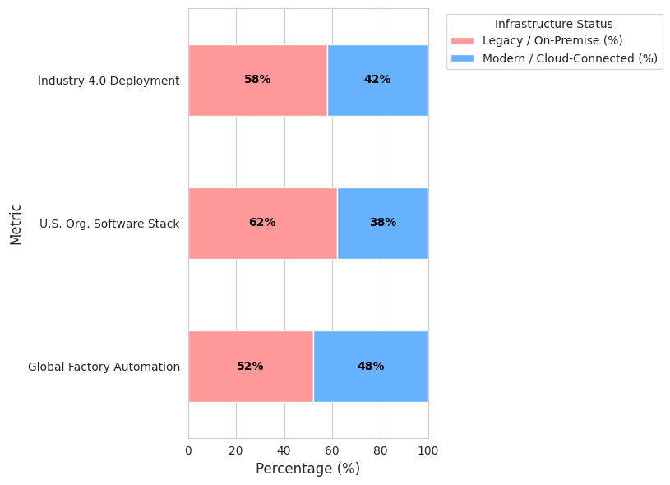
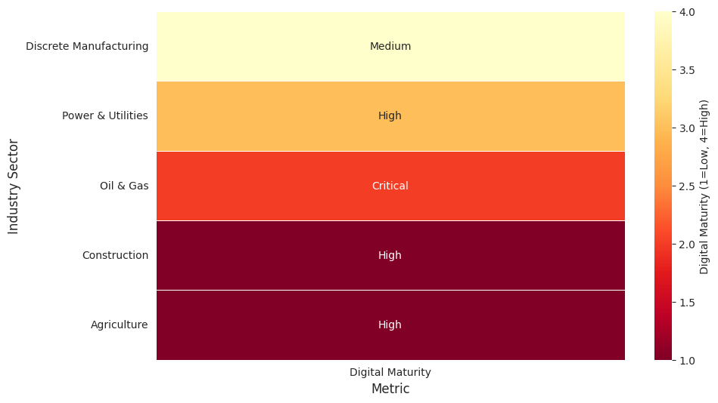
Problem Identification
Majority of industrial systems still rely on legacy/on-premise controls.
High-growth sectors expect cloud-connected control systems.
Digital maturity gap is largest in industries relying on older PLC infrastructure.

Slide 4
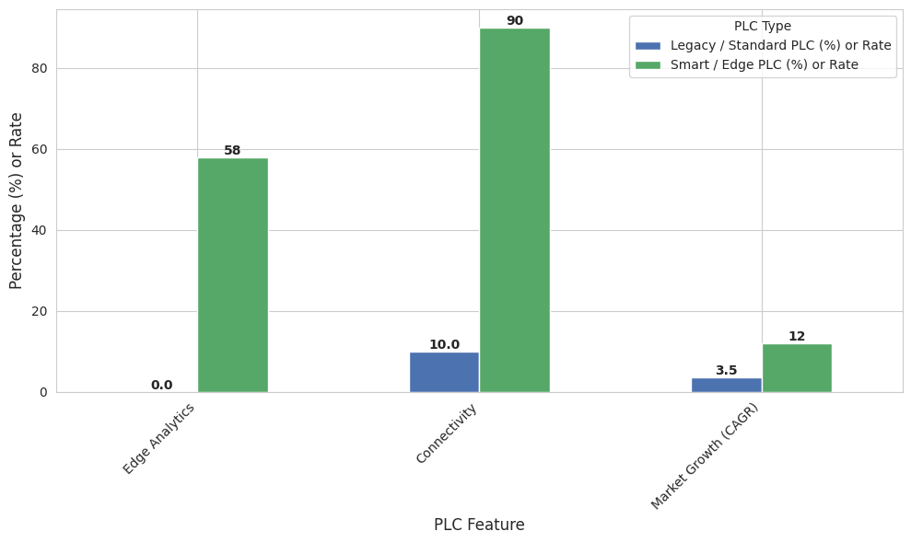
PROBLEM IDENTIFICATION
Legacy/Standard PLCs still dominate the market but lack in edge analytics, IIoT connectivity and limited to serial/local while 58% of new Smart PLCs include built-in data analysis and cloud ready.
While legacy PLC growth is slow (~3-4% replacement), Smart/Edge PLC technology adoption shows high growth (~12%).
The gap between capability and adoption drives demand for retrofit solutions.

Slide 5
LITERATURE REVIEW
Recent studies show increasing demand for IIoT gateways that bridge legacy fieldbus protocols with cloud-ready systems.
RS-232 remains widely used in older PLC installations, despite its distance and noise limitations, making retrofit solutions essential.
MQTT is consistently identified as the preferred lightweight protocol for scalable industrial telemetry and remote monitoring.
Literature highlights that most commercial gateways lack robust write-path safety, posing risks for factory control operations.
Academic work emphasizes the growing need for customizable, edge-level protocol conversion, aligning directly with this project’s objective.

Slide 6
COMPARATIVE ANALYSIS
RS-232 provides maximum compatibility with legacy Click PLC hardware, while RS-485 offers better noise immunity but is unnecessary for short-range lab setups.
ESP32 delivers strong real-time performance and integrated connectivity at a fraction of the cost of SBC-based industrial gateways.
MQTT enables clean topic isolation, scalability, and cross-platform interoperability — capabilities Modbus alone cannot provide.
Commercial gateways are often expensive, closed-source, and difficult to customize for safety-critical or experimental environments.
This project achieves a superior balance of cost, determinism, flexibility, and write-path safety compared to existing solutions.

Slide 7
PROJECT DESCRIPTION
The project develops a bridge that connects a Click PLC to modern IT/OT systems using an ESP32 intermediary.
RS-232 (via MAX3232) carries Modbus RTU data from the PLC into the ESP32 for protocol conversion.
MQTT is used as the lightweight messaging backbone for telemetry and controlled write operations.
The system demonstrates a low-cost, open, and extensible path for modernizing legacy industrial equipment.

Slide 8
WORKING PRINCIPLE
ESP32 periodically polls PLC registers using Modbus RTU over the RS-232 → TTL interface.
Each Modbus response is decoded, sanitized, and converted into structured MQTT payloads.
The OLED display gives real-time feedback such as Wi-Fi status, last read value, polling errors, and latency metrics.
Values published on MQTT and can publish safe write commands back to the PLC.
Any write command follows a validation chain (topic isolation + value checks) to avoid unsafe PLC operations.

Slide 9




System Architecture Overview
The system is divided into four principal subsystems, ensuring a clear
and secure communication pipeline.
PLC Interface
Protocol Bridge
Handles Modbus RTU acquisition, validation, and periodic polling.
Parses Modbus registers, applies function-code allow-lists, and maps validated values to MQTT topics.
Applications Layer
Messaging Layer
Consumes MQTT telemetry for dashboards, analytics, and future OPC UA integration.
Manages reliable data transport over MQTT, with strict topic isolation for safety.

Slide 10
PROJECT SETUP
The Click PLC was configured to output Modbus register HR40001 and HR40002 over its RS-232 communication port.
A MAX3232 level shifter converts the PLC’s RS-232 voltage levels to 3.3V TTL for the ESP32 UART.
ESP32 UART1 was mapped to custom RX/TX pins and configured for 9600 baud, 8N1 Modbus RTU framing.
A local Mosquitto MQTT broker was installed on a laptop to receive telemetry and test write commands.

Slide 11




Project Setup – Software Configuration
Systematic Troubleshooting Enabled Stable Communication Pipeline
OLED Subsystem
Resolved
Network & MQTT
Connected
>
Power Gating:
Enabled VEXT rail via
.
>
Broker:
Mosquitto running on Windows host (
GPIO21 HIGH
GPIO36 LOW
.
192.168.1.162:1883
).
I²C Bus:
Initialized on
>
Firewall Fix:
Changed network profile from Public to Private to allow inbound TCP.
>
SCL=18
SDA=17
>
Library:
Migrated to official Adafruit SSD1306/GFX to fix constructor mismatches.
>
Client:
Verified connectivity via
mosquitto_sub
.
Serial Interface
Stable
Data Acquisition
Active
>
Wiring Fix:
Corrected TX/RX crossover at TTL interface.
>
Polling:
Function Code 03 reads
.
400001-400002
>
Error Resolution:
Eliminated Modbus Error
>
.
224
Timestamping:
Captures start/end times for precise
latency measurement.
>
Verification:
Confirmed PLC Port 2 LED activity synchronized with polling.
>
Output:
Serializes data to JSON for MQTT publication.

Slide 12
PLC Ladder Logic for Testing
The PLC program provides unambiguous signals for verifying Modbus communication
and data freshness.
1
2
3
Heartbeat Output
Static Value (DS1)
Incrementing Counter (DS2)
SP1 energizes Y001 continuously, verifying CPU is in RUN mode.
Constant value 1 moved to DS1 (Modbus register 400001), checking for communication issues.
DS2 increments each PLC scan (Modbus register 400002), verifying fresh data reads.

Slide 13

PROJECT RESULTS
Modbus read cycle averaged 10–12 ms with stable timing jitter for every 30 scans.
MQTT telemetry published without packet drops across repeated cycles.
ESP32 polling loop maintained deterministic timing under continuous load.
RS-232 maintained synchronization with zero framing or parity faults.

Slide 14
PROJECT RESULTS
Topic isolation prevented unintended PLC write collisions.
Serial monitor outputs confirmed consistent Modbus FC03 responses.
Error-handling eliminated Modbus 224 faults during extended testing.
End-to-end chain (PLC → ESP32 → MQTT ) remained stable for multi-hour runs.
Controlled write-path validation ensured safe, bounded register updates.

Slide 15


PROJECT RESULTS
The project successfully demonstrated deterministic Modbus-to-MQTT processing with
low latency and jitter.
11ms
<0.5ms
0
P95 Latency
Jitter
Errors
Achieved 95th-percentile latency, well below the 100 ms target.
Practical jitter (p95 – p50) remained effectively zero.
Zero Modbus timeouts, CRC errors, or parsing faults observed.
The stability of the latency distribution confirms efficient execution without blocking
delays, even with concurrent tasks like OLED rendering and MQTT publishing.

Slide 16
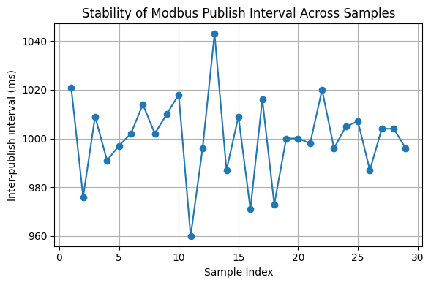
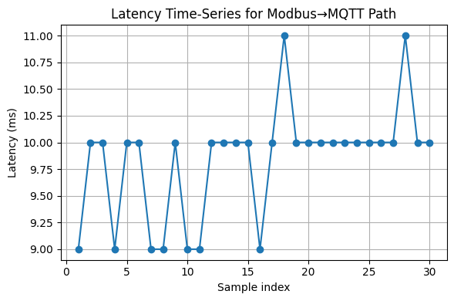
DATA ANALYSIS
LATENCY STABILITY
Modbus polling intervals remained tightly clustered, with no missed or delayed cycles.
Jitter stayed below 0.5 ms, proving stable communication timing.
ESP32 maintained deterministic loop execution under continuous sampling load.
No latency spikes were observed even when MQTT was active.
These results confirm the system is suitable for low-latency industrial telemetry.

Slide 17
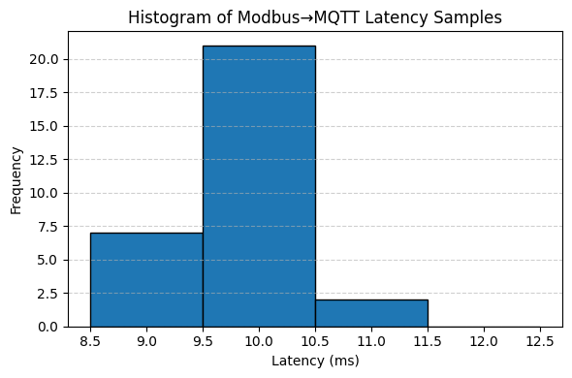
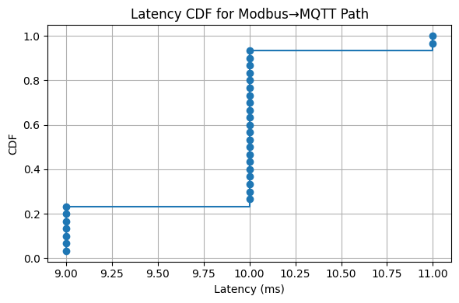
DATA ANALYSIS
DISTRIBUTION & JITTER PROFILE
Histogram shows most latency samples fall between 9.5–10.5 ms, indicating consistent performance.
CDF curve rises steeply, proving extremely low variance in latency.
No heavy-tail behavior means the system does not experience unpredictable delays.
This confirms Modbus→ESP32→MQTT chain meets determinism requirements.
Validates the ESP32 as a reliable low-cost industrial polling device.

Slide 18
FUTURE IMPLICATIONS
The system can evolve into a general-purpose IIoT edge controller capable of handling multiple PLCs and multiple communication channels.
Security upgrades such as TLS encryption and certificate-based authentication can harden the MQTT communication path.
A full MQTT → Node-RED → OPC UA data pipeline can be integrated to support enterprise-level SCADA and MES connectivity.
Additional industrial protocols (Profinet, EtherNet/IP, BACnet) can be layered onto the gateway to widen cross-vendor compatibility.
Predictive maintenance frameworks can subscribe to high-resolution telemetry for anomaly detection and machine diagnostics.
This architecture provides a low-cost path for plants to transition into Industry 4.0 without replacing legacy hardware.

Slide 19
CONCLUSION
The project successfully demonstrated a low-cost and deterministic Modbus-to-MQTT bridge for legacy Click PLCs.
ESP32 proved reliable for continuous Modbus polling, telemetry publishing, and real-time latency measurement.
RS-232 transport showed stable behavior with no data corruption or jitter spikes across extended testing.
The system validated a safe write-path design through topic isolation and value-bound checks.
Overall, the prototype provides a practical foundation for extending legacy automation systems into modern IIoT architectures.

Slide 20
THANK YOU

