Slide 1
Real‑Time Walking Speed Estimation & Gait Analysis
Using Ultrasonic sensor and Edge AI
Charith Sai Sathvik Ale
S. Abdollah Mirbozorgi
Department of Electrical & Computer Engineering
2025 Edge Computing Machine Learning, EE – EE 590
Spring 2025
School of Engineering, UAB

Slide 2
Overview
Motivation & Problem Statement
Comparison & Required Features
Proposed System Concept
System Architecture
Experimental Setup
Data Log
NN Model Validation
Results: Speed Estimation
Conclusion & Future Work
Acknowledgements & References

Slide 3
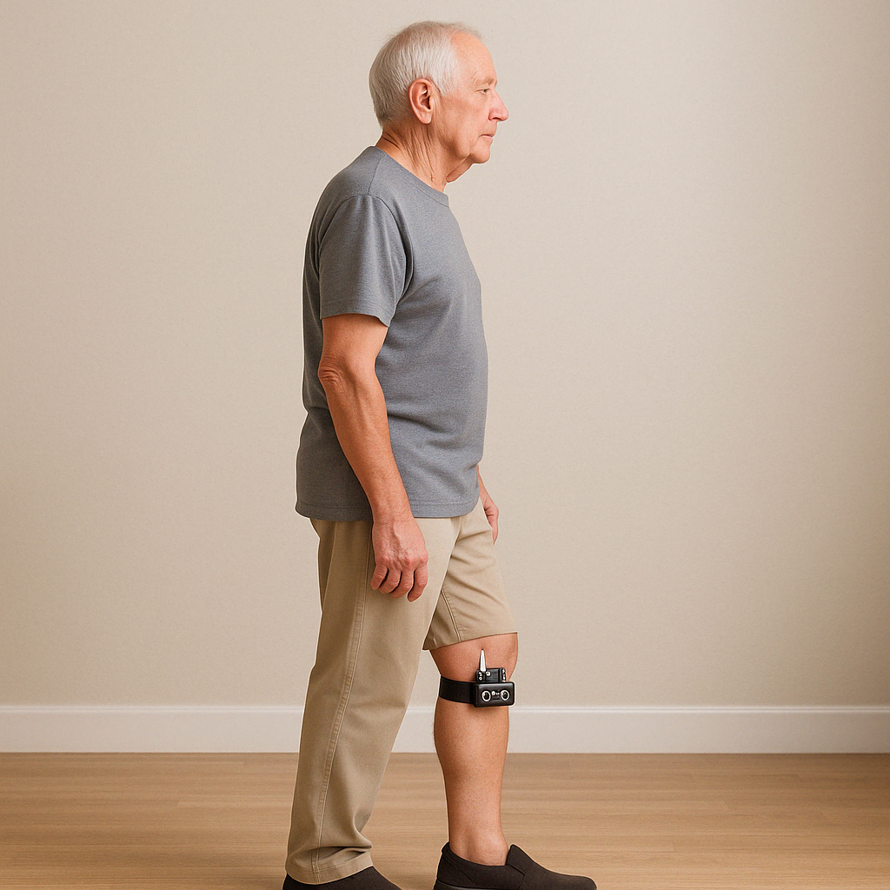
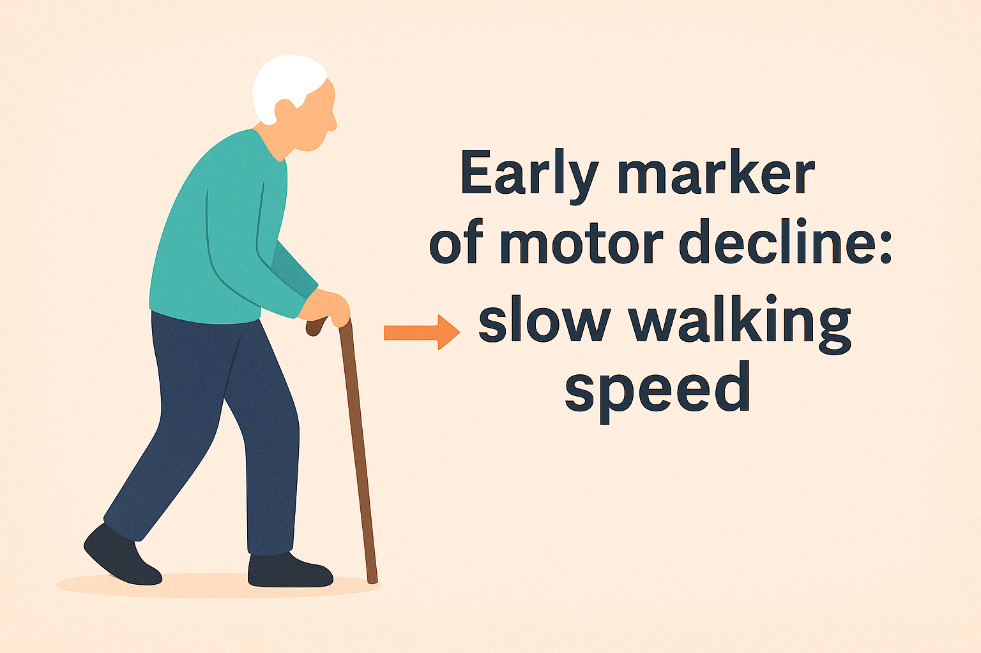
Motivation
Early marker of motor decline: slow walking speed.
Falls, cognitive decline, neurodegenerative risk can be predicted by gait changes.
Need continuous, wearable, low‑cost monitoring in real world.

Slide 4
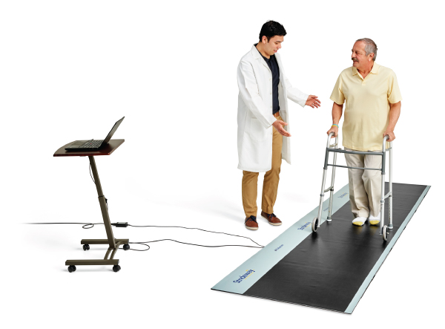
Problem Statement
Existing lab solutions (optical capture, mats, IMUs) are expensive, bulky, lab‑bound. ​
Wearables often uncomfortable, require frequent calibration
Goal: build a low cost wearable that estimates walking speed (0.5–1.5 m/s) and hip/inter‑leg angle, entirely on‑device, real‑time, with LoRa telemetry
Must work outside controlled labs, with minimal calibration.

Slide 5
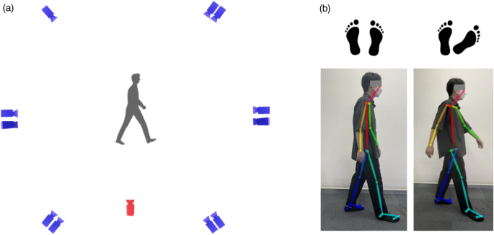
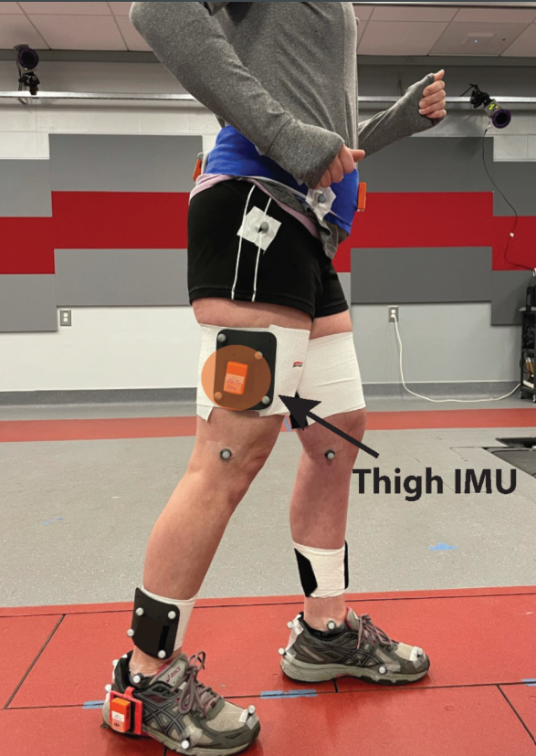
Comparison & Required Features
Approach | Pros | Cons | Required for Our System
Video‑based motion capture | High accuracy | Expensive, fixed setup | ❌
Wearable IMUs | Portable | Calibration, comfort trade‑offs | Partial
Pressure mats | Accurate gait metrics | Floor‑embedded, non‑portable | ❌
Ultrasonic + Edge AI | Low cost, real‑time, wearable | Needs robust signal processing | ✅
​

Slide 6
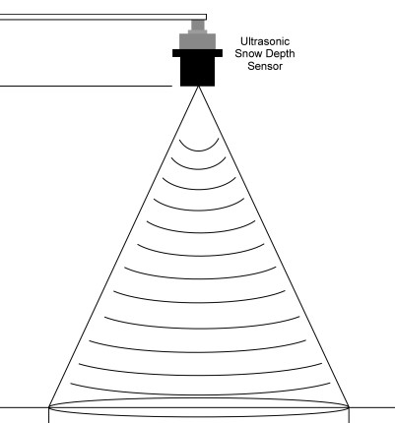
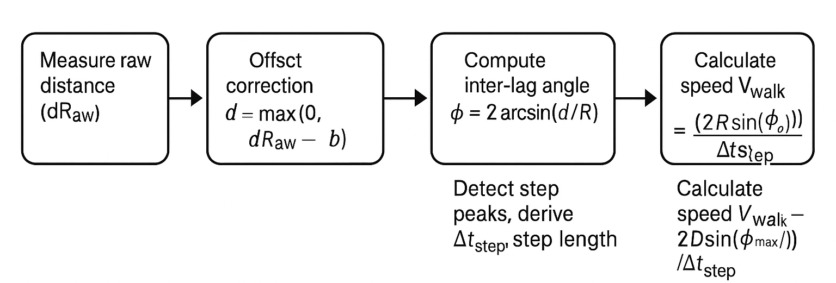
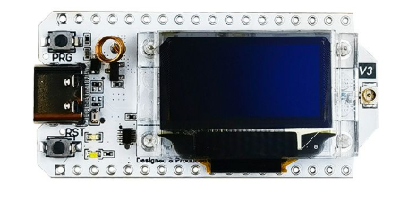
Proposed Concept
Sensor: HC‑SR04 ultrasonic module mounted at knee
Edge Device: ESP32 running lightweight ML & LoRa stack
Data Flow:
Ultrasonic Sensor
Lora 32 Module

Slide 7
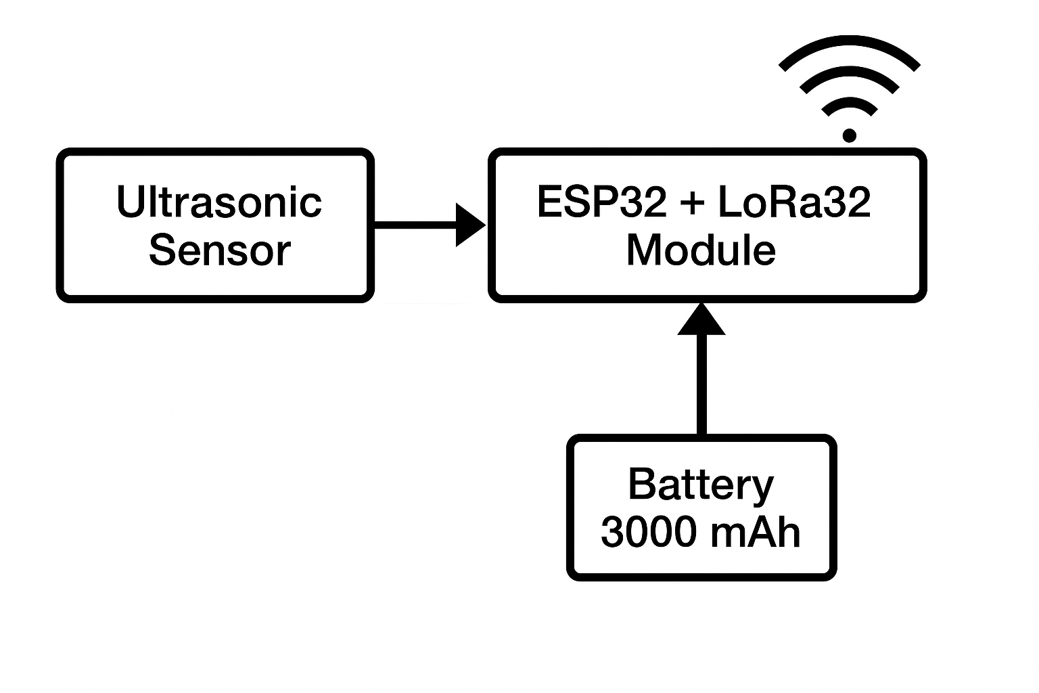
System Architecture & Algorithm
Block Diagram:
Algorithm Highlights:
50 Hz loop via micros() timing
Peak detection toggles rising flag on φ vs. φPrev
Rolling average over BUF_SIZE=5 for step length
Data output: phiMax, dtStep, avgStepLen, avgStrideLen, Speed

Slide 8
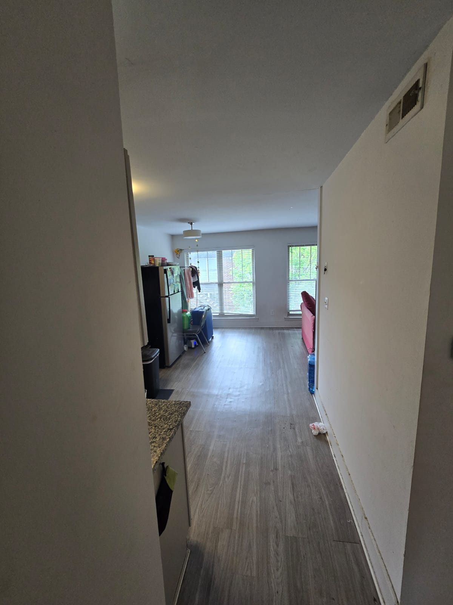
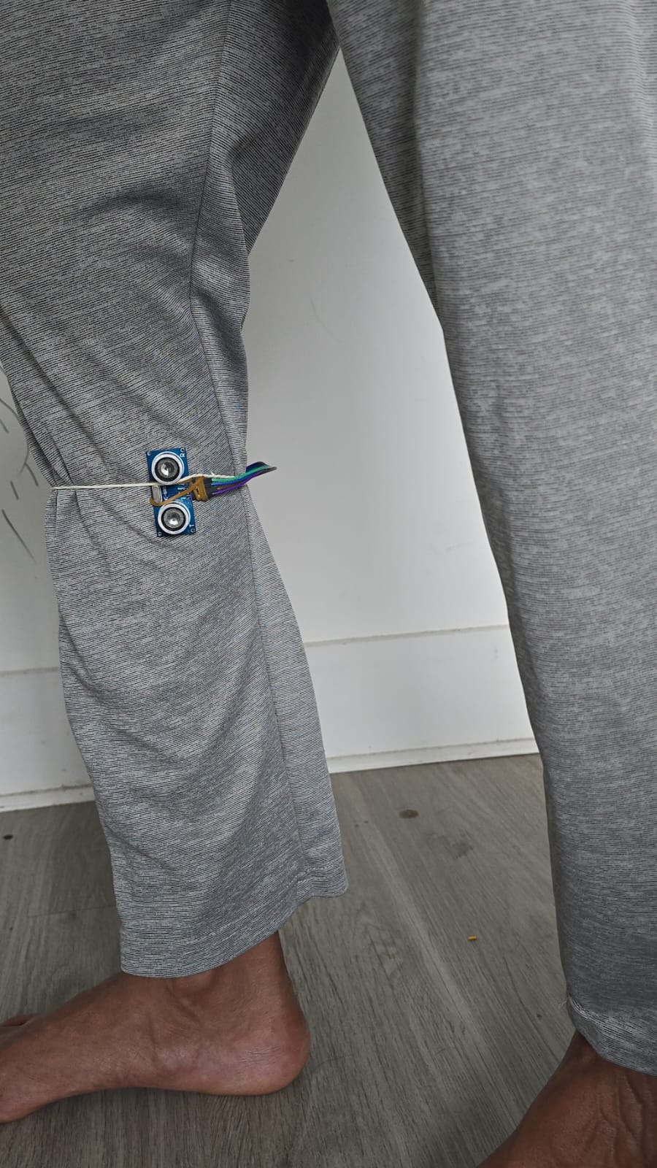
Experimental Setup
Subject: Volunteer walks 7.0 m corridor at varied speeds
Sensor placement: 0.1 m lateral offset from knee pivot
Data logging: Serial CSV captured via IDE Cool Term and saved

Slide 9
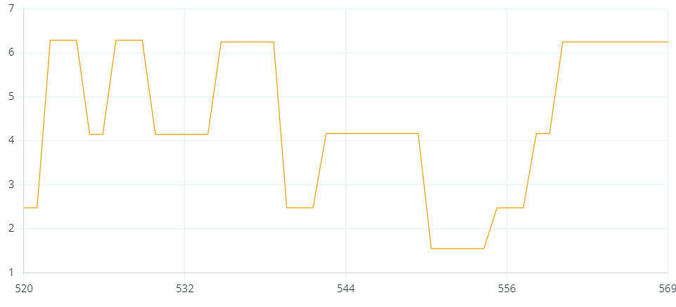
Data Log
The serial plotter showing the raw data capturing step frequency on y- axis with respect to time.

Slide 10
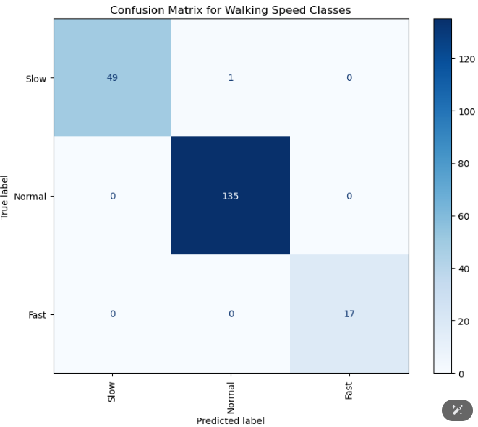
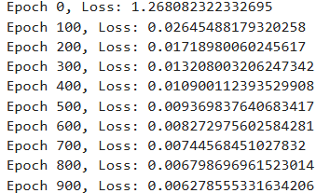
NN Model Validation
Test Accuracy: 0.96

Slide 11
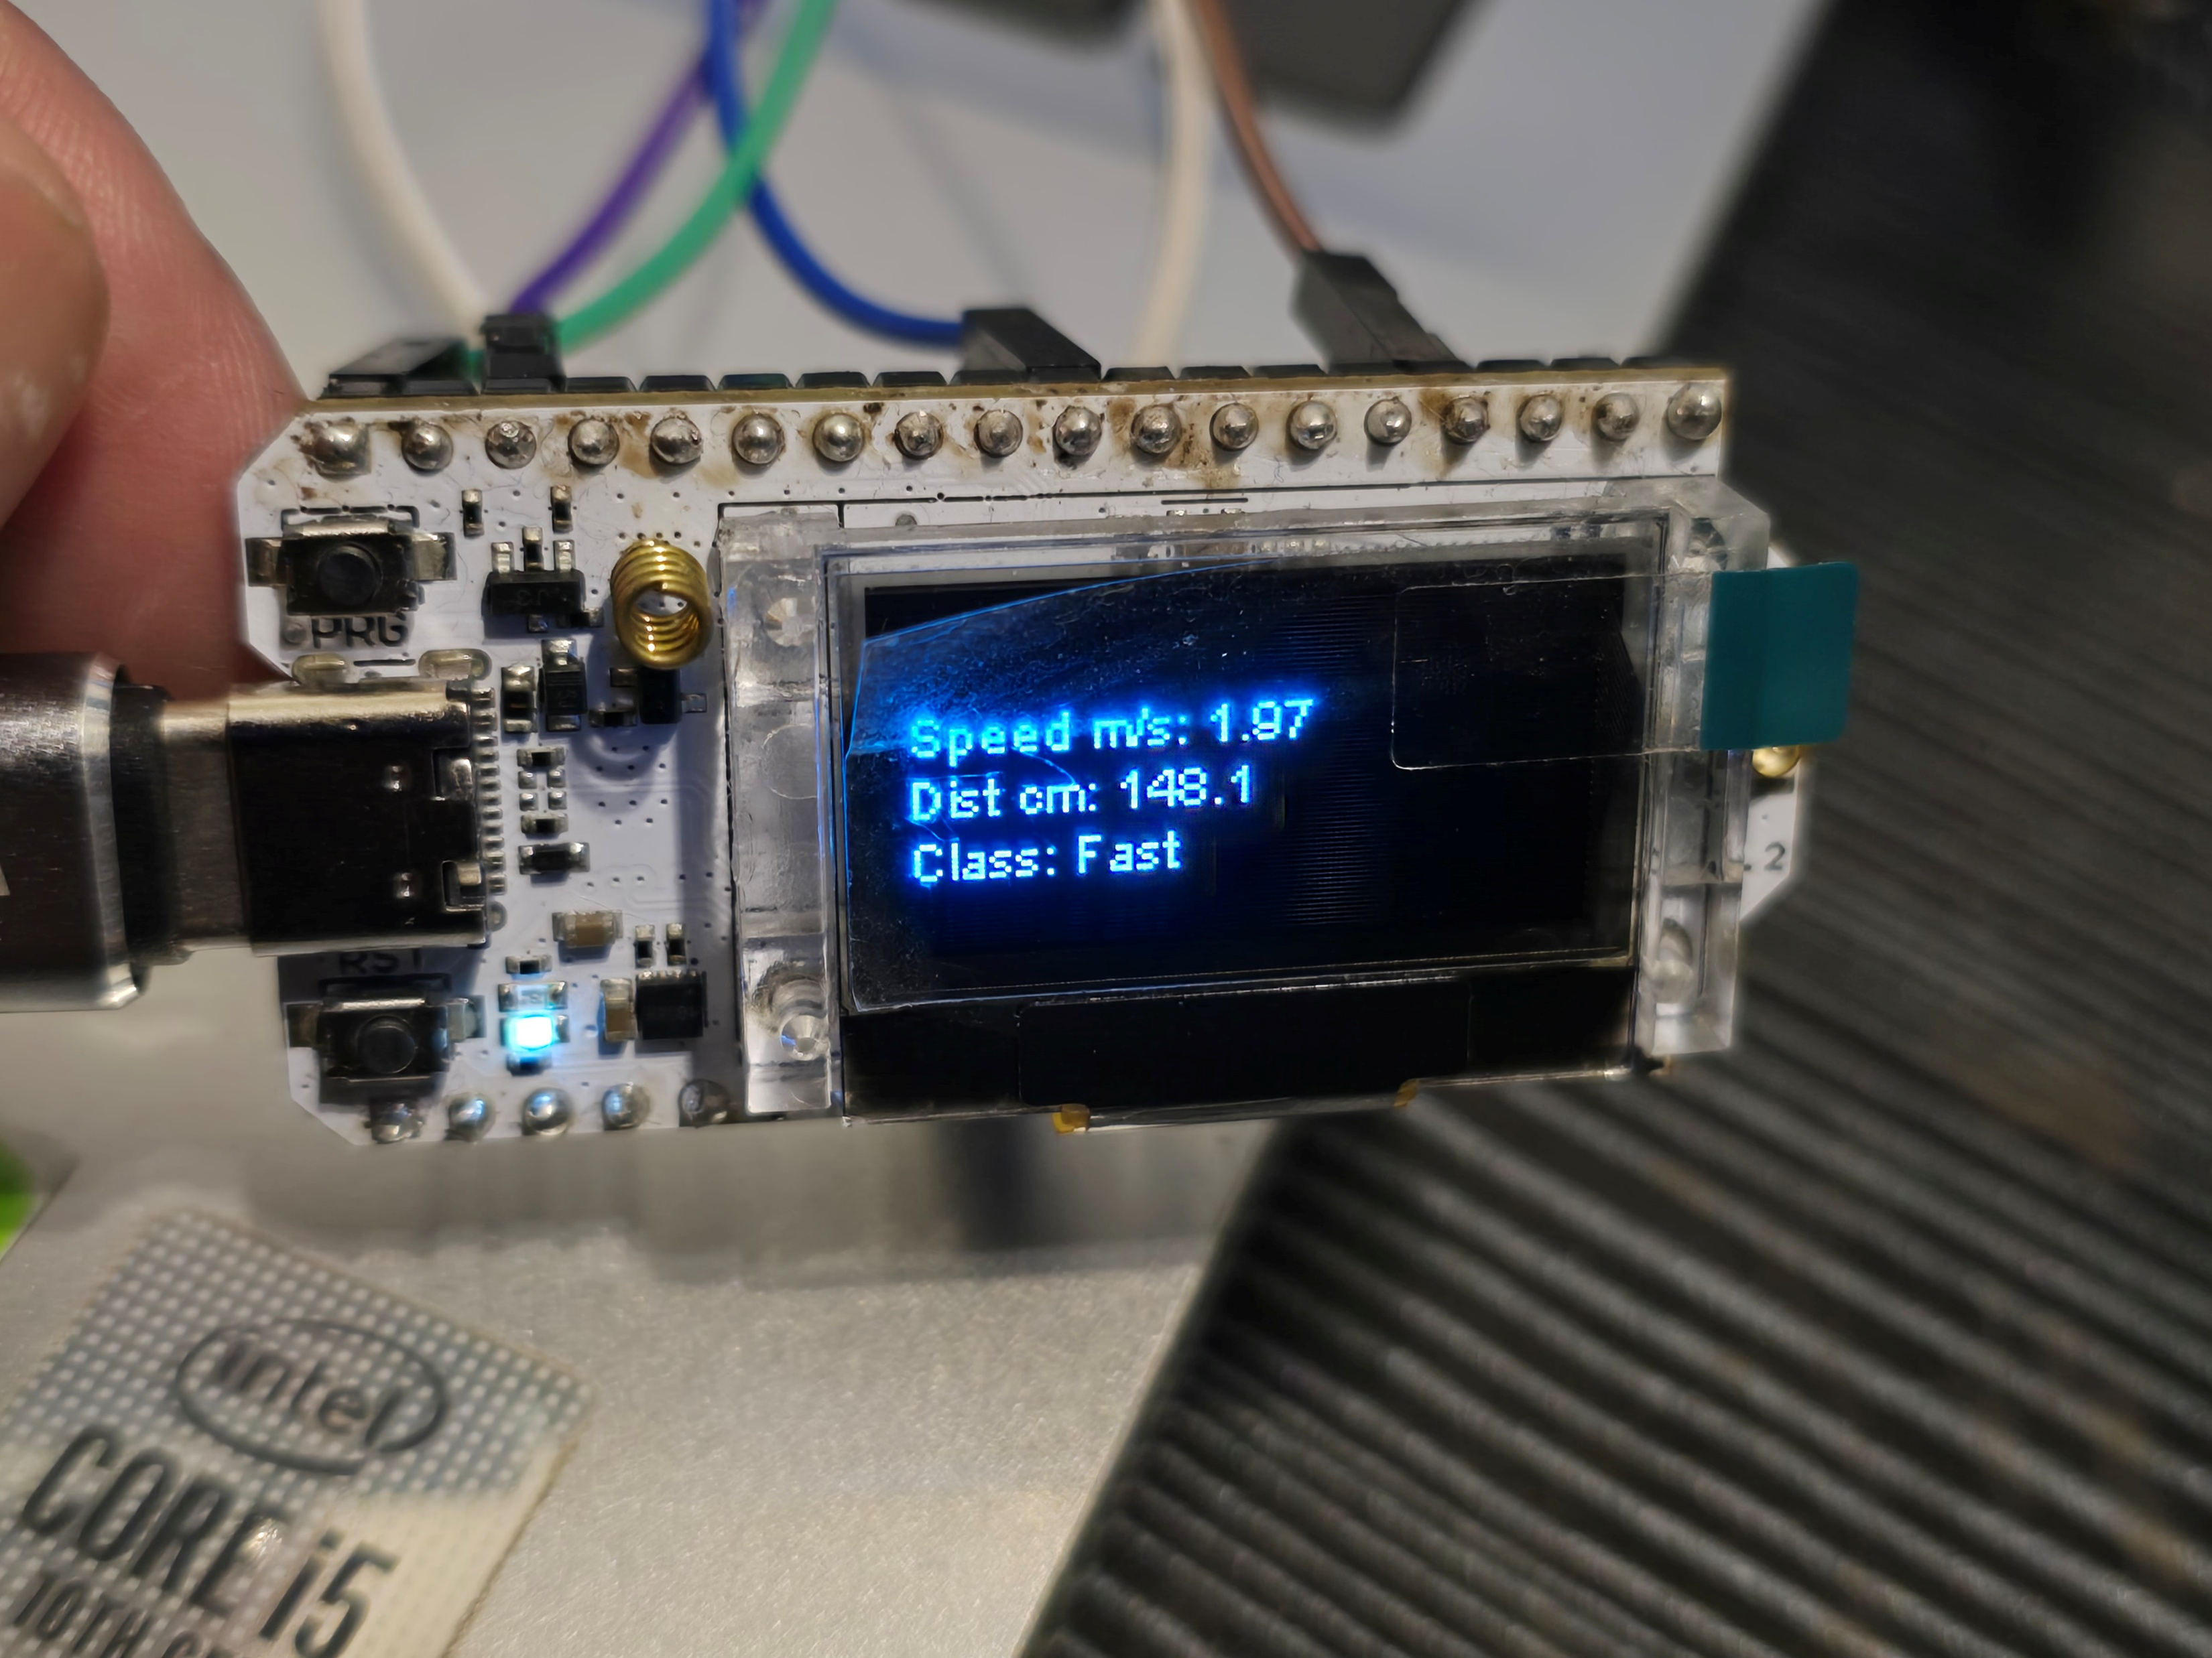
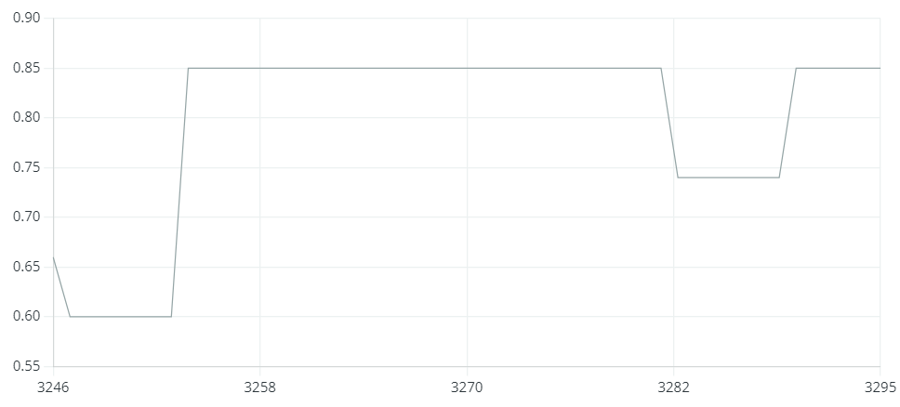
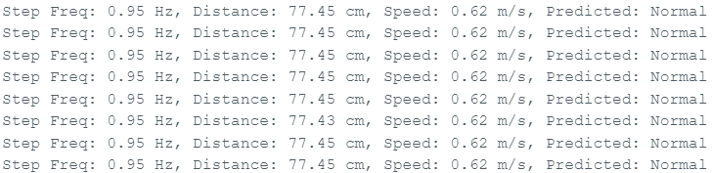
Results
Speed Estimation:
Raw data: ±0.2 m/s spikes at large φₘₐₓ.
Time‐series plot: smooth 0.5–1.5 m/s profile.
Achieved walking speeds from ~0.3 to 1.8 m/s, matching expected range.

Slide 12
Discussion & Validation
Meets report goals:
Real‑time,
Wearable,
Low‑cost,
Fully on-device, accurate.
​
Limitations: Mounting stability, Per‑user calibration. Tested on a single volunteer walking in a straight corridor. Needs more data across:
Diverse users (age, leg geometry, gait patterns)
Varied real‑world terrains (uneven ground, stairs, turns)
Longer recording sessions (fatigue, day‑to‑day variability)
Mitigations: Moving average.

Slide 13
Future Work & Impact
Multi‑sensor fusion (hip + knee) for robustness.
Clinical trials on elderly/Parkinson’s cohorts.
Battery & ergonomic enclosure design.
Deployment in smart‑city and tele‑health systems.
The network achieves a 95% test accuracy on our single-subject dataset, with the majority of errors coming at the "Normal"/"Fast" boundary. This proves that, on an edge device, even a rudimentary two-feature, two-layer MLP can reliably differentiate across wide walking-speed categories in real-time.

Slide 14
Acknowledgements & References
S. Abdollah Mirbozorgi
ChatGPT
Prasanth, H., Caban, M., Keller, U., Courtine, G., Ijspeert, A., Vallery, H., & von Zitzewitz, J. (2021). Wearable Sensor-Based Real-Time Gait Detection: A Systematic Review. Sensors, 21(8), 2727. https://doi.org/10.3390/s21082727J. Breckling, Ed., The Analysis of Directional Time Series: Applications to Wind Speed and Direction, ser. Lecture Notes in Statistics. Berlin, Germany: Springer, 1989, vol. 61.
Ugbolue, U. C., Papi, E., Kaliarntas, K. T., Kerr, A., Earl, L., Pomeroy, V. M., & Rowe, P. J. (2013). The evaluation of an inexpensive, 2D, video-based gait assessment system for clinical use. Gait & posture, 38(3), 483-489.
Zsolt Knoll, László Kocsis, Rita Kiss,Ultrasound-based measurement method for gait analysis using treadmill,IFAC Proceedings Volumes,Volume 36, Issue 15,2003,Pages 347-352,ISSN 1474-6670,https://doi.org/10.1016/S1474-6670(17)33527-9.
(https://www.sciencedirect.com/science/article/pii/S1474667017335279)M. Wegmuller, J. P. von der Weid, P. Oberson, and N. Gisin, “High resolution fiber distributed measurements with coherent OFDR,” in Proc. ECOC’00, 2000, paper 11.3.4, p. 109.

Slide 15
References
Liu, Y., An, H., Ma, H., & Wei, Q. (2023). Online Walking Speed Estimation Based on Gait Phase and Kinematic Model for Intelligent Lower-Limb Prosthesis. Applied Sciences, 13(3), 1893. https://doi.org/10.3390/app13031893
Paramasivam, A., Jenath, M., Sivakumaran, T. S., Sankaran, S., Pittu, P. S. K. R., & Vijayalakshmi, S. (2024). Development of artificial intelligence edge computing based wearable device for fall detection and prevention of elderly people. Heliyon, 10(8).
Bauer, E. K., Bultmann, S., & Behnke, S. (2024). Marker-free human gait analysis using a smart edge sensor system. arXiv preprint arXiv:2411.09538. https://doi.org/10.48550/arXiv.2411.09538 (2007) The IEEE website. [Online]. Available: http://www.ieee.org/
Enhancing Intelligent Shoes with Gait Analysis: A Review on the Integration of Inertial Measurement Units. Sensors, 2024. https://www.mdpi.com/1424-8220/24/24/7880​ FLEXChip Signal Processor (MC68175/D), Motorola, 1996.
Bucinskas V, Dzedzickis A, Rozene J, Subaciute-Zemaitiene J, Satkauskas I, Uvarovas V, Bobina R, Morkvenaite-Vilkonciene I. Wearable Feet Pressure Sensor for Human Gait and Falling Diagnosis. Sensors (Basel). 2021 Aug 3;21(15):5240. doi: 10.3390/s21155240. PMID: 34372477; PMCID: PMC8347941.
Saha SS, Sandha SS, Srivastava M. Machine Learning for Microcontroller-Class Hardware: A Review. IEEE Sens J. 2022 Nov 15;22(22):21362-21390. doi: 10.1109/jsen.2022.3210773. Epub 2022 Oct 5. PMID: 36439060; PMCID: PMC9683383.

