Slide 1




Modeling and Control of a Bridge Crane System
Charith Sai Sathvik Ale
12/03/24
University Of Alabama at Birmingham
Dept of Electrical and Computer Engineering
EE 641 Modern Control Theory

Slide 2
Introduction
Objective: Develop a control system for a bridge crane used primarily in seaport operations for loading containers onto ships. The control system aims to stabilize the crane's operations and improve efficiency and safety during the loading process.
Dynamic Modeling: The project models the bridge crane system dynamically, focusing on variations in load mass from the minimal hook weight to the maximum capacity of the crane. This approach helps tailor control strategies to varying operational demands.

Slide 3
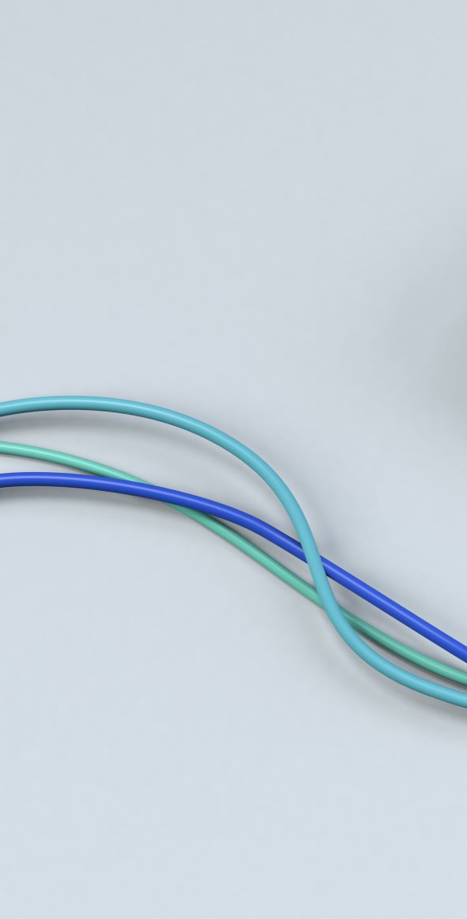
Simplifications for Feasibility:
Assumes a massless, inextensible cable, eliminating the complexities of cable dynamics from the model.
Considers frictionless interaction between the cart and the bridge to simplify the horizontal motion dynamics.
Neglects the engine's nonlinearities and dynamics, focusing on direct control inputs which simplify the development and analysis of the control system.
System Equations: Utilizes fundamental physics to derive nonlinear differential equations that capture the essential dynamics of crane operation under different load conditions.

Slide 4
Linearization Approach: Includes linearizing the derived equations around a nominal operating point to facilitate the application of linear control techniques, enhancing predictability and stability in control responses.
Feedback Control Design: The project emphasizes designing a feedback control system that responds efficiently to real-time operational parameters, ensuring minimal load oscillation and optimal positioning accuracy.
Safety and Efficiency: By addressing the dynamic response of the system to varying loads and operational conditions, the control system design inherently incorporates safety limits and efficiency metrics, crucial for high-risk environments like seaports.
Keywords: Bridge Crane, Dynamic Modeling, Nonlinear Differential Equations, Linearization, Feedback Control System, Load Stability, Seaport Operations, Safety Optimization.

Slide 5
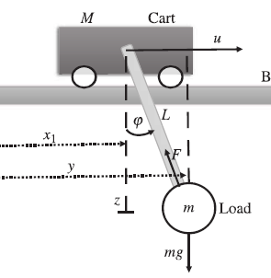
Purpose: Design a control system for a bridge crane that efficiently and safely transfers loads while ensuring stability.
Scope: Involves modeling the crane system's dynamics, designing controllers, and evaluating performance under uncertainty.
Relevance: Bridge cranes are crucial for industrial operations, particularly in logistics and shipping.

Slide 6
Problem Statement
This project addresses key questions such as developing nonlinear state-space equations, performing linearization around equilibrium points, designing optimal controllers, observers, and evaluating the system's stability and robustness under disturbances.

Slide 7
Methodology Overview
Nonlinear State-Space Equations: Formulation of dynamics equations.
Linearization: Simplifying equations around equilibrium for analysis.
Transfer Function Analysis: Examining stability and control feasibility.

Slide 8
Nonlinear State-Space Equations
System Overview:
Purpose: Model the dynamics of a bridge crane system for efficient load transfer.
Components: Cart (mass M), load (mass m), cable (length L).
Dynamics: Governed by the interactions between the cart's motion and the load’s swing.
Equations of Motion:
Horizontal Forces on the Cart: Mx¨1=u+Fsin⁡(ϕ)
Horizontal Forces on the Load: my¨=−Fsin⁡(ϕ)
Vertical Forces on the Load: mz¨=−Fcos⁡(ϕ)+mg
State-Space Representation: x˙=f(x,u)\ where x=[x1,x˙1,ϕ,ϕ˙]
MATLAB Implementation:
Parameter Definition: Mass of cart M, load m, cable length L, gravitational constant g.
State Variables: Position x1​, velocity x˙1​, cable angle ϕ, angular velocity ϕ˙.

Slide 9
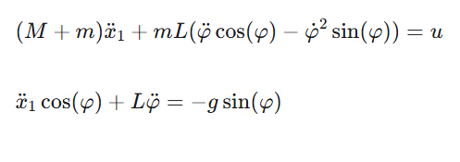
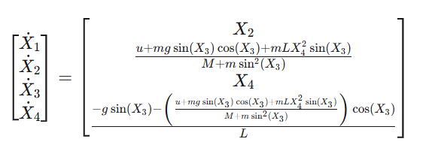
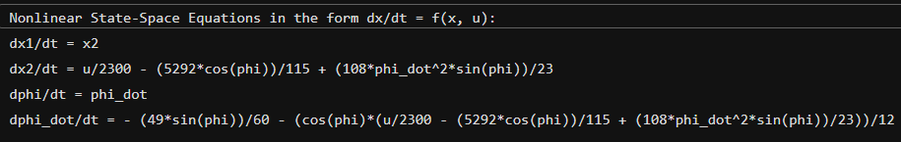

Slide 10
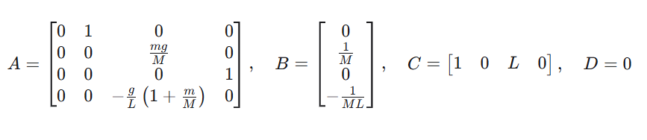
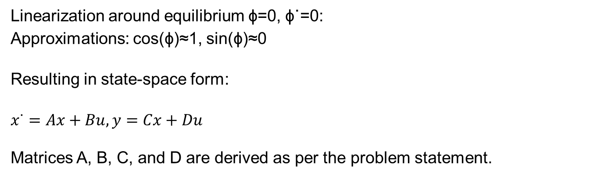
Linearization
Linearization around equilibrium ϕ=0, ϕ˙=0: Approximations: cos(ϕ)≈1, sin(ϕ)≈0
Resulting in state-space form:
$x˙=Ax+Bu,y=Cx+Du$
Matrices A, B, C, and D are derived as per the problem statement.

Slide 11
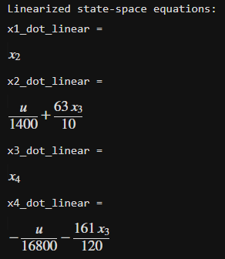
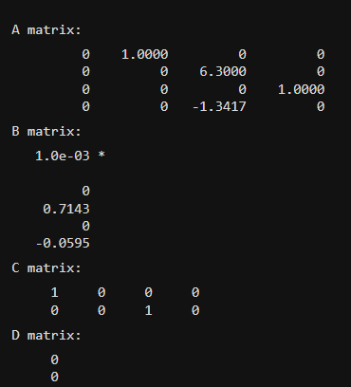

Slide 12
Transfer Function Analysis
Transfer Function Computation:
Output Definitions: Three different outputs for system analysis:
y1: Location of the load (y = x1+L*phi)
y2: Location of the cart (y = x1).
y3: Cable angle (y= phi).
State-Space to Transfer Function: Conversion of state-space models to transfer functions for each defined output using MATLAB.

Slide 13
Pole-Zero Analysis:
Visualization: Pole-zero maps generated for each transfer function to visually assess system dynamics and potential resonances.
Stability Indicators: Poles of the system analyzed for stability; critical for ensuring controlled system response.
Stability Evaluation:
System Stability: Each system output (load, cart, and cable angle) checked for asymptotic stability by examining the location of system poles.
Stability Criteria: Confirms whether all poles have negative real parts, which is necessary for ensuring the system's stability under operational conditions.

Slide 14
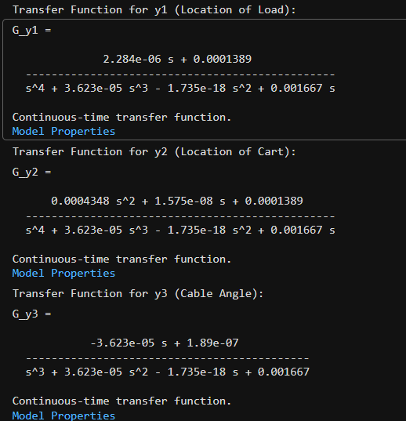
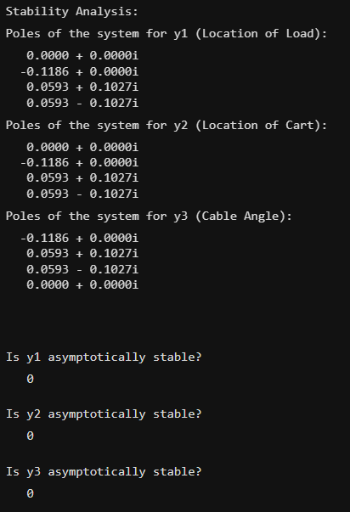

Slide 15
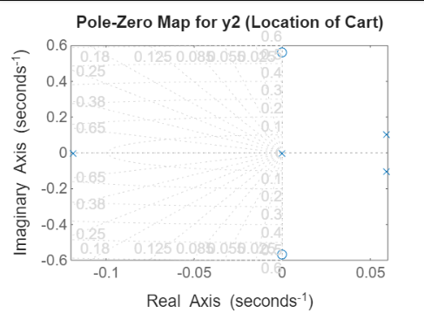
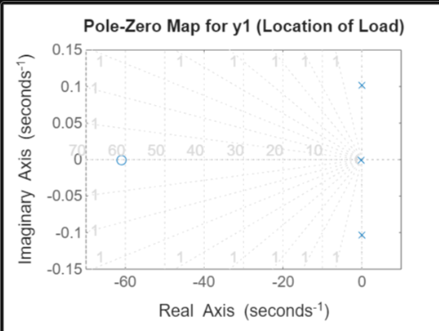
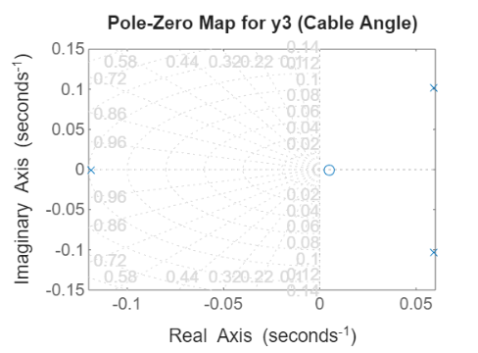

Slide 16
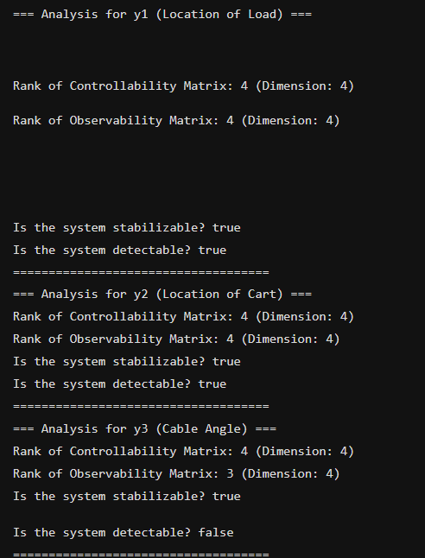

Slide 17
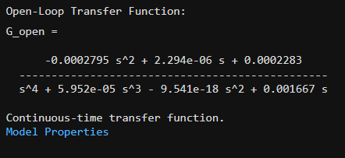
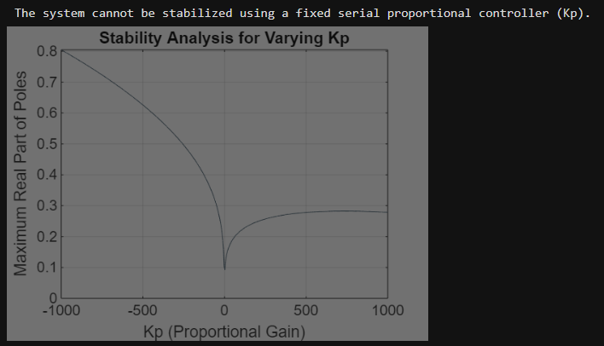
Controller Design
Implementing a series proportional controller to the linear model of the bridge crane system to find whether the system becomes stable or not.
Assuming Kp_values = (-1000, 1000, 500);

Slide 18
Simulink Models
Implementing Linear and Non linear models of bridge crane system using Simulink with initial conditions as given below.
Initial Conditions: x0 = [(W + 1) *m; 0; 0.035 * (1 + V); 0]
Constants values are fixed.
x0 = [6300;0;0.21;0]

Slide 19
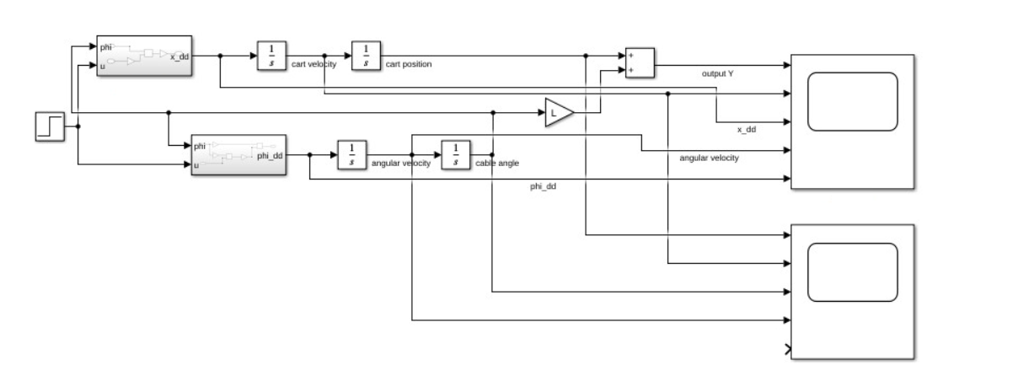
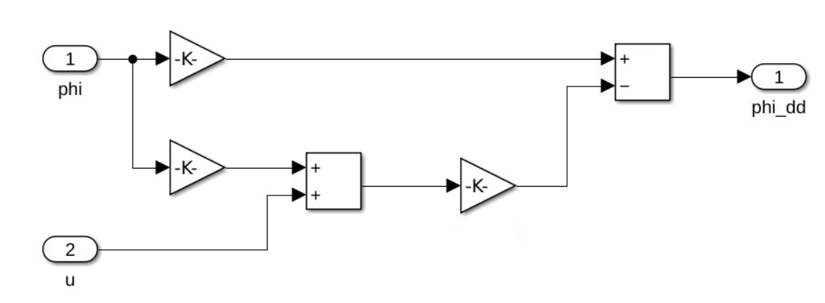
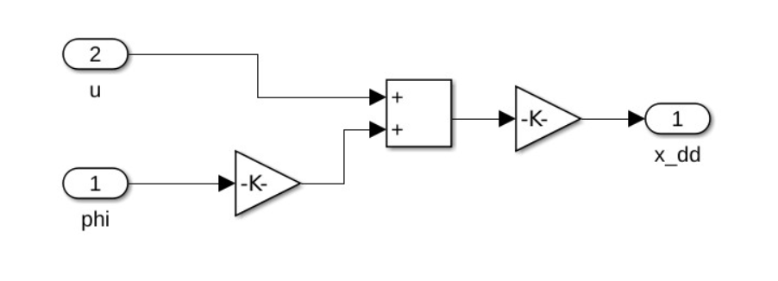
Linear Model
Subsystems

Slide 20
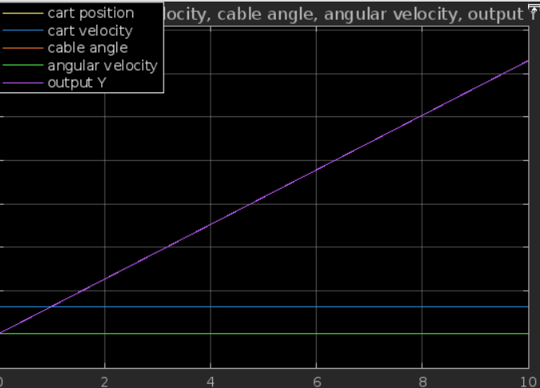
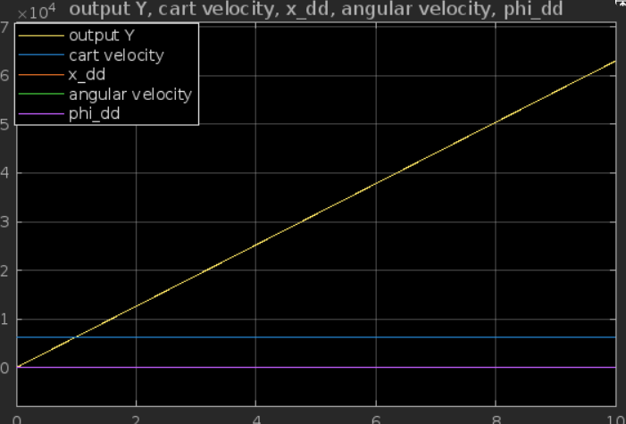

Slide 21
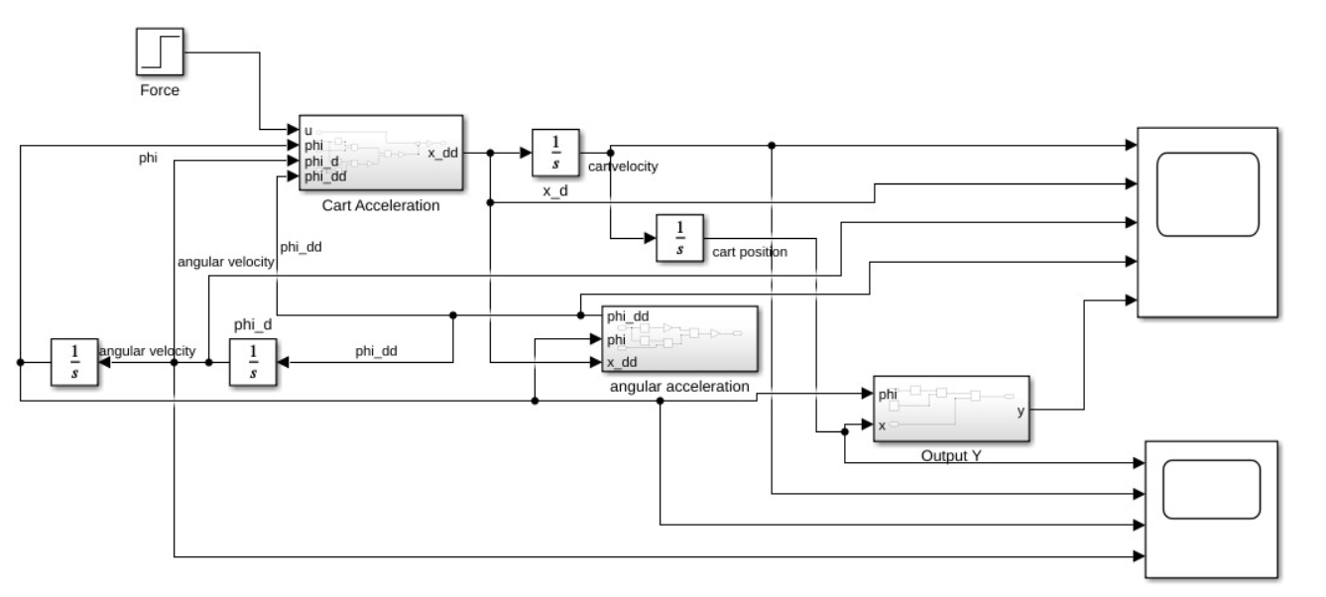

Slide 22
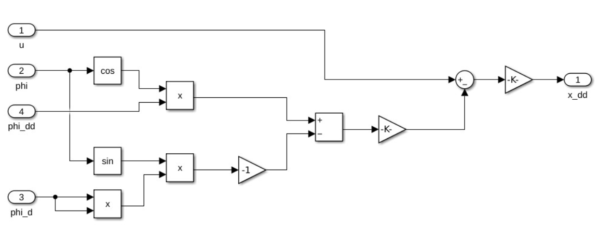
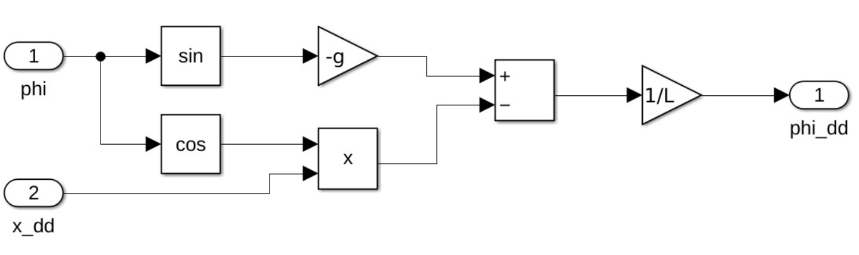

Slide 23
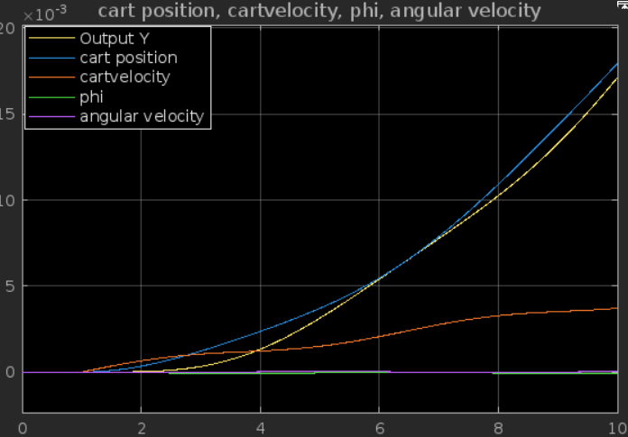
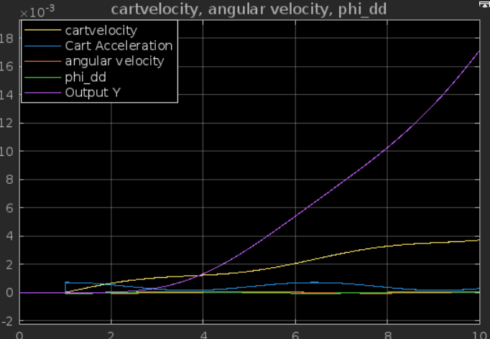

Slide 24
Optimal Controller Design and Evaluation
Purpose: Develop a control strategy that minimizes a predefined cost function by tuning a state feedback controller K.
Focus: Evaluate different configurations for the penalty matrix Q and scalar p on the control effort and system stability.
a. Optimal Controllers Computation:
Objective: Calculate six optimal controllers using different combinations of Q and p.
Method: Utilize Linear Quadratic Regulator (LQR) theory to design controllers.
Matrices:
Q matrices vary to emphasize different state variables.
p values: where H, S, O are derived from constant U.

Slide 25
Impact on Cost Function J:
Analyze how different Q matrices affect the performance index, focusing on trade-offs between state error penalization and control effort.
b. Closed-loop System Analysis:
Eigenvalue Computation: Determine the closed-loop eigenvalues for each controller to assess system stability.
Root Locus Plot: Visual representation of how the closed-loop pole locations vary with changes in p.
c. System Response to Optimal Controllers:
Linear Model Implementation: Simulate the closed-loop response of the linear model under initial conditions.
Control Effort Analysis: Plot and compare the control efforts u for different controller configurations to evaluate efficiency and effectiveness.
d. Nonlinear System Analysis:
Nonlinear Model Testing: Implement the closed-loop controllers in a nonlinear simulation environment.
Stability Testing: Identify for which initial conditions the system remains stable.
Boundary Conditions: Determine the edge-case initial conditions that lead to system stabilization, highlighting the robustness of each controller.

Slide 26
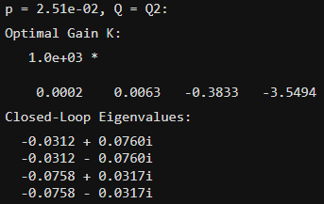
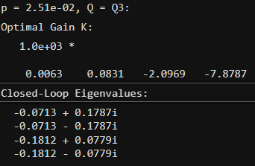
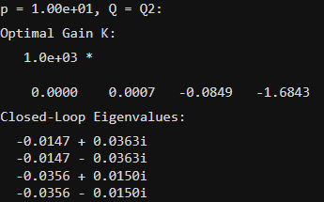
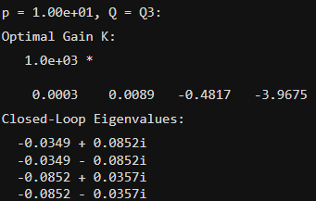
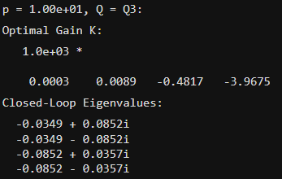
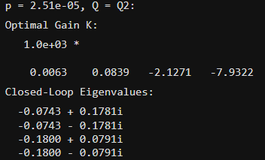
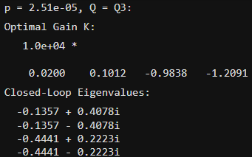
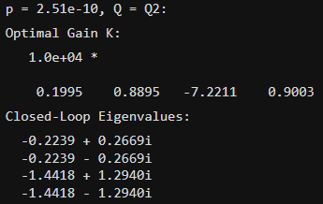
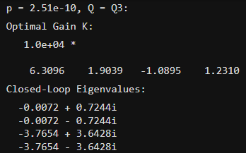

Slide 27
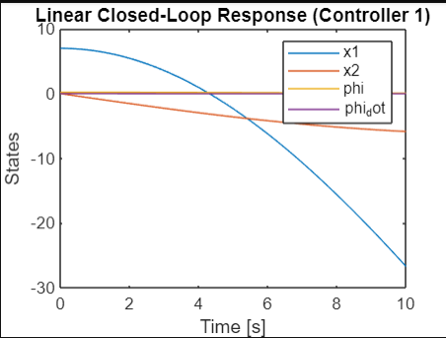
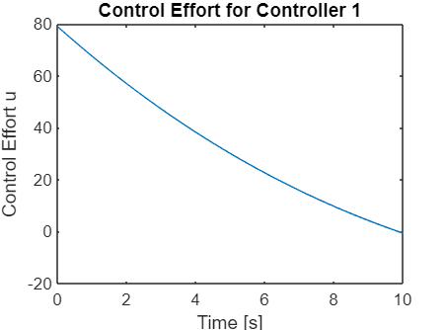
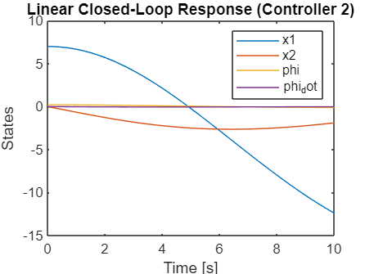
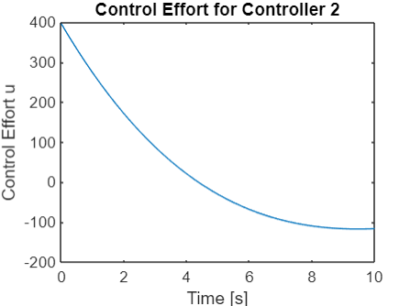
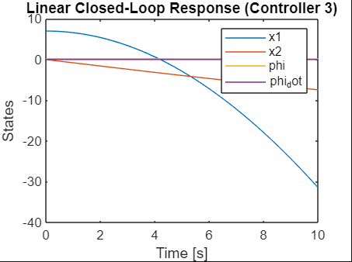
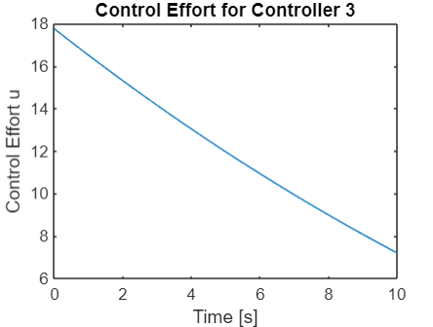

Slide 28
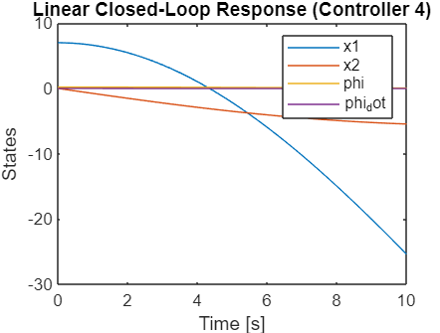
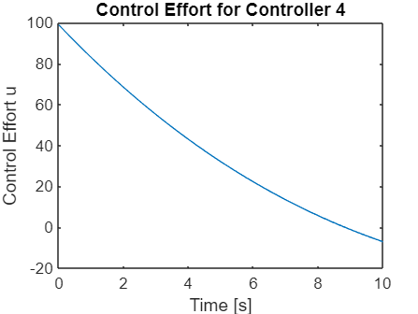

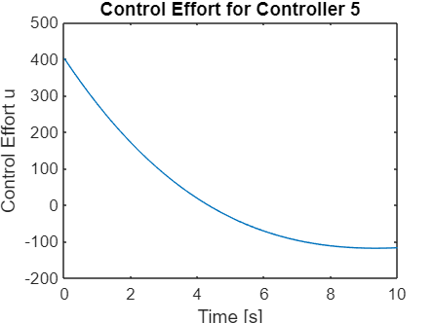
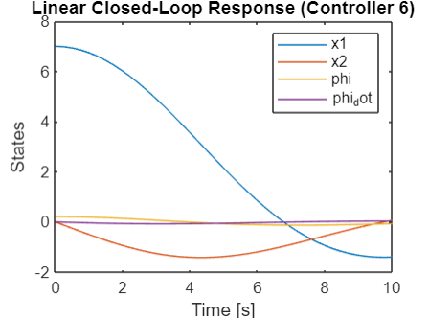
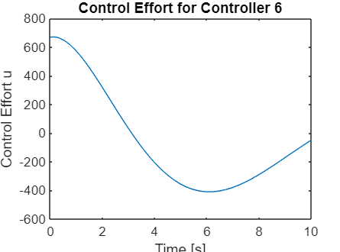
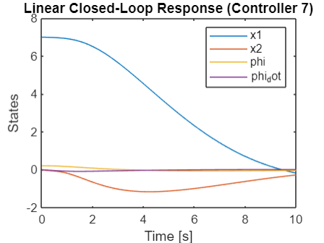
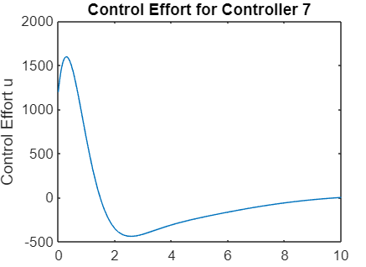
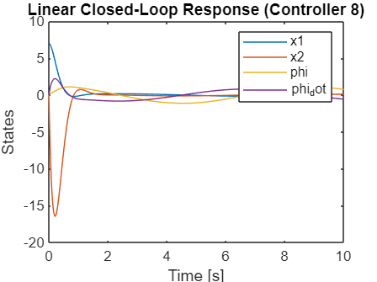


Slide 29


Slide 30









Slide 31









Slide 32
Objectives of System Analysis Under Uncertainty
Objective Overview:
Purpose: Evaluate the performance and stability of a control system under the influence of uncertainties, disturbances (w), and noise (v), using advanced filtering techniques.
Model Description: The system dynamics are described by the equation x_dot=Ax+Bu+Gw, where w and v represent process and measurement noise, respectively, modeled as white noise.

Slide 33
Detailed Objectives:
Kalman Filter Implementation:
Conditions Check: Verify if the necessary conditions for implementing a Kalman filter are met within the system.
Filter Design: Compute the Kalman filter gain L_Kalman​ for different noise covariance values w_var​.
Stability Analysis: Determine the eigenvalues of the Kalman filter to assess its impact on system stability.
Simulink Modeling:
Closed-loop Simulation: Integrate the state controller and Kalman filter into a Simulink model to simulate the system’s response to noise and disturbances.
Controller Selection: Useful
System Response Evaluation:
Observer Comparison: Analyze the system's response using two different observers—Lkalman L1​—under varying noise conditions.
Stability and Response Quality: Identify which observer configuration yields a stable system and superior performance.
Error Analysis:
Quadratic Error Calculation: Compare the quadratic error between the Kalman filter and the L1​observe to what
Impact of Noise Levels: Examine how different values of w_var and v_var affect the performance and accuracy of each observer.
Optimal Use of Kalman Filter:
Benefits of Kalman Filter: In
System Improvement: Explore how adjusting the noise parameters influences the utility of the Kalman filter in maintaining system stability and accuracy.

Slide 34








Slide 35






Slide 36
Optimal Estimation Under Uncertainty:
Accurate State Estimation: The Kalman filter provides an optimal solution for estimating the system states by minimizing the mean of the squared error, even when the system is influenced by random noise and other uncertainties.
Dynamic Adaptation: It continuously updates its estimates based on incoming measurements, making it highly effective in dynamic environments where system parameters may change or where noise characteristics are not static.
Noise and Disturbance Management:
Noise Filtering: The Kalman filter excels in situations where the system is subject to significant measurement noise (v) and process disturbances (w). It effectively separates the true system states from noise, improving control accuracy.
Handling White Noise: Given that both w (process noise) and v (measurement noise) are modeled as white noise in your system, the Kalman filter is particularly suitable as it is designed to optimally estimate the states from such noise characteristics.
Improved System Performance:
Enhanced Control Precision: By providing accurate state estimates, the Kalman filter allows the control system to respond more effectively to deviations from desired performance, thus enhancing overall system precision and reliability.
Stability in Feedback Systems: In systems with feedback loops, accurate state estimation is critical for maintaining stability. The Kalman filter helps prevent the amplification of errors in the feedback path, thereby supporting system stability.

Slide 37
Scenarios Justifying Kalman Filter Implementation:
Complex Dynamics: For systems with complex dynamics and multiple interacting states, like your crane control system with its variable load mass and cable dynamics, the Kalman filter can systematically handle the complexities and provide clear state estimations.
High Uncertainty and Noise Levels: Whenever there's high uncertainty in system measurements and significant external disturbances affecting the system, using a Kalman filter becomes beneficial to achieve reliable control actions based on the most probable current state of the system.
Cost-Effectiveness:
Reduction of Control Effort: By accurately estimating system states, the Kalman filter can reduce unnecessary control efforts, which in turn minimizes wear and energy consumption, leading to cost savings in long-term operations.
Resource Optimization: The improved accuracy and reliability in state estimation allow for better resource allocation and scheduling in industrial applications, optimizing operational efficiency.

Slide 38
System Design with Restrictions
The system's behavior under disturbances and noise is analyzed. Robust control strategies are evaluated to ensure stability and performance. The purpose of this question is to design a system that moves a certain load from one place to another in the shortest time.
For this exercise, we will assume the following parameters:
Mass of the cart (M): 400 kg
Mass of the load (m): 600 kg
Length of the cable (L): 4 m
It is necessary to design an optimal controller and an observer (not necessarily optimal) for the linear system, which will also work with the nonlinear system. The nonlinear system starts near the origin equilibrium point.
Using the appropriate input, the nonlinear system (the hook) must be brought to position y=−5 meters and then wait until the hook oscillations (swinging) are dampened enough (the hook does not swing more than ±15cm). Then, the system should move to y=+5 meters and wait until the swinging is small enough. You must design the appropriate reference input signal.
Time is calculated from the moment the cart motion starts from the origin to the arrival of the load to y=+5meters. Additional limitations are:
∣u∣<500, ∣u_dot∣<500 ; Overshoot <50%

Slide 39



Slide 40

Control System Design
Here we will design a system with original values of constants making the system stable by implementing controller and observer.

Slide 41
Conclusion
Optimal Control Analysis: The exploration of six different optimal controllers has illustrated the impact of varying the control penalty matrix Q and scalar p on the system's cost function J. Each configuration was evaluated to determine how well it minimized control efforts and system state deviations.
Stability and Performance: Stability analysis through closed-loop eigenvalues confirmed that the designed controllers maintained system stability across all tested scenarios. This demonstrates the robustness and reliability of the control strategies under varying conditions.
Superiority of Kalman Filter: The comparison between the Kalman filter and a standard observer L1​ in handling uncertainties showed the Kalman filter’s superior capability in noise filtering and accurate state estimation. This was particularly evident in environments with high levels of disturbances and process noise.

Slide 42
Effectiveness of Kalman Filter:
Enhanced System Accuracy: The Kalman filter’s dynamic adaptation to incoming data and its optimal estimation capabilities have significantly improved the accuracy of state predictions, leading to more effective control actions.
Operational Efficiency: By providing precise state estimations, the Kalman filter helps reduce unnecessary control actions, thereby enhancing operational efficiency and reducing wear and energy consumption.
Recommendations for Practical Application:
Wider Implementation: Based on the findings, the implementation of the Kalman filter is highly recommended for similar industrial control systems, especially those experiencing high levels of uncertainties and noise.
Continued Development: It is advisable to continue refining the Kalman filter’s parameters and exploring its integration with other advanced control techniques to maximize its effectiveness across various dynamic environments.
Future Research Directions:
Nonlinear System Exploration: Further research should investigate the Kalman filter's performance within more complex nonlinear systems to fully understand its limitations and capabilities.
Cost-Effectiveness Analysis: Conducting a detailed cost-benefit analysis to evaluate the economic impacts of implementing Kalman filters in large-scale industrial systems would be beneficial.

Slide 43
References
IEEE Standards Association. IEEE Guide for Control of Industrial Systems.
Modern Control by Arie Nakhmani.
MATLAB Documentation.

Slide 44
Q&A
Open floor for any questions from the audience.

Slide 45
Thankyou!

