Slide 1
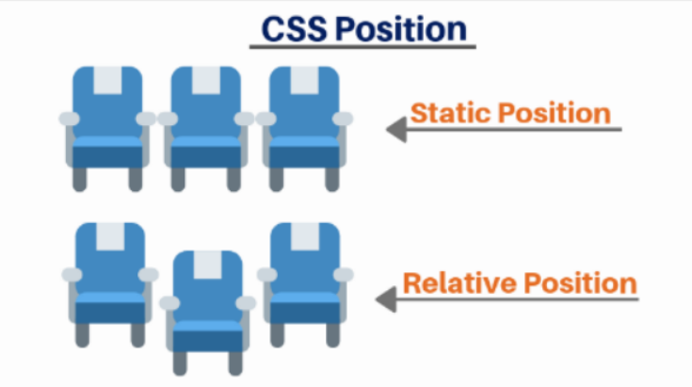

Slide 2
Position
The position CSS property sets how an element is positioned in a document.
The top, right, bottom, and left properties determine the final location of positioned elements.

Slide 3
Static position
The element is positioned according to the normal flow of the document.
The top, right, bottom, left, and z-index properties have no effect.
This is the default value of the position property.

Slide 4
An element with position: static; is not positioned in any special way; it is always positioned according to the normal flow of the page:
CSS code :
div.static { position: static; border: 3px solid #73AD21; }
This <div> element has position: static;

Slide 5
Relative Position
The element is positioned according to the normal flow of the document, and then offset relative to itself based on the values of top, right, bottom, and left.
The top and bottom properties specify the vertical offset from its normal position.
the left and right properties specify the horizontal offset.

Slide 6
Setting the top, right, bottom, and left properties of a relatively-positioned element will cause it to be adjusted away from its normal position. Other content will not be adjusted to fit into any gap left by the element.
This <div> element has position: relative;
CSS code:
div.relative { position: relative; left: 30px; border: 3px solid #73AD21; }

