Slide 1
Data Science Salaries: How Experience, Role, and Location Shape Compensation
Charity Smith
09 March 2025
MSDS670 Data Visualization

Slide 2

Research Question
What are the salary trends, distributions, and factors affecting compensation in data science roles globally?
Goal: uncover insights for professionals and employers.

Slide 3
Data
Data Science Job Salaries (from Kaggle)
Dataset contains global salary information for data science roles.
Includes salary, job title, experience level, company location.
work_year | experience_level | employment_type | job_title | salary | salary_currency | salary_in_usd | employee_residence | remote_ratio | company_location | company_size
2023 | SE | FT | Principal Data Scientist | 80000 | EUR | 85847 | ES | 100 | ES | L
2023 | MI | CT | ML Engineer | 30000 | USD | 30000 | US | 100 | US | S
2023 | MI | CT | ML Engineer | 25500 | USD | 25500 | US | 100 | US | S
2023 | SE | FT | Data Scientist | 175000 | USD | 175000 | CA | 100 | CA | M
2023 | SE | FT | Data Scientist | 120000 | USD | 120000 | CA | 100 | CA | M
2023 | SE | FT | Applied Scientist | 222200 | USD | 222200 | US | 0 | US | L

Slide 4

Methodology
Data Aggregation & Processing: Grouped salary data by job title, experience level, and country to analyze trends.
Visualization Techniques: Used bar charts, box plots, line charts, and a choropleth map to highlight key salary insights.
Comparison & Insights: Compared salaries across roles, locations, and experience levels to identify patterns in pay distribution.

Slide 5
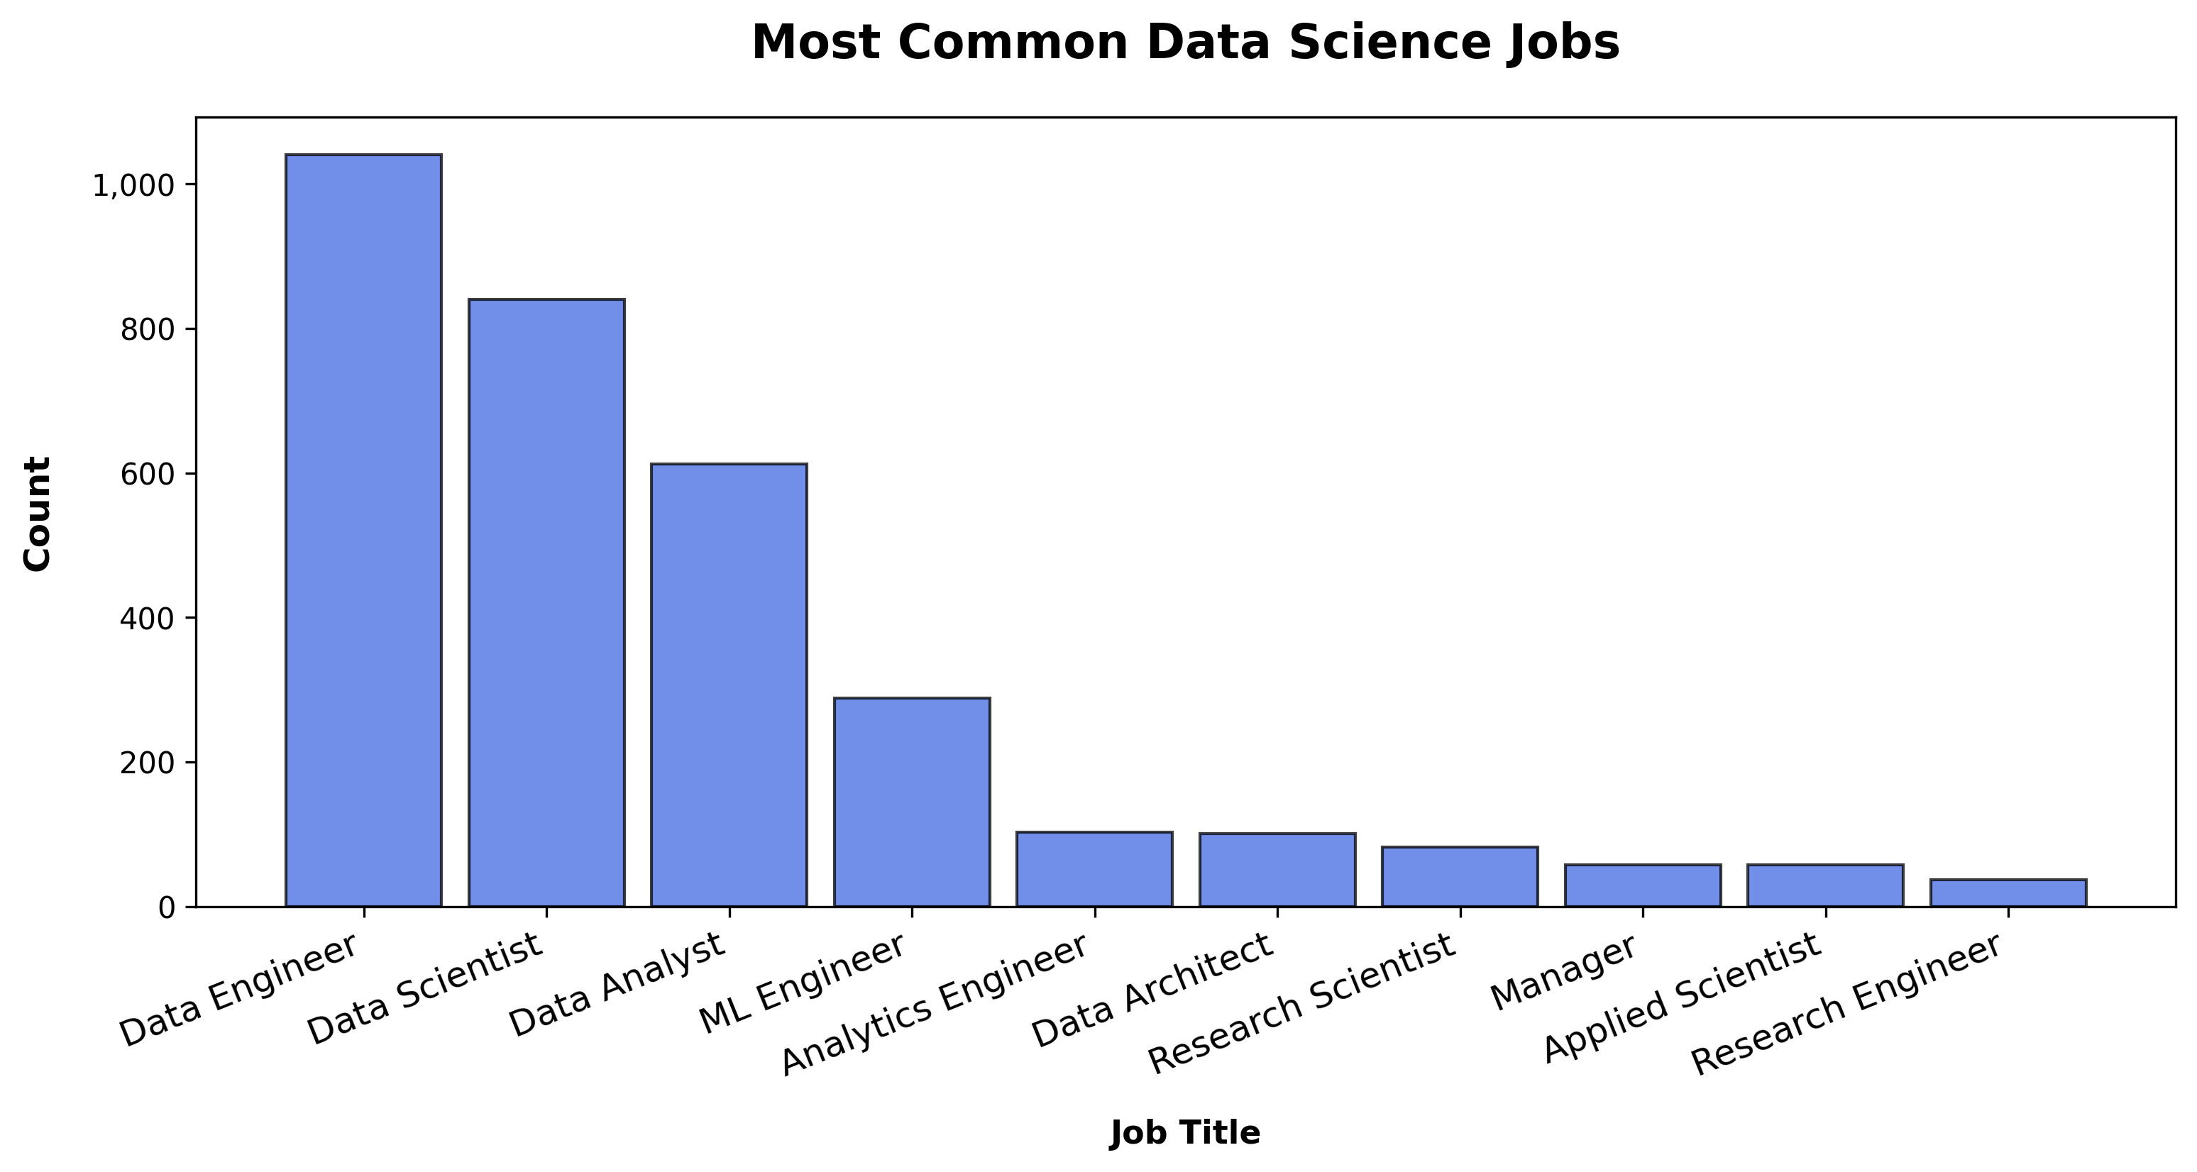
Most Common Data Science Jobs
Data Engineer, Data Scientist, and Data Analyst dominate.
ML Engineer is also a highly common role.
Understanding role prevalence helps contextualize job trends.

Slide 6
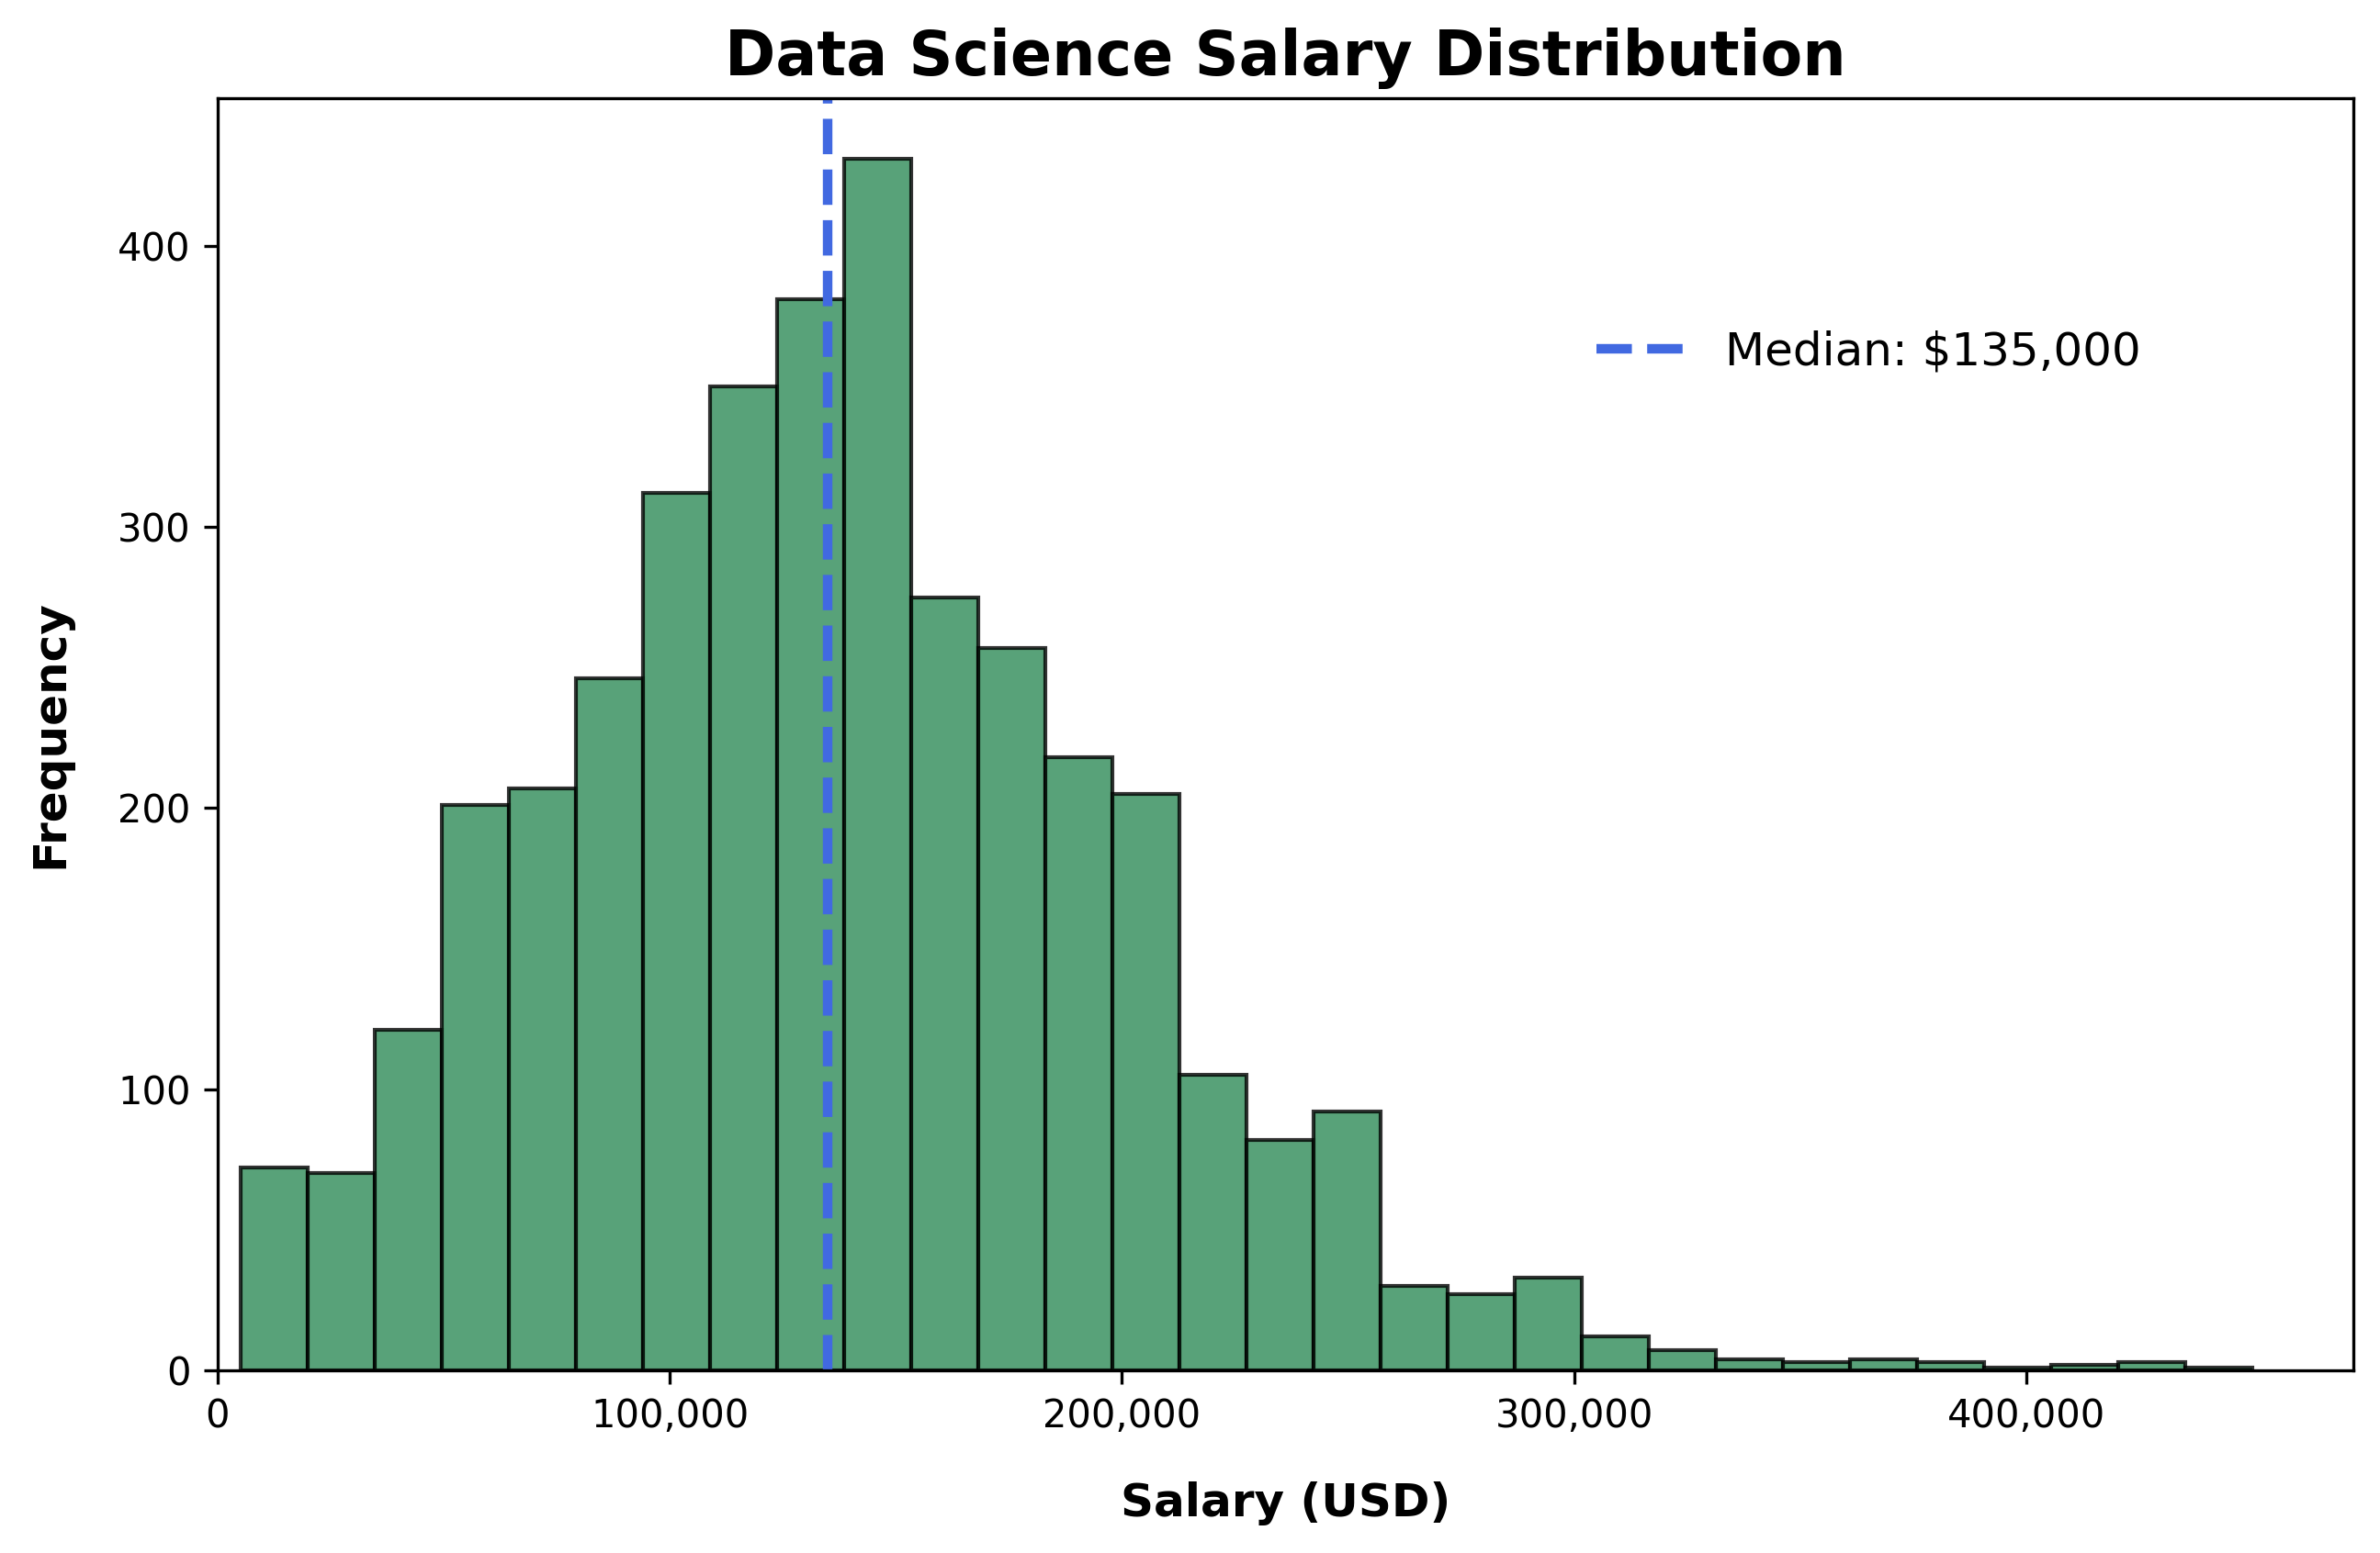
Salary Distribution Across All Data Science Jobs
Most salaries cluster around $100,000 - $150,000.
A few high salaries exist, but the median is a better indicator.
The distribution is skewed, showing some exceptionally high earners.

Slide 7
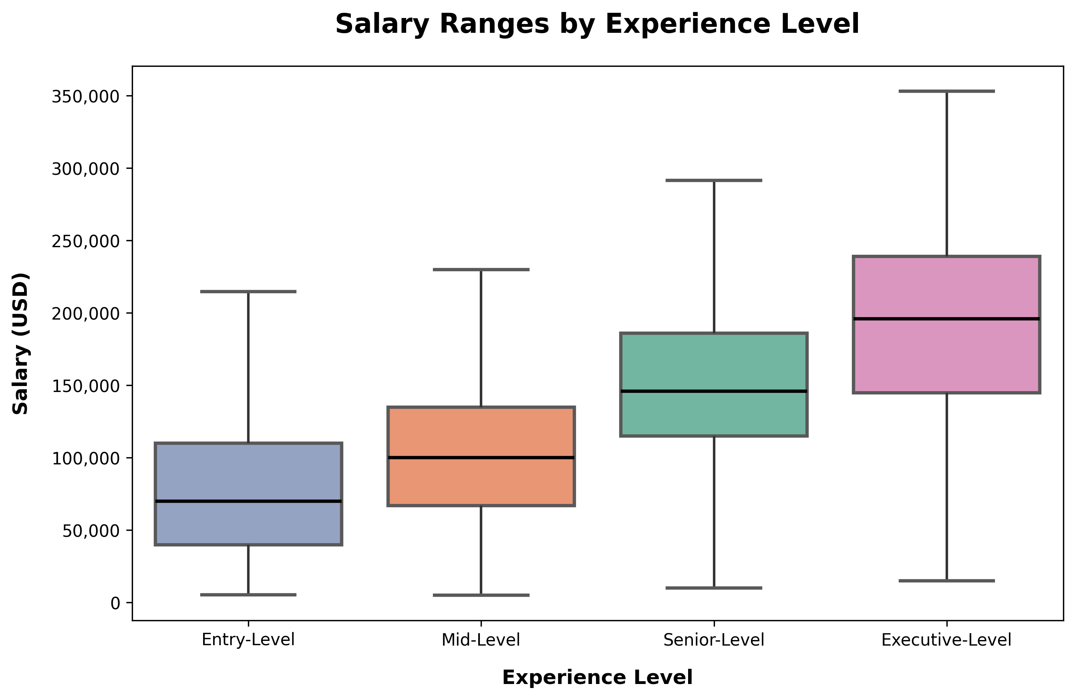
Salary Distribution by Experience Level
The pay gap widens significantly with experience.
Mid-level and senior roles see steady salary growth.
The interquartile range (IQR) expands at higher experience levels.

Slide 8
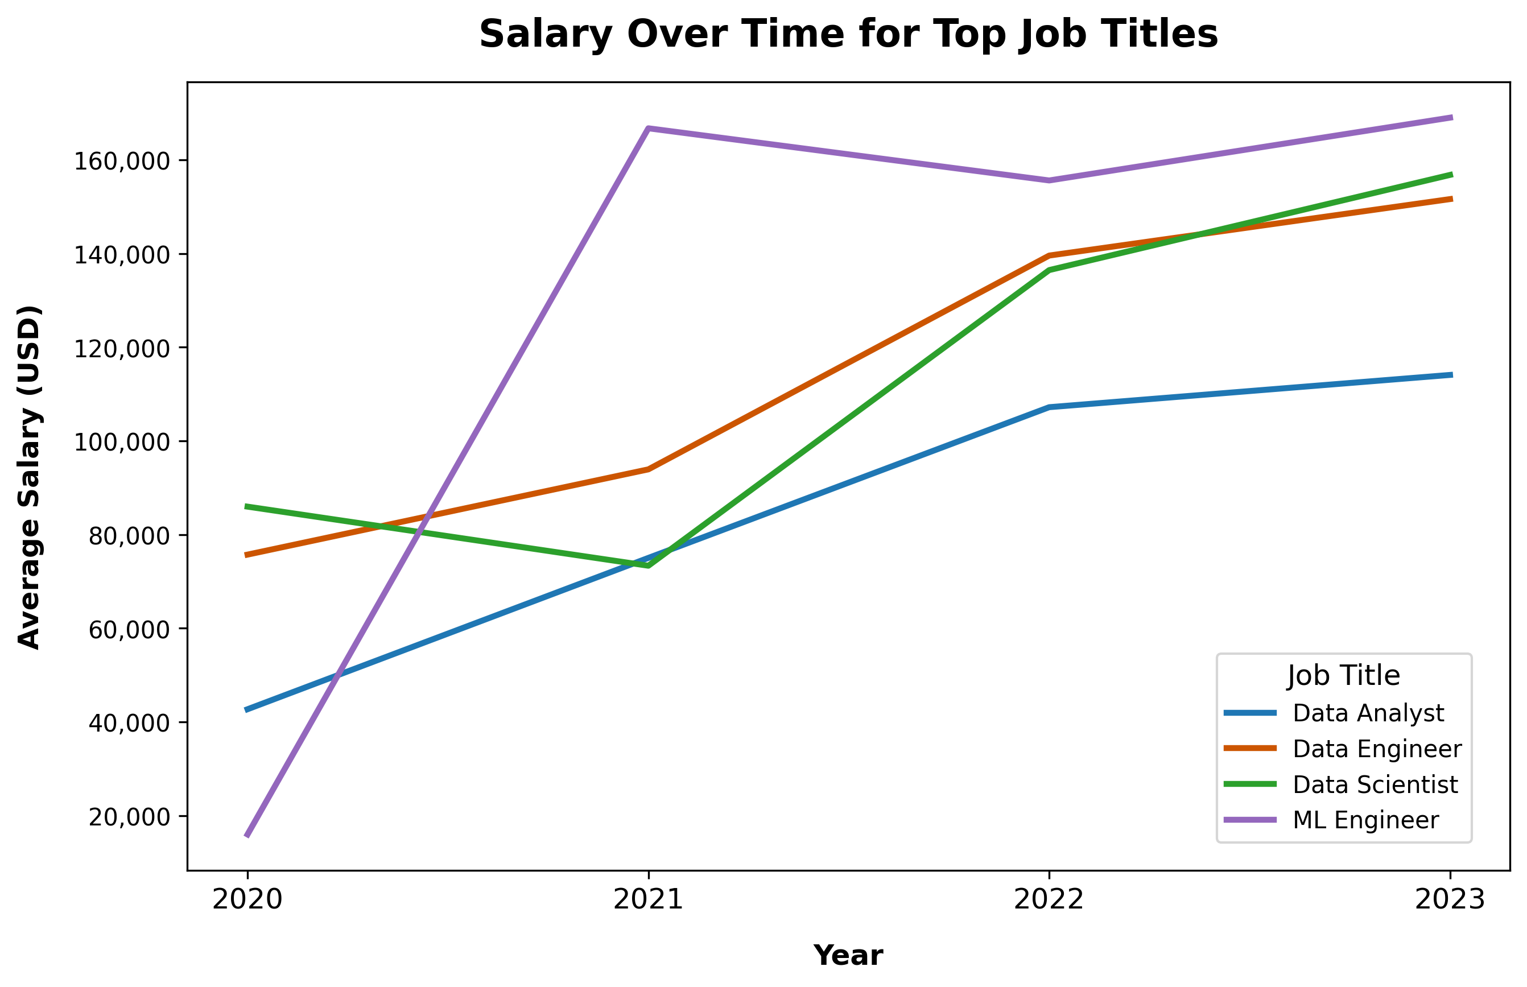
Salary Growth Over Time for Top Job Titles
Machine Learning Engineers have the highest and fastest salary growth.
Data Scientists and Data Engineers see strong, consistent increases.
Data Analysts remain the lowest-paid but show steady progress.

Slide 9
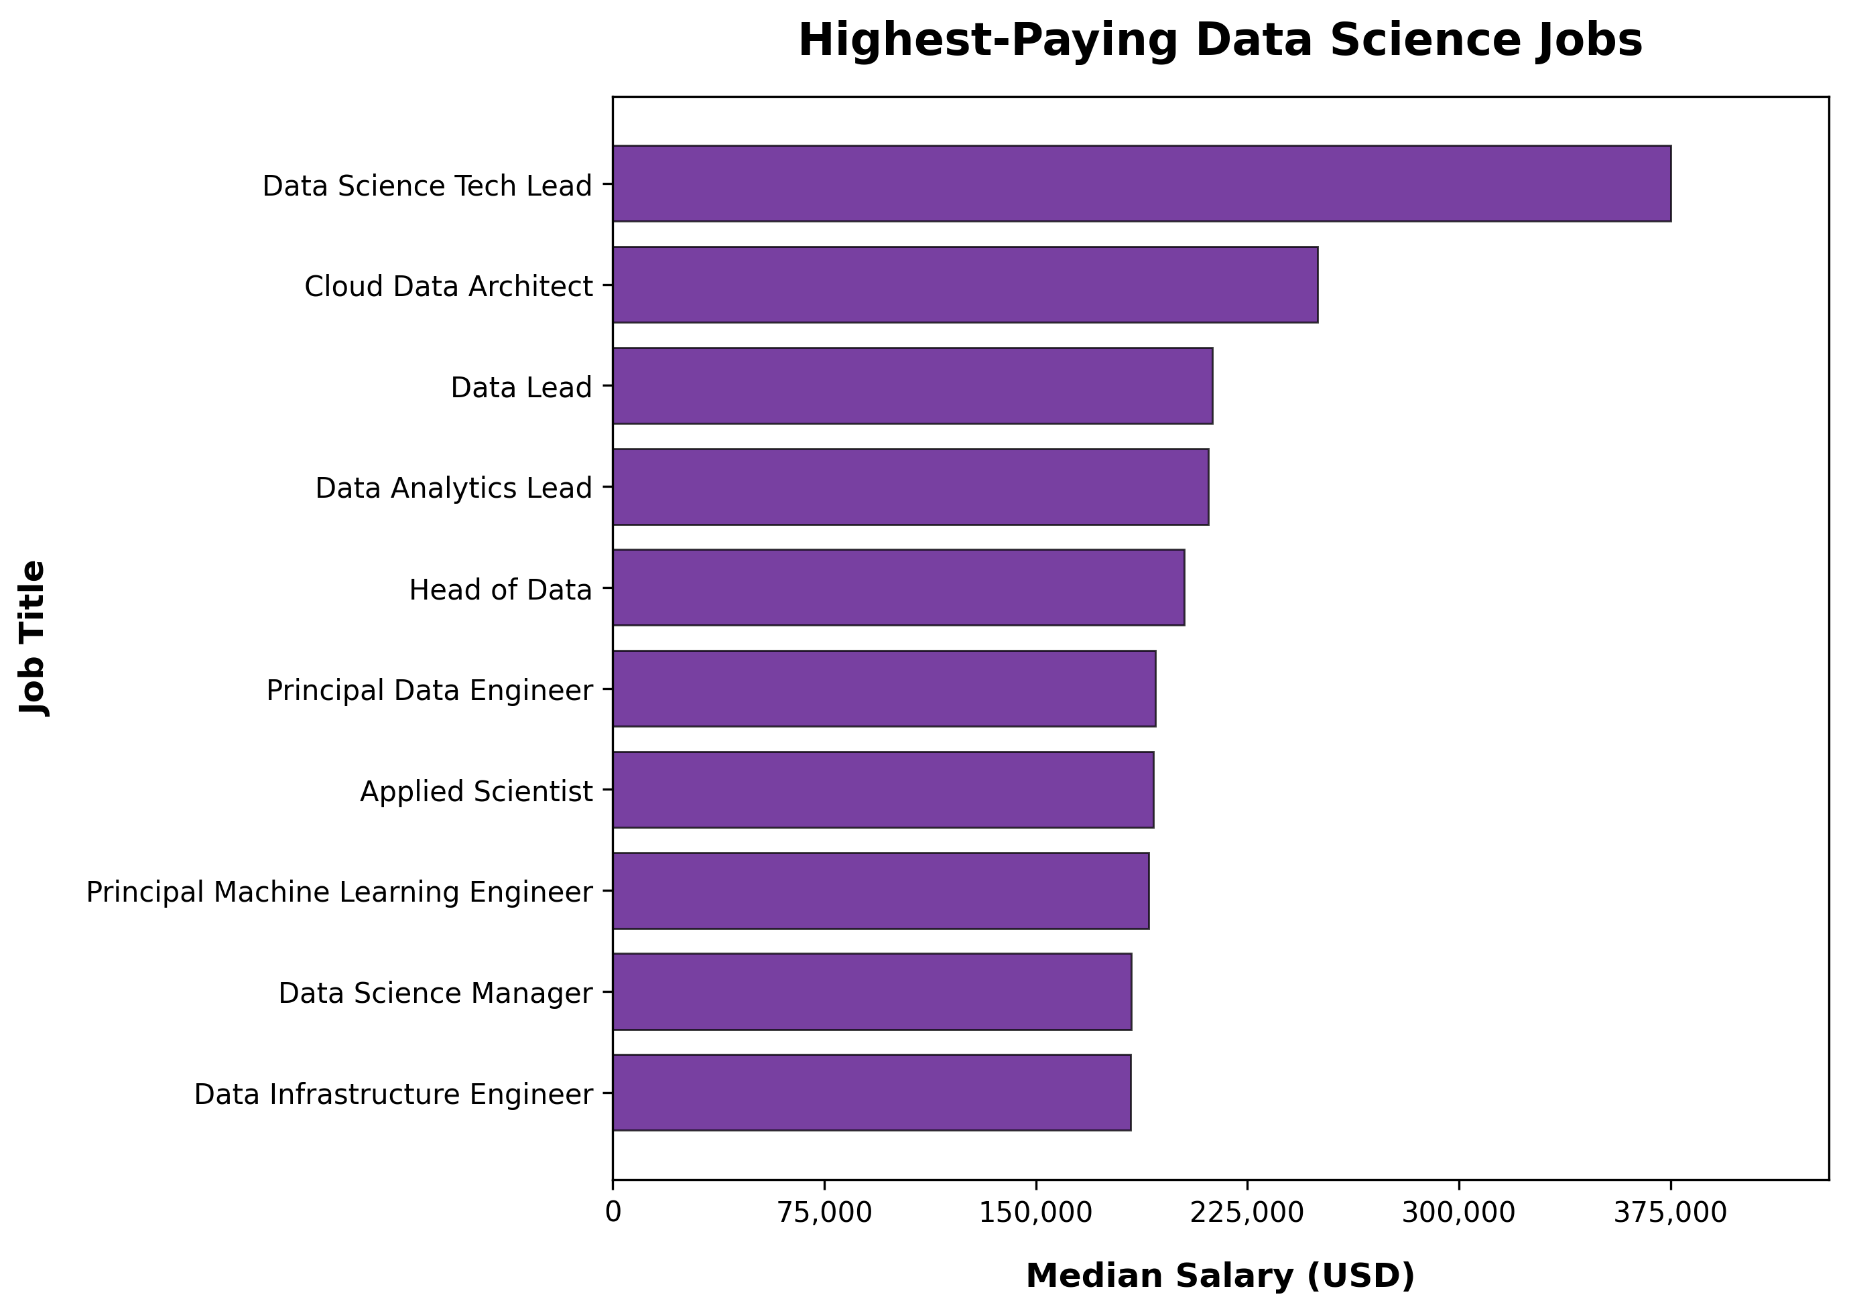
Highest Paying Data Science Job Titles
Leadership and specialized technical roles ("Data Science Tech Lead" and "Cloud Data Architect") pay the highest.
Engineering and applied science roles also rank highly.
Advanced technical skills yield premium compensation.

Slide 10
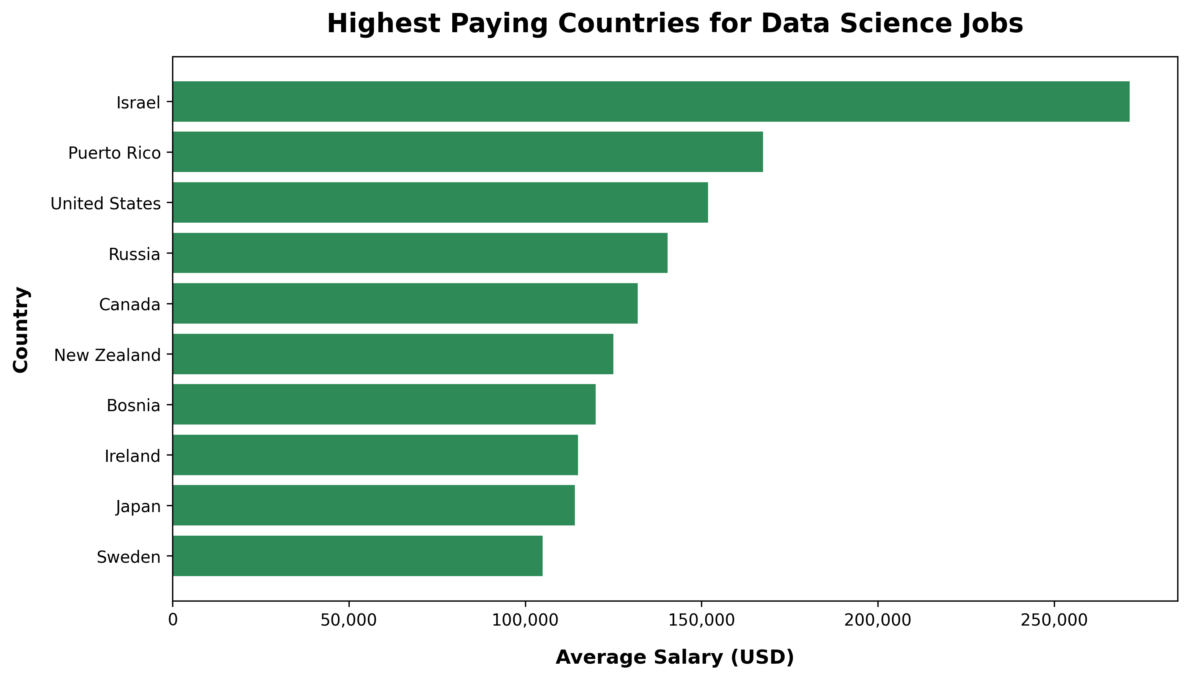
Highest Paying Countries for Data Science Jobs
Israel, Puerto Rico, and the U.S. lead in data science salaries.
Differences likely due to cost of living, demand, and industry hubs.
Understanding geography helps professionals and recruiters.

Slide 11
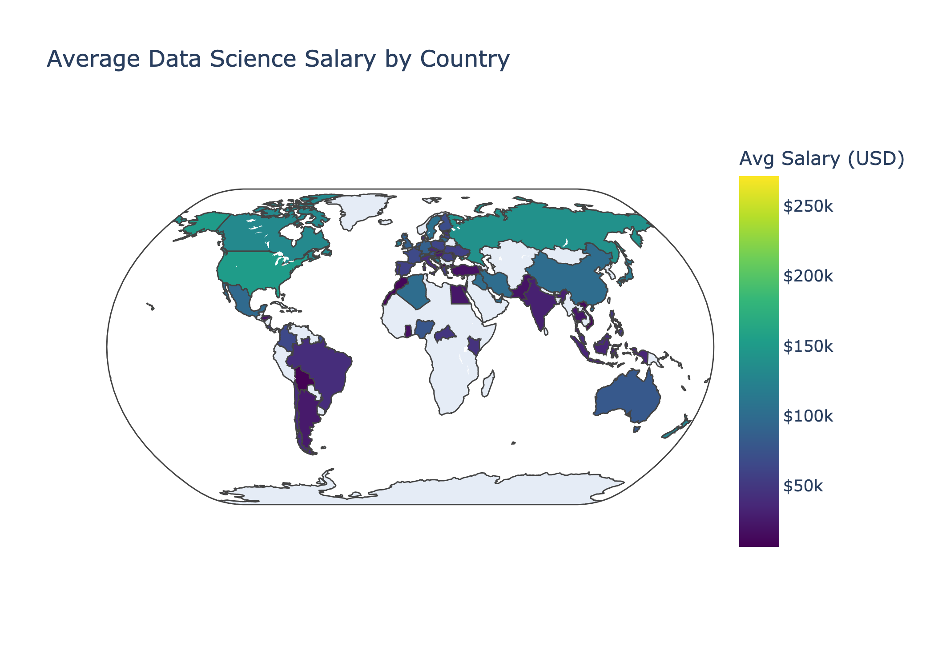
Global Salary Trends
Salaries vary significantly by region.
North America, Europe, and parts of Asia show higher salaries.
Developing countries tend to have lower salaries.

Slide 12

Conclusions
Experience and job role play a major role in salary differences.
Salary growth is strongest in technical and leadership roles.
Location remains a key factor, with the U.S. and Israel leading in pay.
These insights can guide salary negotiations and career planning.

