Slide 1
Influence of scripting programming
Presented by: Carlo Gaballo

Slide 2
Presentation Objectives
Writing,
Debugging, and
Testing Scripts with Selection, Repetition, and Parameter Passing

Slide 3
What is Scripting Programming?
It is a high-level language focusing on automation, simplicity, and rapid development. Code is interpreted line by line, enabling immediate execution.

Slide 4
Importance of Scripting Programming
Rapid Prototyping
Automation
Simplicity
Web Development
System Administration

Slide 5
Scripting language overview

Slide 6
Scripting Languages Overview
JavaScript:
Web Development: Dynamic and interactive web applications (client-side and server-side).
Influence: Powers modern web browsers, ensuring seamless user experiences.
Python:
Automation: Automating tasks and scripting for efficiency.
Data Analysis: Dominates data science and analytics with libraries like Pandas.
Influence: Key player in data science, machine learning, and automation.
Ruby:
Web Development: Developer-friendly web framework - Ruby on Rails.
Influence: Strong presence in scalable web applications for startups and tech companies.
.

Slide 7
Key Concepts in Scripting Programming

Slide 8
Key Concepts in Scripting Programming
Selection
Repetition
Parameter Passing

Slide 9
What is Selection?
Selection refers to the ability to make decisions in a program. In JavaScript, this is typically done using if, else if, and else statements. These conditional statements allow you to execute different blocks of code based on specific conditions.

Slide 10
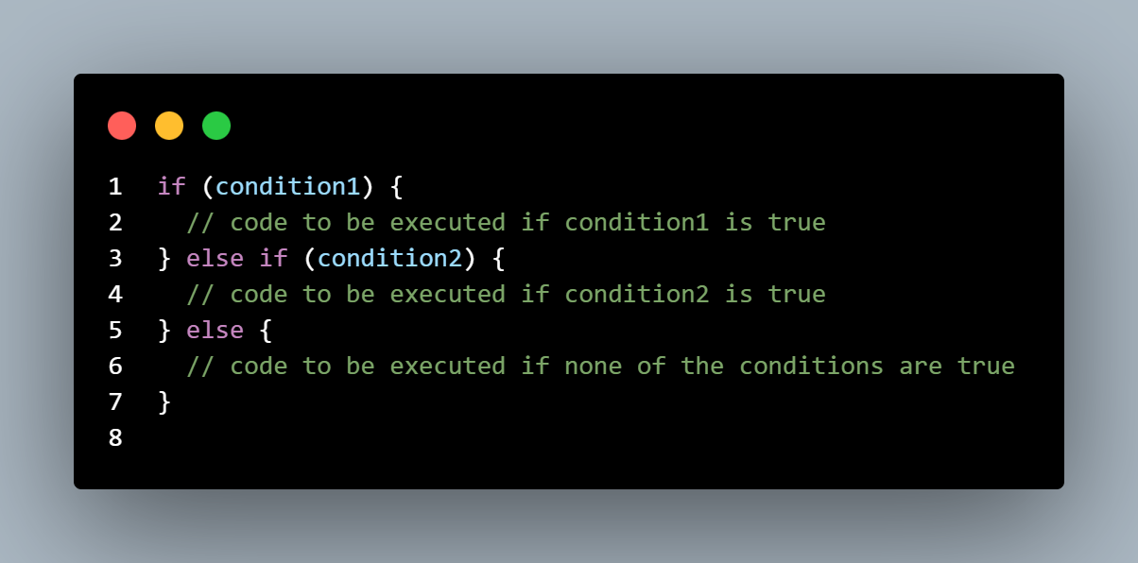
Selection: Conditional Statements
if Statement: Executes a block of code if a specified condition is true.
else if Statement: Adds more conditions to the if statement for alternative execution.
else Statement: Specifies a block of code to be executed if the conditions of the if statements are false.

Slide 11
What is Repetition?
Repetition involves executing a block of code multiple times. In JavaScript, loops like for, while, and do-while are used for repetition.

Slide 12
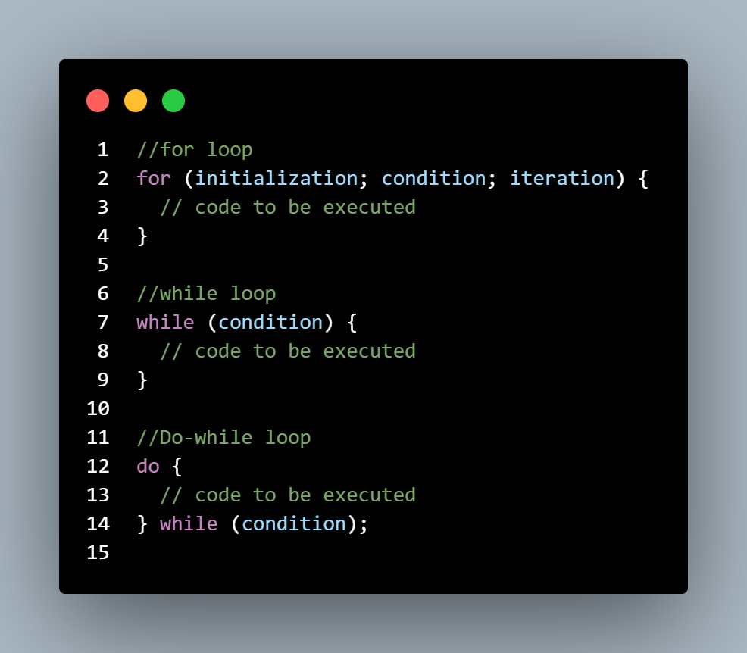
Repetition: Loop Structures
for Loop: Executes code a specified number of times, defining the initialization, condition, and iteration statement.
while Loop: Executes code as long as a specified condition is true, allowing flexibility in loop initiation.
do-while Loop: Similar to the while loop, but guarantees the code inside the loop will be executed at least once.

Slide 13
What is Parameter Passing?
Parameter passing involves passing data (parameters) to functions in JavaScript. Functions can receive parameters, process them, and return results.

Slide 14
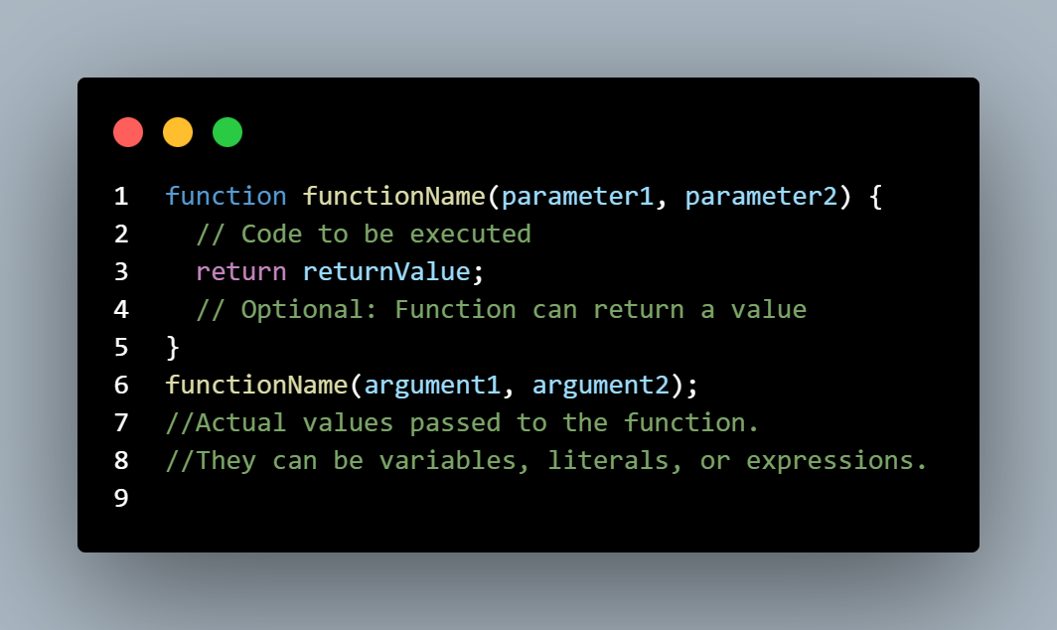
Parameter Passing: Functions and Function Parameters
Functions: Blocks of reusable code; can accept parameters and return values.
Function Parameters: Values passed to a function, allowing dynamic data processing.
Arguments vs. Parameters: Arguments are the actual values passed into a function, while parameters are the variables that accept the arguments.

Slide 15
Writing and Testing Scripts
with Selection, Repetition, and Parameter Passing

Slide 16
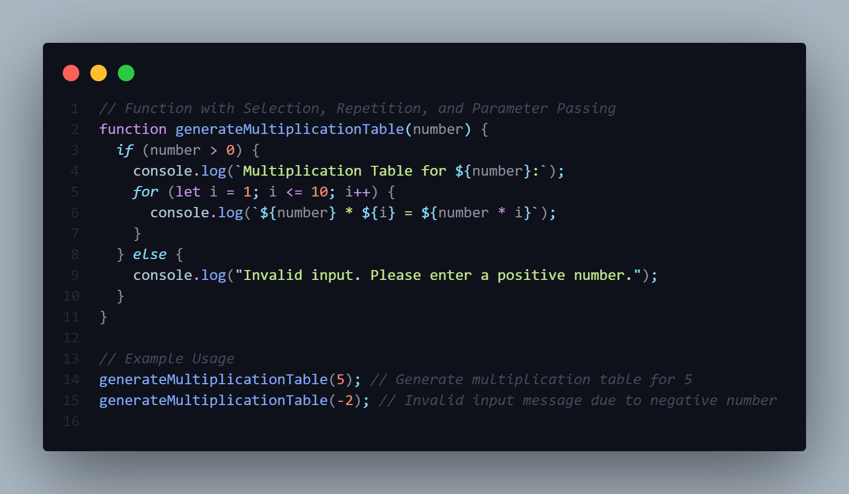
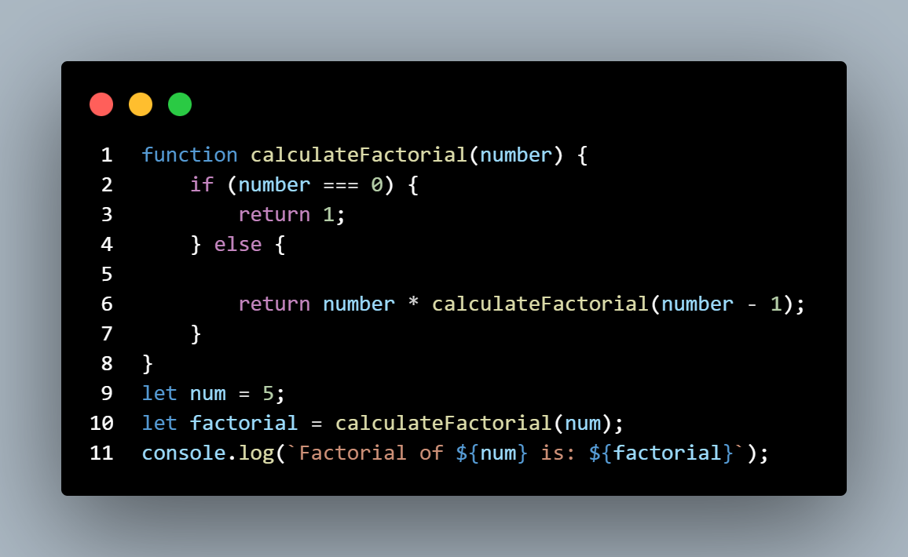

Slide 17
Debugging

Slide 18
What is Debugging?
Debugging is the process of identifying, fixing, and eliminating errors (bugs) in software code. It is a crucial skill in programming because errors are inevitable, and finding and fixing them is essential to ensure that a program functions correctly.

Slide 19
Common Errors in Programming
Syntax Error
Runtime Error
Logic Error

Slide 20
What is Syntax Error?
Syntax errors occur when the code violates the rules of the JavaScript language. They are typically detected by the JavaScript interpreter before the code is executed. Syntax errors prevent the program from running and need to be fixed for the code to be valid.

Slide 21
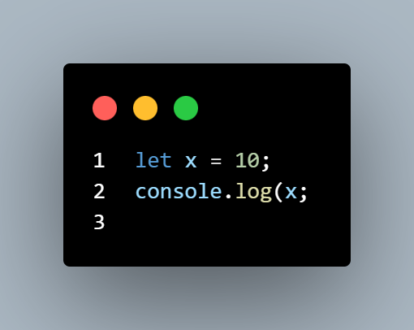
Syntax Error
In this example, there's a missing closing parenthesis ) in the console.log() statement. When you run this code, you'll encounter a syntax error because the syntax of the statement is incorrect.

Slide 22
What is Runtime Error?
Runtime errors occur during the execution of the code. They happen when the JavaScript interpreter encounters an unexpected condition that prevents it from continuing to execute the code. Runtime errors do not stop the entire program; they only interrupt the specific part of the code where the error occurred.

Slide 23
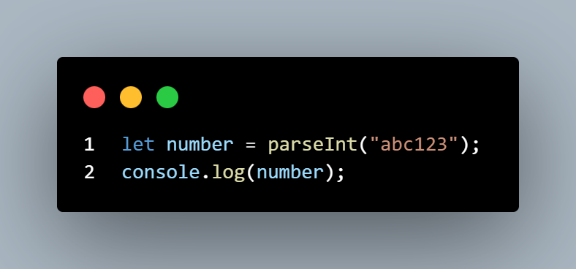
Run Time Error
In this example, parseInt("abc123") attempts to convert the string "abc123" into an integer. However, since the string contains non-numeric characters, it cannot be converted to a valid number. As a result, the parseInt function returns NaN (Not a Number), which is a special value in JavaScript indicating an invalid numeric operation.

Slide 24
What is Logical Error?
Logical errors occur when the code does not produce the expected output due to incorrect logic. Unlike syntax and runtime errors, logical errors do not generate error messages or warnings. The program runs without issues, but it doesn't behave as intended.

Slide 25
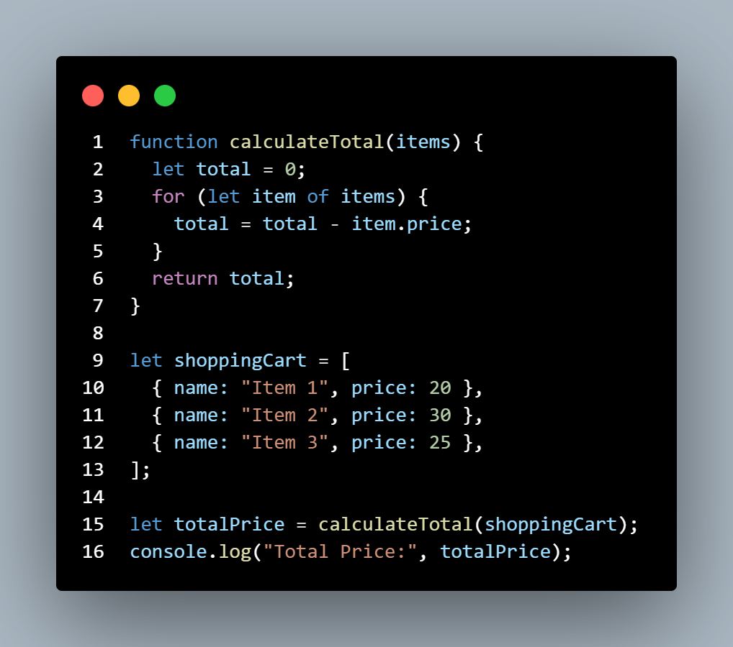
Logic Error
In this example, there's a logic error in the calculateTotal function. Instead of adding the item prices to the total, it subtracts them. As a result, the totalPrice variable contains an incorrect value. This type of error can be challenging to spot because the code runs without any errors, but the output is unexpected due to flawed logic.

Slide 26
Debugging Strategies
Console.log: Inserting log messages to trace the flow and values of variables.
Debuggers: Using built-in browser debuggers or IDE tools for step-by-step code inspection.
Code Reviews: Collaborative analysis by peers to catch errors and improve logic.

Slide 27
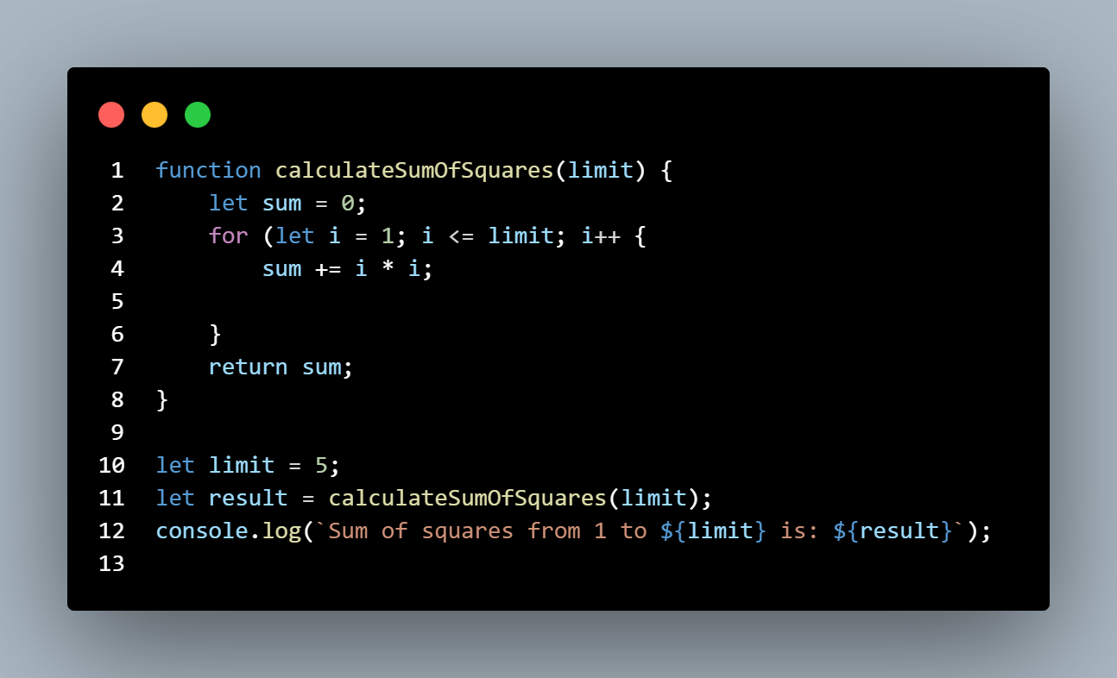

Slide 28
Conclusion and Takeaways

Slide 29
Conclusion and Takeaways
Key Points Summary
Scripting languages enable automation, web development, and data analysis.
Selection, repetition, and parameter passing are fundamental concepts in scripting.
Understanding syntax, debugging, and testing are crucial for script reliability.
Importance of Mastering Concepts
Selection: Enables decision-making, optimizing program flow.
Repetition: Streamlines tasks, enhancing efficiency and productivity.
Parameter Passing: Enhances modularity, making code flexible and reusable.

Slide 30
Thank you
FOR LISTENING THAT’S ALL

