Slide 1
Optosurf simulation

Slide 2
Gaussian function definition

Slide 3
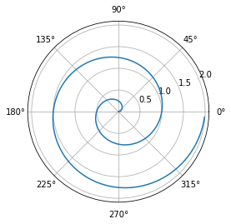
Equation dcsdc definition and window integration
The Gaussian Equation is defined as: $y=e^{−{\left(\left(x−μ\right)/σ\right)}^{n}}$“. The python was coded as:
Unable to display output for mime type(s): text/html
Unable to display output for mime type(s): application/javascript, application/vnd.bokehjs_exec.v0+json

Slide 4
Unable to display output for mime type(s): text/html
Unable to display output for mime type(s): application/javascript, application/vnd.bokehjs_exec.v0+json
Unable to display output for mime type(s): application/javascript, application/vnd.bokehjs_load.v0+json
Unable to display output for mime type(s): text/html
Unable to display output for mime type(s): application/javascript, application/vnd.bokehjs_exec.v0+json

Slide 5
Window integration
The optosurf head has a 32 pixels line detectors. This is simulated by performing a window integration:

