Slide 2
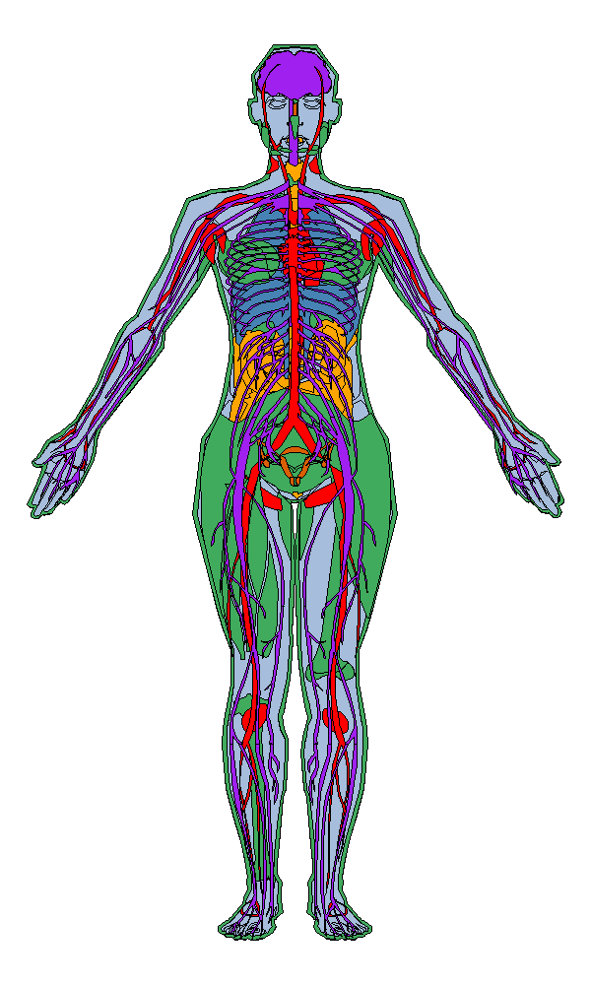
10 brain regions,
1 nerve, & pituitary gland
Spinal cord
Thyroid
Minor salivary gland
3 esophagus
Lung
2 heart & 3 arteries
Liver
Breast
Pancreas
Adrenal gland
Spleen
Kidney
Stomach
Ovary, uterus
prostate, testis,
& vagina
Small intestine
2 colon
2 adipose tissue
Skeletal muscle
2 skin, whole blood, &
2 transformed cells

