Slide 1
Travelytics
Project 1
Team Members: Charles Lee, Kristen N. Broersma, Cynthia Wonsch, Jimmy Fung

Slide 2

Motivation & Summary
We are trying to find Americans’ travel preferences and the reasons that influence their destination choice.
Null Hypothesis: Travel advisories have no effect on Americans traveling abroad.
Alternative Hypothesis: If travel advisories are considered then the number of Americans traveling abroad should decline in the year going forward.

Slide 3

Data Analysis
What are the Top 10 Travel destinations of Americans traveling abroad?
Do travel advisories affect the decision making of Americans traveling abroad?
Does weather influence the decision making process of picking a place to travel?
Found top 10 travel destinations based on monthly number of travelers.
Searched within the travel advisory the number of mentions per destination and ran a T-Test.
We visualized travel data for all 10 destinations year by year.
Used a linear regression to compare temperature and passenger number.
We analyzed rain to explain anomalies.

Slide 4

Data Cleanup & Exploration
Merging Data and Aggregation
Data Request
Isolating Flights to Foreign Nations
Ranking Destinations
Travel Advisory JSON
Types of Advisories
Determining Negative Advisory
Travel Update Status
Travel Advisory Output Dictionary
Data Plots
Temperature/Rainfall Data

Slide 5
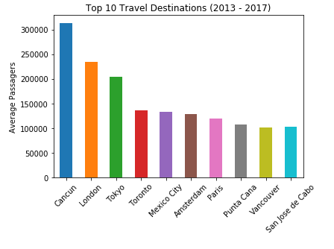
Top 10 Travel Destinations for Americans going abroad
Cancun, Mexico
London, England
Tokyo, Japan
Toronto, Canada
Mexico City, Mexico
Amsterdam, The Netherlands
Paris, France
Punta Cana, Dominican Republic
Vancouver, Canada
San Jose Del Cabo, Mexico

Slide 6

Weather’s impact on Travel
We ran 10 regressions on Temperature Vs. Travel
Out of the top ten cities, 7 had a positive correlation between temperature and travel.
The 3 cities that had a negative correlation were Mexican beach destination cities.

Slide 7
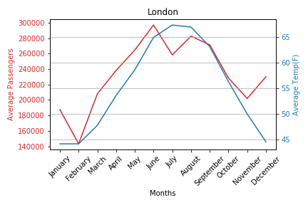
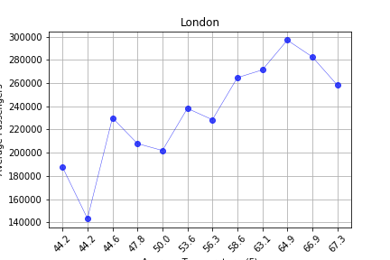
Similar patterns in:
Tokyo, Toronto, Amsterdam, Paris, Vancouver
Temperature vs. Number of Passengers

Slide 8
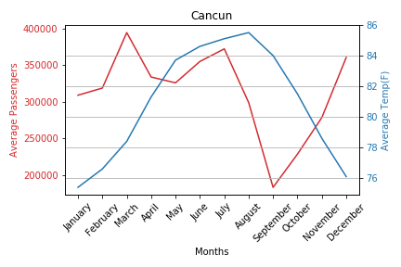
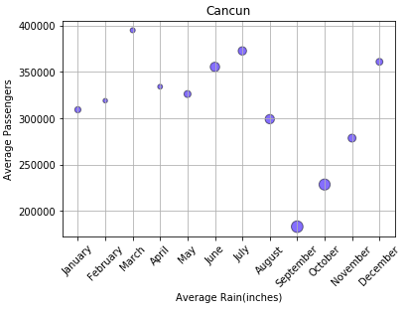
Similar patterns in:
Punta Cana, San Jose del Cabo
Rain vs. Number of Travelers

Slide 9

Discussion
We expected to find a greater influence from travel advisories on the destination choice by Americans.
We expected that travel advisories would decrease passenger number to those destinations.
There are other more important factors influencing the destination choice.
We found out temperature had a greater impact in decision.

Slide 10

In Conclusion
We were unable to reject our Alternative hypothesis .
Linear regressions shows that travel patterns correlates to temperature, with the exceptions of a few anomalies.
Majority of anomalies can be explained by rain.

Slide 11

Post mortem
Obtaining free historical weather data.
We used manual-wikipedia lookups pertaining to weather.
Manipulating dataframes.
Data formatting, for historical values. (JSON)
Finding the best way to determine the if travel advisory has a positive or negative effect, and determining what the advisory states.
Find the best way to automate the process.
Further analysis of Mexico City

Slide 12
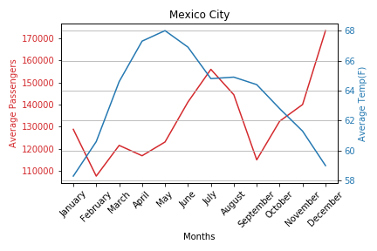
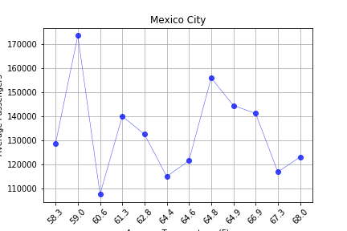
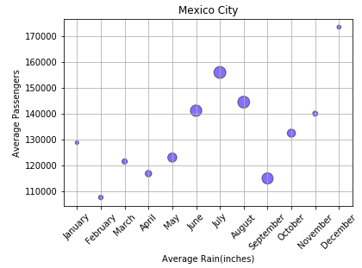

Slide 13

Questions

