Slide 1
How to Gamify Technical Debt and Introduce Change Successfully
Jason Jones, M.S.
Intermountain Healthcare

Slide 2
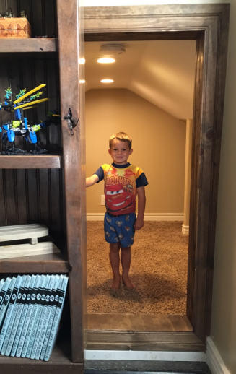

About me?
Software Engineering Supervisor @ Intermountain Healthcare
Interested in Change; What’s new?
Like to build things (Deck, hidden room)
WVC Planning Commissioner
HOA Board -> Built $430k pool
Cycling- 100 & 200 mile races
Passionate about eradicating child trafficking
www.theAbolitionistsMovie.com
www.OURrescue.org

Slide 3
News
News sensational & often negative (grabs attention)
Earthquakes, Tsunamis, Droughts, Tornados
Poverty
Gender Education Gap
Shootings & Violence
Human Trafficking traps 26 million people
2 Million are sexually exploited children
Example: Niece & 9/11
“People kept crashing into buildings all day long”

Slide 4

Hans Gosling
2 Minute clip
https://www.ted.com/talks/hans_and_ola_rosling_how_not_to_be_ignorant_about_the_world

Slide 5
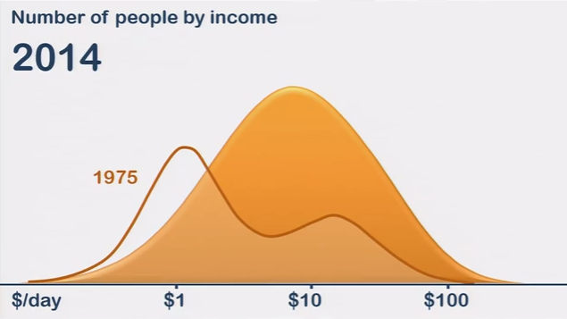
Life is Good
Most things are better today than ever in recorded history
Deaths from natural disasters:
1900: ~500,000 each year;
2014: = 22,452;
Years in school for boys & girls is approaching parity.
Violent crime in U.S. down dramatically since 1990.
Global poverty in last 20 years has been cut in half.
How not to be Ignorant About the World, Hans & Ola Rosling. https://www.ted.com/talks/hans_and_ola_rosling_how_not_to_be_ignorant_about_the_world
http://www.ifrc.org/world-disasters-report-2014/data

Slide 6
Change
Life is good because people like you and me decided to improve the world around us, and they succeeded.
Life is good, but we can make it better.
Who made New Year’s Resolutions for 2016?

Slide 7
Overview
Implementing Change: Hard or Easy? Resisted or Welcomed?
Patterns for successful, lasting Change
Gamification of Technical Debt at Intermountain Healthcare

Slide 8
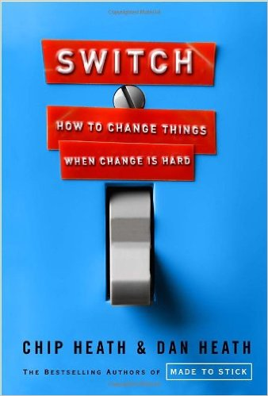

“Switch: How to Change When Change is Hard” “Happiness Hypothesis”

Slide 9
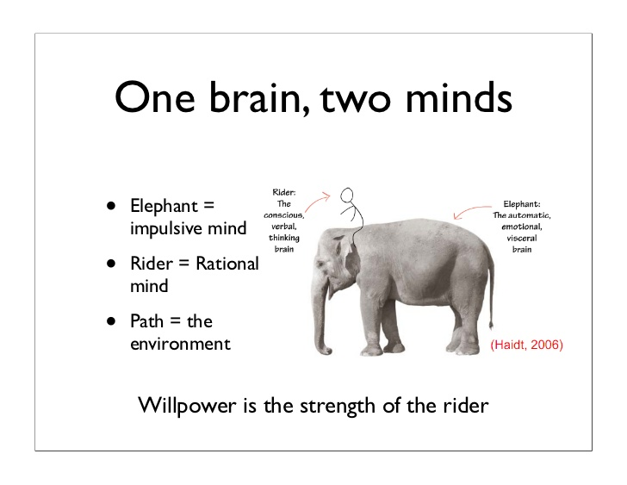
One Brain, Two Minds
“Using Neuroscience to Influence Behavior”, Stanford Business presentation

Slide 10
Elephant
Weaknesses
Lazy and skittish
Emotional and instinctive
Quick payoff (ice cream) over long-term vision (health, etc)
Instant gratification
Usually the cause of failed change efforts
Strengths
Emotional energy (compassion, loyalty, competition, etc)
Provides the passion to drive to completion
“To make progress toward a goal, whether it’s noble or crass, requires the energy and drive of the Elephant.” Switch.

Slide 11
Tim Urban
5 minute clip
https://www.ted.com/talks/tim_urban_inside_the_mind_of_a_master_procrastinator?language=en

Slide 12
Rider
Strengths
Ability to think long-term
Planning
Analysis
Weaknesses
Tendancy to over-think
Analysis paralysis
“If you reach the Riders of your team but not the Elephants, team members will have understanding without motivation. If you reach their Elephants but not their Riders, they’ll have passion without direction. In both cases the flaws can be paralyzing.” Switch

Slide 13
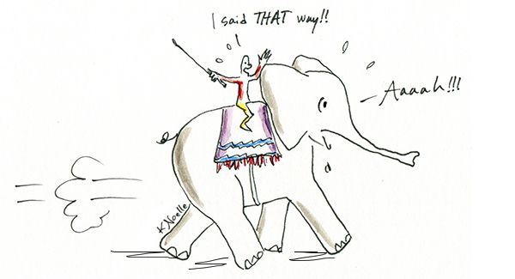
Appeal to both the Elephant and the Rider
“Anytime the six-ton Elephant and the Rider disagree about which direction to go the Rider is going to lose. He’s completely overmatched.” Switch, pg 7.

Slide 14
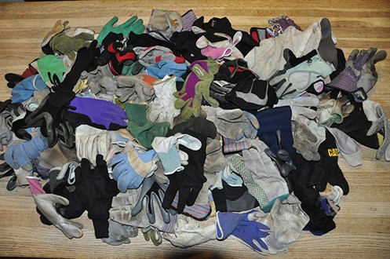
Glove Shrine
Jon Stegner had an idea to reduce costs by $1 Billion over 5 years.
V.P.’s didn’t buy into his plan
424 gloves in many different factories
Prices negotiated separately
$5 - $17 for same gloves
Emotional connection to Elephant then engage Rider

Slide 15
Path
Popcorn study
Stale, unlimited supply in 2 sizes
53% more popcorn, 173 calories, 21 handfuls
Taste study: radishes vs cookies
Geometric test: 8 minutes vs 19 minutes
“When people try to change things, they’re usually tinkering with behaviors that have become automatic, and changing those behaviors requires careful supervision by the Rider.”
“Change is hard because people wear themselves out… What looks like laziness is often exhaustion.” Switch

Slide 16
Successful Change Leader must do 3 things
Direct the Rider
Motivate the Elephant
Shape the Path

Slide 17
1. Direct the Rider
What looks like resistance is often a lack of clarity. So provide crystal-clear direction.
Find the Bright Spots
Script the Critical Moves
Point to the Destination

Slide 18
Find the Bright Spots
Vietnam malnutrition story, Jerry Sternin
6 months to improve child malnutrition
Poor sanitation
Poverty nearly universal
Clean water not readily available
Low understanding about nutrition
Government opposition & shoestring budget
Any kids bigger than average?
Why?

Slide 19

Destination Postcard
Destination postcards do double duty: They show the Rider where you’re headed,
and they show the Elephant why the journey is worthwhile.” Switch pg 82
Notes:
When you describe a compelling destination, you’re helping to correct one of the Rider’s great weaknesses—the tendency to get lost in analysis. Our first instanct, in most change situations, is to offer up data to people’s Riders: Here’s why we need to change. Here are the tables and graphs and charts that prove it. The Rider loves this. He’ll start pouring over the data…and he’ll be inclined to debate with you about the conclusions you’ve drawn. To the Rider, the ‘analyzing’ phase is often more satisfying than the ‘doing’ phase, and that’s dangerous for your switch. Notice what happens, though, when you point to an attractive destination: The Rider starts applying his strengths to figure out how to get there…”

Slide 20
2. Motivate the Elephant
What looks like laziness is often exhaustion. The Rider can’t get his way by force for very long. So it’s critical that you engage people’s emotional side. (Remember the Glove Shrine)
Find the Feeling
Shrink the Change
Grow Your People

Slide 21
Shrink the change
Business cliché “Raise the Bar” is wrong approach to motivate a reluctant Elephant.
Shrink the Change
“Make the change small enough that they can’t help but score a victory. Once people clean a single room, or pay off a single debt, their dread starts to dissipate, and their progress begins to snowball.” Switch, pg 134
Free car wash card study: 8 stamps vs 10.
56% more & faster success

Slide 22
3. Shape the Path
What looks like a people problem, is often a situation problem. (Think of shrinking movie popcorn buckets)
Tweak the Environment (Factory equipment safety)
Build Habits
Rally the Herd
Keep the Switch Going

Slide 23

Case Study
Case Study: Opportunity to put Change principles into practice
Still a work in progress
Challenges
Engineering reorganization created orphaned applications
Hundreds of applications (some unknown)
Dramatic differences and micro cultures within new engineering department
Various levels of documentation from none to some
~20% have Bamboo (continuous integration) builds
How do you motivate teams to reduce technical debt?
How do you motivate teams to take ownership of documenting old apps—especially the orphaned apps?

Slide 24
Interns
We didn’t.
We hired interns.

Slide 25
Shape the Path @ Intermountain
Interns to track down details on orphaned apps
Leverage existing tools (SVN/Git, Confluence, Bamboo, Sonar)
Auto-generated Confluence pages
Create transparency on technical debt

Slide 26

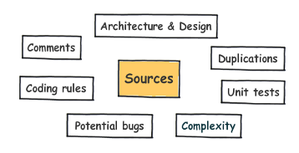
SonarQube
20+ Languages supported

Slide 27
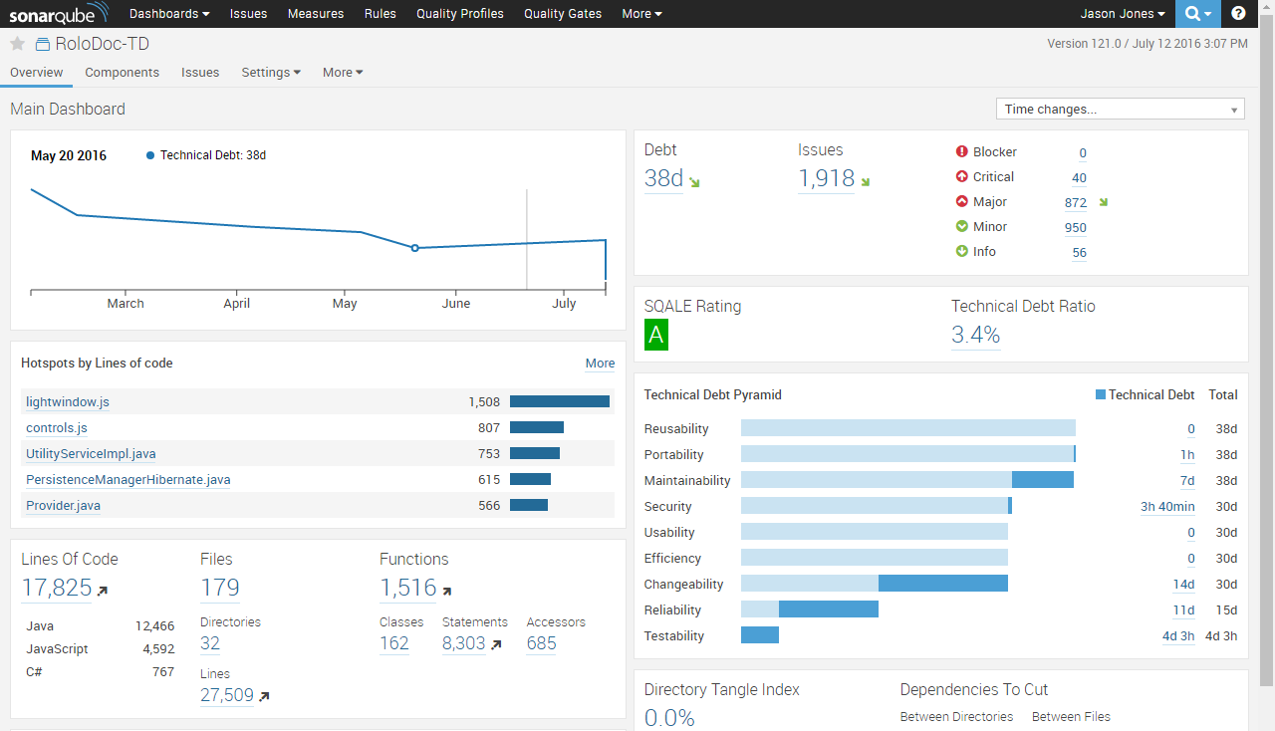

Slide 28
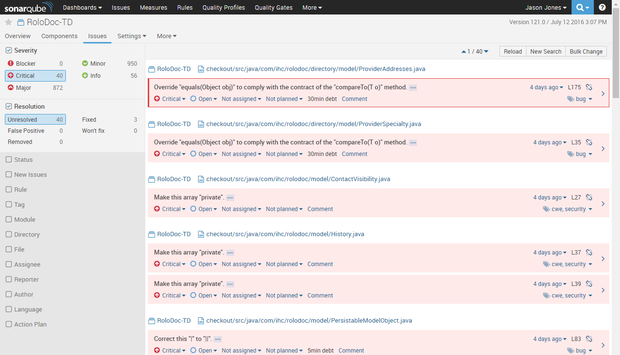

Slide 29
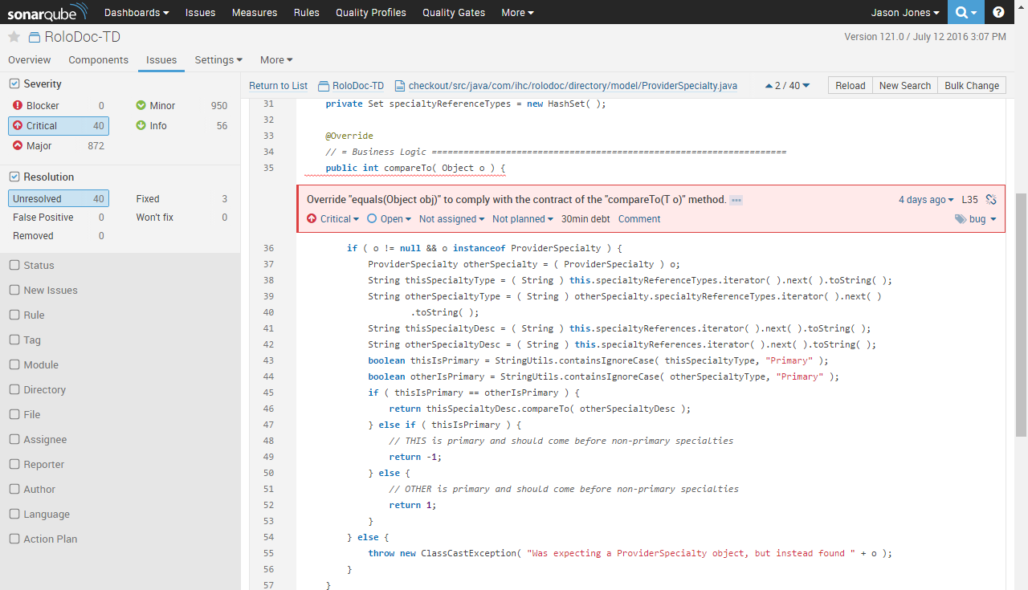

Slide 30
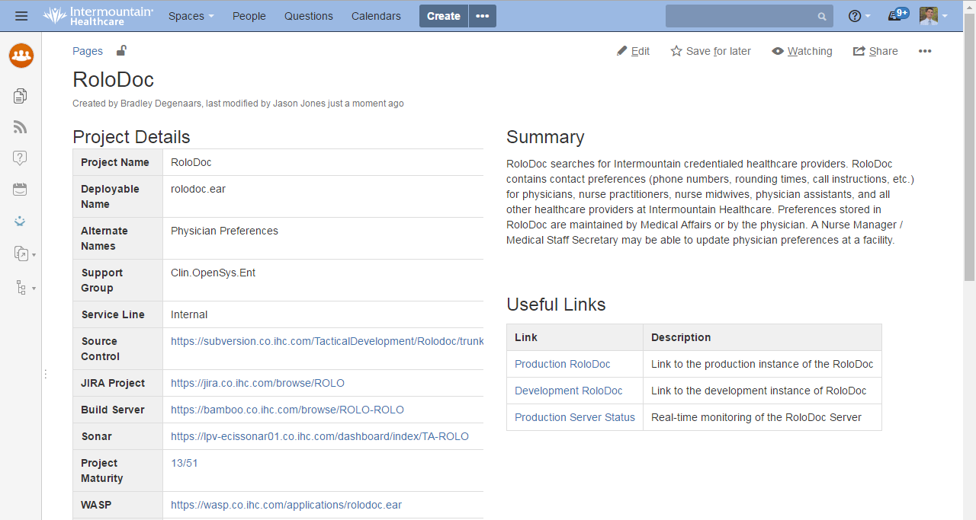

Slide 31
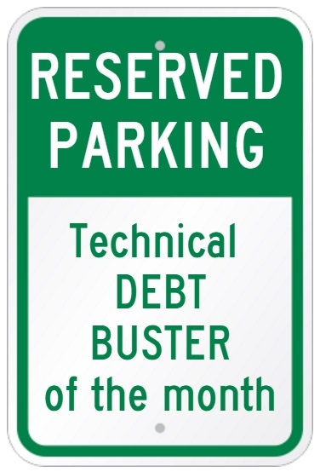
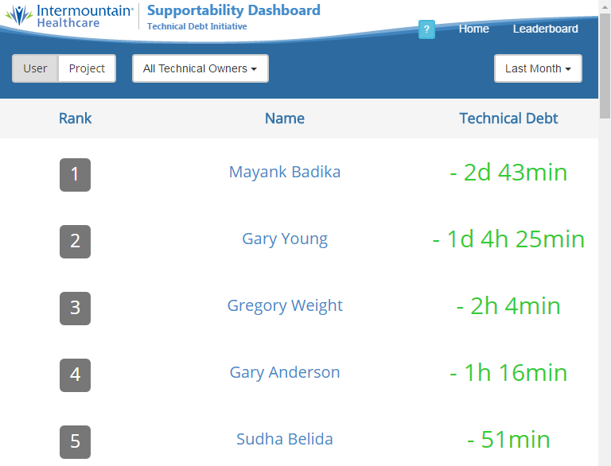
Motivate the Elephant @ Intermountain
Motivate the Elephant
Technical Debt Buster of the Month parking
Leaderboards monitors

Slide 32
Direct the Rider @ Intermountain
Supportability Dashboard
1 stop shopping for application metadata
Auto generated from existing Confluence documentation
Stats dashboards
Project Debt History
Individual contributions to technical debt with each commit

Slide 33
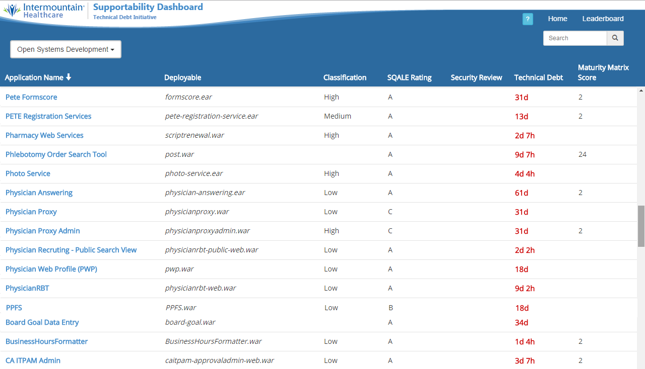

Slide 34
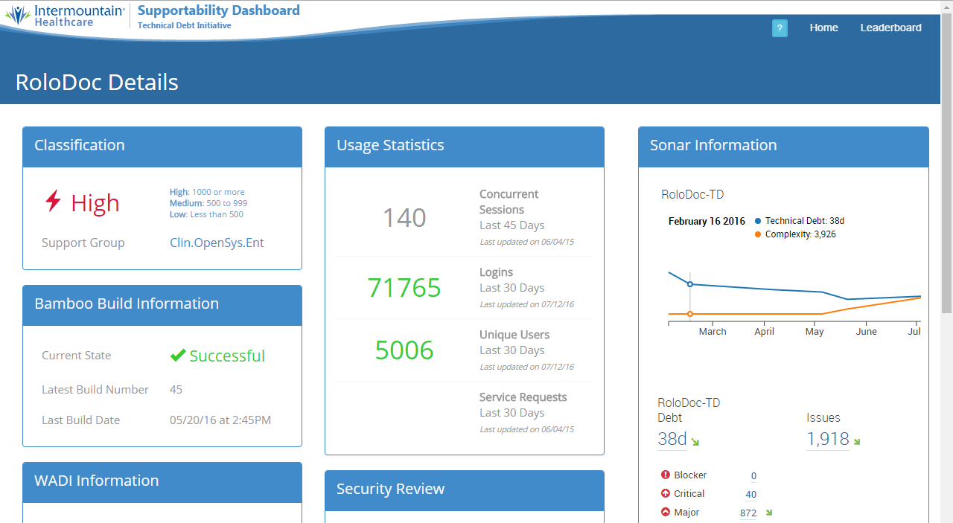

Slide 35
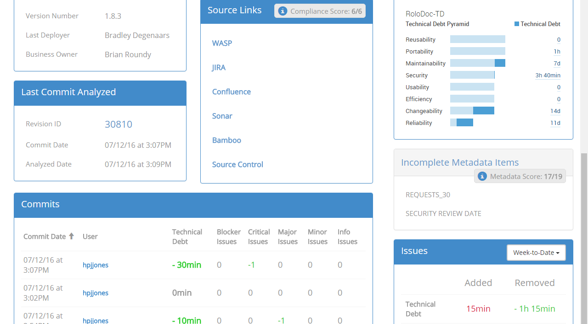

Slide 36
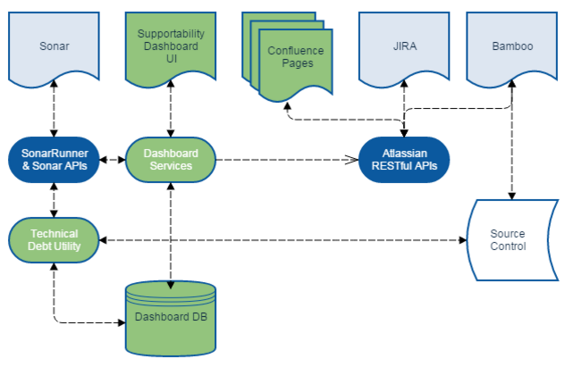
Intermountain Technical Debt Architecture

Slide 37
Your debt busting solution
Keep It Simple
Start with out of the box Continuous Integration Builds with Bamboo, Jenkins
Add Sonar for Technical Debt metrics
Find ways to
Direct the Rider
Motivate the Elephant
Shape the Path
Then if needed
Add Leaderboard
Add Supportability Dashboard

Slide 38
Conclusion
In order to implement lasting Change personally, at home, or at work you must
Direct the Rider
Motivate the Elephant
Shape the Path
Life is Good and it’s Getting Better as we learn to successfully implement lasting Change.
Questions?

Slide 39
References & Followup
OpenWest, SonarQube presentation by Jeremy Mefford at 3pm in EH2-B. https://www.openwest.org/schedule/#talk-111
“Using Neuroscience to Influence Behavior”, Stanford Graduate School of Business http://www.slideshare.net/StanfordBusiness/using-neuroscience-to-influence-behavior
“Switch: How to Change Things When Change is Hard”, Chip & Dan Heath https://www.amazon.com/Switch-Change-Things-When-Hard/dp/0385528752
“Inside the mind of a Master Procrastinator" by Tim Urban https://www.ted.com/talks/tim_urban_inside_the_mind_of_a_master_procrastinator?language=en
“How not to be ignorant about the world” by Hans & Ola Rosling https://www.ted.com/talks/hans_and_ola_rosling_how_not_to_be_ignorant_about_the_world

