Slide 1
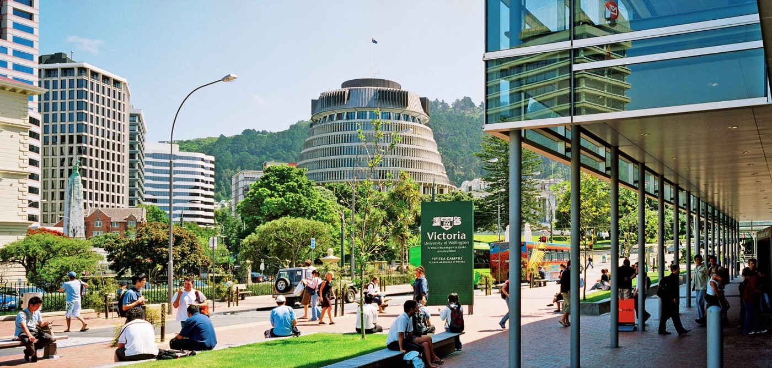
Charlene Leong
Victoria University of Wellington
Bachelor of Engineering with Honours
In Electronics and Computer Systems Engineering 2019
Mitsubishi Electric R&D Internship
Nov 2018 - Feb 2019

Slide 2
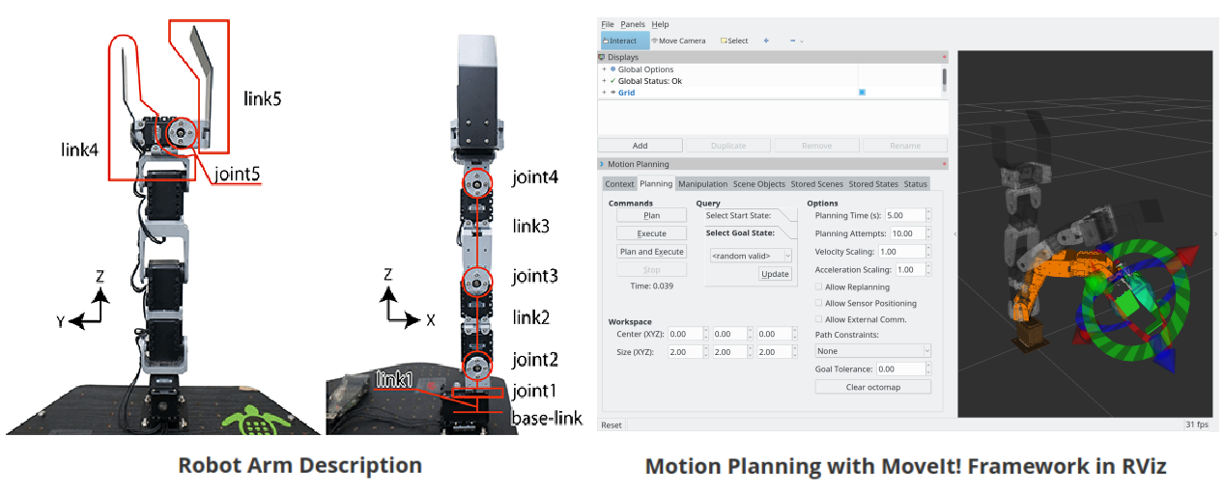
Global Blackbox Optimisation for
Automatic Parameter Tuning of Motion Planning Algorithms
The focus of this project has been to investigate global blackbox optimisation methods for tuning motion planning for the CRANEV2+ arm. This has been implemented using the MoveIt motion planning framework interfacing with the Open Motion Planning library (OMPL) in ROS.

Slide 3

Global Blackbox Optimisation for
Automatic Parameter Tuning of Motion Planning Algorithms
Global Blackbox Optimisation
- When the relationship between parameters and evaluation is unknown
- Cannot calculate gradient
f(x) s the objective score
x* is the set of hyperparameters that yields the lowest value of the score
x can take on any value in the domain X.
Global blackbox optimisation when -
- empirical optimum might not always the best.
- search space is complex such as being mixed integer-continuous (eg. regularisation and kernel)
domain constrained (eg. positive regularisation), combinatorial (eg. feature selection)
or have conditional dimensions (eg. architecture of a NN).
- handle stochastic, non-convex and non-continuous functions, efficient in terms of function evaluations, flexible in terms of search space and parallelisable in execution. The main bottleneck is often evaluating the objective function f(x) f(x)f(x).

Slide 4
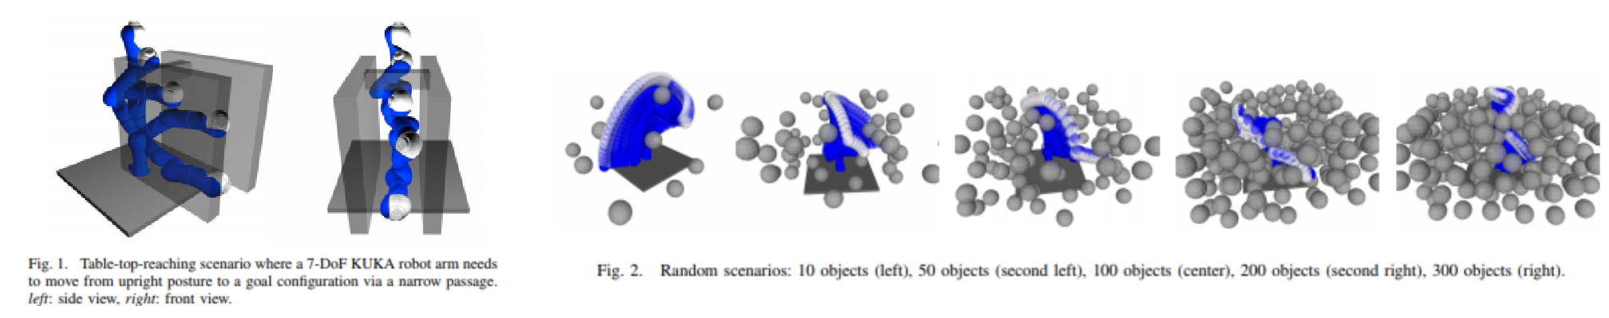
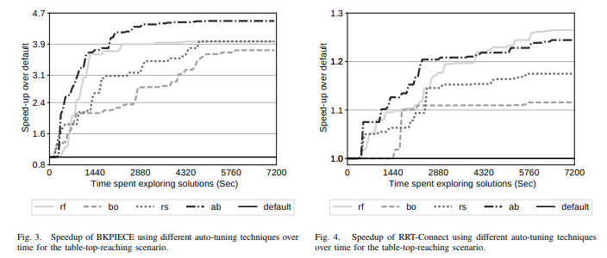
Global Blackbox Optimisation for
Automatic Parameter Tuning of Motion Planning Algorithms
Reference Paper
Automatic Parameter Tuning of Motion Planning Algorithms (IROS 2018)

