Slide 1

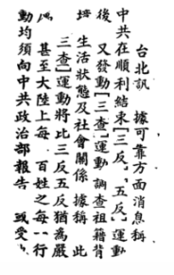
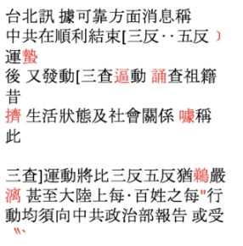






Image buckets + Unicode labels
Paper Section
Google Tesseract OCR Model
Unicode
≈ç√
Retrain new OCR model eg. (Kraken)
Unicode
Image buckets + Unicode label
X 7000 buckets

