Slide 1
Adapting the Pre-trained Deep Model to Novel Categories Classification
TA: Zhou Linjun & Shen Zheyan
2018.08.03

Slide 2
Problem Definition
Traditional Image Classification Problem:
DNN Framework
(e.g. AlexNet)
N classes
Training Data
Test on testing data
Use Some methods to adapt the pre-trained model to new classification problem
Novel Classes Classification Problem:
Another M classes
Training Data
Uh, I don’t want to spend many hours to re-train a model.
Well, the new dataset is too small and cannot use Deep model.

Slide 3
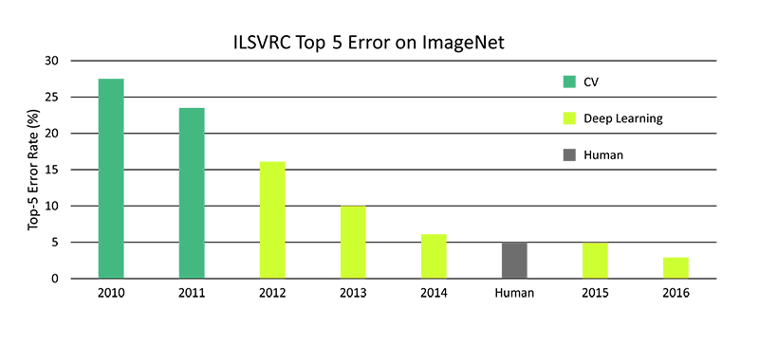

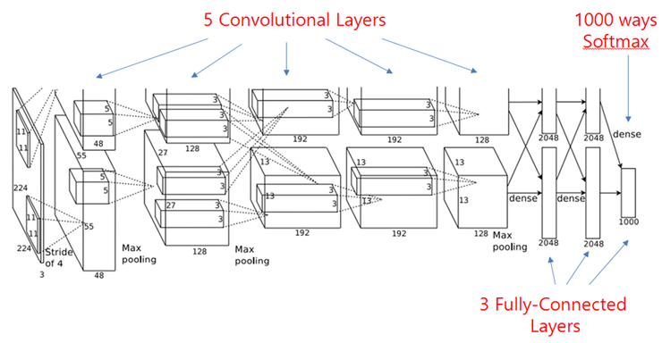
AlexNet: The one that started it all
AlexNet was designed by and named after Alex Krizhevsky
This model won LSVRC2012 (Large Scale Visual Recognition Challenge 2012 )
It was the first deep learning paper that showed state of the art performance in a real computer vision task
It did that with a large margin over the other algorithms.
Lower-level features (lines, shapes) -> higher-level semantics

Slide 4
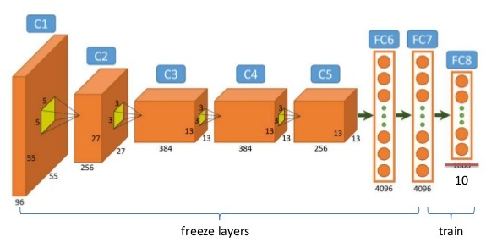
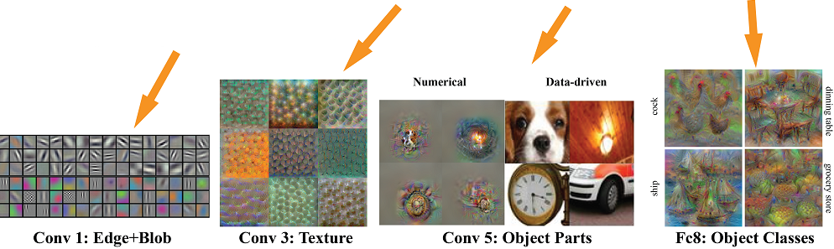
Fine-tune pre-trained networks
Take a trained model and fine-tune it for a particular task. (continue training)
First few layers are usually common across similar domains
Last few layers are task-specific
In theory, all layers can be fine-tuned with larger adjustment of latter layers and minor adjustment of former layers.
In practice, usually freeze former layers and in this experiment, we freeze all layers except the last two layers.

Slide 5

Softmax regression v.s. Fine-tune
Softmax regression
Generalization of logistic regression to the case where we want to handle multiple classes.
Softmax regression using extracted fc7 features is equivalent to train the fc8 layer alone with former layers fixed.
Fine-tuning
Continue training on a pre-trained model
Besides the last fc8 layer, some former layers also need to be tuned.

Slide 6

Metric-Based Classification
Cosine Similarity measure: For two features $u$ and $v$:
$$cos_sim(u,v)= \frac{<u, v>}{{\left|\left|u\right|\right|}_{2}∙{|\left|v\right||}_{2}}$$
cos_sim -> 1 means two items are mostly similar.
Calculate Cosine Similarity and Find the maximum as its predicted class.
Algorithm:
Class 1
Training Images
Class 1
Average fc7 layer feature
Pre-trained
AlexNet
Pre-trained
AlexNet
Test Image Feature
Test Image
…
…
Class M
Training Images
Class M
Average fc7 layer feature

Slide 7


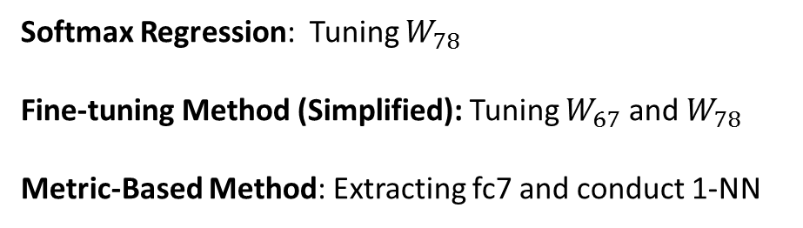
Experiment - Introduction
Conv1~Conv5
Layers
Fc6
layer
Fc7
layer
Fc8
layer
$$W_{67}$$
$$W_{78}$$
Softmax Regression: Tuning $W_{78}$
Fine-tuning Method (Simplified): Tuning $W_{67}$ and $W_{78}$
Metric-Based Method: Extracting fc7 and conduct 1-NN
Nearest
Neighbor
Classifier

Slide 8
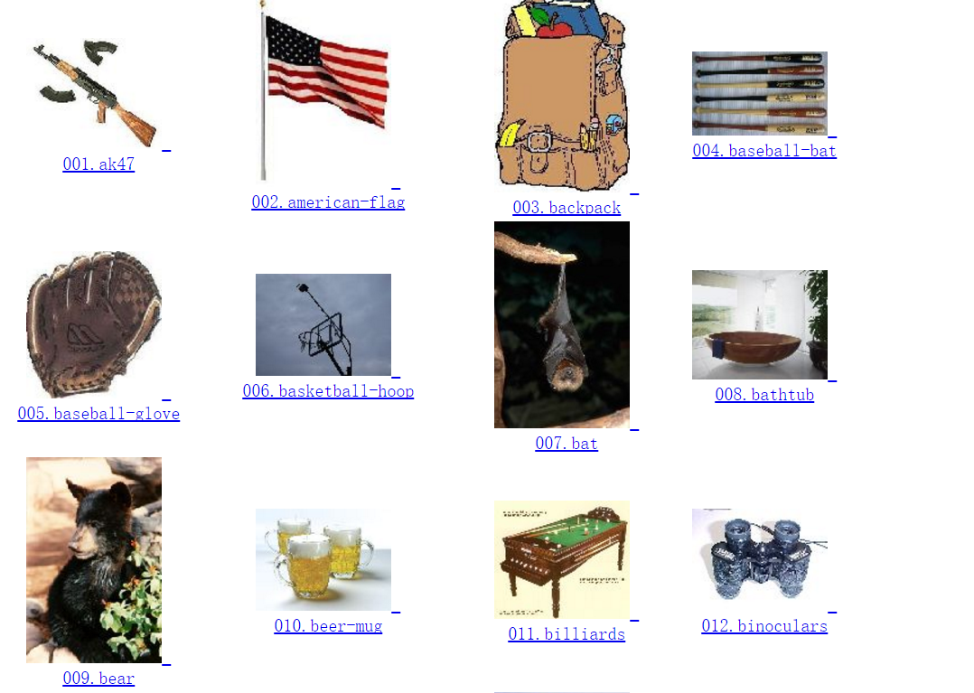

Experiment - Dataset
Base Classes Dataset – ILSVRC2015
Novel Classes Dataset – Caltech256
Example:
Example:
Total Classes: 1,000
Average #Images each class: Around 1,300
Total Classes: 256 (We only use 50 of them in our experiment)
Average #Images each class: Around 100

Slide 9
Experiment – Details(1)
Aim: We have a pre-trained Alexnet Model, how could we apply the model to a new classification task?
ImageNet
1000 classes
Alexnet
Model
Caltech256
Dataset
50 classes
3 Methods
Training Data (4 groups experiment):
1 image per class (1-shot)
5 images per class (5-shot)
20 images per class (20-shot)
50 images per class (50-shot)
Testing Data:
20 images per class

Slide 10
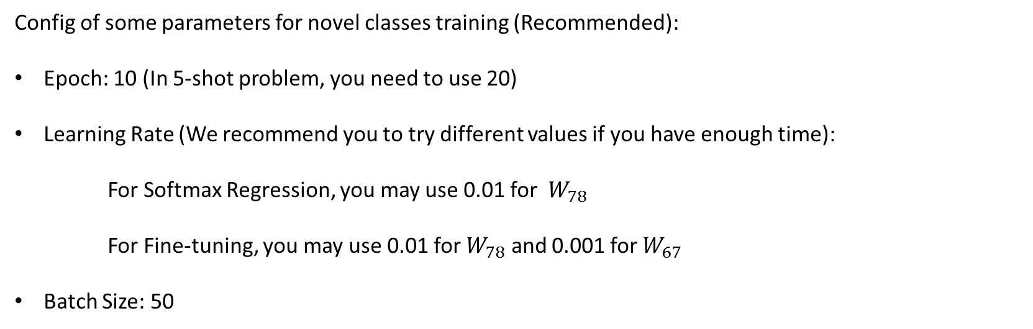
Experiment – Details(2)
Config of some parameters for novel classes training (Recommended):
Epoch: 10 (In 5-shot problem, you need to use 20)
Learning Rate (We recommend you to try different values if you have enough time):
For Softmax Regression, you may use 0.01 for $W_{78}$
For Fine-tuning, you may use 0.01 for $W_{78}$ and 0.001 for $W_{67}$
Batch Size: 50

Slide 11
Experiment – Details(3)
What you will do in this experiment?
Read the structure of AlexNet and Get familiar with it. (In file alexnet.py)
Add some codes to complete the softmax regression and fine-tuning method. (In file finetune.py)
Copy finetune.py and change some codes to get fc7 feature for training data and testing data.
[Bonus Task] Write a new file to finish metric-based method (using cosine distance) with what you get in Step 3.
[Bonus Task] Compare with the three methods, fill in the table on next page and give some basic conclusions.

Slide 12
Experiment – Report
Evaluation Metric: Top-1 Accuracy
 | 1 | 5 | 20 | 50
Fine-Tuning
Softmax Regression
Metric-Based Method
Shots
Method

Slide 13
Experiment – Report
 | 1 | 5 | 20 | 50
Fine-Tuning | 0.137 | 0.458 | 0.674 | 0.749
Softmax Regression | 0.187 | 0.563 | 0.715 | 0.777
Metric-Based Method | 0.232 | 0.498 | 0.680 | 0.695
Shots
Method
Conclusion:
Compared with Fine-Tuning, Softmax performs much better on more training data.
Compared with learning method, metric-based method performs better on low shot learning.

Slide 14
Thank you!

