Slide 1
Deep Learning for Natural Language Processing
Computer Science Department
Tsinghua University
Notes:
Hi everyone, I’m Zhou Hao, the TA of this class and He is Zhang Zheng, another TA.
Today I will introduce u the project of Deep Learning for Natural Language Processing

Slide 2
Project
Sentence-level Sentiment Classification
The film seems a dead weight.
This movie is awesome!
Just an average comedic dateflick but not a waste of time.
Notes:
Sentence-level Sentiment Classification

Slide 3
Outline
Task Definition
Instruction
Your Work
Evaluation
Code
Notes:
This is the outline of this introduction

Slide 4
Task Definition
Given a natural language text, classify the sentiment label.
E.g. input: This movie is awesome! The film seems a dead weight.
output: 4(very positive) 0(very negative)
Five-class sentiment labels
0(very negative), 1(negative), 2(neutral), 3(positive), 4(very positive)
Notes:
First of all, we need to figure out what’s Sentence-level Sentiment Classification
This task is defined as Given a natural language sentence, classify the sentiment label
For example, given the input as This movie is awesome! The output sentiment label is very positive
given the input as The film seems a dead weight. The output sentiment label is very negative
In this task, we use Five-class sentiment labels.

Slide 5
Instruction
Work Flow
Load Dataset
Load Word Vector
Build Neural Network
Training
Test
Your Work
Notes:
After knowing the task definetion, u may have a question, how to train a neural network to classify the sentences’ sentiment labels?
The general work flow is shown in the slide.
First u should load the dataset and word vector then u need to build neural network model, after that u can train your model and test it.
And your work is build neural network in tensorflow.

Slide 6
Instruction
Dataset
Stanford Sentiment Treebank
Train (8544), dev (1101) and test (2210)
Word Vector
Glove.300d
A Recurrent Neural Network Framework
Notes:
We adopt the stanford sentiment treebank as our dataset, the trainset and develop set contain sentences and sentiment labels, the test set only contains sentences which are used to predict the sentiment label and calculate the accuracy to evaluate the performance of your model.
We adopt the GLOVE word vector which contains 300 dimension digits for each word.
Finally we prepare a Recurrent Neural Network Framework and leave about 20 lines for you to implement.

Slide 7
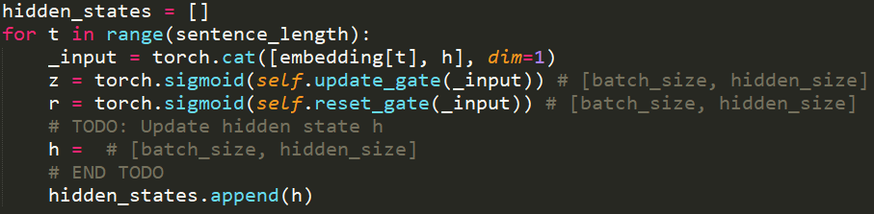
Your Work
Implement the GRU code with #TODO in network.py
Notes:
Secondly, you can use the formula and knowledge u learned in the morning to implement the code of gru cell and LSTM cell with #todo in rnn_cell.py, which may lead to a higher accuracy.

Slide 8
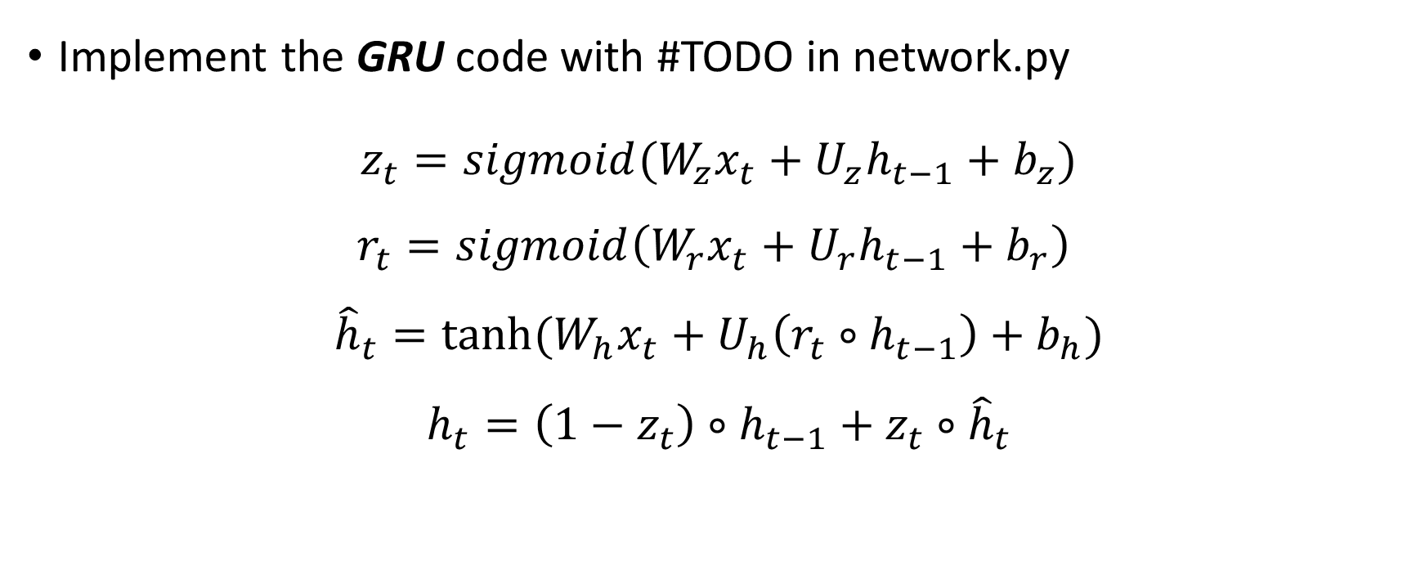
Your Work
Implement the GRU code with #TODO in network.py
$z_{t}=sigmoid(W_{z}x_{t}+U_{z}h_{t−1}+b_{z})$
$$r_{t}=sigmoid\left(W_{r}x_{t}+U_{r}h_{t−1}+b_{r}\right)$$
$${\hat{h}}_{t}=tanh⁡(W_{h}x_{t}+U_{h}\left(r_{t}∘h_{t−1}\right)+b_{h})$$
$$h_{t}=\left(1−z_{t}\right)∘h_{t−1}+z_{t}∘{\hat{h}}_{t}$$
Notes:
Secondly, you can use the formula and knowledge u learned in the morning to implement the code of gru cell and LSTM cell with #todo in rnn_cell.py, which may lead to a higher accuracy.

Slide 9
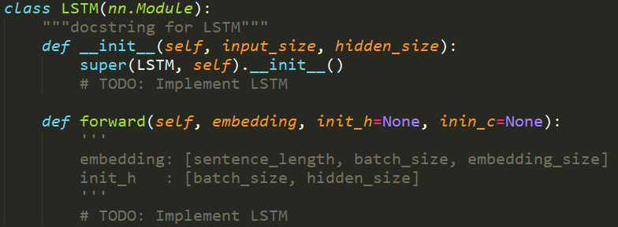
Your Work
Implement the LSTM code with #TODO in network.py
Notes:
Secondly, you can use the formula and knowledge u learned in the morning to implement the code of gru cell and LSTM cell with #todo in rnn_cell.py, which may lead to a higher accuracy.

Slide 10
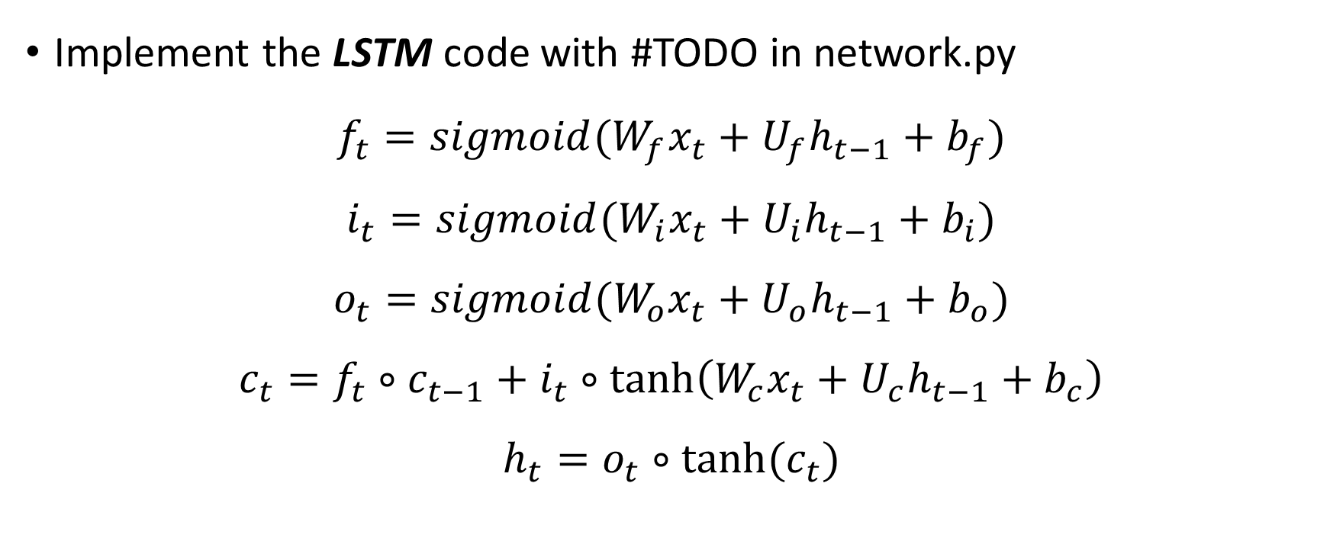
Your Work
Implement the LSTM code with #TODO in network.py
$$f_{t}=sigmoid(W_{f}x_{t}+U_{f}h_{t−1}+b_{f})$$
$$i_{t}=sigmoid(W_{i}x_{t}+U_{i}h_{t−1}+b_{i})$$
$$o_{t}=sigmoid(W_{o}x_{t}+U_{o}h_{t−1}+b_{o})$$
$$c_{t}=f_{t}∘c_{t−1}+i_{t}∘\tanh\left(W_{c}x_{t}+U_{c}h_{t−1}+b_{c}\right)$$
$$h_{t}=o_{t}∘tanh⁡(c_{t})$$
Notes:
Secondly, you can use the formula and knowledge u learned in the morning to implement the code of gru cell and LSTM cell with #todo in rnn_cell.py, which may lead to a higher accuracy.

Slide 11
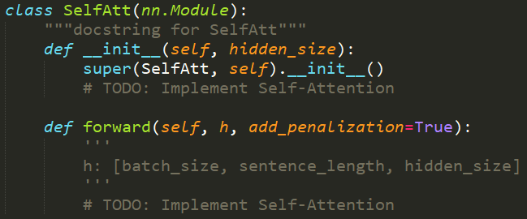
Your Work
Implement self-attention mechanism in network.py
Notes:
Finally, u can try other neural networks such as Different layer and unit size, Recursive Neural Network, Dropout to improve the accuracy.

Slide 12



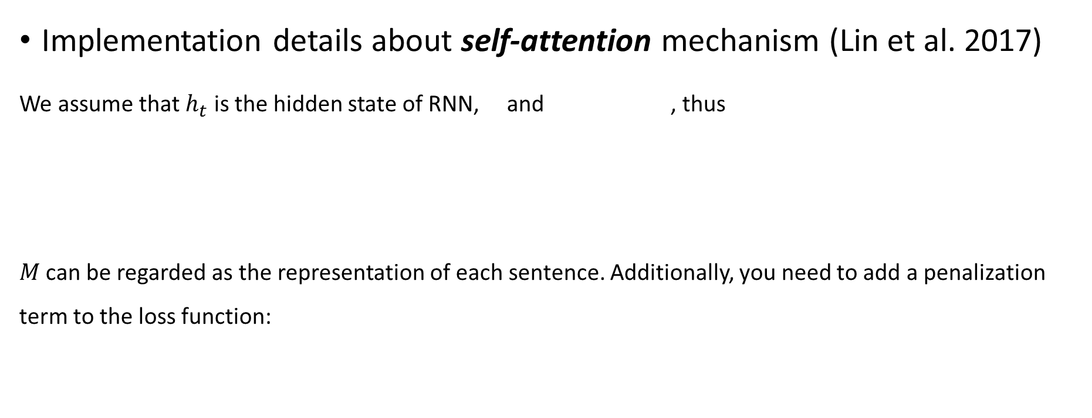
Your Work
Implementation details about self-attention mechanism (Lin et al. 2017)
We assume that $h_{t}$ is the hidden state of RNN, and , thus
$M$ can be regarded as the representation of each sentence. Additionally, you need to add a penalization term to the loss function:
Notes:
Finally, u can try other neural networks such as Different layer and unit size, Recursive Neural Network, Dropout to improve the accuracy.

Slide 13
Your Work
Try other neural networks or tricks to improve the accuracy
Multi-layer RNN or Bi-directional RNN
Change unit size
Recursive Neural Network
Dropout
…
Notes:
Finally, u can try other neural networks such as Different layer and unit size, Recursive Neural Network, Dropout to improve the accuracy.

Slide 14
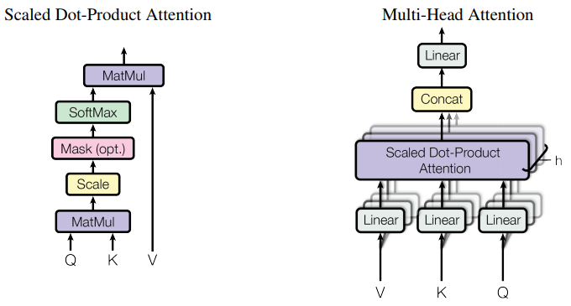
Your Work(Optional)
Implement Transformer in network.py (Vaswani et al. 2017)
You can find detailed information from paper Attention is All You Need.
Notes:
Finally, u can try other neural networks such as Different layer and unit size, Recursive Neural Network, Dropout to improve the accuracy.

Slide 15
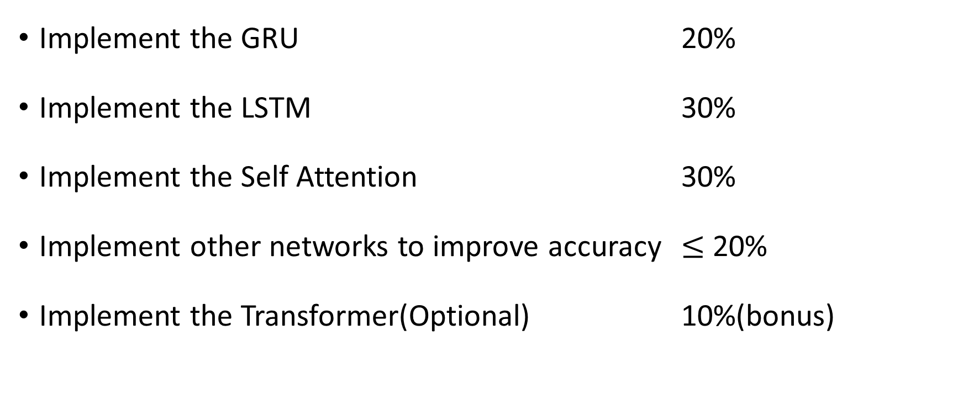
Evaluation
Implement the GRU 20%
Implement the LSTM 30%
Implement the Self Attention 30%
Implement other networks to improve accuracy $≤$ 20%
Implement the Transformer(Optional) 10%(bonus)
Notes:
We evaluate your project as follows:
If u Implement the RNN framework, u can get 60% score
If u Implement the GRUCell, u can get 20% score
If u Implement the BasicLSTMCell , u can get 10% score
If u Implement other networks to improve accuracy, u can get 10% score

Slide 16
Code
Code and Dataset
~/work/SST
Command
python main.py --mode GRU
Mode can be GRU/LSTM/Attention for different tasks
A file named `prediction` will be generated automatically
Notes:
U can access the dataset, word vector and framework code on github through this url
And Some commands u should know.
First, u can download the data and code to your work space using this git clone command
Second, if u implement the framework, u can using this command to train your model, and the model will be saved in train directory. If u want to train new model, please remove all file in train directory otherwise, the framework will load the latest model in train directory and continue training.
Finally, at the end of this class, u should generate a result file of the test set using this command. If u want to use model of specific epoch x, please add the parameter two hyphen–inference_version x, without this parameter, this command use the latest model in train directory to test.

Slide 17
Reference
Zhouhan Lin, Minwei Feng, Cicero Nogueira dos Santos, Mo Yu, Bing Xiang, Bowen Zhou, and Yoshua Bengio. 2017. A structured self-attentive sentence embedding. In Proceedings of International Conference on Learning Representations.
Vaswani A, Shazeer N, Parmar N, et al. Attention is all you need[C]//Advances in neural information processing systems. 2017: 5998-6008.
PyTorch API 1.1 for Python: https://pytorch.org/docs/stable/index.html
Notes:
U can access the dataset, word vector and framework code on github through this url
And Some commands u should know.
First, u can download the data and code to your work space using this git clone command
Second, if u implement the framework, u can using this command to train your model, and the model will be saved in train directory. If u want to train new model, please remove all file in train directory otherwise, the framework will load the latest model in train directory and continue training.
Finally, at the end of this class, u should generate a result file of the test set using this command. If u want to use model of specific epoch x, please add the parameter two hyphen–inference_version x, without this parameter, this command use the latest model in train directory to test.

Slide 18
Q&A

