Slide 1
Introduction
The purpose of the project is to design a park recommendation model.
The model will first evaluate the user’s preference from three aspects: distance, rating and weather condition. Then the model will assign the different weights to three factors. Users will be able to get the top 5 parks based on their preference.
There are three datasets that will be used for this project. We get park location data and rating data via scraping, and weather date via API calling.
Park Recommendation Model Design
Qing Gao
DSCI510

Slide 2
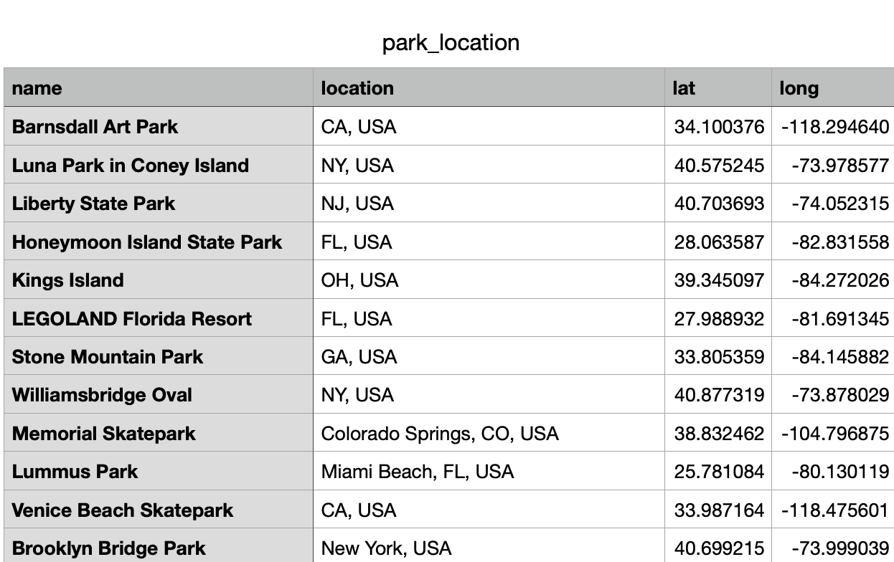
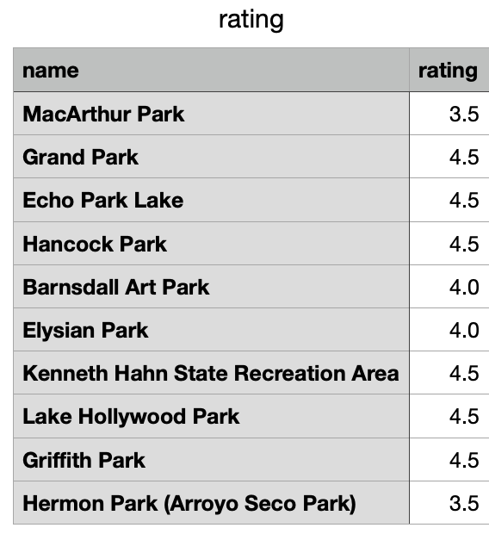
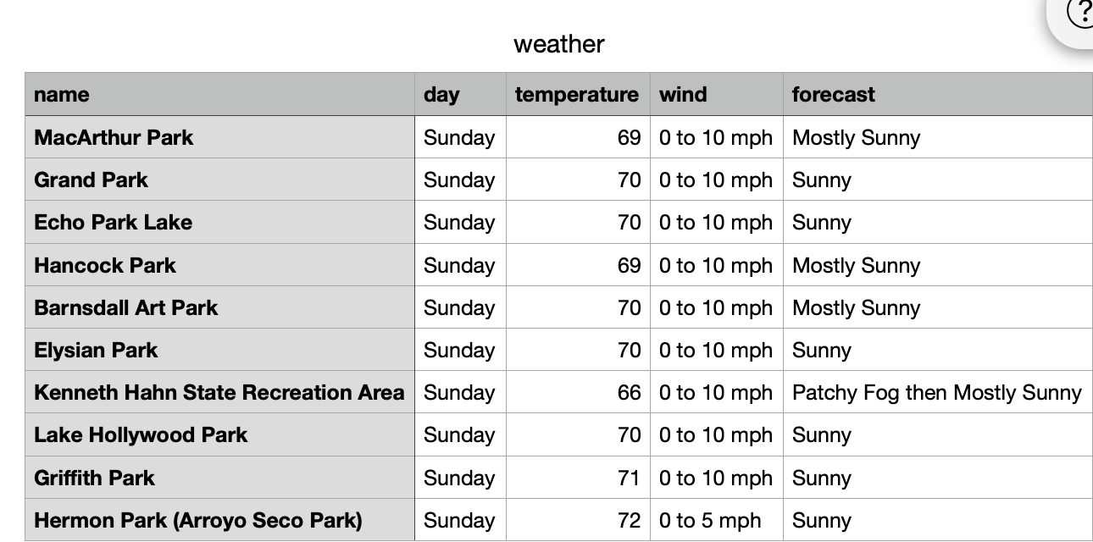
Datasets Description
Parks
Get all parks location
Scarpe from https://www.latlong.net/
Get all the parks latitudes and longitudes
Get ten nearest location
Rating
Get all rating information
Scrape data from google.com
Store all parks’ rating in csv file
Weather
Get all weather information
Call API https://api.weather.gov/gridspoints/
Get all parks’ weather based on the latitude and longitude

Slide 3
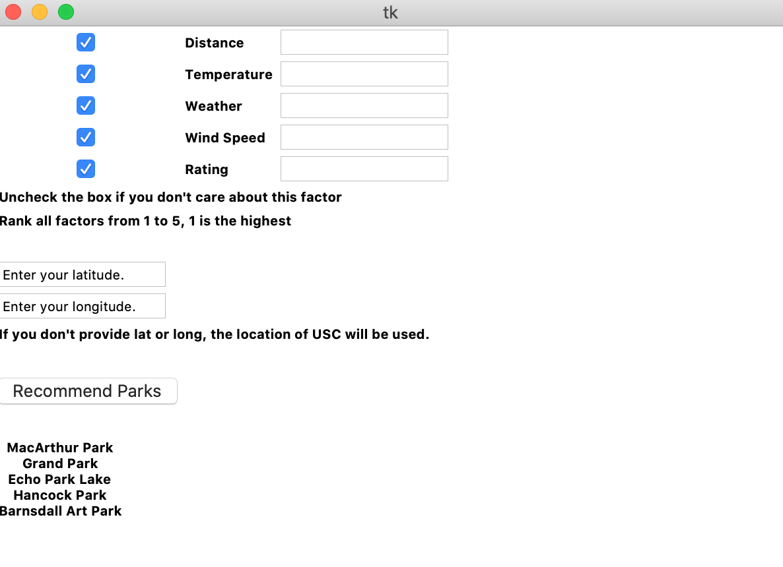
Analysis
Here’s a python interface!
First, there’s a user interface by python with tkinter library, users can choose which factors are important to them, then rank them from 1 to 5. For the factors users don’t want, they can uncheck the corresponding checkbox on the left. Then they can input their latitude and longitude representing their current location.
After this, we’ll perform descriptive statistical analysis to gather some statistical data about the previous data we collected. Then based on these data, we will design an algorithm to return top 5 parks among 10 nearest parks to the user’s current location.
Here’s an example. The current location is USC campus. For now, distance is the only thing that matters. You can see the five top parks listed.

Slide 4
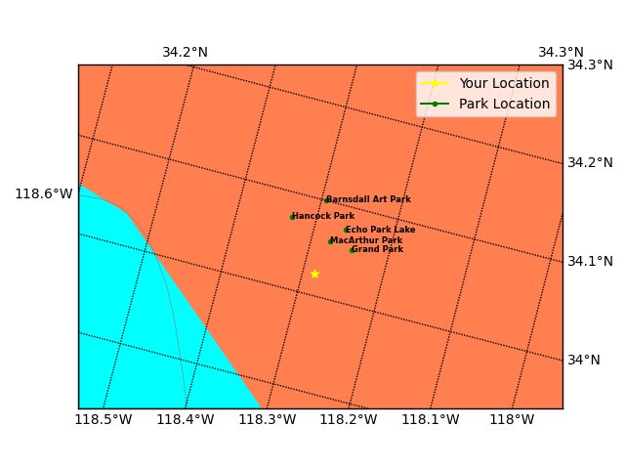
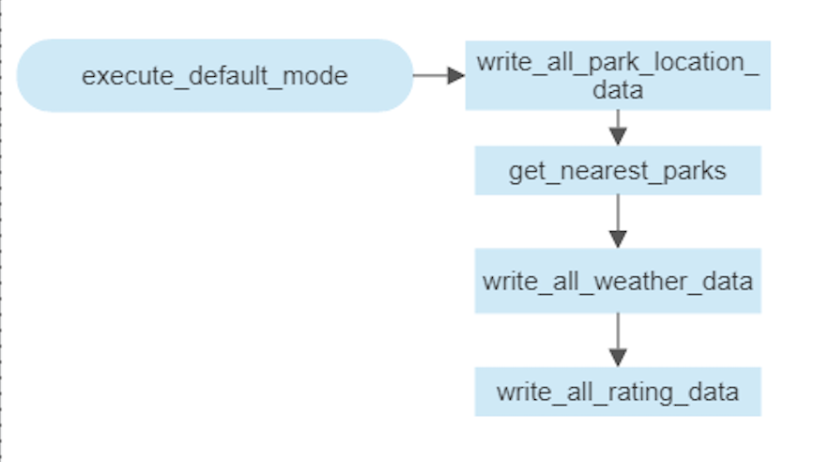
Results and Vitualization
We use Basemap library to draw our results on a map. The yellow star is USC location while the rest of recommended parks are represented using green spots. Looks like we have some good parks in the north. ☺

Slide 5
Evaluation and Conclusion
Evaluation : There is no easy way to perform a good evaluation on my result. One evaluation I can think of is to ask LA people who have visited most of these parks to use my app and see if my recommendation works for them.
Conclusion : The model is practical, and I like it a lot. Since I’m a park lover, I’m about to use this model later to help me find some good parks to visit in the future. There are several things we can and need to do better though:
Collect user feedbacks to see how well we are doing, and we can probably apply machine learning techniques to improve the model to give better recommendation to users.
Add more factors such as crime rate, and of course, whether this is a park for pets.
Allow more customization, for example, users can prefer rainy/windy days over sunny days.
Make my data more accurate. For instance, rating can come from various sources( yelp, google rating etc).
Improve user interface, let user input address instead of latitude and longitude.

