Slide 1
Translating VINCI CDW and Millennium SOPs for OMOP: BMI and Demographics
Daniel Park – B.S.
OMOP ETL
VA Informatics and Computing Infrastructure (VINCI)

Slide 2
Overview
In this session, we will be examining the CDW and Millennium SOPs for demographics and BMI data, focusing on how these sources align with the OMOP CDM. Additionally, we will reference the OMOP_CDW and OMOP_Millennium databases in our script examples
Demographic data, such as age, gender, race, and ethnicity, helps us understand health trends, address disparities, and provide personalized care
Body Mass Index is an important health measure, connecting patient data to risks for conditions like diabetes, heart disease, and obesity

Slide 3
Demographic
OMOP Person domain is derived from the following source tables:
  OMOP_CDW
    Spatient Spatient
    Dim.Race
    Dim.Ethnicity
    PatSub.PatientRace – contains prior and after introduction of standard race and ethnicity categories 2003
    PatSub.PatientEthnicity – contains new ethnicity categories from VistA
  OMOP_Mill
    SVeteranMill.SPerson

Slide 4
Demographic: Gender
Gender is sourced from the following raw resources:
Gender from [Source].[SPatient.SPatient]
Sex from [Source].[VitalStatus_Mini]
Gender from [Manual].[Patient_Gender]
The process involves identifying patients with a single Gender or determining the most frequent Gender when multiple records exist. The distinct Gender is selected based on the following priority order:
Manual chart review (highest priority) – Manually reviewed records take precedence.
VitalStatus_Mini – valid SSN and consistent ICN mappings required
SPatient.SPatient (lowest priority).

Slide 5
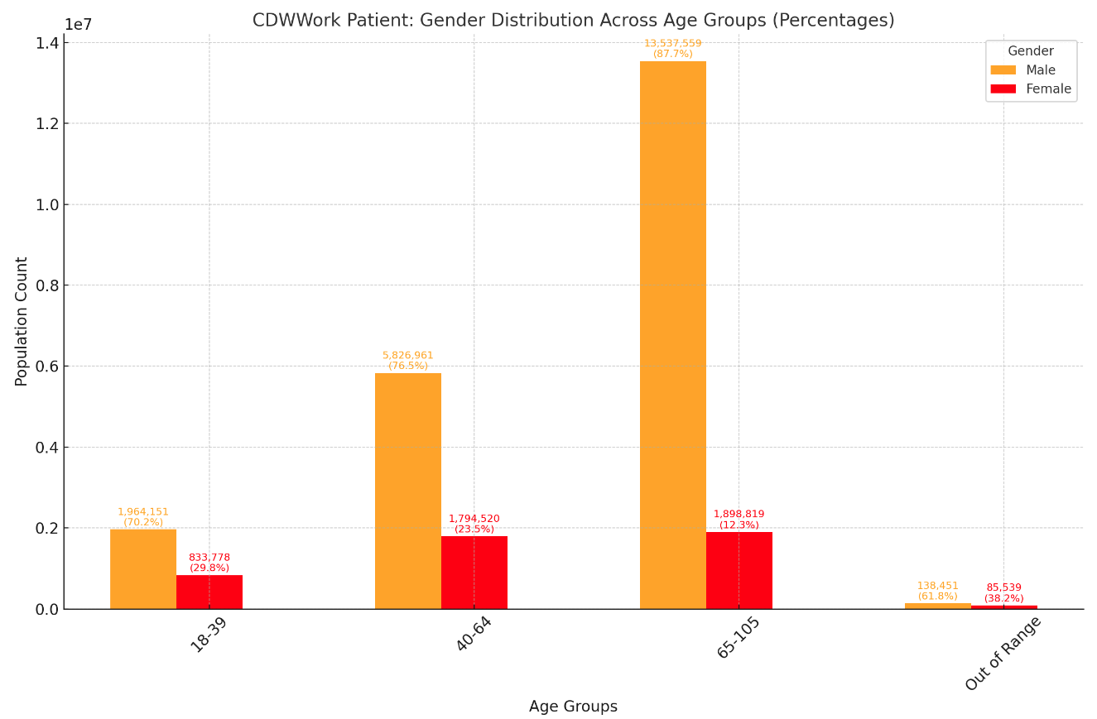
Gender cont.

Slide 6
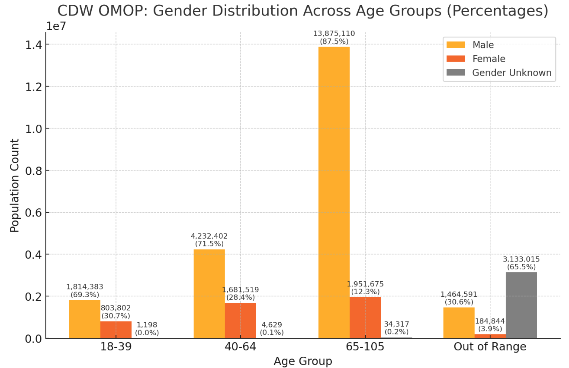
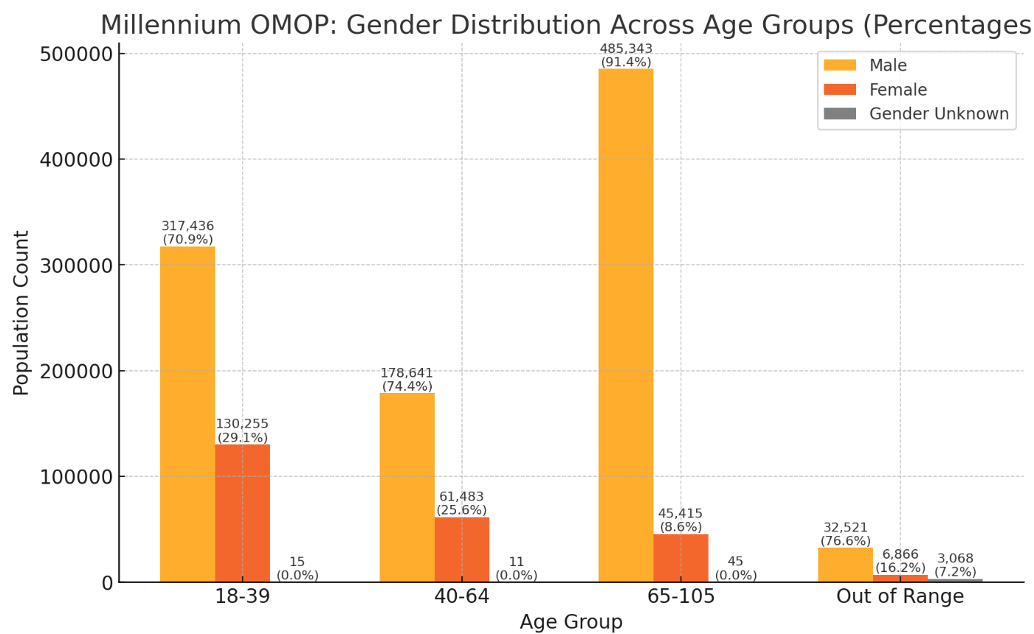
Gender cont.
* Gender identity is not currently a standard variable in the PERSON table and is instead stored in the OBSERVATION table. While gender identity information has not yet been transformed into the OMOP format, plans for this transformation are underway for the near future.

Slide 7
Gender SQL CDW & Millennium OMOP
-- OMOP_CDW
SELECT
gender.concept_name as gender
FROM OMOP_CDW.OMOPV5.PERSON as person
left join OMOP_CDW.OMOPV5.CONCEPT as gender
on person.GENDER_CONCEPT_ID = gender.CONCEPT_ID
--OMOP_Millennium
SELECT
gender.concept_name as gender
FROM OMOP_Millennium.OMOPV5Mill.PERSON as person
left join OMOP_ Millennium. OMOPV5Mill.CONCEPT as gender
on person.GENDER_CONCEPT_ID = gender.CONCEPT_ID

Slide 8
Demographic: Race
The CDW dataset includes extensive information about veterans but requires more advanced queries to standardize non-standard race categories and, in some instances, to resolve discrepancies where multiple records for the same individual have varying race values across different facilities. While the full script it too lengthy to break down, here are some key steps:
Mapping Race Values (standard race value)
Handling Multiple Race values (race assignment)
Identifying Patients with Unmapped Values (non-mappable race values)
https://vaww.vhadataportal.med.va.gov/Portals/0/DataQualityProgram/Reports/Best_Practices_Guide_Race_Data.pdf

Slide 9
Race cont
In our implementation of OMOP, we applied these best practices by standardizing non-standard race values to align with Office of Management and Budget (OMB), reconciling multiple race records across different facilities.
In Millennium OMOP, Race, Ethnicity, and Gender data are derived from a single source, the SVeteranMill.Person table.

Slide 10
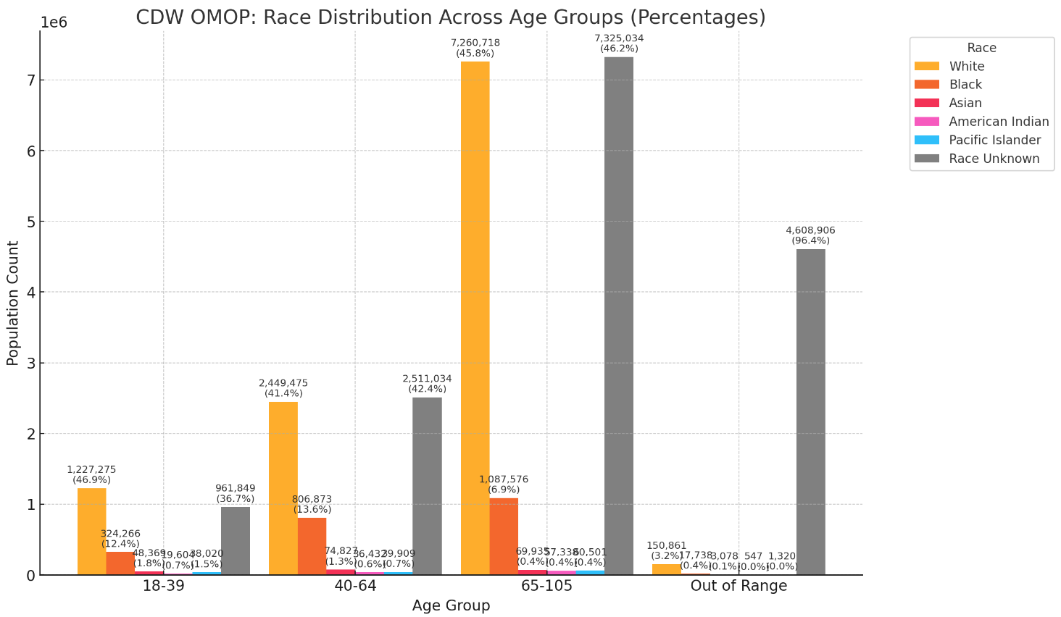
Race cont.

Slide 11
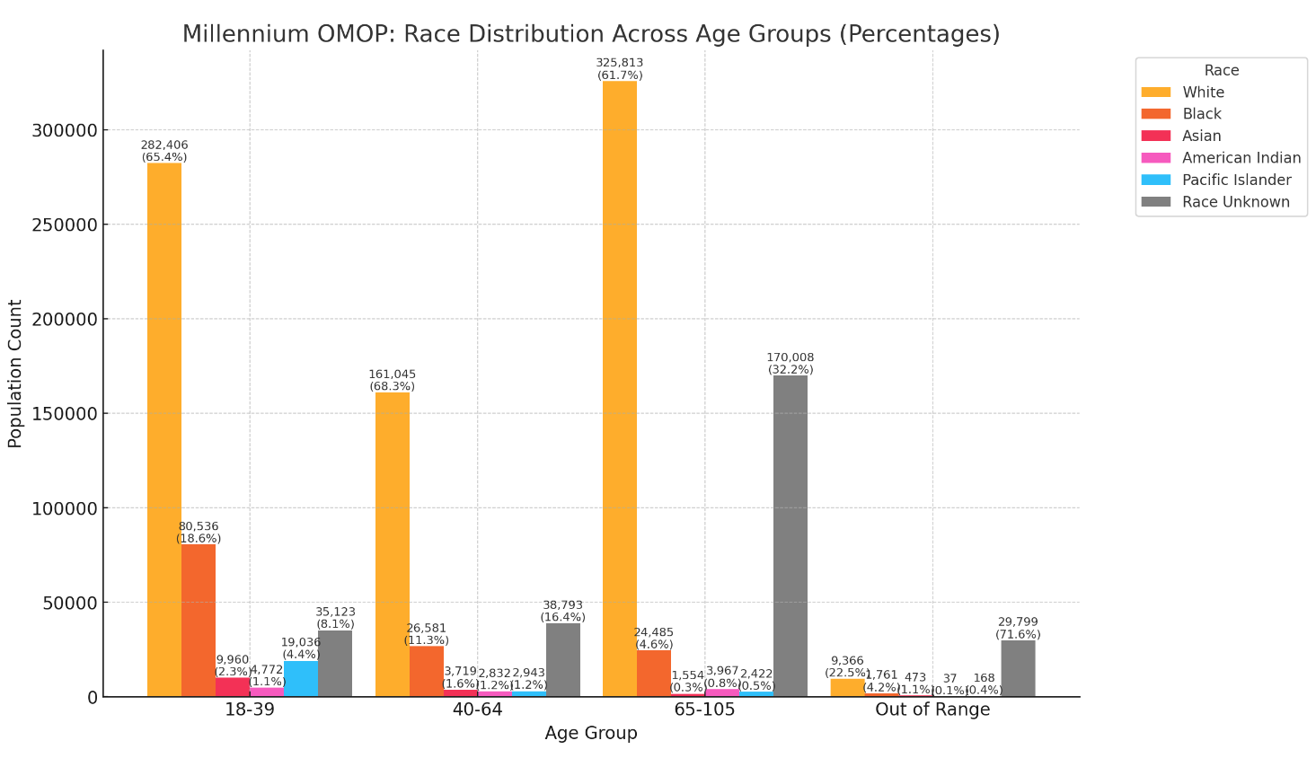
Race cont.

Slide 12
Race SQL
Standardized race concepts in the PERSON table
CONCEPT_ID=8527; White race
CONCEPT_ID=8516; Black or African American CONCEPT_ID=8557; Native Hawaiian or Other Pacific Islander
CONCEPT_ID=8657; American Indian or Alaska Native CONCEPT_ID=8515; Asian
* OHDSI designated the code 8552 (Race Unknown) as non-standard, and it is now mapped to 0 (No matching concept)
-- OMOP_CDW
SELECT
gender.concept_name as gender,
race.concept_name as race
FROM OMOP_CDW.OMOPV5.PERSON as person
left join OMOP_CDW.OMOPV5.CONCEPT as gender
on person.GENDER_CONCEPT_ID = gender.CONCEPT_ID
left join OMOP_CDW.OMOPV5.CONCEPT as race
on person.RACE_CONCEPT_ID = race.CONCEPT_ID
--OMOP_Millennium
SELECT
gender.concept_name as gender,
race.concept_name as race
FROM OMOP_Millennium.OMOPV5Mill.PERSON as person
left join OMOP_ Millennium. OMOPV5Mill.CONCEPT as gender
on person.GENDER_CONCEPT_ID = gender.CONCEPT_ID
left join OMOP_ Millennium. OMOPV5Mill.CONCEPT as race
on person.RACE_CONCEPT_ID = race.CONCEPT_ID

Slide 13
Demographic: Ethnicity
Like Race, Ethnicity follows the same OMB standards, adopted by Jan 1, 2003. Prior to this, ethnicity was recorded within race, but after 2003, ethnicity was collected separately, distinguishing only between Hispanic and Non-Hispanic
Data Source:
  Dim.Ethnicity: Frequently reported ethnicity
  PatSub.PatientEthnicity: New recording methods
  PatSub.PatientRace: Pre- and post 2003 race ethnicity categories
Key logic
  Only ethnicity data from the newer recording method is used in OMOP if both methods exists.
  If ethnicity data is captured in multiple methods, OMOP prioritizes self-identified information

Slide 14
Ethnicity SQL
-- OMOP_CDW
SELECT
gender.concept_name as gender,
race.concept_name as race,
ethnicity.concept_name as ethnicity
FROM OMOP_CDW.OMOPV5.PERSON as person
left join OMOP_CDW.OMOPV5.CONCEPT as gender
on person.GENDER_CONCEPT_ID = gender.CONCEPT_ID
left join OMOP_CDW.OMOPV5.CONCEPT as race
on person.RACE_CONCEPT_ID = race.CONCEPT_ID
left join OMOP_CDW.OMOPV5.CONCEPT as ethnicity
on person.ETHNICITY_CONCEPT_ID = ethnicity.CONCEPT_ID
--OMOP_Millennium
SELECT
gender.concept_name as gender,
race.concept_name as race,
ethnicity.concept_name as ethnicity
FROM OMOP_Millennium.OMOPV5Mill.PERSON as person
left join OMOP_ Millennium. OMOPV5Mill.CONCEPT as gender
on person.GENDER_CONCEPT_ID = gender.CONCEPT_ID
left join OMOP_ Millennium. OMOPV5Mill.CONCEPT as race
on person.RACE_CONCEPT_ID = race.CONCEPT_ID
left join OMOP_ Millennium. OMOPV5Mill.CONCEPT as ethnicity
on person. ETHNICITY _CONCEPT_ID = ethnicity.CONCEPT_ID

Slide 15
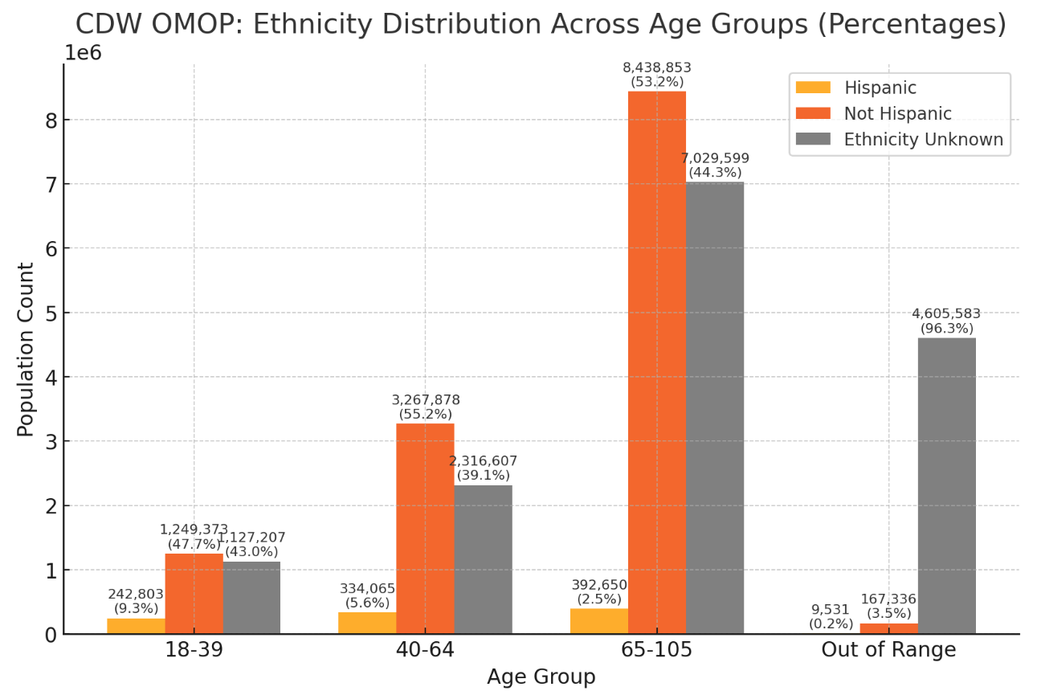
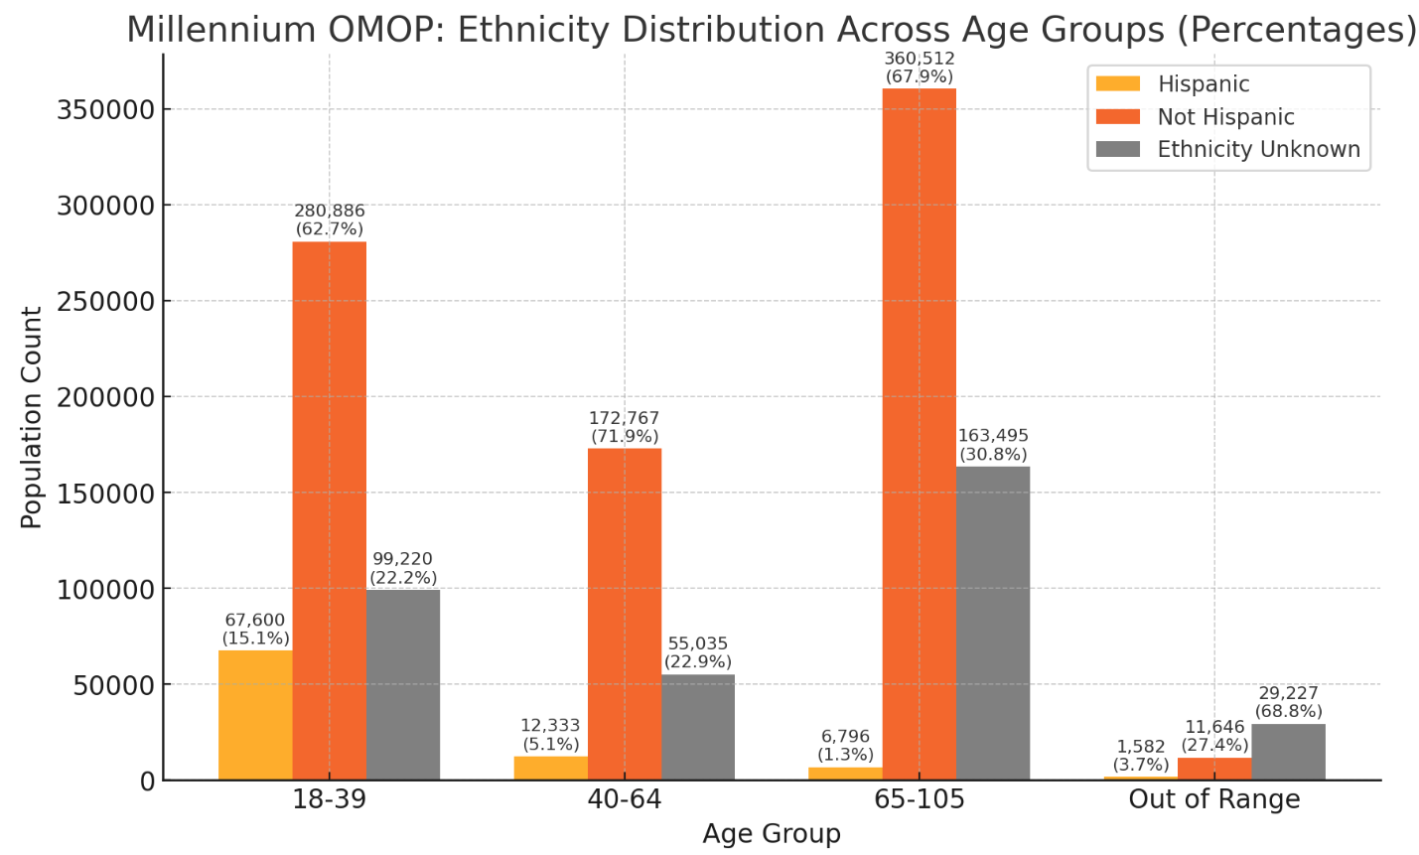
Ethnicity cont.

Slide 16
Demographic: Age
Date of birth (DOB) is sourced from the following raw resources:
[Source].[SPatient.SPatient]
[Source].[VitalStatus_Mini]
[Manual].[Patient_DOB]
The process involves identifying patients with a single DOB or determining the most frequent DOB when multiple records exist. The distinct DOB is selected based on the following priority order:
Manual chart review (highest priority),
VitalStatus_Mini, and
SPatient.SPatient (lowest priority).

Slide 17
Age SQL
-- OMOP_CDW
SELECT
gender.concept_name as gender,
race.concept_name as race,
ethnicity.concept_name as ethnicity,
CASE
WHEN person.BIRTH_DATETIME is not null THEN
DATEDIFF(Year,person.BIRTH_DATETIME, getdate()) -
CASE
WHEN month(person.BIRTH_DATETIME) > month(getdate())
or (month(person.BIRTH_DATETIME) = month(getdate()) and day(person.BIRTH_DATETIME) > day(getdate()))
THEN 1
ELSE 0
END
ELSE NULL
END as Age
FROM OMOP_CDW.OMOPV5.PERSON as person
left join OMOP_CDW.OMOPV5.CONCEPT as gender
on person.GENDER_CONCEPT_ID = gender.CONCEPT_ID
left join OMOP_CDW.OMOPV5.CONCEPT as race
on person.RACE_CONCEPT_ID = race.CONCEPT_ID
left join OMOP_CDW.OMOPV5.CONCEPT as ethnicity
on person.ETHNICITY_CONCEPT_ID = ethnicity.CONCEPT_ID

Slide 18
BMI
Use Weight and Height found in OMOP Measurement to calculate BMI
CDW OMOP data source:
  Vital Sign (99%)
  Patient Lab Chem
Millennium OMOP data source:
  Clinical Event Mill. Clinical Event

Slide 19
BMI: Weight
Weight lookup
SELECT a.MEASUREMENT_SOURCE_CONCEPT_ID
, a.MEASUREMENT_CONCEPT_ID
, b.CONCEPT_NAME
, a.MEASUREMENT_SOURCE_VALUE
, AVG(a.VALUE_AS_NUMBER) AS AVG_VALUE
, a.UNIT_CONCEPT_ID
, a.UNIT_SOURCE_VALUE
, a.x_source_table
, count(*) row_count
FROM CDW_OMOP.OMOPV5.MEASUREMENT as a
INNER JOIN CDW_OMOP.OMOPV5.CONCEPT as b
on a.MEASUREMENT_SOURCE_CONCEPT_ID = b.CONCEPT_ID
WHERE CONCEPT_NAME like '%body weight%’ and CONCEPT_NAME not like ‘%urine%’ and CONCEPT_NAME not like ‘%blood%’ and CONCEPT_NAME not like ‘%volume%’
GROUP BY a.MEASUREMENT_SOURCE_CONCEPT_ID
, a.MEASUREMENT_CONCEPT_ID
, b.CONCEPT_NAME
, a.MEASUREMENT_SOURCE_VALUE
, AVG(a.VALUE_AS_NUMBER) AS AVG_VALUE
, a.UNIT_CONCEPT_ID
, a.UNIT_SOURCE_VALUE
, a.x_source_table
order by row_count desc

Slide 20
BMI: Weight cont.
MEASUREMENT_SOURCE_CONCEPT_ID | MEASUREMENT_CONCEPT_ID | CONCEPT_NAME | MEASUREMENT_SOURCE_VALUE | AVG_VALUE | UNIT_CONCEPT_ID | UNIT_SOURCE_VALUE | x_source_table | row_count | unit issue
3025315 | 3025315 | Body weight | WEIGHT | 202.4594709 | 0 | NULL | VitalSign | 397,348,542 | *lbs
3026600 | 3026600 | Body weight Estimated | LOINC|8335-2 | 205.3464562 | 0 | lbs | PatLabChem | 3,276
3013762 | 3013762 | Body weight Measured | LOINC|3141-9 | 209.5559379 | 0 | lbs | PatLabChem | 2,495
3025315 | 3025315 | Body weight | LOINC|29463-7 | 232.4625407 | 0 | LBS | PatLabChem | 623
3026600 | 3026600 | Body weight Estimated | LOINC|8335-2 | 199.7986928 | 0 | lbs. | PatLabChem | 306
3013762 | 3013762 | Body weight Measured | LOINC|3141-9 | 203.9776952 | 4124425 | Lb | PatLabChem | 276
3025315 | 3025315 | Body weight | LOINC|29463-7 | 94.21748299 | 4122383 | KG | PatLabChem | 169
3026600 | 3026600 | Body weight Estimated | LOINC|8335-2 | 178.0400229 | 0 |  | PatLabChem | 141
3023166 | 3023166 | Body weight Stated | LOINC|3142-7 | 178.6866406 | 0 |  | PatLabChem | 128
3023166 | 3023166 | Body weight Stated | LOINC|3142-7 | 205.9813187 | 0 | LBS | PatLabChem | 94
3013762 | 3013762 | Body weight Measured | LOINC|3141-9 | 166.7885385 | 0 |  | PatLabChem | 89
3026600 | 3026600 | Body weight Estimated | LOINC|8335-2 | 0.07637931 | 8504 | g | PatLabChem | 58
3025315 | 3025315 | Body weight | LOINC|29463-7 | 172.9117647 | 0 |  | PatLabChem | 50
3013762 | 3013762 | Body weight Measured | LOINC|3141-9 | 124.0722222 | 8576 | mg | PatLabChem | 43 | * lbs?
3023166 | 3023166 | Body weight Stated | LOINC|3142-7 | 0.075309091 | 8504 | g | PatLabChem | 11
3003176 | 3003176 | Fetal Body weight estimated by US | LOINC|11727-5 | 149.5 | 0 |  | PatLabChem | 6
3023166 | 3023166 | Body weight Stated | LOINC|3142-7 | 0.0471 | 8504 | GRAMS | PatLabChem | 2
3013762 | 3013762 | Body weight Measured | LOINC|3141-9 | 0.026 | 9502 | G | PatLabChem | 1 | *unit mapped to Gauss (upper case)
3013762 | 3013762 | Body weight Measured | LOINC|3141-9 | 0.0385 | 8504 | GRAMS | PatLabChem | 1

Slide 21
BMI: Height
Height lookup
select a.MEASUREMENT_SOURCE_CONCEPT_ID
, a.MEASUREMENT_CONCEPT_ID
, b.CONCEPT_NAME
, a. MEASUREMENT_SOURCE_VALUE
, AVG(a. VALUE_AS_NUMBER) AS AVG_VALUE
, a. UNIT_CONCEPT_ID
, a. UNIT_SOURCE_VALUE
, a. x_source_table
, count(*) row_count
FROM CDW_OMOP.OMOPV5.MEASUREMENT as a
INNER JOIN CDW_OMOP.OMOPV5.CONCEPT as b
on a.MEASUREMENT_SOURCE_CONCEPT_ID = b.CONCEPT_ID
where CONCEPT_NAME like '%body height%'
group by a.MEASUREMENT_SOURCE_CONCEPT_ID
, a.MEASUREMENT_CONCEPT_ID
, b.CONCEPT_NAME
, a. MEASUREMENT_SOURCE_VALUE
, AVG(a. VALUE_AS_NUMBER) AS AVG_VALUE
, a. UNIT_CONCEPT_ID
, a. UNIT_SOURCE_VALUE
, a. x_source_table
order by row_count desc

Slide 22
BMI: Height
MEASUREMENT_SOURCE_CONCEPT_ID | MEASUREMENT_CONCEPT_ID | CONCEPT_NAME | MEASUREMENT_SOURCE_VALUE | AVG_VALUE | UNIT_CONCEPT_ID | UNIT_SOURCE_VALUE | x_source_table | row_count | unit issue
3036277 | 3036277 | Body height | HEIGHT | 69.16989234 | 0 | NULL | VitalSign | 180,717,911 | *in
3036277 | 3036277 | Body height | LOINC|8302-2 | 69.29607885 | 4121360 | inches | PatLabChem | 2,448
3023540 | 3023540 | Body height Measured | LOINC|3137-7 | 69.41764706 | 4121360 | in | PatLabChem | 510
3036277 | 3036277 | Body height | LOINC|8302-2 | 68.98924731 | 4121360 | In | PatLabChem | 95
3019171 | 3019171 | Body height Stated | LOINC|3138-5 | 5.144927536 | 4118332 | ft | PatLabChem | 88
3019171 | 3019171 | Body height Stated | LOINC|3138-5 | 7.066666667 | 4121360 | in | PatLabChem | 88 | *ft
3036277 | 3036277 | Body height | LOINC|8302-2 | 69.60606061 | 0 |  | PatLabChem | 48
3023540 | 3023540 | Body height Measured | LOINC|3137-7 | NULL | 0 |  | PatLabChem | 23 | *no value
3019171 | 3019171 | Body height Stated | LOINC|3138-5 | 5.5 | 0 |  | PatLabChem | 6 | *ft
3023540 | 3023540 | Body height Measured | LOINC|3137-7 | 69.33333333 | 4121360 | inches | PatLabChem | 3
3023540 | 3023540 | Body height Measured | LOINC|3137-7 | 189 | 0 | LBS | PatLabChem | 1 | *coded as height but appears to be weight

Slide 23
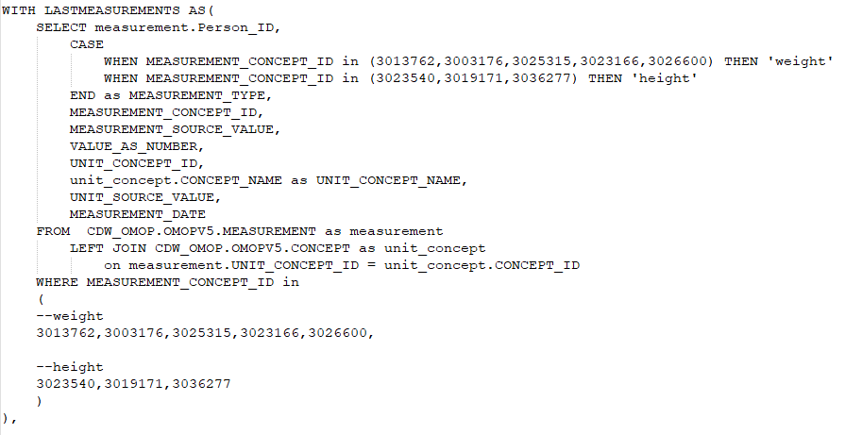
BMI SQL
Filter Measurement table for weight and height using measurement concept id
Find the weight and height to calculate BMI

Slide 24
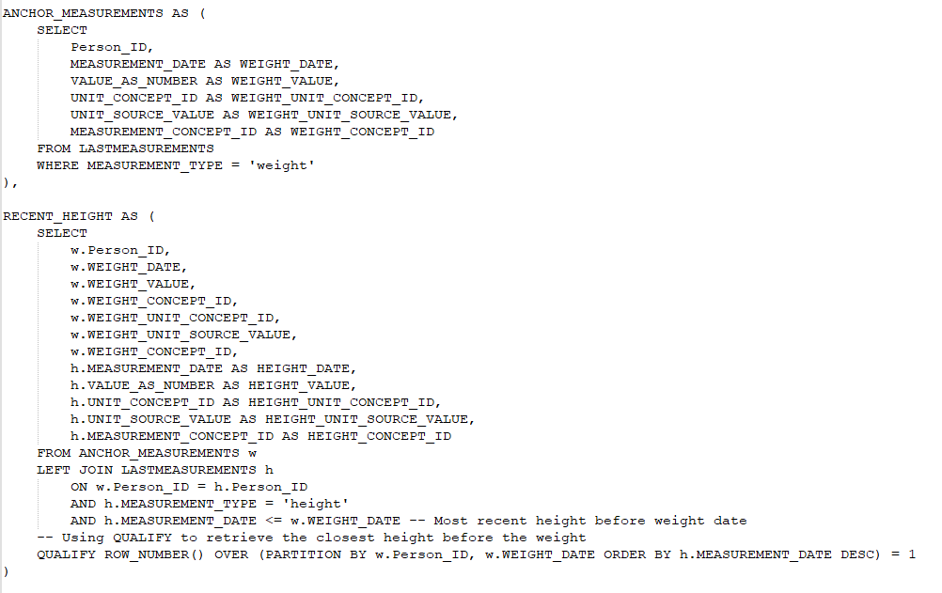
BMI SQL
Anchor on weight date and find most recent height prior to the weight date

Slide 25
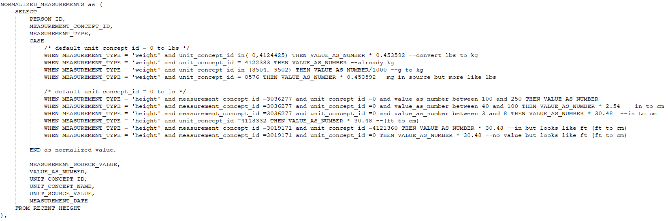
BMI SQL
Normalized values
* Typical Height Ranges
Centimeters (cm):
  Common range: 100–250 cm
Inches (in):
  Common range: 40–100 in
  (e.g., 5 ft = 60 in, 6 ft = 72 in)
Feet (ft):
  Common range: 3–8 ft (used less frequently as a numeric value, usually a combination like 5.7 ft).
Millimeters (mm):
  Common range: 1000–2500 mm

Slide 26
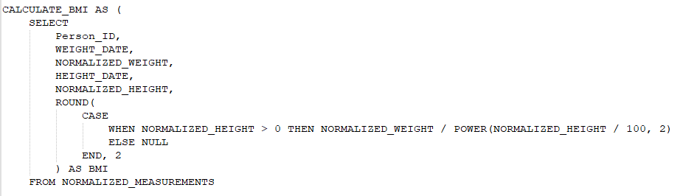
BMI SQL
Calculate BMI

Slide 27
BMI
Results
* Normal
Weight_concept_id | Weight | WEIGHT_Normalized | WEIGHT_UNIT_CONCEPT_ID | WEIGHT_UNIT_SOURCE_VALUE | Height_concept_id | Height | HEIGHT_Normalized | HEIGHT_UNIT_CONCEPT_ID | HEIGHT_UNIT_SOURCE_VALUE | CALCULATED_BMI | BMI_STATUS
3025315 | 197 | 89.357624 | 0 | NULL | 3036277 | 72 | 182.88 | 0 | NULL | 26.72 | Valid
3025315 | 146 | 66.224432 | 0 | NULL | 3036277 | 68 | 172.72 | 0 | NULL | 22.2 | Valid
3025315 | 134 | 60.781328 | 0 | NULL | 3036277 | 65 | 165.1 | 0 | NULL | 22.3 | Valid
3025315 | 175.1 | 79.4239592 | 0 | NULL | 3036277 | 68 | 172.72 | 0 | NULL | 26.62 | Valid
3025315 | 280 | 127.00576 | 0 | NULL | 3036277 | 79 | 200.66 | 0 | NULL | 31.54 | Valid
3025315 | 239 | 108.408488 | 0 | NULL | 3036277 | 74 | 187.96 | 0 | NULL | 30.69 | Valid
3025315 | 199 | 90.264808 | 0 | NULL | 3036277 | 73 | 185.42 | 0 | NULL | 26.25 | Valid
3025315 | 168 | 76.203456 | 0 | NULL | 3036277 | 67 | 170.18 | 0 | NULL | 26.31 | Valid
3025315 | 223 | 101.151016 | 0 | NULL | 3036277 | 66 | 167.64 | 0 | NULL | 35.99 | Valid
3025315 | 188.8 | 85.6381696 | 0 | NULL | 3036277 | 62 | 157.48 | 0 | NULL | 34.53 | Valid
High
Weight_concept_id | Weight | WEIGHT_Normalized | WEIGHT_UNIT_CONCEPT_ID | WEIGHT_UNIT_SOURCE_VALUE | Height_concept_id | Height | HEIGHT_Normalized | HEIGHT_UNIT_CONCEPT_ID | HEIGHT_UNIT_SOURCE_VALUE | CALCULATED_BMI | BMI_STATUS
3025315 | 434.4 | 197.0403648 | 0 | NULL | 3036277 | 66 | 167.64 | 0 | NULL | 70.11 | High
3025315 | 289.91 | 131.5008567 | 0 | NULL | 3036277 | 46.378 | 117.80012 | 0 | NULL | 94.76 | High
3025315 | 485 | 219.99212 | 0 | NULL | 3036277 | 69 | 175.26 | 0 | NULL | 71.62 | High
3025315 | 390.4 | 177.0823168 | 0 | NULL | 3036277 | 60 | 152.4 | 0 | NULL | 76.24 | High
3025315 | 511 | 231.785512 | 0 | NULL | 3036277 | 69 | 175.26 | 0 | NULL | 75.46 | High
3025315 | 289 | 131.088088 | 0 | NULL | 3036277 | 3 | 91.44 | 0 | NULL | 156.78 | High
3025315 | 602.74 | 273.3980421 | 0 | NULL | 3036277 | 71 | 180.34 | 0 | NULL | 84.06 | High
3025315 | 276 | 125.191392 | 0 | NULL | 3036277 | 47 | 119.38 | 0 | NULL | 87.84 | High
3025315 | 495 | 224.52804 | 0 | NULL | 3036277 | 69 | 175.26 | 0 | NULL | 73.1 | High
3025315 | 793.6 | 359.9706112 | 0 | NULL | 3036277 | 68 | 172.72 | 0 | NULL | 120.67 | High

Slide 28
BMI
Results
Weight_concept_id | Weight | WEIGHT_Normalized | WEIGHT_UNIT_CONCEPT_ID | WEIGHT_UNIT_SOURCE_VALUE | Height_concept_id | Height | HEIGHT_Normalized | HEIGHT_UNIT_CONCEPT_ID | HEIGHT_UNIT_SOURCE_VALUE | CALCULATED_BMI | BMI_STATUS
3025315 | 14.7 | 6.6678024 | 0 | NULL | 3036277 | 70 | 177.8 | 0 | NULL | 2.11 | Low
3025315 | 16 | 7.257472 | 0 | NULL | 3036277 | 76 | 193.04 | 0 | NULL | 1.95 | Low
3025315 | 8 | 3.628736 | 0 | NULL | 3036277 | 67 | 170.18 | 0 | NULL | 1.25 | Low
3025315 | 22.6 | 10.2511792 | 0 | NULL | 3036277 | 68 | 172.72 | 0 | NULL | 3.44 | Low
3025315 | 15 | 6.80388 | 0 | NULL | 3036277 | 69 | 175.26 | 0 | NULL | 2.22 | Low
3025315 | 70 | 31.75144 | 0 | NULL | 3036277 | 98 | 248.92 | 0 | NULL | 5.12 | Low
3025315 | 18 | 8.164656 | 0 | NULL | 3036277 | 71.5 | 181.61 | 0 | NULL | 2.48 | Low
3025315 | 19.1 | 8.6636072 | 0 | NULL | 3036277 | 75 | 190.5 | 0 | NULL | 2.39 | Low
3025315 | 141.76 | 64.30120192 | 0 | NULL | 3036277 | 70 | 177.8 | 0 | NULL | 2.08 | Low
3025315 | 77 | 34.926584 | 0 | NULL | 3036277 | 76 | 193.04 | 0 | NULL | 9.37 | Low

Slide 29
Key points
Search for weight and height in OMOP Measurement
Evaluate the values and select appropriate concept IDs for analysis
Address inconsistent units and ensure all measurements are normalized

Slide 30

VINCI@VA.GOV with “OMOP” in the subject line

Slide 31
Reference
OMOP Academy (va.gov)
VA OMOP V5 CDM Specifications
VA Millennium OMOP Data Specifications V1.01.pdf
https://vaww.vhadataportal.med.va.gov/Portals/0/DataQualityProgram/Reports/Best_Practices_Guide_Race_Data.pdf
Data Review: Vital Signs in Millennium Data (va.gov)
VIReC Factbook: Corporate Data Warehouse (CDW) Vitals Sign 1.1 Domain (va.gov)

