Slide 1
Stop, Shop, and Roll
How not to lose in the new cybersecurity landscape.
Project Team: Charles A. Hulebak, Will Bobe, Alivia Coon, Edward Kim

Slide 2
Table of Contents
Background
Incident Response
The Threat
The Response
Cybersecurity Program Improvement
Introduction
Creating a Cybersecurity Department
Using the NIST Framework
To Be Continued

Slide 3
Background

Slide 4
Background
Stop, Shop, and Roll, Inc. (SSR) is a mega corporation formed from the merger of three large companies. Despite optimistic projections about IT synergies resulting from the merger, the blending of the IT departments has been difficult, symbolized by the hiring and firing of 3 separate CIOs. Successive cost cutting and consolidating measures implemented by these CIOs have left the Cybersecurity department dangerously unprepared for the current threat landscape.
This lack of preparation led to monday’s disastrous Ransomware incident and related Data Breach. Luckily Stop, Shop, and Roll merely needs to Stop, Drop, and Roll by instituting (1) good incident response, and (2) a plan to mature cybersecurity capabilities.

Slide 5
Key Issues and Complicating Factors
Simmons made 12 observations that highlight a deep lack of cybersecurity maturity in SSR.
No IT Strategy 9. No logs
No Policy Enforcement 10. No BCP.
A disconnect between Compliance and Security. 11. Nowhere to report.
IT Operations doesn’t conduct investigations 12. No staff, small budget.
No vetting of Third Parties
No centralized asset repository
No formal incident management process
Too many passwords

Slide 6
The Problem and How to Solve it
SSR currently faces two problems:
How to respond to the Ransomware and Data Breach Incident; and
How to develop and mature SSR’s Cybersecurity Capabilities.
Thankfully, many other companies have dealt with similar problems in the past, and various solutions exist. Namely, the Cybersecurity Program Management Framework (CPM).

Slide 7
Incident Response

Slide 8
The Threat
Landscape
Enemy
Tools
What are we dealing with?

Slide 9
The Threat: Landscape
Although the current incident was caused by Ransomware, merely focusing on a single threat will not prepare the company to deal with the multi-form, phased, and varied attacks which will hit vulnerable companies from every direction.
Malicious actors are legion, as are their tools of cyber-mischief.

Slide 10
The Threat: Enemy
Many adversaries exist in cyberspace. They may range from “script-kiddies” who use minor vulnerabilities to troll for fun, to “advanced-persistent-threats” posed by state actors who have nearly unlimited human and financial capital to penetrate your system, steal your data, and destroy your company.
The current ransomware attack may have come from a hacker who purchased the vector of attack online from a dark-net broker, or even from the Russian or Chinese government.

Slide 11
The Threat: Tools
Spyware, Ransomware, Phishing, Spear-Phishing, Cat-Phishing, Whaling, Trojans, Viruses, Insider-Espionage . . . just to name a few.
The tools and techniques malicious actors use to penetrate your system, steal your data, and destroy your integrity are varied.
According to most cybersecurity professionals, every major company either knows it has undergone a cybersecurity incident, or hasn’t discovered it yet.
The only defense, beyond reverting to the stone age, is preparation and having a good Incident Response Framework in place to mitigate the damage to continue business operations.

Slide 12
The Response
Introduction
Your Team + RACI
Your Plan
The Framework (17 - 24)
The Timeline
The Budget
Conclusion
Putting out the fire.

Slide 13
Intro: How to Respond
Like any good project, you will need to pick your team, and develop your plan. Once you have your team and your plan, you will need to execute as fast as possible to contain the threat.

Slide 14
Your Team
A Cross-Functional Incident Response Team will be essential to make sure you cover all your bases.
Info Security Staff (ISS): to handle investigation of the incident.
IT Staff: to help the ISS with specialized knowledge of apps/systems.
Legal Representative: legality of searches and contacting law enforcement.
Business Representative: to help ISS understand business implications.
Communication Representative: to speak for the company.
Incident responders: for specialized expertise to help ISS.
Breach notification providers: to comply with breach notification laws.

Slide 15
RACI: Who is responsible for what?
Action | Coordination | Logs (analysis and gather) | Forensics | Emergency Change Management | Technical Assurance | Monitoring and investigation | Law enforcement liaison | Media Messaging | International Messaging | Staff Messaging | Customer Messaging | Partner Messaging
Responsible Party
CIO/CISO/CPO | A |  |  | I | I | I | I | I | AR | AR | I | AR
Director of Cybersecurity | R | I | I | A | A | I | I | C | C | C | C | C
IT Operations | I | I | I | R | R
Enterprise Architecture | I |  |  | R | R
Enterprise Risk Management | I | I | I | I | C
Internal Audit | I |  |  |  |  | I
Internal Investigations | I | AR | AR | C | I | AR | AR
Forensic Services | I |  | R |  |  | R
Law Department | I |  |  |  |  | C
External Legal Counsel | I
R = Responsible = The person who performs the work. There must be one “R” on every row, no more and no less. “R” is the only letter that must appear in each row.
A = Accountable = The person ultimately accountable for the work or decision being made. Use this letter where appropriate, but not to excess – only when a key decision or task is at hand. There can be from zero to one “A’s” in each row, but no more than one.
C = Consulted = Anyone who must be consulted with prior to a decision being made and/or the task being completed. There can be as many “C’s” as are appropriate in each row.
I = Informed = Anyone who must be informed when a decision is made or work is completed. There can be as many “I’s” as are appropriate in each row.
https://www.healthprivacyforum.com/sites/healthprivacyforum/files/cybersecurity_incident_response_-_how_to_survive_an_attack.pdf

Slide 16
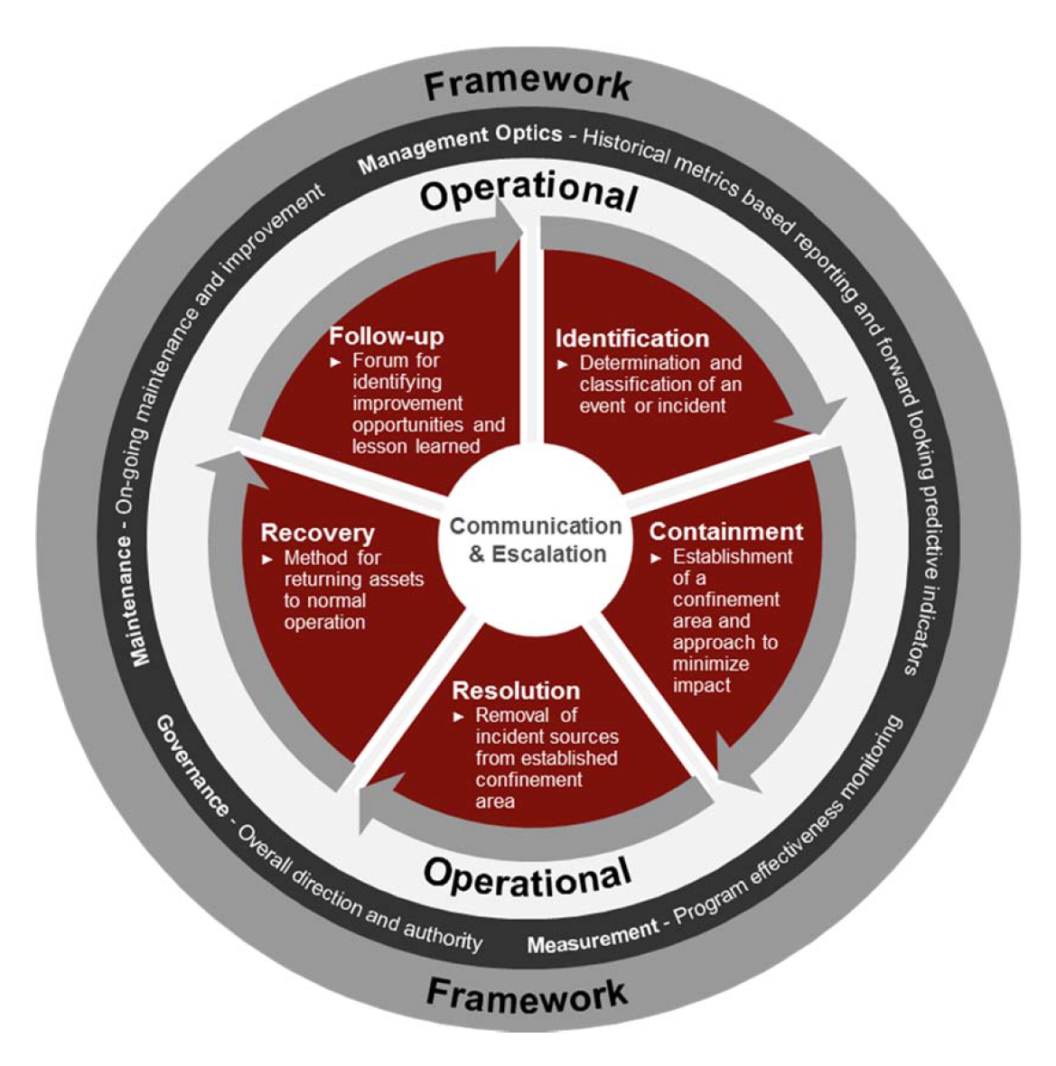
Your Plan: Incident Response Framework
A company must attempt to reduce chaos and formalize incident response procedures. Incident response typically follows a lifecycle, and is formalized as to provide effective and immediate response to minimize damage to a corporation. Typical steps include:
Identification,
Containment,
Resolution,
Recovery,
Follow-up

Slide 17
Understanding the Framework
The Framework is easy to understand:
The identification phase deals with determining that there is an incident.
The containment phase is in place to prevent further damage from occurring.
The resolution phase involves performing actions to eradicate the issue.
The recovery phase involves performing actions to return to normal operations.
The follow-up phase consists of lessons learned, including a summary of the incident and details of the other phases.

Slide 18
Identification
Identification: Where is the fire?
Windows servers are reported to be impacted by the ransomware attack
At least the C-suite computers are reported to be impacted by the ransomware attack
There appears to be a data breach as reported by Special Agent Leonard
It is important at this stage to establish documentation. Documentation should continue throughout the IR process.
References:
https://www.sans.org/reading-room/whitepapers/incident/incident-handlers-handbook-33901
https://nvlpubs.nist.gov/nistpubs/specialpublications/nist.sp.800-61r2.pdf

Slide 19
Containment 1 of 3
Containment: Making sure the fire doesn’t spread.
Attempt to isolate the affected machines from the rest of the network
This will help prevent the spread of the ransomware
E.g., remove the affected machines from the network by pulling the ethernet cable
Identify and patch any other potential vectors that are operating in the production environment
E.g., machines running the same software suite, improperly configured firewalls, routers and other devices
https://www.sans.org/reading-room/whitepapers/incident/incident-handlers-handbook-33901
https://nvlpubs.nist.gov/nistpubs/specialpublications/nist.sp.800-61r2.pdf

Slide 20
Containment 2 of 3
Hire an external Information Security Team (IST)
Due to budget cuts, there is no dedicated Information Security Team in place with experience in investigating and responding to incidents.
Assign Legal and Business representatives that are familiar with the business to guide the IST.
Hire a Public Relations, and Breach Notification firms to handle the fallout from the Incident.

Slide 21
Containment 3 of 3
Take a forensic image of any machines that will be reimaged or otherwise replaced
This will help maintain any evidence in an unaltered state which will be vitally important in the event of litigation
Should be performed by an external source
Cost between $5,000 and $15,000 for typical cases, but can cost up to $100,000 (https://www.vestigeltd.com/thought-leadership/digital-forensic-services-cost-guide-vestige-digital-investigations)
Containment should happen as fast as possible to prevent further damage. This is especially true of the isolation.
https://www.sans.org/reading-room/whitepapers/incident/incident-handlers-handbook-33901
https://nvlpubs.nist.gov/nistpubs/specialpublications/nist.sp.800-61r2.pdf

Slide 22
Resolution
Resolution: Putting out the fire.
Penetration of Systems
Cleaning and re-imaging hard drives
Hardening systems and network against attacks
Including thorough patching and removal of vulnerabilities
Dealing with Aftermath
Ensure the Breach Notification Firm is in communication with the IST and has all necessary information in regards to the Breach.
Hire a law firm to settle subsequent litigation matters.
https://www.sans.org/reading-room/whitepapers/incident/incident-handlers-handbook-33901
https://nvlpubs.nist.gov/nistpubs/specialpublications/nist.sp.800-61r2.pdf

Slide 23
Recovery
Recovery: Rebuilding the house.
Penetration of Systems
Restoring previously affected machines to production
This phase requires testing, monitoring, and validation that the machines are clean and ready to be returned to production
Dealing with Aftermath
Work with the PR firm to restore investor and consumer trust in the brand.
https://www.sans.org/reading-room/whitepapers/incident/incident-handlers-handbook-33901
https://nvlpubs.nist.gov/nistpubs/specialpublications/nist.sp.800-61r2.pdf

Slide 24
Follow-up
The follow-up phase: Making sure this doesn’t happen again. The follow-up should have:
When and by whom the incident was detected
How widespread and impactful the incident was
Steps taken to contain and eradicate the issue
Steps taken for recovery
Positive feedback
What went well?
Negative feedback
What could have been done better?
https://www.sans.org/reading-room/whitepapers/incident/incident-handlers-handbook-33901
https://nvlpubs.nist.gov/nistpubs/specialpublications/nist.sp.800-61r2.pdf

Slide 25
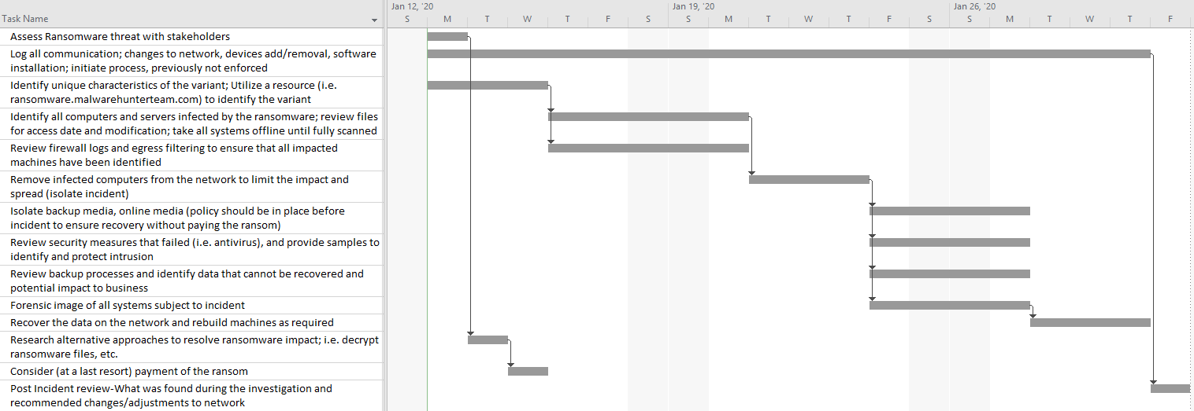
2 Week Timeline
https://www.sans.org/reading-room/whitepapers/ActiveDefense/ransomware-37317

Slide 26
Budget for this particular Incident
Following this ransomware attack, SSR will have to consider many financial factors, including the direct cost of the ransom payment, and indirect costs associated with downtime, reputation loss, liability, collateral damage, and data loss. Monetizing these factors, SSR could expect the following financial loss:
Type of Loss Cost of Loss
Direct cost: ransom payment 10M
Indirect cost: enforced downtime 961M
Indirect cost: reputation loss 1.25B
Indirect cost: liability 1.25B
Indirect cost: collateral damage 135M
Indirect cost: data loss 270M
Total Loss 3.877B
Refer to Addendum A for calculations
https://digitalguardian.com/blog/whats-cost-data-breach-2019
https://www.sentinelone.com/blog/what-is-the-true-cost-of-a-ransomware-attack-6-factors-to-consider/

Slide 27
Conclusion to Incident Response
Creating an effective team of internal and external responders, and implementing the incident response framework will put out this particular fire. A quick and decisive response will mitigate damage to the company’s finances and public reputation. However, in order to better prepare for the inevitable next attack the company needs to improve its Cybersecurity Program.

Slide 28
Cybersecurity Program Improvement

Slide 29
Introduction
Why do we care?
CPM Maturity Model
CPM Framework
The basics.

Slide 30
Why do we care?
Experts have recently coined the term “cyber fatality” to describe corporations that have been put out-of-business by an especially devastating cyber attack. Just this monday, SSR suffered what may turn out to be a Merck-level incident, which ended up costing that company around 1.3 billion dollars.
There is nothing stopping the Ransomware hackers from attacking SSR again, a few weeks after we restore all the systems from backup. The only defense is to advance SSR’s cybersecurity capabilities to an acceptable level.
For more information on Merck cyber attack. See https://www.insurancejournal.com/news/national/2019/12/03/550039.htm

Slide 31
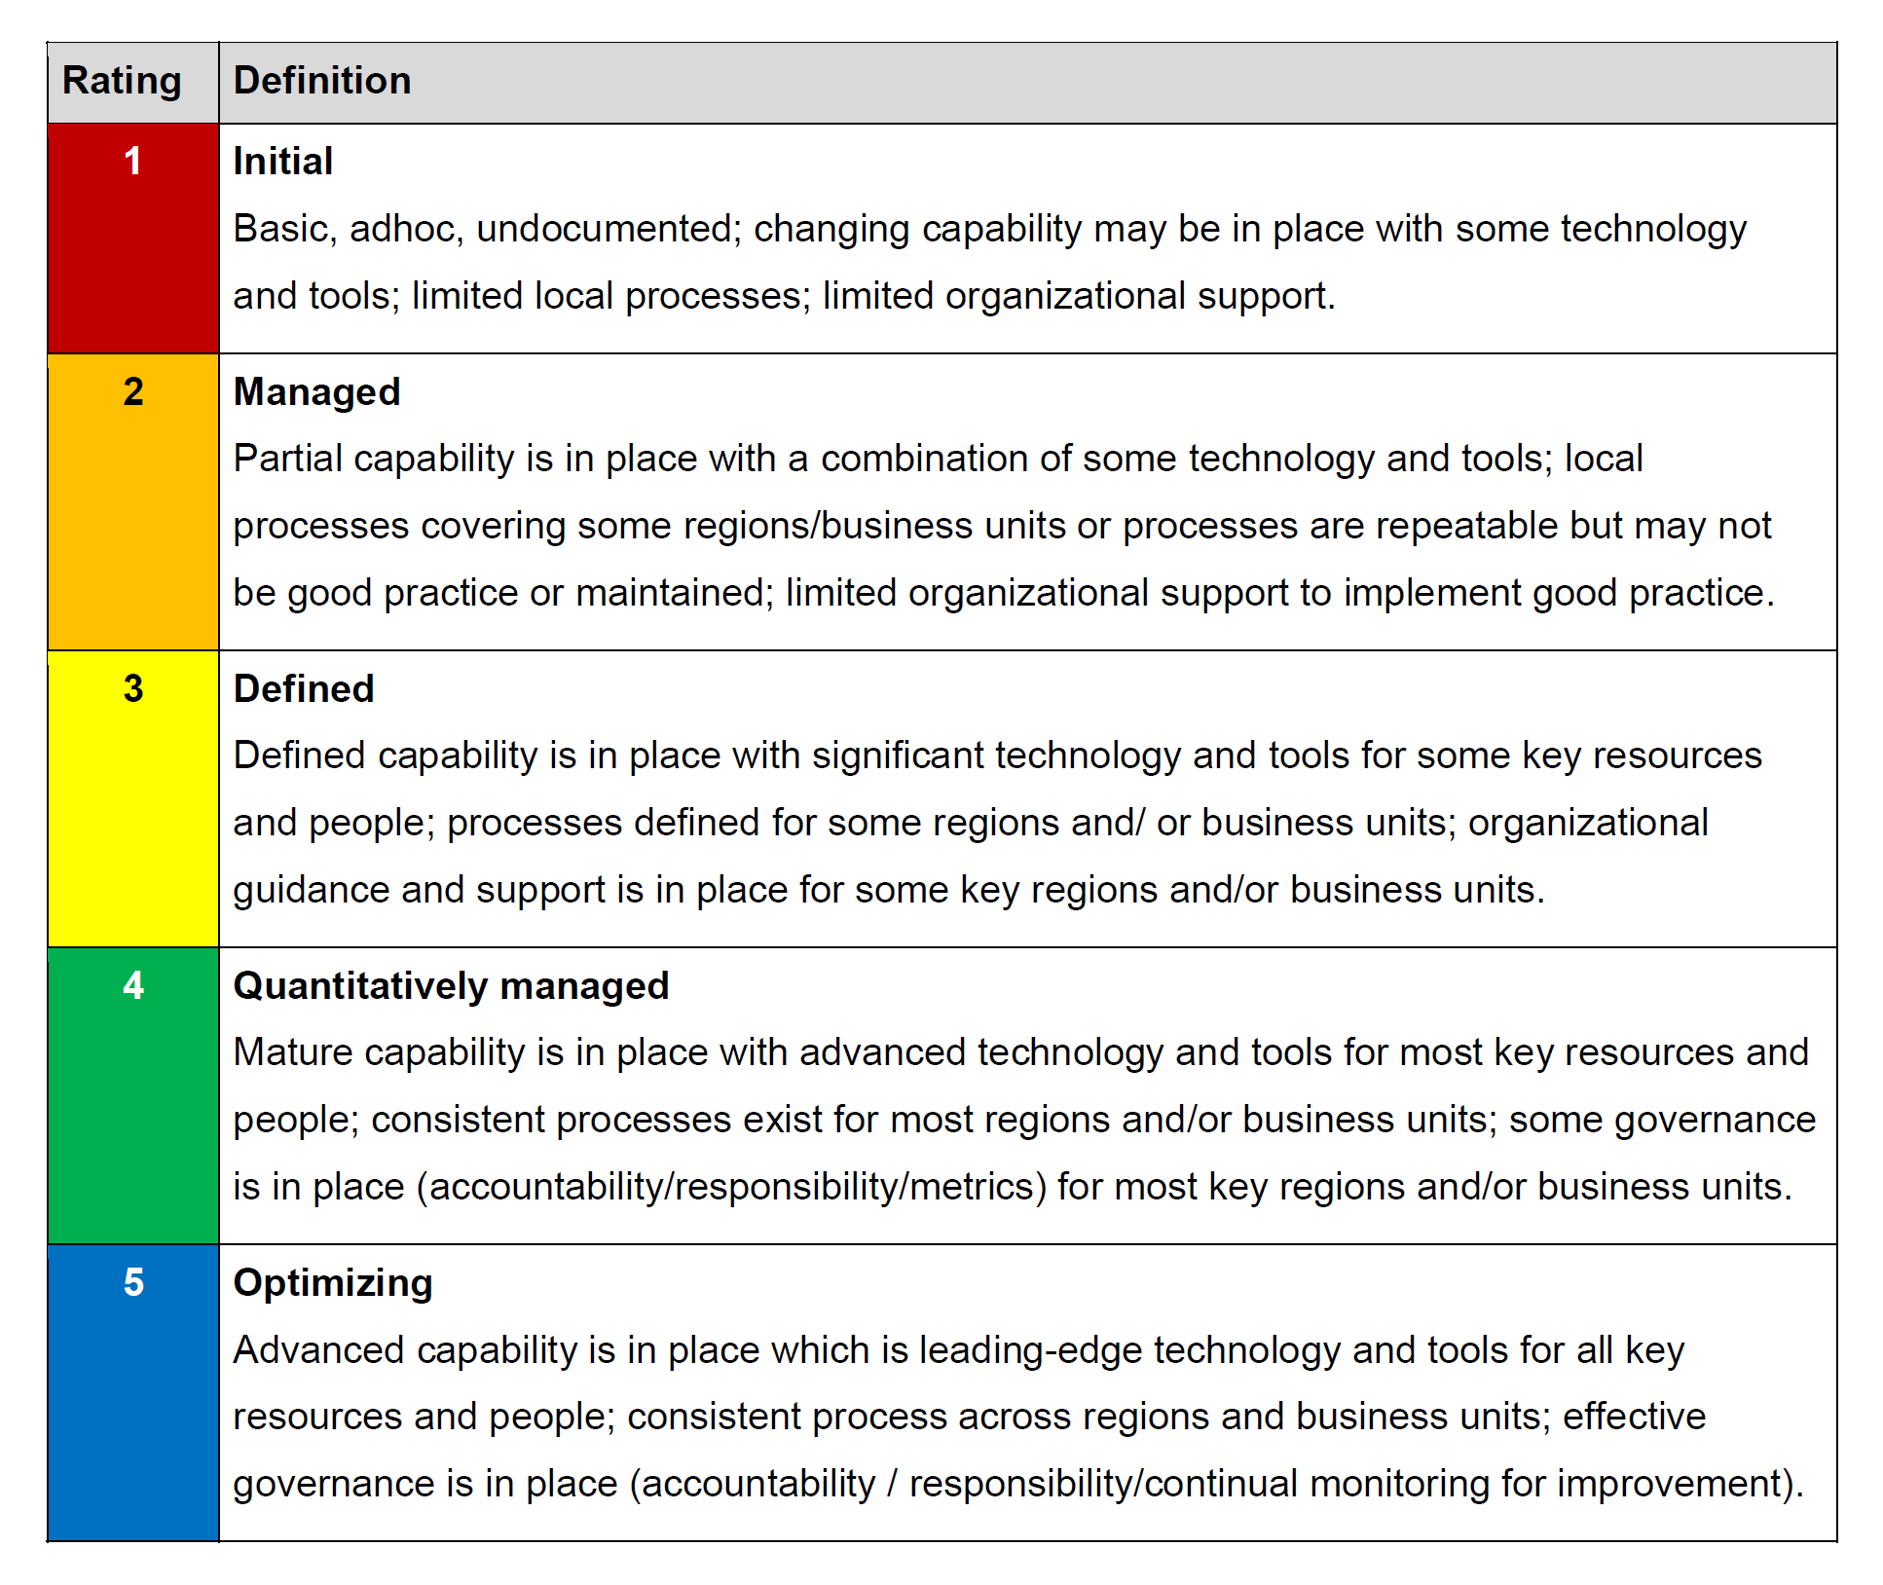
CPM Maturity Model
The CPM Maturity Model shows how developed a corporation’s cyber defense capabilities are.
Currently we are at a 1. There are no logs, no dedicated cybersecurity department, and the IT Operations staff doesn’t even conduct investigations.
As an online business giant, we need to take this to a 5.

Slide 32
Cybersecurity Program Management Framework
How do we take this to a 5?
All successful Cybersecurity Departments must be able to:
Complicate the attack
Detect the attack
Respond to the attack
Educate the workforce; and
Govern effectively.

Slide 33
Creating a Cybersecurity Department
Initial Steps
Creating a Cybersecurity Dept.
One team, with one mission.

Slide 34
Initial Steps
The first step will be to create and fund a dedicated Cybersecurity department (CSD). This CSD will plan, direct, and execute all cybersecurity tasks within SSR. Forming the CSD will clarify duties and responsibilities within SSR, and resolve many of the 12 Simmons observations. Namely, the CSD can create and implement IT strategy, Policy enforcement, conduct formal investigations, ensure all transactions are logged, and conduct the formal incident management process. Most importantly, every dollar allocated to the Cybersecurity Department won’t be siphoned off to IT Help Desk or other services, but be dedicated to improving Cybersecurity.
Hint: Instead of starting from scratch, consider buying an existing cybersecurity firm.

Slide 35
Creating a Cybersecurity Department
Bring the current skill set and capabilities together to develop the department
Move PCI team to new department
Realign PCI team’s goals with security, rather than merely compliance
Move IT operations personnel that conduct monitoring and incident response to the new department
Provide training (in-house or externally)
Hire skilled experts

Slide 36
Using the NIST Framework
IPDRR
Identify
Protect
Detect
Respond
Recover
Long Term Plans
A clear framework for developing cybersecurity capabilities.

Slide 37
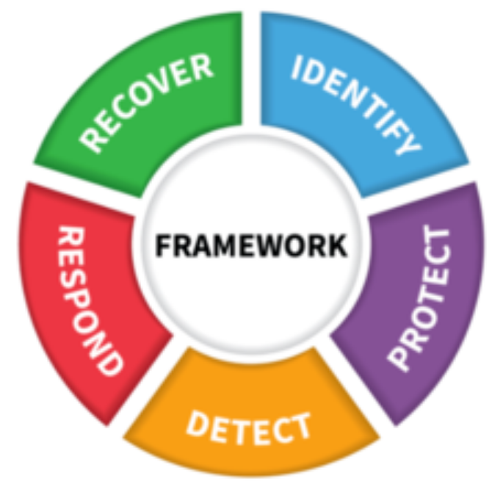
IPDRR
Leverage the NIST Cybersecurity Framework
Identify
Protect
Detect
Respond
Recover
https://www.nist.gov/cyberframework/online-learning/five-functions

Slide 38
Identify
All of the organization’s assets, policies, mission, etc., need to be identified, documented, and tracked, examples of what needs to be identified include:
Assets for the organization (people, data, systems and devices, facilities)
Allows for centralization of asset repository and inventory
Legal requirements (policies, agreements, regulations, legislation)
Establish accountability
Allows for appropriate policy enforcement
Threats, vulnerabilities, risks
Vendor security
Maintain vendor policies and review; vetting for security
Reporting metrics
Have a workflow for reporting to executive management on security issues

Slide 39
Protect
An executable plan needs to be in place to protect all of the organization’s assets (personnel, data, systems, devices, etc.). Examples of protection:
Security first versus compliance first
Security will result in compliance
Safeguards to ensure delivery of critical services
Redundancy of systems, servers, connections, etc. to allow for normal operations to continue during incidents
Credential and authentication management (e.g., Active Directory with appropriate Organizational Units, single sign on (SSO), and multifactor-authentication)
Integration across the enterprise
Awareness training for personnel and partners

Slide 40
Detect
A well maintained detection scheme needs to be in place. This includes:
Intrusion detection and prevention systems (e.g., Snort)
Snort is free, cost of personnel to configure and maintain
Address logging and monitoring
Appropriate event logging and analysis (e.g., ELK stack)
Appropriate training for determining false positives and negatives in events and logging
Pricing for ELK stack running on the cloud up to around $106,000/year (https://cloud.elastic.co/pricing)
Possible to run ELK locally with reduced functionality, likely to cost more for engineers to maintain than it would for the cloud
Monitoring systems, personnel, facilities, etc.
Monitoring will be conducted by the new department, with dedicated personnel and systems

Slide 41
Respond
Effective and efficient event and incident response is key to a well-established cybersecurity program. This should include:
Defined criteria for incident response
Appropriate framework established, reviewed, and maintained for incident response
Framework should be repeatable
Clear and appropriate assignment of roles for incident response team or teams
Incidents mitigated and contained
Review after action reports and follow-ups that results in appropriate modification to incident response plans

Slide 42
Recover
A plan for recovery after an incident is vital. This can be one of the most chaotic times, and without a clear path toward recovery, it will cost more time and money to do so. Recover should include:
Plans for mitigation, including public relations
Plans for processes, lessons learned, how activities will be restored to normal
The plans should build resiliency and be a part of the enterprise Disaster Recovery Plan/Business Continuity Plan
Consider whether to have a cold, warm, or hot site (if any)
Well maintained backup and recovery plan and process
Including testing the process/time it takes to perform a full recovery

Slide 43
Long Term Plans
Long term plans include a methodical refinement of the plans laid out. Refinement should include:
Reciprocal application, review, and modification of the plans
Lessons learned
Pros and cons of the plan (i.e., what’s working, what’s not)
A willingness to let go of parts of the plan that are not working and to try new ideas

Slide 44
To Be Continued
Key Issues and Complicating Factors Revisit
Two Year Timeline
Budget
Conclusion
Timeline, Budget, Conclusion

Slide 45
Key Issues and Complicating Factors Revisit
Through the implementation of the NIST framework, we have resolved all of the Simmons concerns.
IT Strategy 9. Logs
Policy Enforcement 10. A solid BCP.
Connecting Compliance and Security. 11. A single place to report.
Formal investigations 12. A cyber team with sufficient staff,
Vetting of Third Parties and budgeting.
A centralized asset repository
A formal incident management process
A simple, multi-factor authentication system

Slide 46
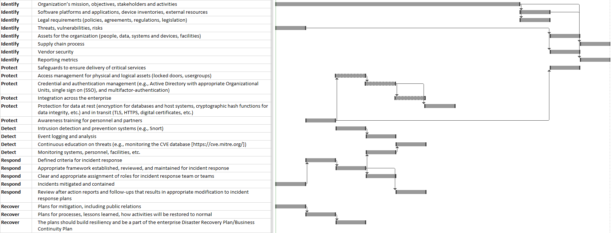
Two Year Timeline
This timeline represents the work that SSR will be doing in a 2 year timeframe. The duration of each task translates to a multi-phased plan for addressing key issues milestones and capability improvements delivered every quarter (approx every 3-5 months).
Y1 Y2
Q1 Q2 Q3 Q4 Q1 Q2 Q3 Q4

Slide 47
Budget: Quick Facts
Quick facts for SSR: 25 billion dollar company. 12.5 billion in revenue (time-revenue).
SSR should be spending: 400 million on IT (3.2% revenue). 40 million on IT Security (10% of IT Budget).
SSR is spending: Too little on Security.
References:
Time Revenue method to calculate company value: https://www.investopedia.com/terms/t/times-revenue-method.asp
Large companies (>2billion) spend 3.2% of revenue on IT: https://blog.techvera.com/company-it-spend
6-14% of ITBudget is Security (10% selected): https://www.pionline.com/article/20190501/ONLINE/190509988/financial-services-firms-spend-6-to-14-of-it-budget-on-cybersecurity-survey
Example datapoint. Amazon spends 13.6 billion on IT: https://www.wsj.com/articles/amazon-alphabet-and-walmart-were-top-it-spenders-in-2018-11547754757
Consider purchasing Cybersecurity Firm: https://www.businessinsider.com/amazon-web-services-acquires-harvestai-2017-1
Cyber security for business – counting the costs and finding the value https://media.kaspersky.com/en/business-security/cybersecurity-for-business-counting-the-costs-finding-the-value.pdf

Slide 48
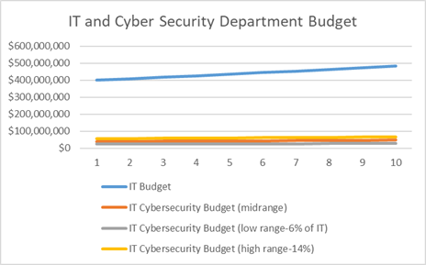
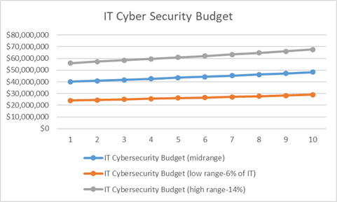
Budget Continued.
Creating a dedicated cybersecurity budget will only cost a fraction of the overall IT budget while providing sufficient security to SSR.
Low-end protection would only run about 6% of the IT Budget, while higher-end protection would run about 14% of the IT Budget.

Slide 49
Conclusion
Cybersecurity capabilities are a central pillar to business success in any large corporation. Developing cybersecurity capabilities within SSR will be an ongoing process. The initial foundations can be laid within a 2 year period, but there will need to be constant reassessment and improvement to combat new and emerging threats as time progresses. The new world of technology has given us an unprecedented capability to process information, communicate, and sell to people worldwide but this capability comes with risks. A good, clear-eyed, mature cybersecurity program can mitigate those risks.

Slide 50
Resources/Addendum A
P. Kral, "Incident Handler's Handbook | SANS Institute", Sans.org, 2012. [Online]. Available: https://www.sans.org/white-papers/33901/.
Information Systems Audit and Control Association (ISACA), COBIT 5. Rolling Meadows, IL: Information Systems Audit and Control Association (ISACA), 2013. [Online]. Available: https://store.isaca.org/s/store#/store/browse/detail/a2S4w000004KoCDEA0.
"Cost of a data breach 2022", Ibm.com, 2022. [Online]. Available: https://www.ibm.com/reports/data-breach.
"What's the Cost of a Data Breach in 2019?", Digital Guardian, 2019. [Online]. Available: https://digitalguardian.com/blog/whats-cost-data-breach-2019.
"Assessing Security and Privacy Controls in Information Systems and Organizations", csrc.nist.gov, 2022. [Online]. Available: https://csrc.nist.gov/publications/detail/sp/800-53a/rev-5/final#pubs-documentation.
"Information Security Handbook: A Guide for Managers", csrc.nist.gov, 2006. [Online]. Available: https://csrc.nist.gov/publications/detail/sp/800-100/final.
Informative References Asset Management (ID.AM)”, ", csrc.nist.gov, 2006. [Online]. Available: https://csrc.nist.gov/publications/detail/sp/800-100/final.
"The Cost of Malicious Cyber Activity to the U.S. Economy", whitehouse.gov, 2018. [Online]. Available: https://www.whitehouse.gov/wp-content/uploads/2018/03/The-Cost-of-Malicious-Cyber-Activity-to-the-U.S.-Economy.pdf.
"Cybersecurity Framework Manufacturing Draft", csrc.nist.gov, 2016. [Online]. Available: https://www.nist.gov/system/files/documents/2017/06/12/csf-manufacturing-profile-draft.pdf.
"Framework for Improving Critical Infrastructure Security", csrc.nist.gov, 2018. [Online]. Available: https://nvlpubs.nist.gov/nistpubs/CSWP/NIST.CSWP.04162018.pdf.
"Framework Resourcescsrc.nist.gov, 2022. [Online]. Available: https://www.nist.gov/document/2018-04-16frameworkv11core1xlsx.

