Slide 1
HIGH GEAR ENGINE COMPANY
Project Team: Will Bobe, Alivia Coon, Charles Ajax Hulebak, Edward Kim

Slide 2
Table of Contents
Background
High Gear History
IT Background
Corporate Information Technology Functions
Information Technology Challenges
Information Technology Risk Management
Scope and Approach
Main Concerns
Information Technology Department Transformation
IT Risk Rankings
Translating Observations in an Action Plan
COBIT Categorization of Risks
Calculating and Prioritizing Risks
Quantifying Probability and Impact
Quantifying Financial Impact based on Risks
Solutions
Implementation and Recommendations
Timeline
Information Technology Timeline and Milestones
Budget
IT Department Budget
Addendum and References
Addendum A
Addendum B
References

Slide 3
Background
A concise history of HG and root issues

Slide 4

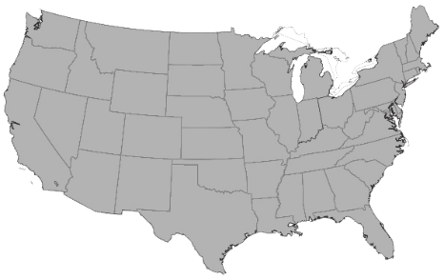
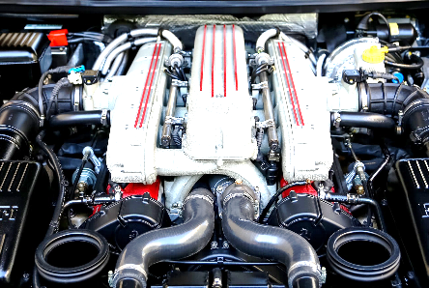

High Gear History
High Gear Engine Company (HG) is a global automotive supplier with operations around the world. Founded in 1937, HG specializes in engines for automobiles, industrial, mining and farming equipment, and many others.
HG business units and specializations:
Velocity Engines – Focuses on high-end sports cars and consumer-grade engines. These products command a premium in the market and
Long Haul Motors – Produces diesel and large engines for semi-trailer trucks. Long haul is known well known in the market for its durability and is a recognized leader in the trucking industry.
Bigger Digger Power and Motor – Specializes in mining equipment engines and motors. They supply to the major mining and industrial equipment manufacturers and often “white label” their engines as their customers’ brand.
HG is located in Detroit, Michigan and has over 75 plants, performance labs and manufacturing facilities worldwide.
Image Credit: MustangJoe from Pixabay
Image Credit: David Jewiss from Pixabay
Image Credit: darkworkX from Pixabay

Slide 5
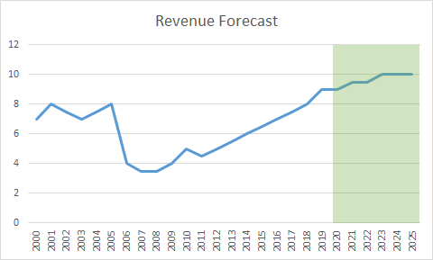
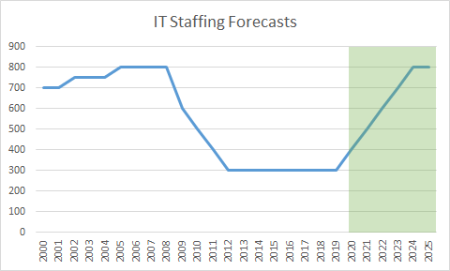
IT Background
HG was purchased by Velocity Partners following bankruptcy and the economic downturn in 2008. In effort to remain competitive in the business, HG downsized by reducing employees and closing several global locations. Business has increased during the past five years, increasing profitability and revenue over $9 billion annually, with plans for 17% compounded annual revenue growth and a profit margin of 15%. These business successes and future forecasts are providing the ability to reopen some factories and other opportunities to support future growth.
HG is seeking to support this future growth by making some major changes in technology, which has been deferred for nearly a decade and needing improvements to infrastructure and applications. Prior to economic shifts, the HG IT department had over 800 employees, dedicated teams for each business unit and centralized team to share corporate responsibilities for IT systems. There was an excessive amount redundancies and duplicated efforts, ranging from personnel to systems. HG currently employs a much smaller amount of personnel, with about 300 personnel to manage the responsibilities, while IT support and services have suffered. In effort to main
In effort to improve future growth for HG’s technology transformation, HG has hired a new CIO, Sara Miller, who is a seasoned executive with industry experience and eagerness to develop both short and long-term solutions for the company.

Slide 6
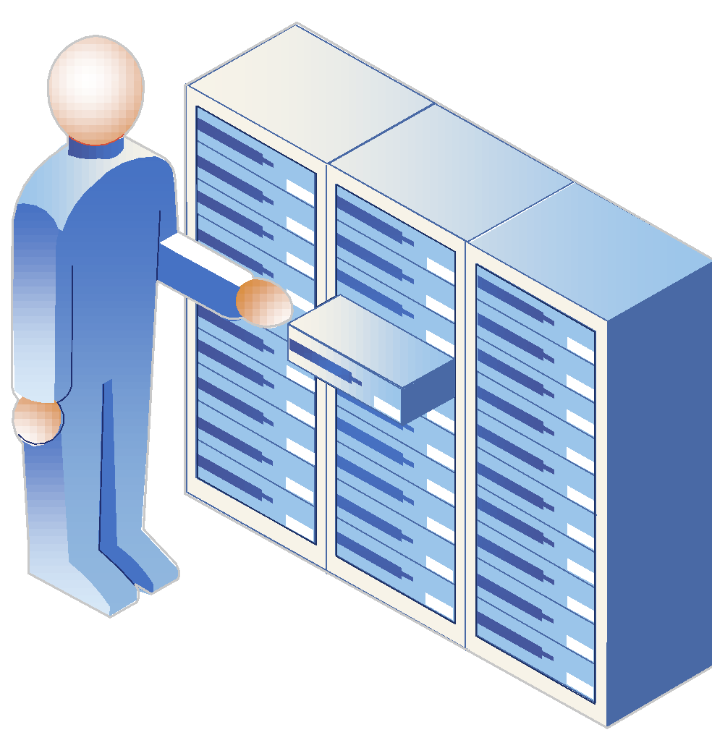
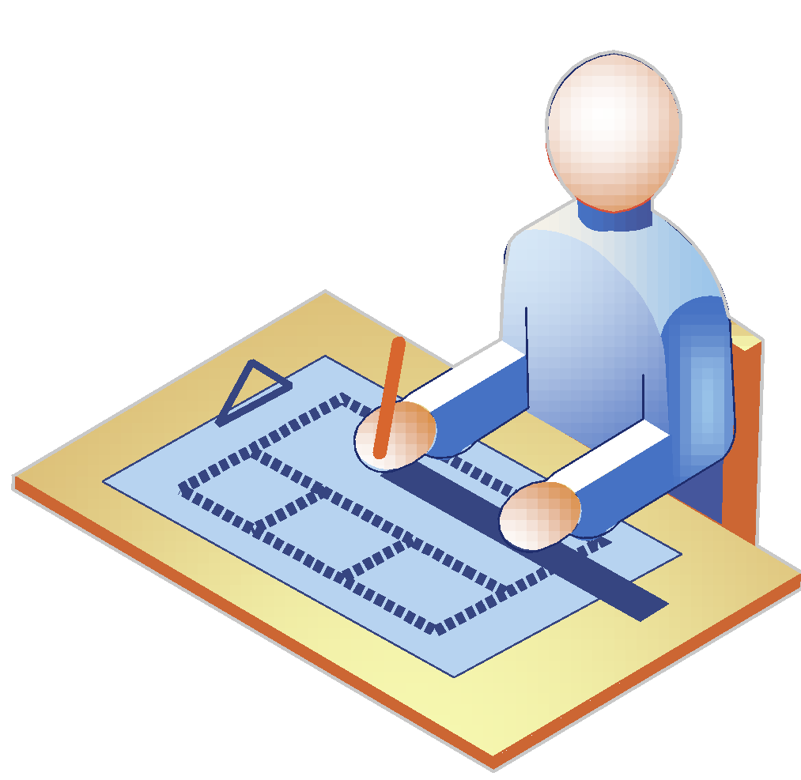



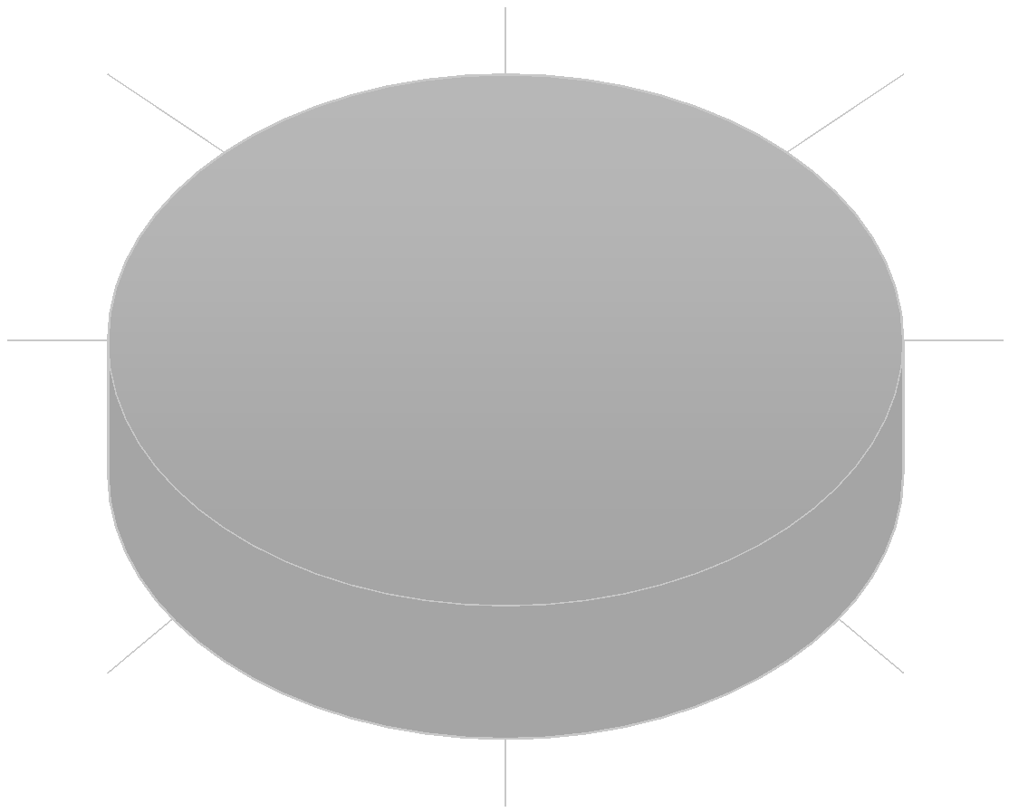


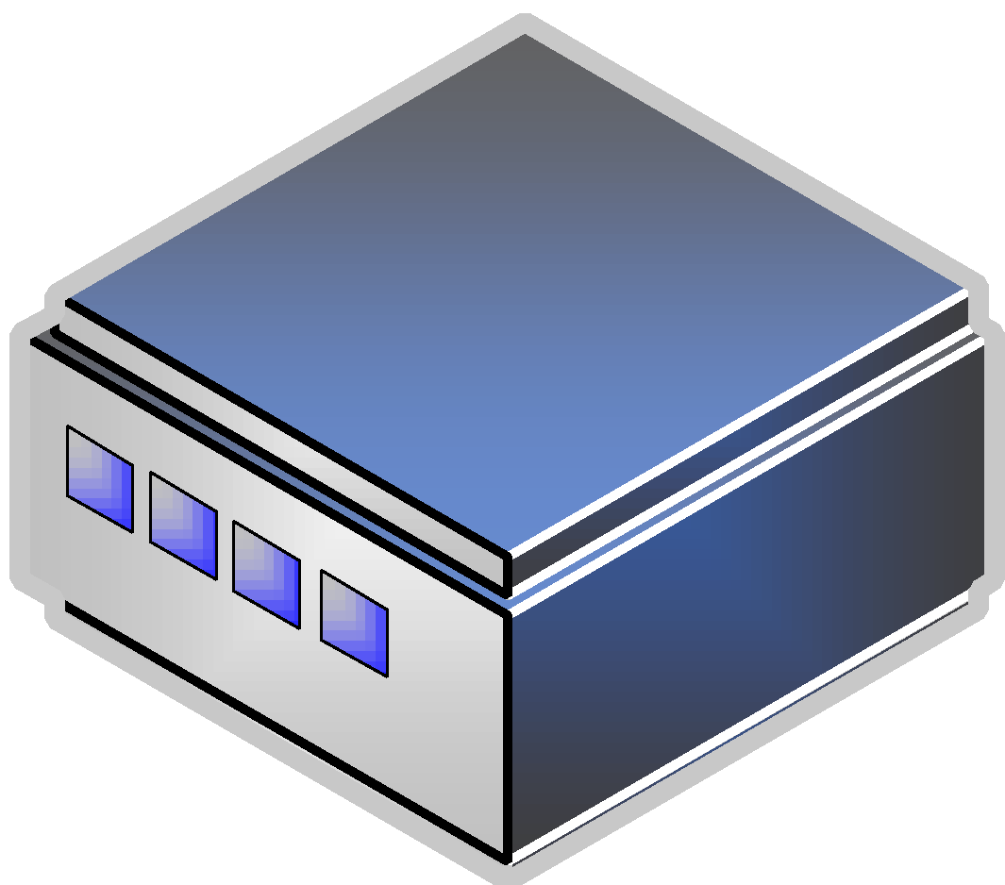

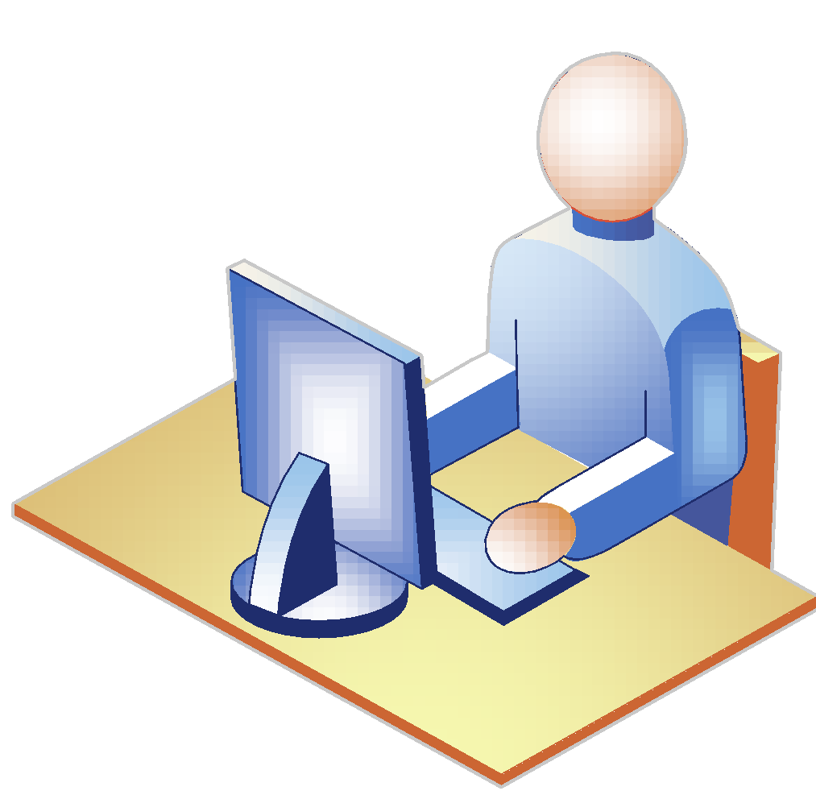

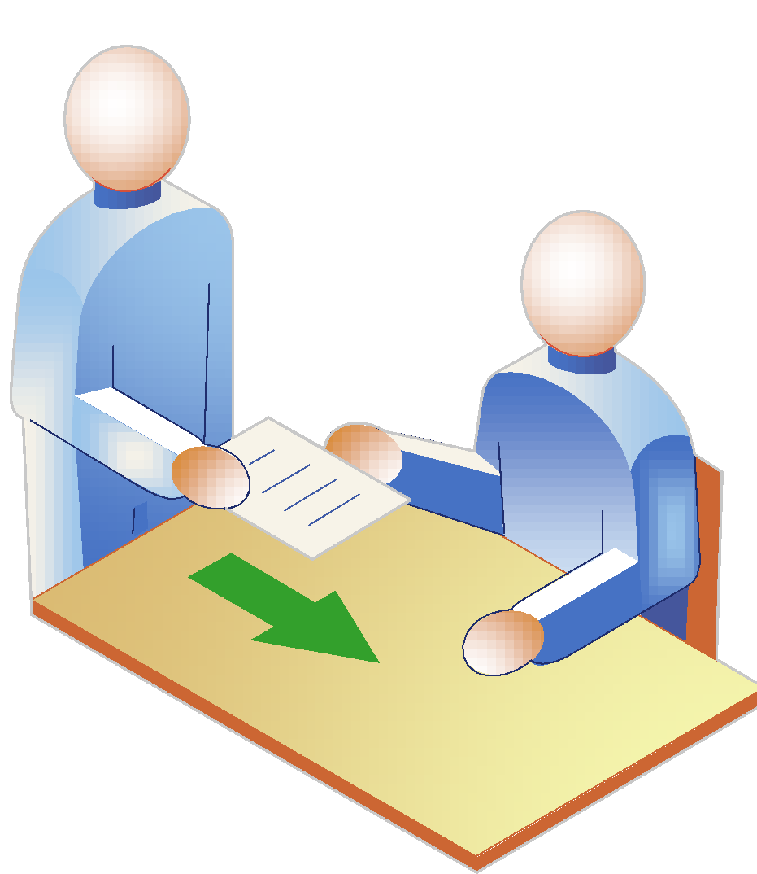
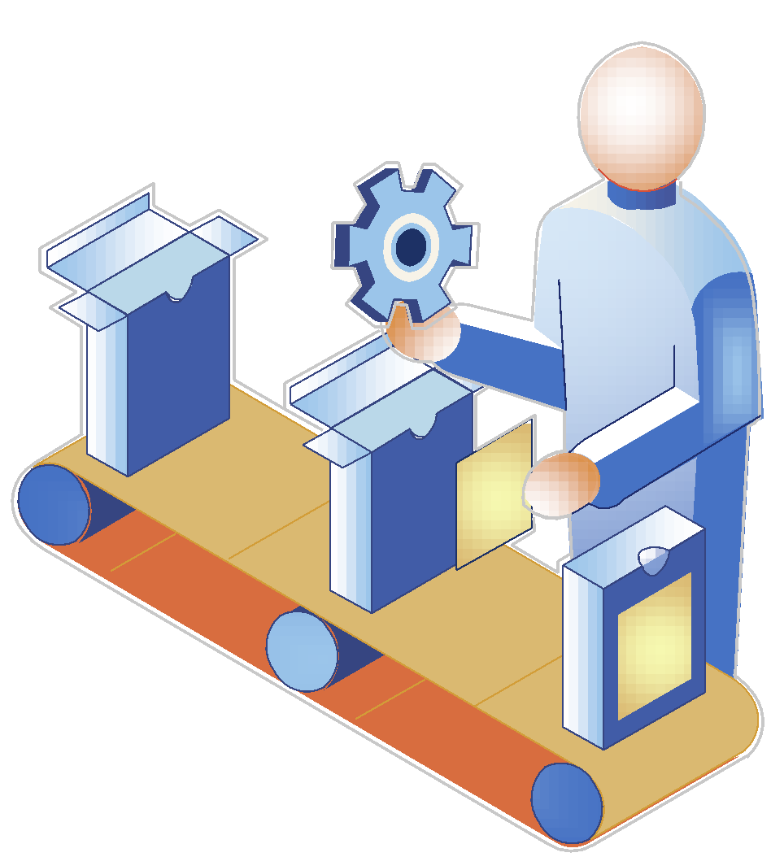
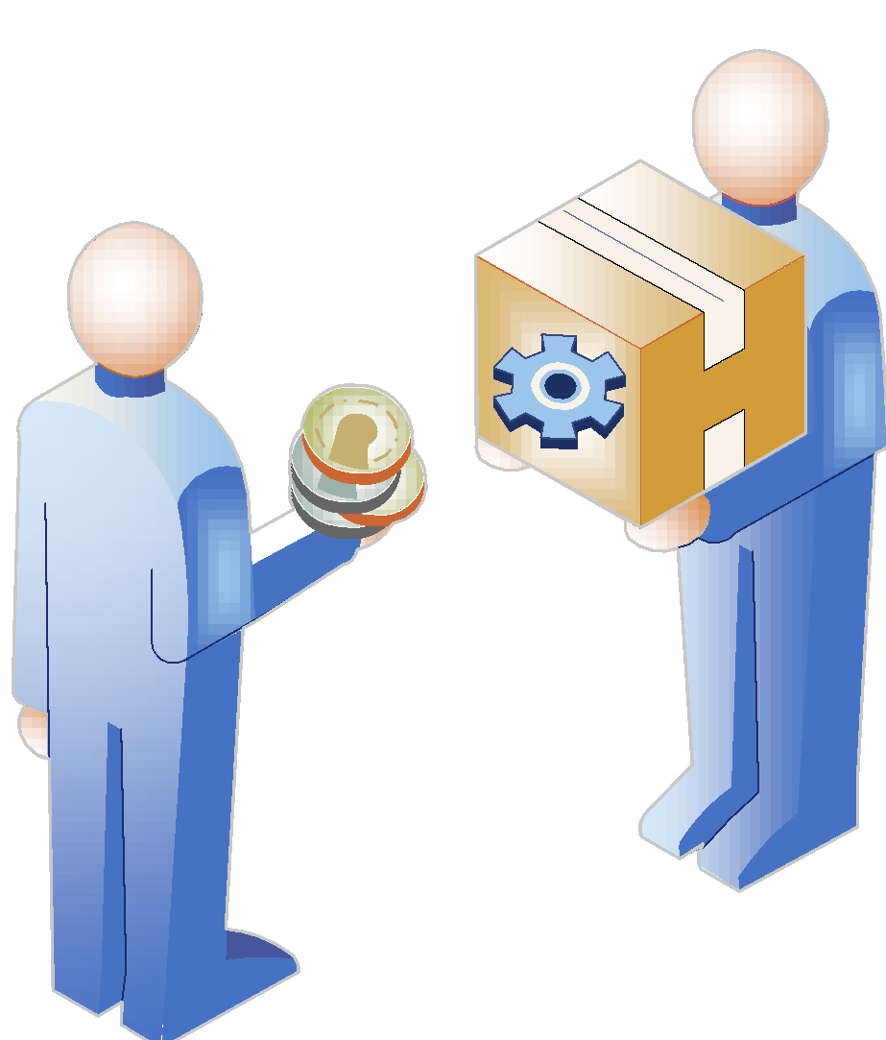
Corporate Information Technology Functions
Following the economic shifts, HG has operated as three independent business units with management by corporate IT.
Corporate and shared IT functions:
Information Security
IT Risk Management
IT Audit and Compliance
IT Operations
Disaster Recovery
IT Infrastructure
IT Strategy
Email and Office Productivity
Telecommunications
Enterprise Architecture
IT Financial Management
Business Analytics and Information
Management
EDI (Electronic Data Interchange)
IT Program Management
IT Helpdesk and Support
IT Vendor Management
Business unit IT functions:
Engineering and CAD Systems
Product Lifecycle Management
Research and Development
ERP Systems
Supply Chain Systems
Customer Relationship Management
Systems
Business Initiative Program
Management
Manufacturing and Shop-Floor Systems
Long Haul Motors
Corporate IT
Bigger Digger P&M
Velocity Engines

Slide 7

Information Technology Challenges
The new CIOs first three weeks were spent interviewing all the major business and IT stakeholders in the company. Her preliminary observations included:
No one is accountable for information security
Connectivity is a problem
There are too many ERPs and they are expensive to maintain
IT audit issues are piling up
Manufacturing and shop floor systems are old and causing the production line to stop
PCs and operating systems are old and unsupported
No one understands how the applications and business systems work except the vendor
In response to these challenges, Miller is seeking to incorporate an IT Risk Management Framework in alignment with the business continuity plan to meet the current and future needs of HG.
Image Credit: Gerd Altmann from Pixabay

Slide 8
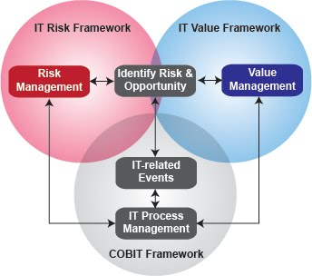
Information Technology Risk Management
Miller is seeking to incorporate ISACA’S Risk IT framework, complementing COBIT while focused on positioning HG IT with business objectives, building trust and value.
Her tangible business efforts are focused on fewer operational surprises and failures, increased information quality, greater stakeholder confidence, reduced regulatory concerns, and innovative applications supporting new business initiatives.
ISACA’s risk management framework is divided into three domains, including Risk Governance, Risk Evaluation, and Risk Response.
The IT risk framework is seeking to provide transparency with end-to-end processes, identifying adverse IT-related risks that could impact a range of internal and external stakeholders, including executive management, corporate risk managers, operational risk managers, business continuity managers, CFOs, business managers, regulators, insurers and more.

Slide 9
Scope and Approach
Enterprise, Business Units, and Shared IT Responsibilities

Slide 10
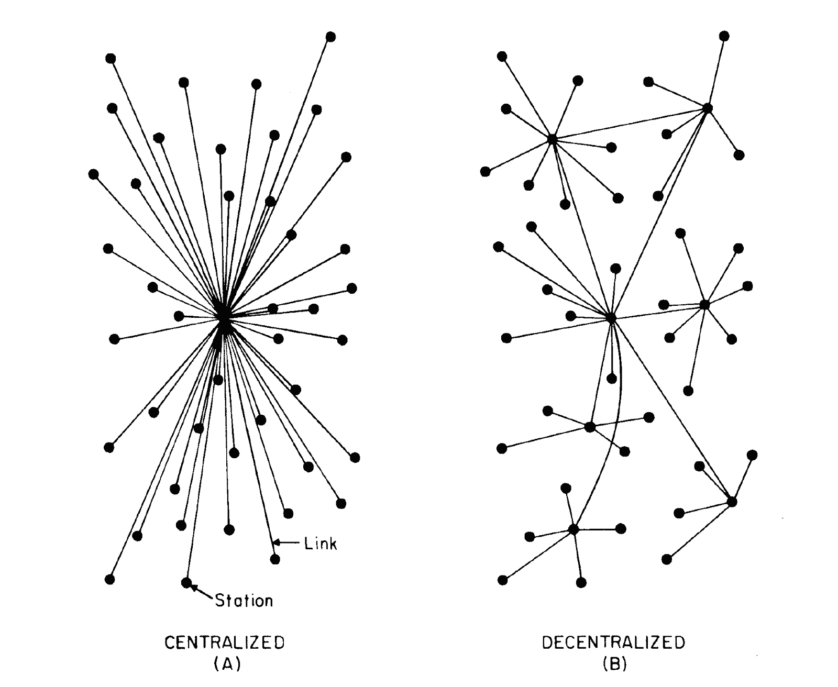
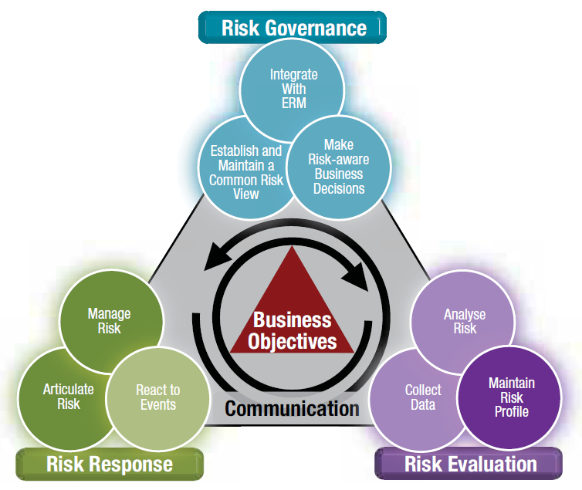
Main Concerns
Decentralized
Centralized
HG has undergone a history of transformation, and as the company strategizes success into the future many considerations will have to consider.
Transforming the IT from decentralized to a centralized department between corporate, business units, and shared responsibilities.
Resolving many of Miller’s observations, which have created projects and urgent action items to be addressed within the next three months.
Utilizing ISACA’s IT Risk Management framework, HG has translated many of their largest challenges toward short and long-range implementation plans.
Image Credit: Software Advice™, Inc.
Image Credit: ISACA

Slide 11
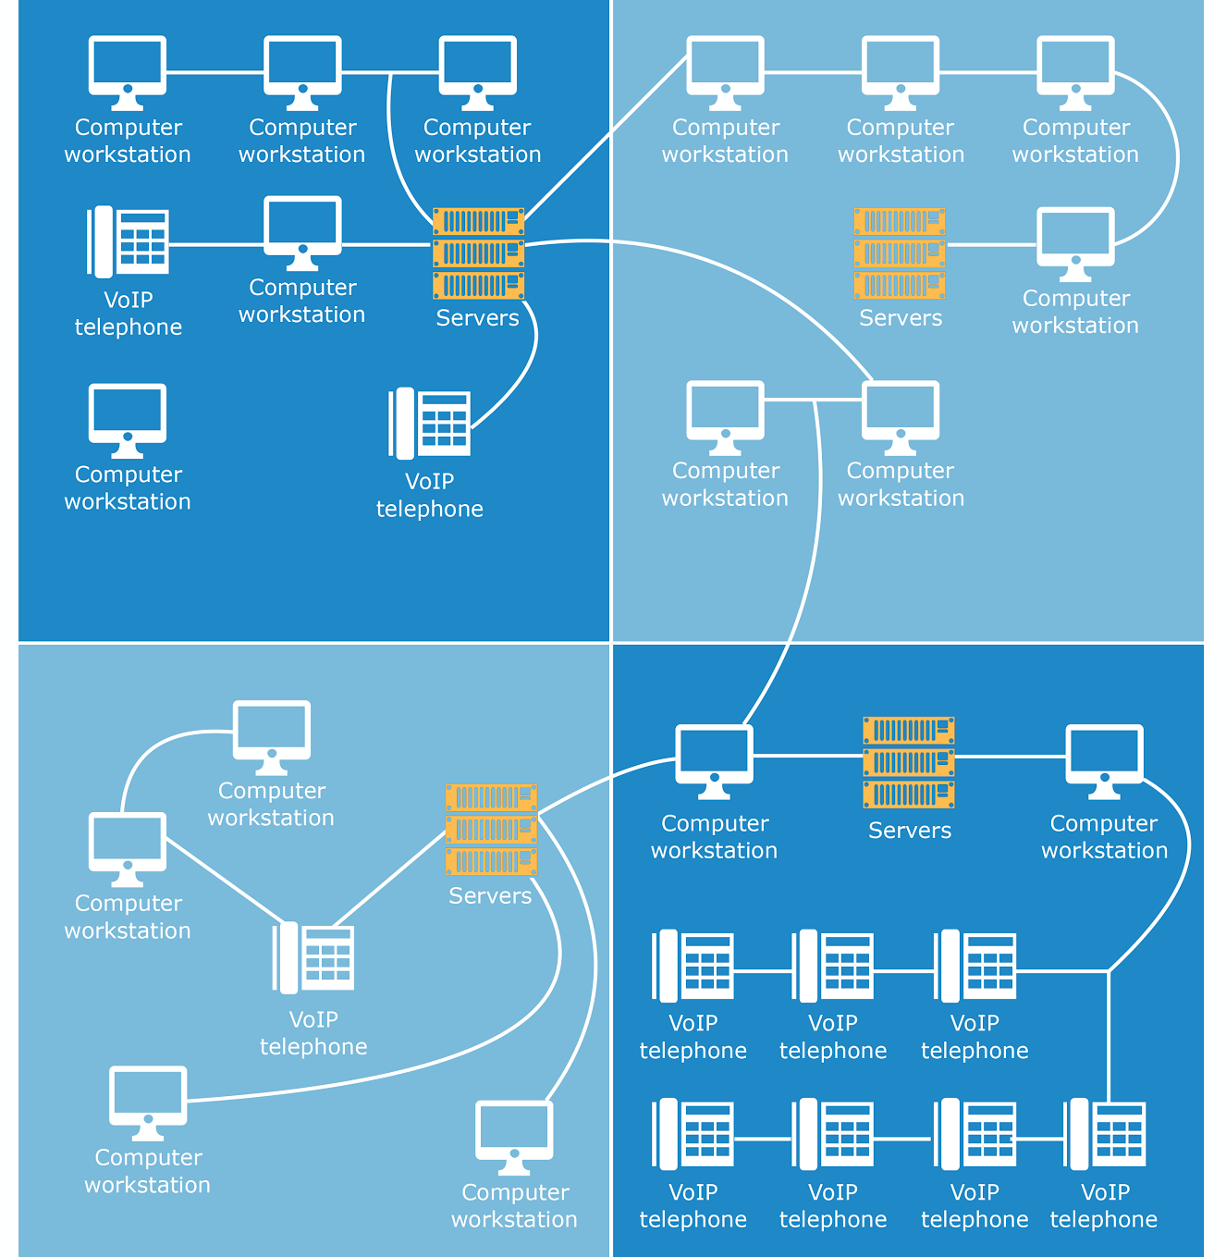
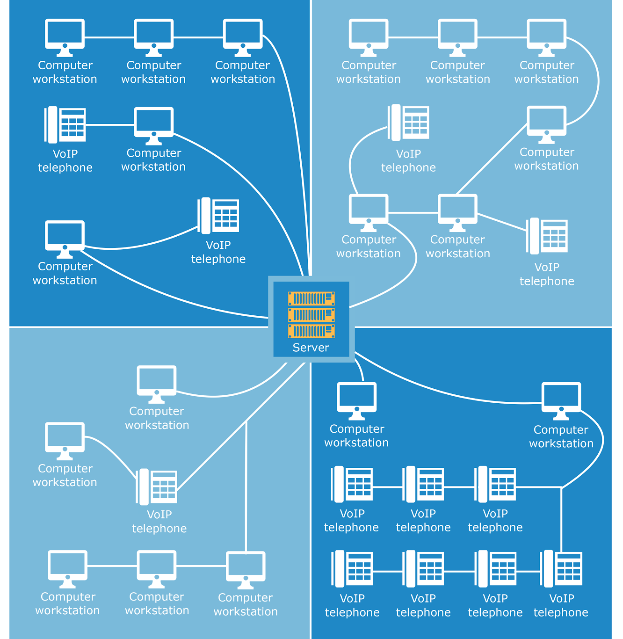
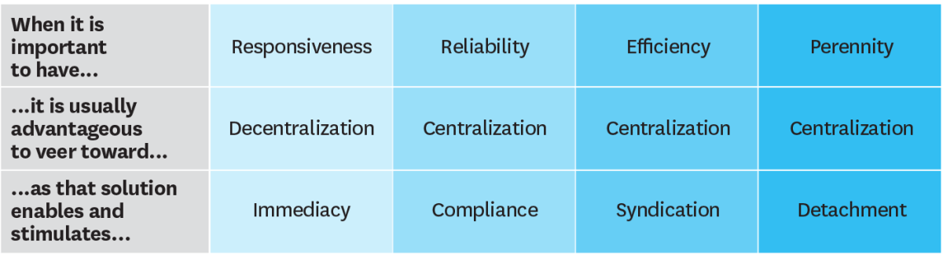
Information Technology Department Transformation
HG’s IT department historically operated with over 800 staff members, with dedicated teams for each business unit and a centralized team to operated the shared corporate IT systems. Previous to that, HG IT was very decentralized with CIOs for each of the businesses, and dual reporting lines to each business unit and the global CIO of HG.
There were many redundant systems and functions, and although the decision to centralize was recognized to yield cost savings and create efficiency, the leadership was reluctant to make changes because the business units were previously performing well. This was the trend until HG hit bankruptcy.
As the turmoil settled, HG IT has remained focused on business recovery and profitability. With increasing profits and a much stronger IT budget, HG IT is seeking to transform into the most highly efficient department within the organization.
This transformation is going to be led by Miller, who is seeking to bring more autonomy between the business units, with a focus toward reliability, compliance, and company profitability.
Image Credit: Software Advice™, Inc.
Image Credit: HBR.org

Slide 12
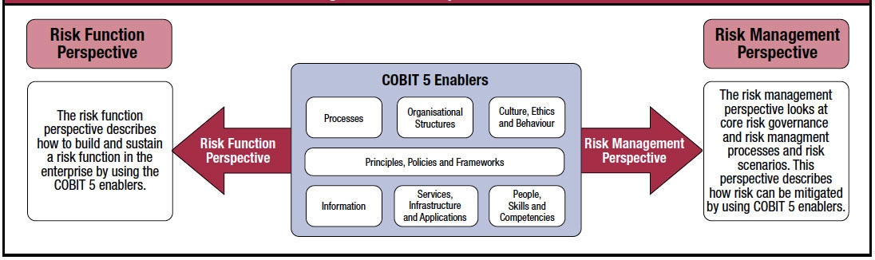
IT Risk Approach
Miller has recognized that many of the business goals and objectives and been impacted by a neglected IT department over the years.
Utilizing the COBIT framework, she is seeking to address business goals related to financial performance, customers, internal efficiencies, while promoting business growth.
Furthermore, Miller seeks to translate these 7 observations into many projects to address the needs of HG and the IT department within the near-term future, as well as phased implementations during the next few years of the department and business growth. Miller is intending to incorporate the ISACA Risk IT Framework which will address Risk Evaluation, Risk Governance, and Risk Response.
For the future of HG IT and following the implementation of these projects, Miller is seeking to participate in the next HG Risk Audit, in which the IT department can be assessed with other business lines as part of the Risk Universe analysis.
ISACA, COBIT 5 for Risk

Slide 13
Translating Observations into an Action Plan
Miller’s initial observations include:
No one is accountable for information security
Connectivity is a problem
There are too many ERPs and they are expensive to maintain
IT audit issues are piling up
Manufacturing and shop floor systems are old and causing the production line to stop
PCs and operating systems are old and unsupported
No one understands how the applications and business systems work except the vendor
These observations have generated the following twenty projects:
• Hire information security manager and 1 security analyst for each business unit
• Enterprise AV license
• Firewall
• Additional software (i.e. VPN, network security tools, manuals)
• Advanced infosec annual training for security team
• Basic infosec training for company, quarterly/annual (4 hours p/staff)
• Hire annual external consultant for penetration testing and assessment
• Determine business internet speed, increase service plan for bandwidth increase or additional (redundant) data line
• Invest in IT capital improvements, servers, new router, switch, and infrastructure equipment & Service Plans
• Configure firewall and network equipment to limit unnecessary data on network
• Consolidate and streamline business processes to meet current business needs
• Invest in a 3rd party ERP suite
• Hire an internal IT auditor to work in partnership with corporate and business units
• External IT audit consultant, annually
• Replace shop floor systems and establish redundant support systems, i.e. RAID and UPS
• IT security analysts responsible for monthly audits of essential systems, and weekly audits of critical systems
• Develop corporate-wide phasing plan to standardize and replace old systems and applications
• Replace 5000 computers with business applications
• Applications and specialized software, updated
• Quarterly/Annual training IT training budget

Slide 14
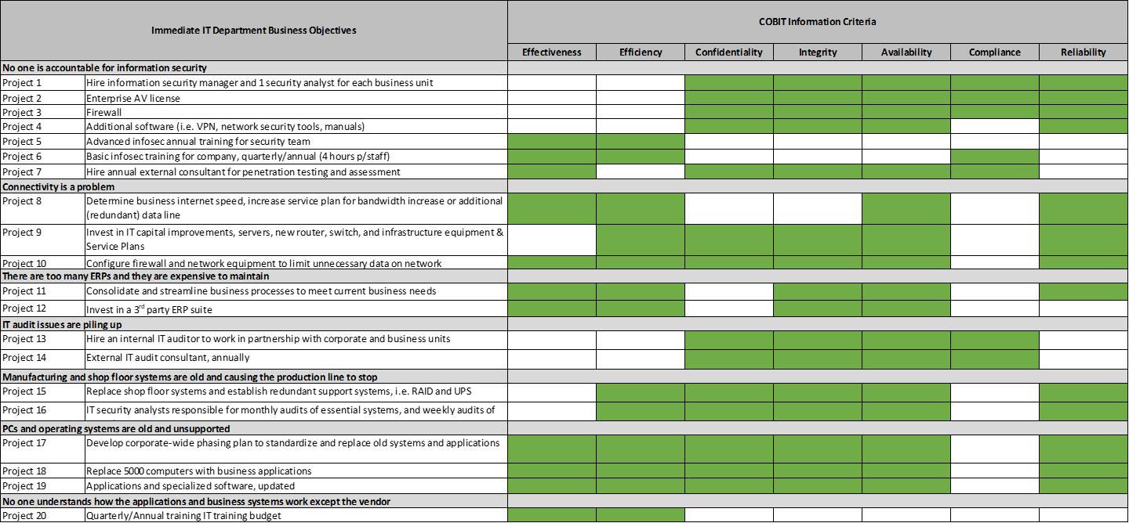
COBIT Categorization of Risks
This figure describes COBIT business goals and impacts mapped using COBIT information criteria.

Slide 15
Calculating and Prioritizing Risks

Slide 16
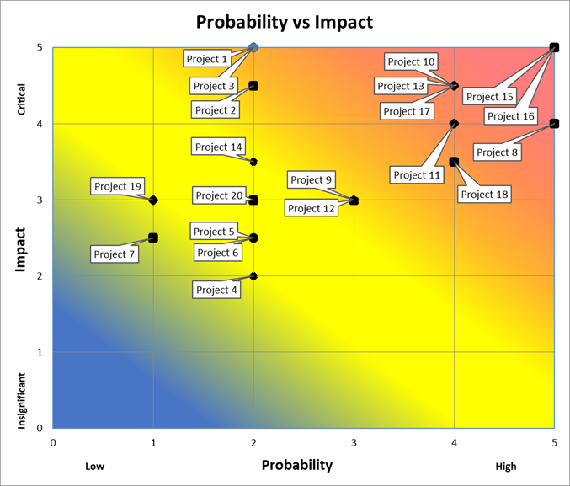
Quantifying Probability and Impact
Following the ability to analyze the probability of the risk occurrence (scale of 1-5), Impact to the business (scale 1-5), and impact occurrence timeframe (near, medium, and far) associated with these risks, a probability and impact matrix provided insight for subsequent analysis. both the prioritization and scheduling of completing these objectives. (refer to Addendum A for data)
Risk = Probability (or Likelihood) x Impact

Slide 17
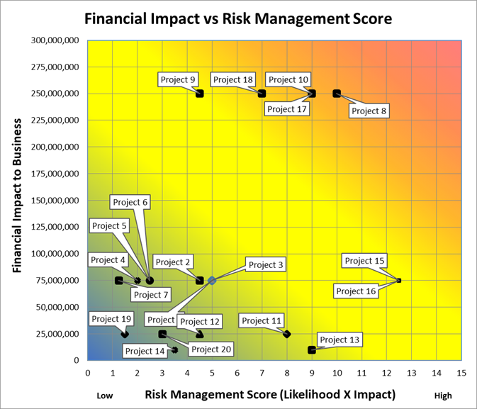
Quantifying the Financial Impact based on Risks
In addition, Miller and the IT staff were able to quantify the value of these risks and correlate the financial impact to the business. (refer to Addendum A)
Risk = Risk Management Score X Financial Impact

Slide 18
Solutions
Suggested Courses of Action

Slide 19
Implementation Recommendations
A Closer Look
Problem:
Manufacturing and shop floor systems are old and causing the production line to stop
Software implementation can be a lengthy upfront process, but the benefits it provides in the long run are worth the time commitment. HG will be investing money to gain efficiencies. Putting in the time to understand how a software system works, what features it has that HG can use will help to use it to its full potential and for business operations to reap the rewards.
Solutions:
Replace shop floor systems and establish redundant support systems, i.e. RAID and UPS
IT security analysts responsible for monthly audits of essential systems, and weekly audits of critical systems

Slide 20
Timeline
Projected timeline of solutions

Slide 21
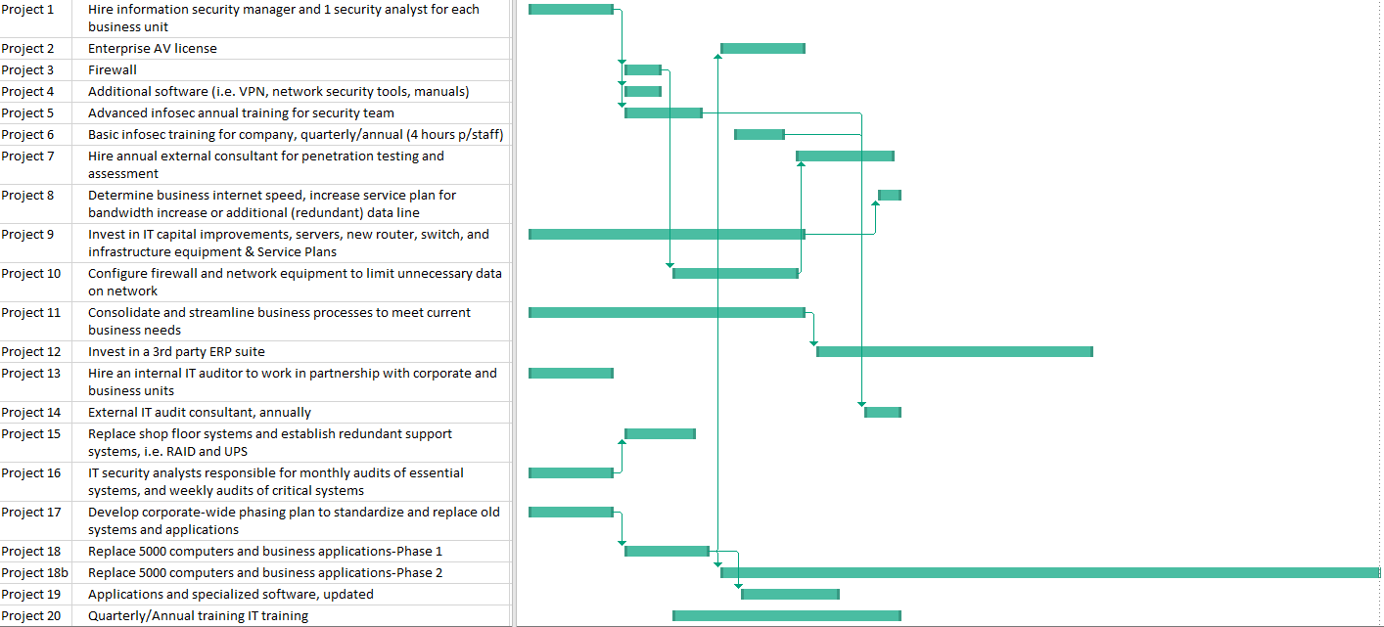
Information Technology Timeline and Milestones
This timeline represents the work that Miller will be doing in a 3 month timeframe. The duration of each project is based on realistic data, keeping the high priority items to start first followed by the supplemental tasks. Refer to Addendum B for more details.

Slide 22
Budget

Slide 23
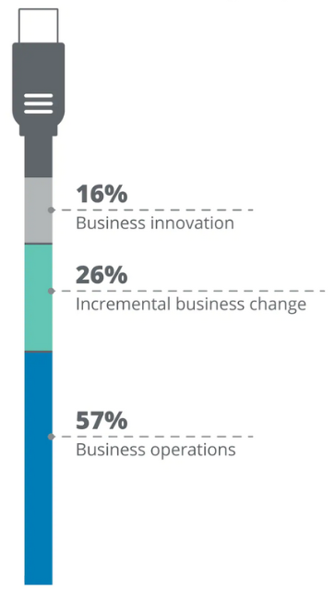
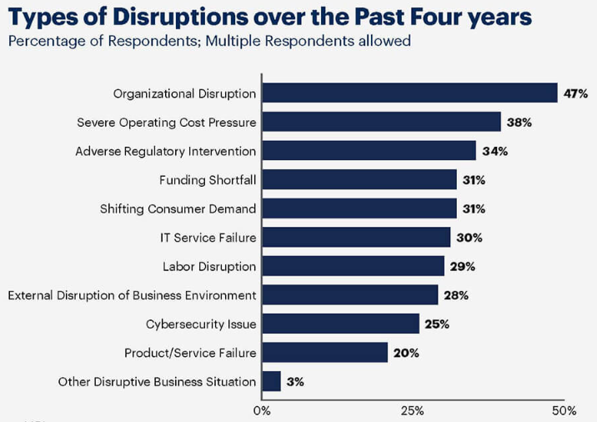
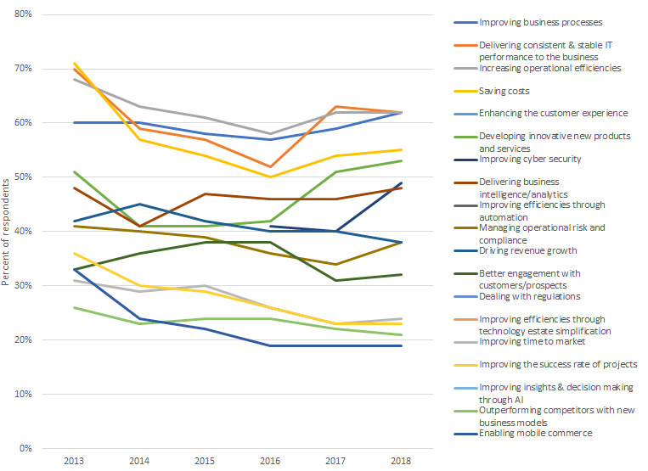
IT Department Budget
HG IT is seeking to align their budget as a percentage of business revenue to sustain current and future initiatives. With current performance and recognizing the importance of information technology investments, HG is allocating 2% of their revenue toward HG IT, amounting to $180M annually⁸. Although this nearterm investment of correcting these initial issues will consume nearly $28M of the annual revenue, HG IT is seeking to utilize the $180M annual budget for a number of other projects.
This budget allocation is seeking to invest in business innovation, incremental business changes, and large investment toward business operations which drive production and revenue.
Following these initial project investments, Miller is seeking to address IT risk concerns within the industry, high frequency Help Desk issues as well as receive feedback from the staff to improve business performance.
Image Credit: Gartner, 2019
Image Credit: 2016-2017 Global CIO Survey, N=1,081
Image Credit: Harvey Nash & KPMG

Slide 24
Addendum and References

Slide 25
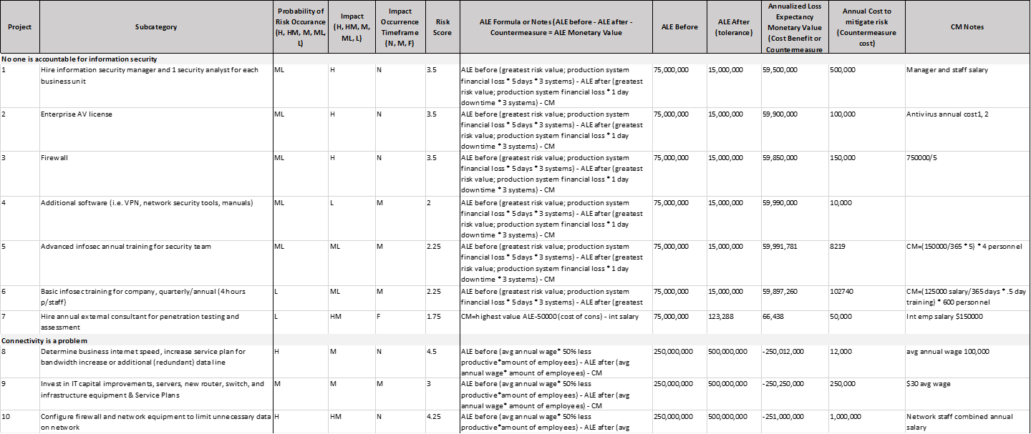
Addendum A

Slide 26
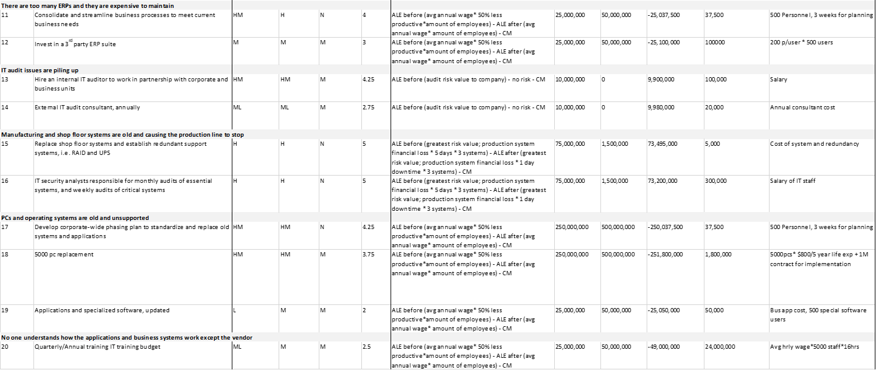
Addendum A

Slide 27
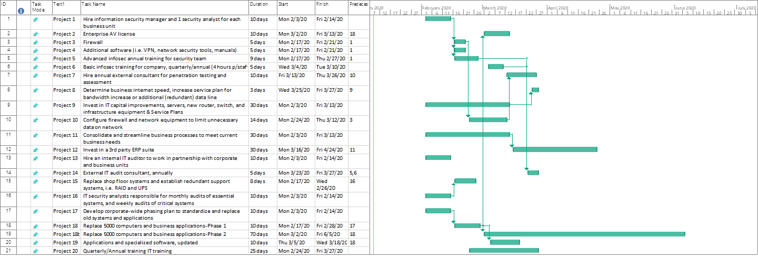
Addendum B

Slide 28
References:
COBIT® 5: Enabling Processes. Rolling Meadows, IL.: ISACA, 2012.
COBIT® 5: Implementation. Rolling Meadows, IL.: ISACA, 2012.
COBIT® 5: A Business Framework for the Governance and Management of Enterprise IT. Rolling Meadows, IL.: ISACA, 2012.
COBIT® 5: The RiskIT Practitioner Guide. Rolling Meadows, IL.: ISACA, 2009.
COBIT® 5: The RiskIT Framework. Rolling Meadows, IL.: ISACA, 2009.
Lavanya, N. & Malarvizhi, T. (2008). Risk analysis and management: a vital key to effective project management. Paper presented at PMI® Global Congress 2008—Asia Pacific, Sydney, New South Wales, Australia. Newtown Square, PA: Project Management Institute.
Czagan, D. (2019, April 15). Quantitative Risk Analysis. Infosec Resources; InfoSec Institute. https://resources.infosecinstitute.com/quantitative-risk-analysis/
Kark, K., Shaikh, A., & Brown, C. (2020). Technology budgets: From value preservation to value creation. Deloitte Insights; Deloitte. https://www2.deloitte.com/us/en/insights/focus/cio-insider-business-insights/technology-investments-value-creation.html

