Slide 1


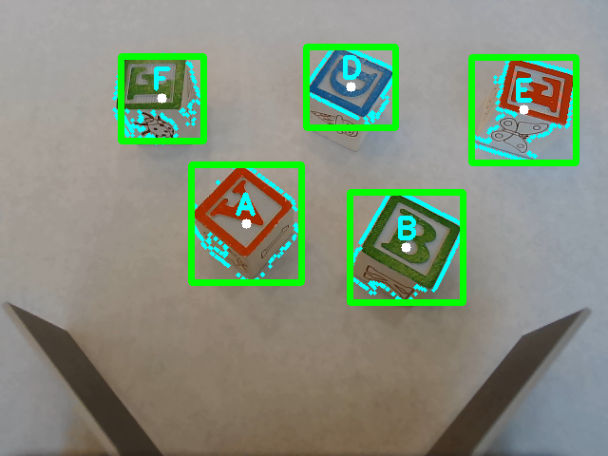
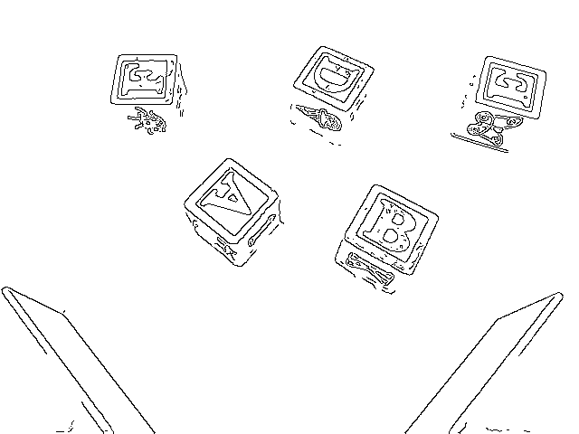
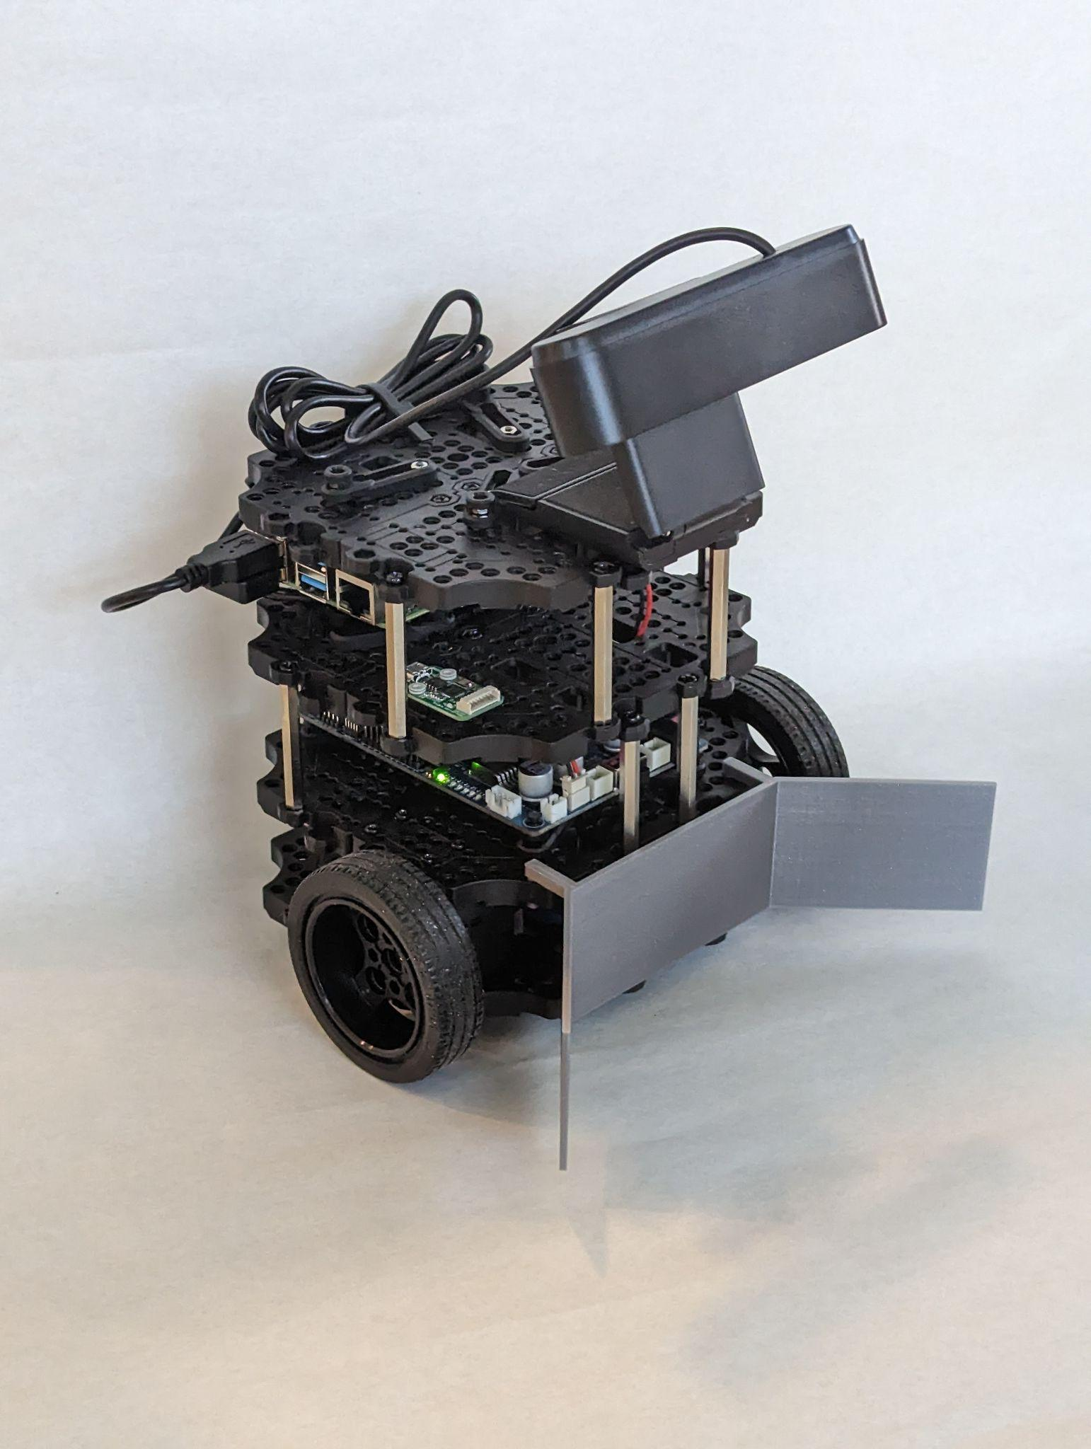
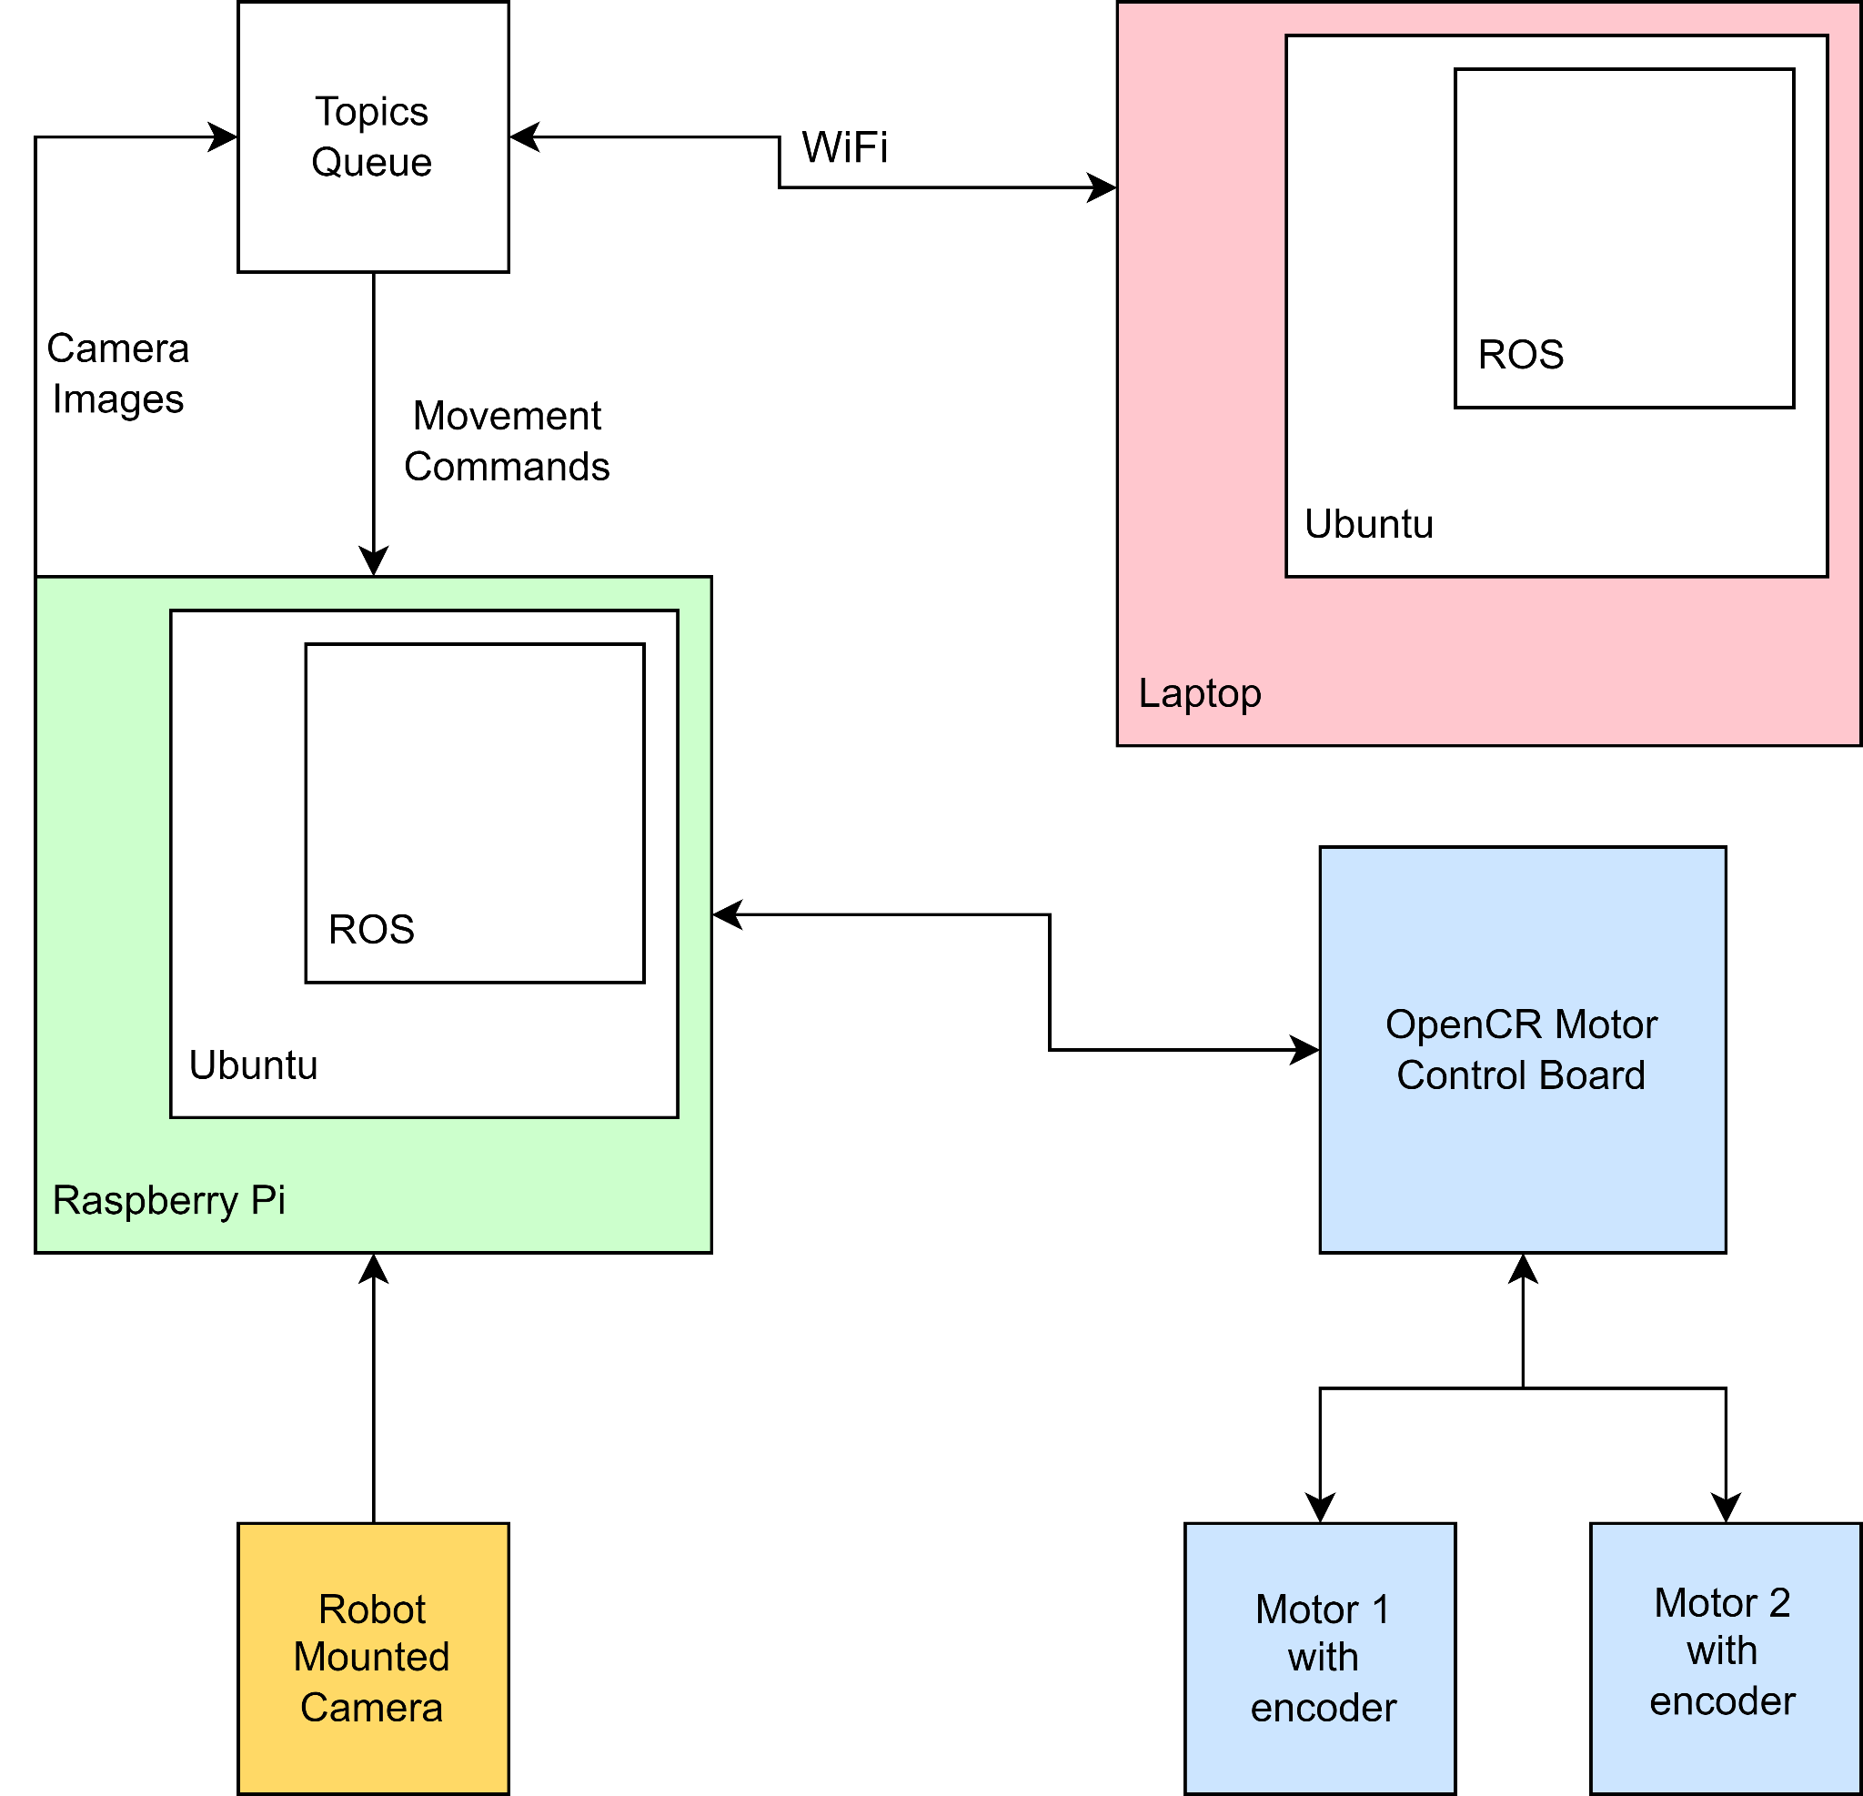
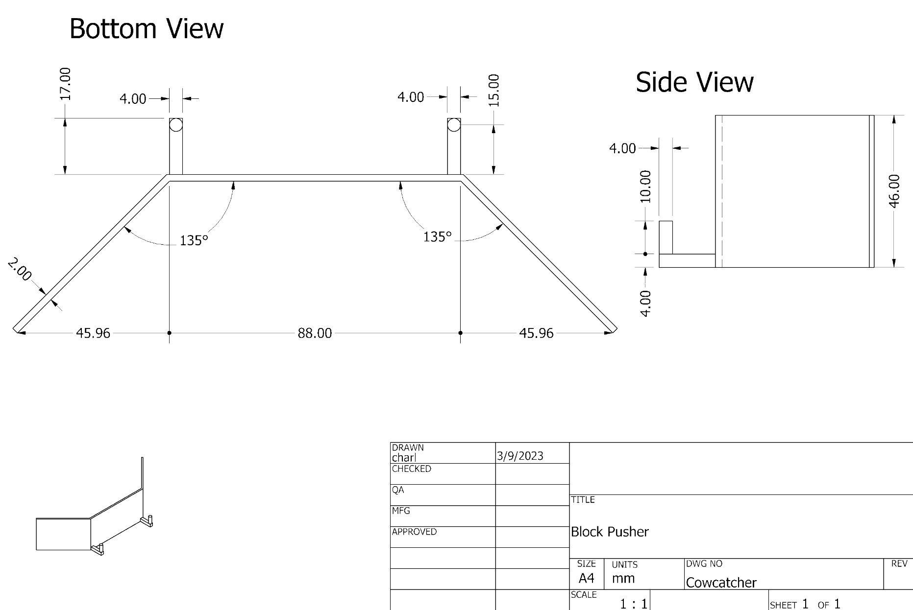
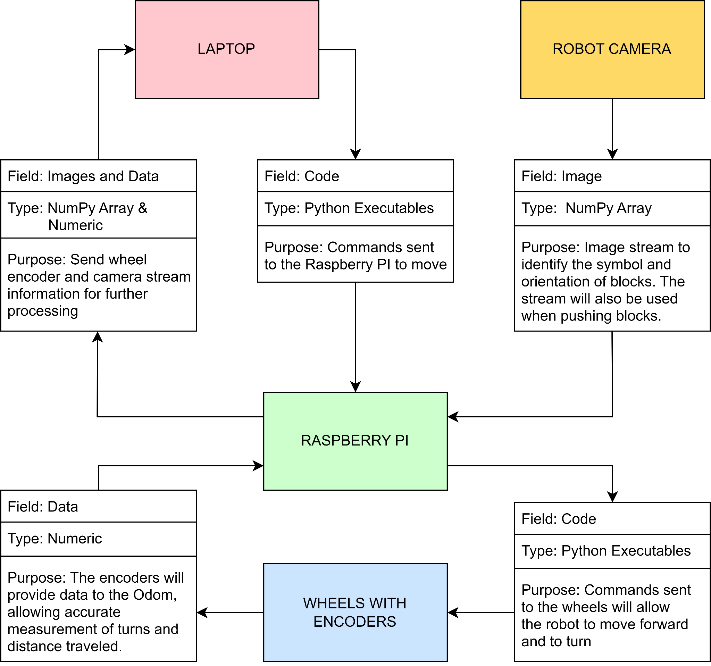
NibblesBot
Ethen Carrell, Charles Moertle, Calab Reeder
Dept. Of Computer Science and Information Technology
Abstract
A common problem in robotics is locating objects and arranging them in some manner. In most cases, this is accomplished using an overhead camera that provides a “God’s eye” view, i.e., a view of an entire area. In this project, we are attempting a variation of this problem by removing the overhead camera and relying solely on a camera attached to the mobile robot that only provides a partial view of the area. In order to test our approach, our team’s goal is to use a TurtleBot3 Burger robot to rearrange several blocks into a specified order. To accomplish this task, we will assemble the mobile robot and modify it to suit the problem. The overall approach has the robot searching a designated area for blocks in a back-and-forth search pattern. As each block is found, the block will be moved to a staging area for further processing. After scanning the entirety of the area, the robot will identify each block in the staging area then move the blocks to the desired order.
Design
To facilitate the search and movement of the robot, we have enclosed the search area with a black line of tape that serves as the boundary. The area inside the boundary is made of white paper to increase the contrast of the colored blocks that the robot needs to find and retrieve. We have also drawn a circle around the starting position of the robot to serve as a staging area for further processing once the robot has retrieved all the blocks in the area.
The robot’s search pattern follows an out-and-back path. After reaching a wall, it executes a 90-degree turn, moves forward a brief distance, performs another 90-degree turn, and resumes the search.
The project relies on two main computer vision algorithms: Canny edge detection and ORB (Oriented FAST and Rotated BRIEF) feature detector. We use Canny edge detection to identify the blocks in front of the robot, which then allows for dynamic cropping of the blocks in real-time. These dynamic crops are then fed to the ORB algorithm, which is used to identify the letter on each block to sort them in a specified order.
Figure 3: Live object detection using OpenCv and ORB (Orientated FAST, Rotated BRIEF).
Figure 6: Live edge detection using OpenCV and Canny.
Future Work
Several challenges were encountered during the development of the project, such as obstacles, color detection issues, and difficulties in identifying similar letters. The problem of obstacle avoidance adds another layer of complexity, which necessitates further algorithmic design. While a 2D LiDAR system could be used to detect obstacles that are taller than the robot, smaller obstacles would require alternative methods. Integrating object avoidance capabilities would enable NibblesBot to navigate more realistic environments and locate blocks with greater accuracy. The color yellow posed a significant challenge in terms of detection due to variations in light levels. Therefore, future development efforts should consider methods for maintaining consistent color detection in response to changes in the environment. Additionally, identifying similar letters proved difficult due to their near-indistinguishable appearance when rotated. To overcome this issue, refining algorithms and expanding the dataset could be explored as potential solutions
Figure 1: NibblesBot built from the TurtleBot3 Burger base with an Argmao camera and 3d printed block catcher.
Figure 4: Block diagram outlining the hardware and software components in the system.
References
ROBOTIS e-Manual, https://emanual.robotis.com/docs/en/platform/turtlebot3/overview/.
ROS.org, http://wiki.ros.org/turtlebot3.
Acknowledgements
We would like to thank Dr. John Nicholson and Dr. Leong Lee for their support of students in the Department of Computer Science and Information Technology. Additionally, we would like to thank Kevin Loyall for making the NibblesBot logo in the top right.
Kevin Loyall
(859) 612 – 2779
kevina.loyall@gmail.com
Figure 2: Schematics for the catcher attached to the front of the robot.
Figure 5: Message diagram defining the data being passed between each component.

