Slide 1

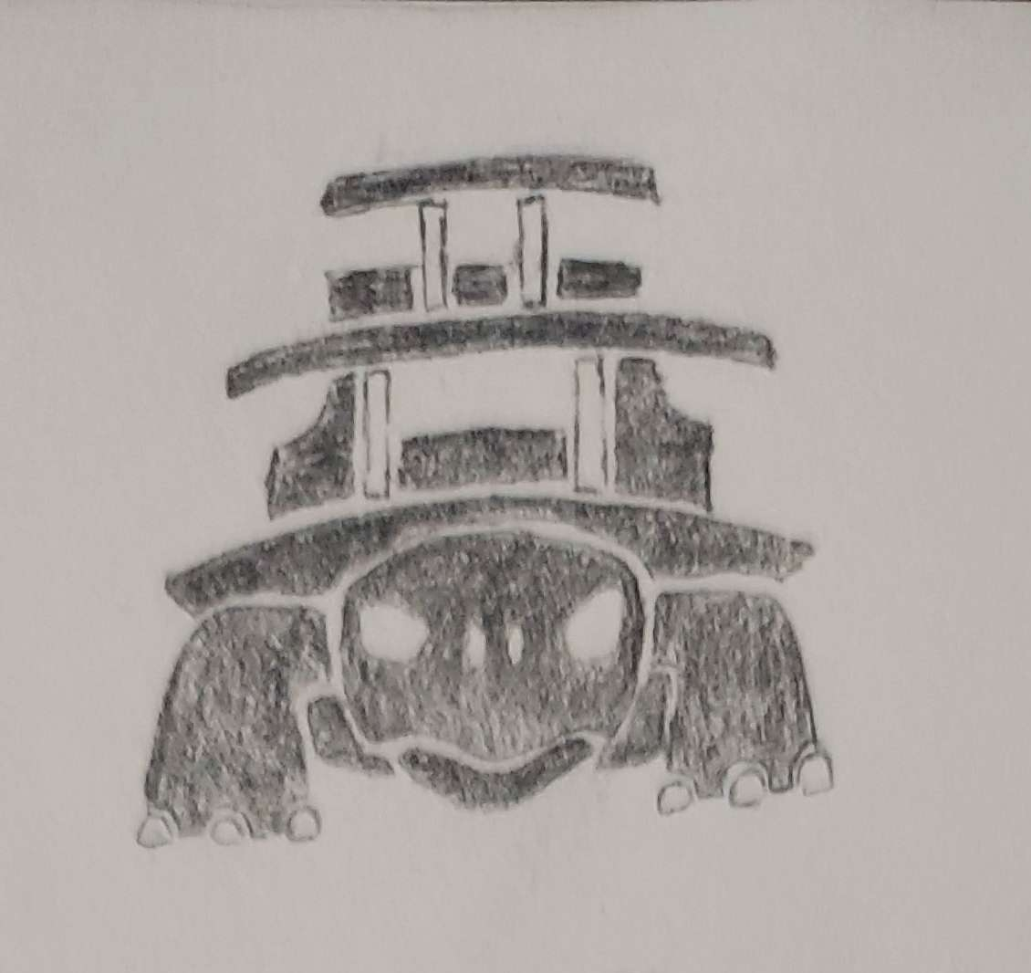
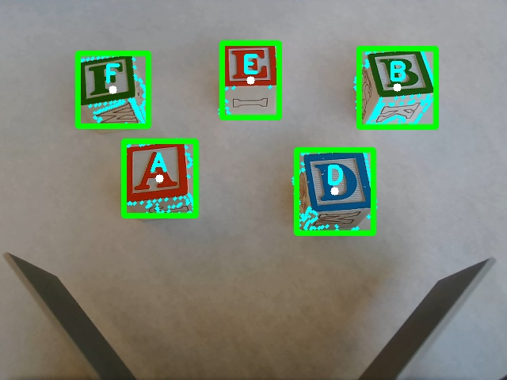
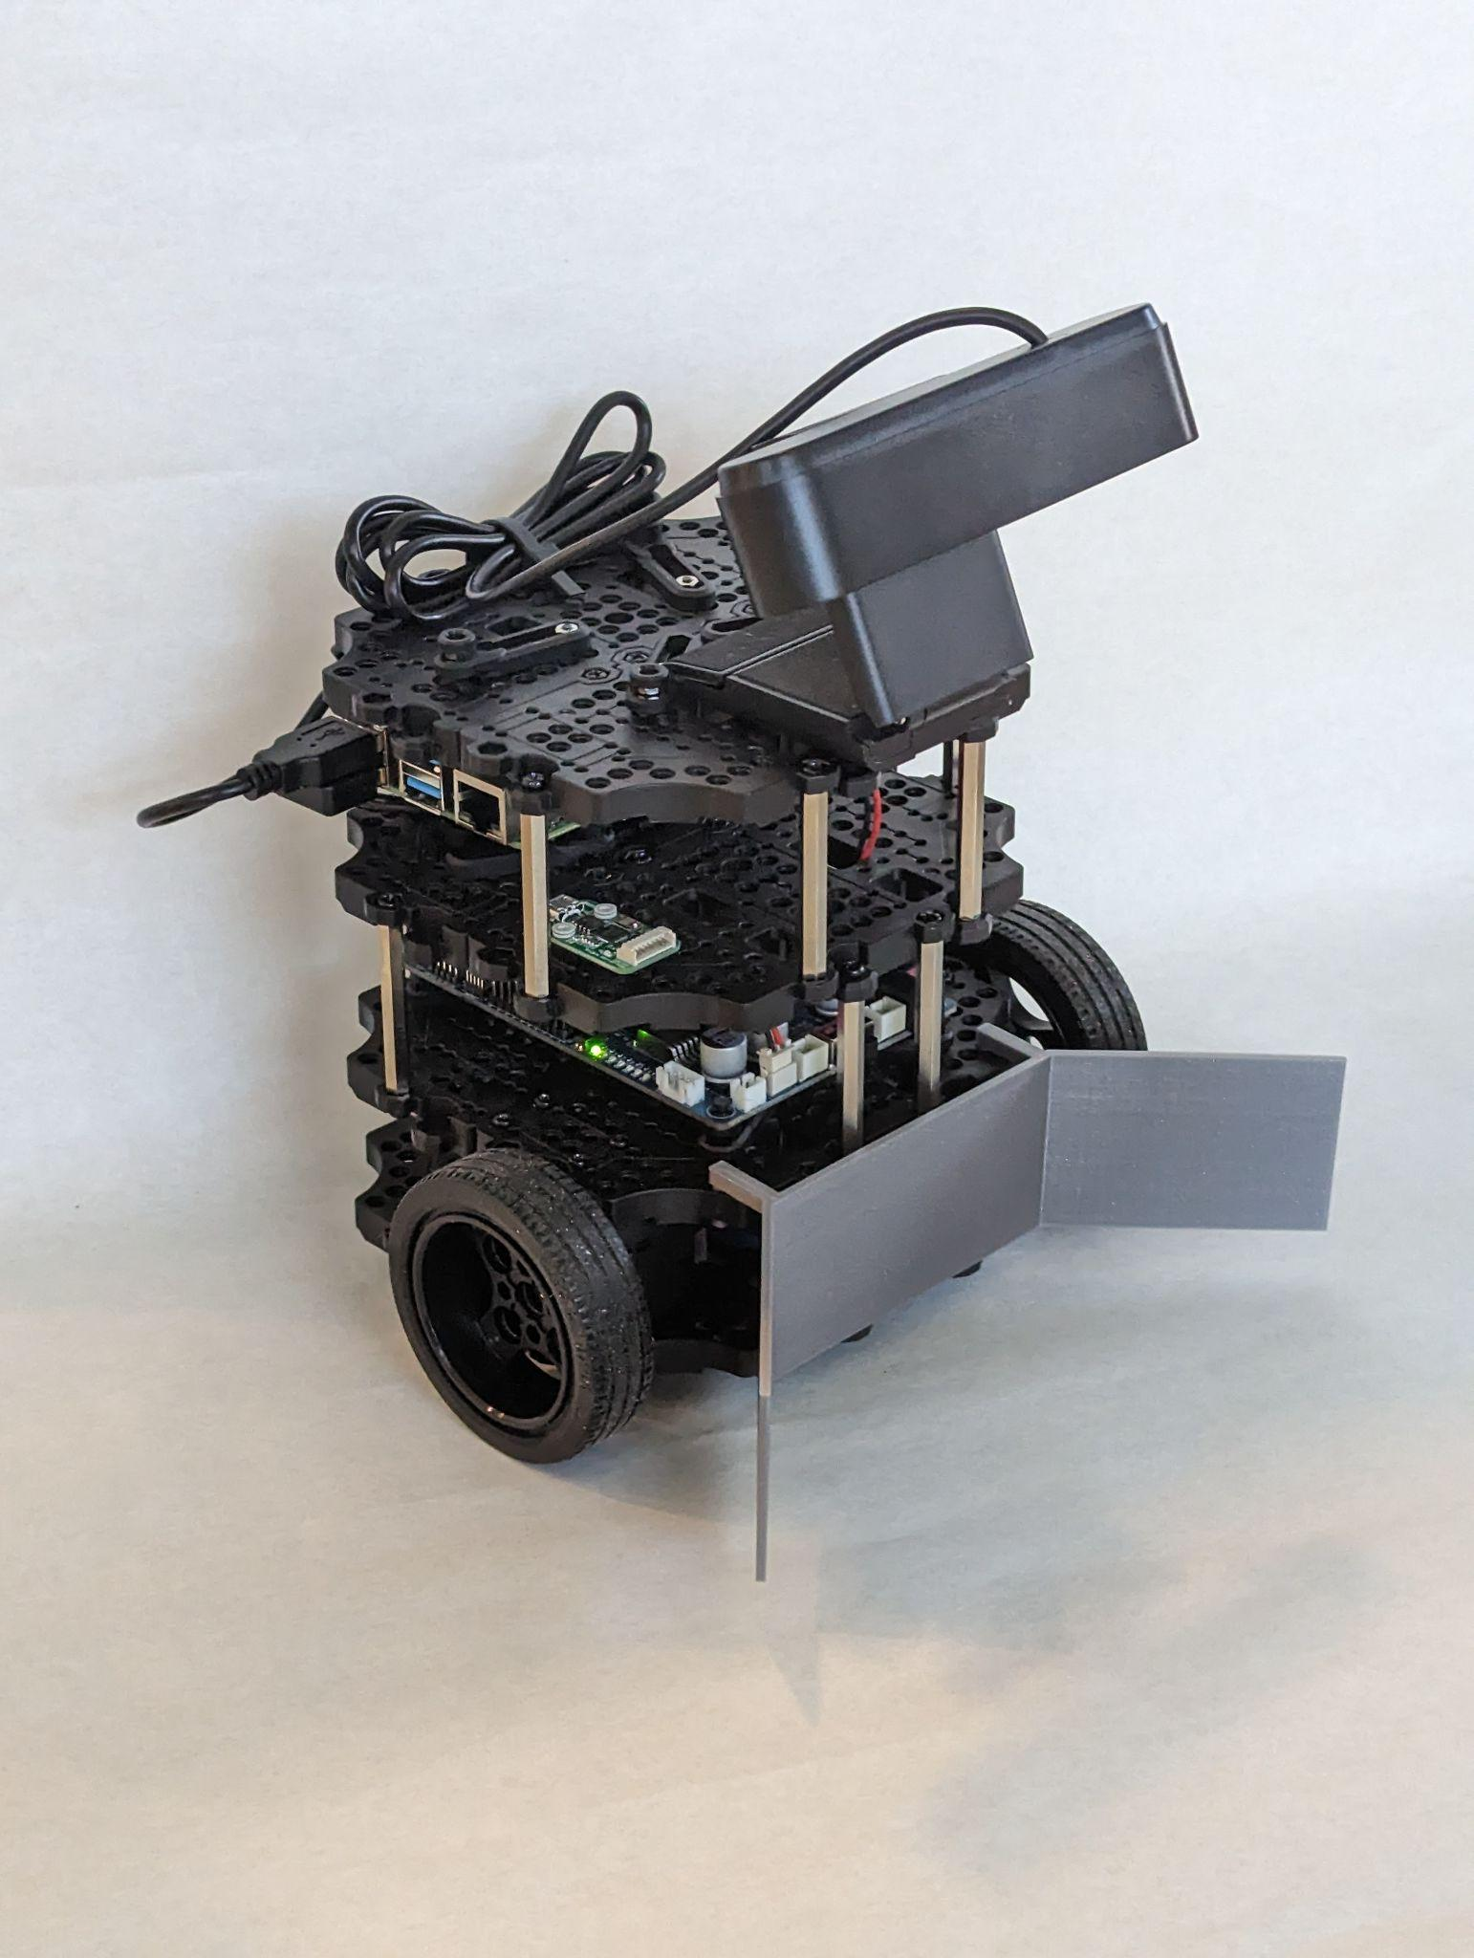
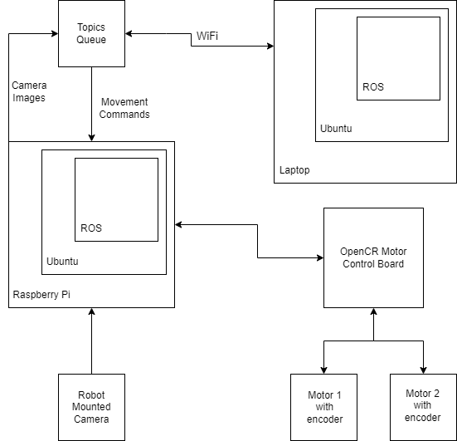
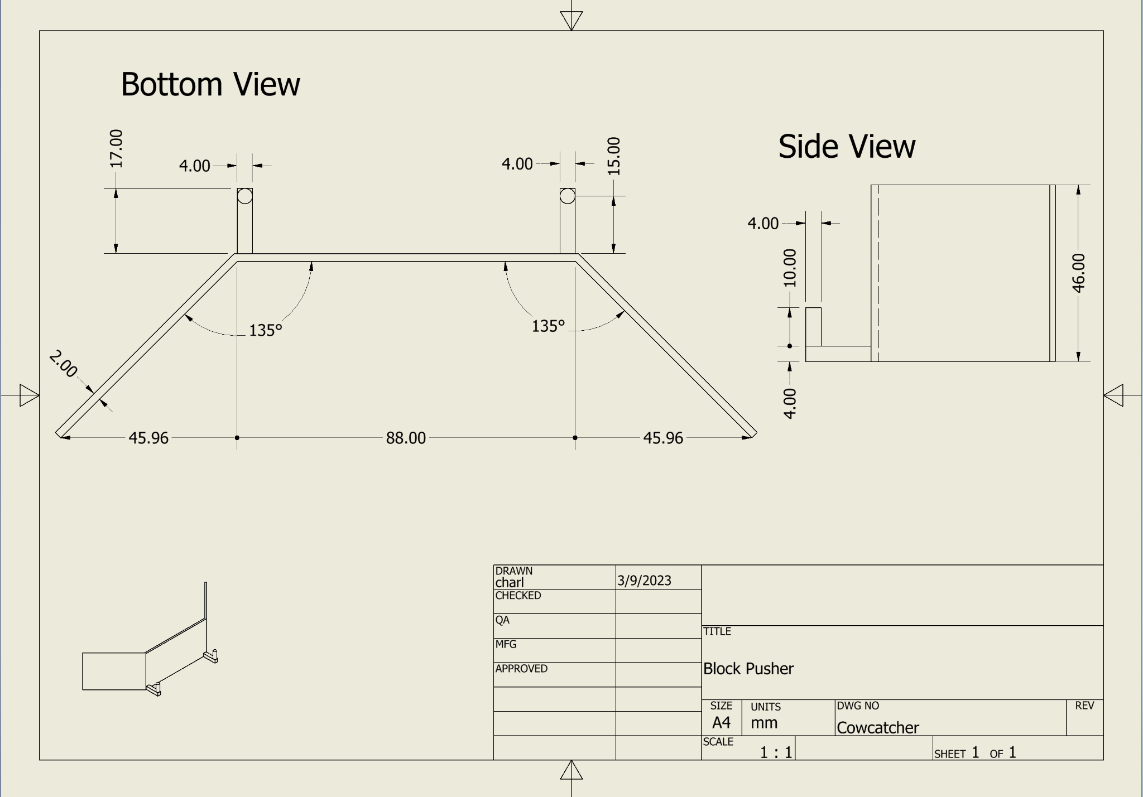
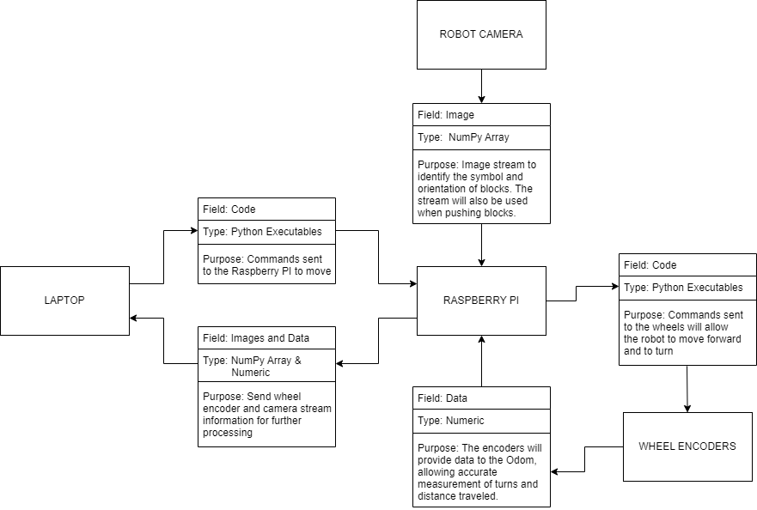
NibblesBot
Ethen Carrell, Charles Moertle, Calab Reeder
Dept. Of Computer Science and Information Technology
Abstract
Future Work
A common problem in robotics is locating objects and arranging them in some manner. In most cases, this is accomplished using an overhead camera that provides a “God’s eye” view, i.e., a view of an entire area. In this project, we are attempting a variation of this problem by removing the overhead camera and relying solely on a camera attached to the mobile robot that only provides a partial view of the area. In order to test our approach, our team’s goal is to use a TurtleBot3 Burger robot to rearrange several blocks into a specified order. To accomplish this task, we will assemble the mobile robot and modify it to suit the problem. The overall approach has the robot searching a designated area for blocks in a back and forth search pattern. As each block is found, the block will be moved to a staging area for further processing. After scanning the entirety of the area, the robot will identify each block in the staging area, then move the blocks to the desired order.
NibblesBot’s goal was to create a robot able to identify and arrange blocks in a specified order. Some hindrances to the project were obstacles and the color of some of the blocks. Obstacles avoidance adds an additional layer of complexity to the problem that will need further algorithmic design. A LiDAR can be used for obstacles with a height that reaches the top of NibblesBot but smaller obstacles will require other methods. The goal of adding object avoidance will be to allow NibblesBot to find blocks in an environment that is more similar to a real world environment. The color yellow was a large issue when it came to color detection for our design due to light level issues. Further development should consider methods of maintaining a constant color detection in response to light level changes in NibbleBot’s environment.
Limitations
Figure 4: Live object detection using OpenCv and ORB (Orientated FAST, Rotated BRIEF).
The objective of the NibblesBot experiment is to arrange blocks in a specified order without relying on an overhead camera. To accomplish this task, we established several limitations, namely: exclusion of yellow-colored blocks, avoiding the use of similar letters, and not allowing obstacles in the area. We chose to exclude yellow blocks due to computer vision’s tendency to have difficulty when detecting reflective surfaces, which often appear as white or yellow. Therefore, we avoided using yellow blocks to prevent confusion in our algorithms. Additionally, we implemented the second limitation to avoid confusion among similar letters. Our current identification algorithm struggles to differentiate between letters like W and M, which have rotational similarities. Finally, we imposed the last limitation of having no obstacles to keep the project simple and to solely focus on detecting and organizing the blocks.
Design
The NibblesBot is a small mobile robot built on the open source TurtleBot3 Burger platform by ROBOTIS. The robot is equipped with a Raspberry Pi 4B, an OpenCR board, two PID drive motors, and an 11.1V Li-Po battery giving an estimated 2 hours of operating time. In addition to the provided equipment, we also attached a usb camera to the top of the robot for video recognition and a 3D printed catcher to the front of the robot to make it easier to maneuver the blocks.
To facilitate the search and movement of the robot, we have enclosed the search area with a black line of tape that serves as the boundary. The area inside the boundary is made of white paper to increase the contrast of the colored blocks that the robot needs to find and retrieve. We have also drawn a circle around the starting position of the robot to serve as a staging area for further processing once the robot has retrieved all the blocks in the area.
The project relies on two main computer vision algorithms: Canny edge detection and ORB (Oriented FAST and Rotated BRIEF) feature detector. We use Canny edge detection to identify the blocks in front of the robot, which then allows for dynamic cropping of the blocks in real-time. These dynamic crops are then fed to the ORB algorithm, which is used to identify the letter on each block.
Figure 1: Final design of NibblesBot.
Technology
The project employs a range of technologies, including TheConstruct Gazebo, TheConstruct ROSject, TurtleBot3 Burger, and an Argmao 1080p camera. TheConstruct Gazebo is a simulation service that enables code testing without using the actual robot. TheConstruct ROSject served as the integrated development environment (IDE), allowing the execution of remote commands on the robot. The TurtleBot3 Burger is the physical robot used in the project, and it was equipped with an Argmao camera on top to facilitate the use of computer vision algorithms.
Figure 5: Block diagram outlining the hardware and software components in the system.
References
ROBOTIS e-Manual, https://emanual.robotis.com/docs/en/platform/turtlebot3/overview/.
ROS.org, http://wiki.ros.org/turtlebot3.
Canny Documentation, https://docs.opencv.org/4.x/da/d22/tutorial_py_canny.html
ORB Documentation, https://docs.opencv.org/4.x/db/d95/classcv_1_1ORB.html
Acknowledgements
We would like to thank Dr. John Nicholson and Dr. Leong Lee for their support of students in the Department of Computer Science and Information Technology.
Figure 2: Schematics for the catcher attached to the front of the robot.
Figure 3: Message diagram defining the data being passed between each component.

