Slide 1

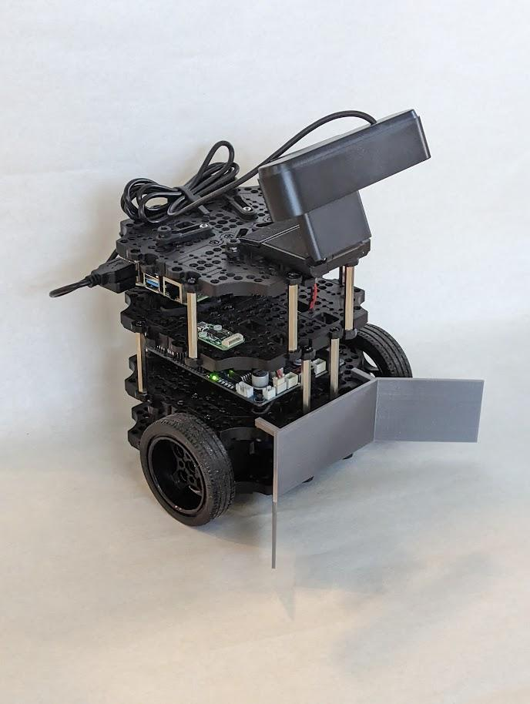
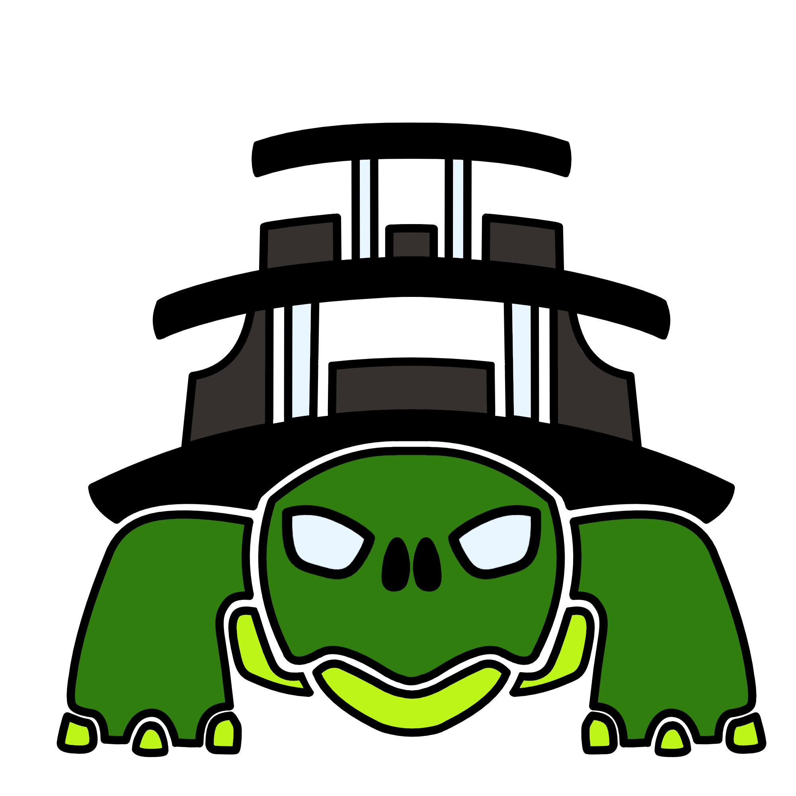
NibblesBot
Ethen Carrell
Charles Moertle
Calab Reeder

Slide 2
Introduction
Common problem in robotics is finding and arranging objects with an overhead camera
We don’t use an overhead camera, but we still want to find and arrange blocks
We built on a robot kit called TurtleBot3 Burger, added a camera and a cow catcher
The robot, we call it NibblesBot, searches an area, gathers all the blocks it finds in a staging area, then once all the blocks in an area are found the robot organizes the blocks it already found.

Slide 3
Design
Environment Design
Hard and smooth wood board
White sheet for more contrast
Have yet to use black tape as boundary
Algorithm Design
Search and retrieval
Finds block with computer vision
Delivers block to staging area
Computer Vision
ORB
Canny

Slide 4
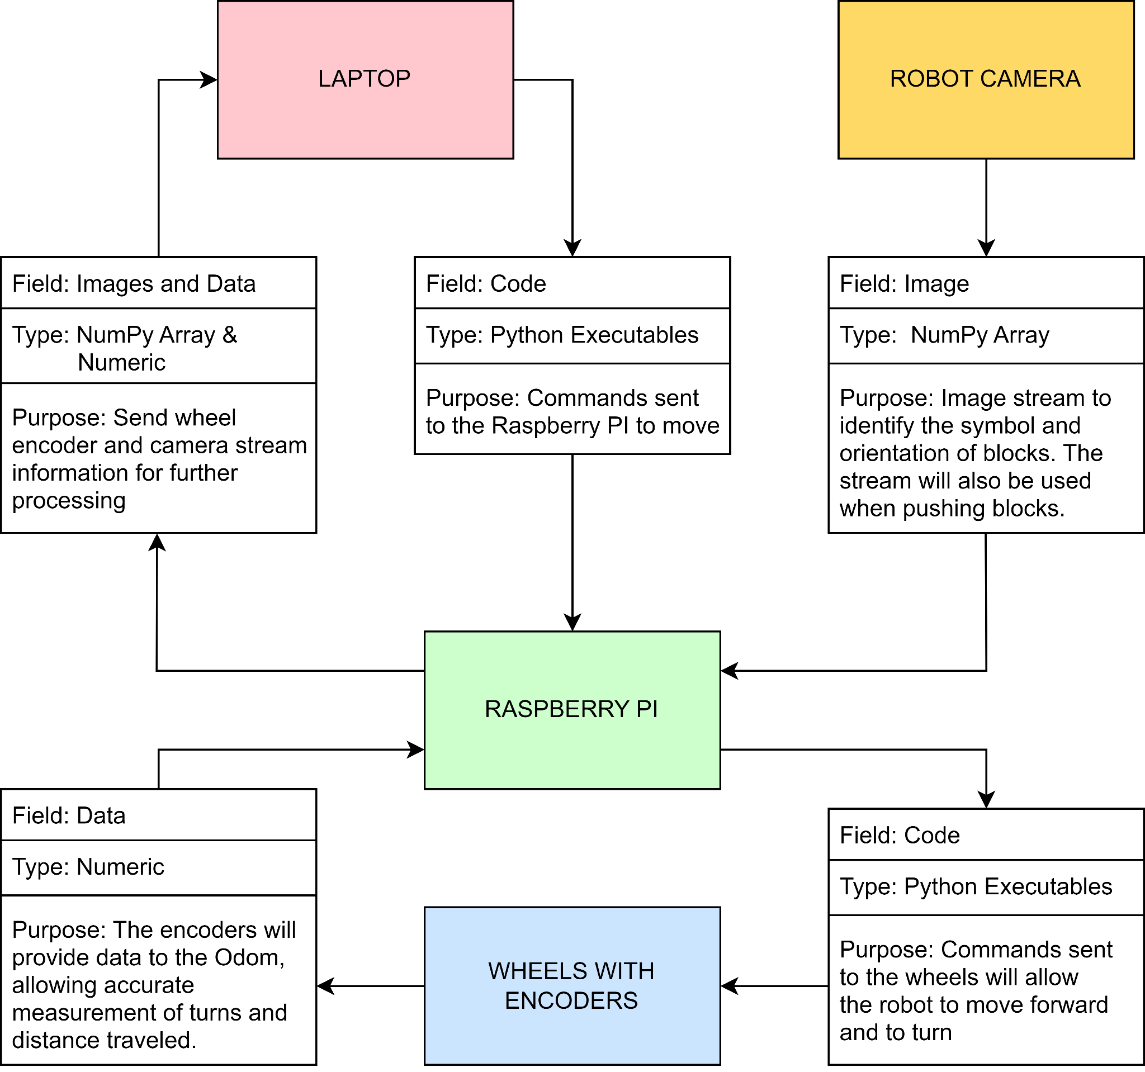
Design
Hardware Design
Raspberry Pi 4
OpenCR
Argmao Camera
Cow Catcher
Two PID motors with encoders

Slide 5
Technology
Argmao Camera
Oracle Virtual Box vs. Dual Boot
TurtleBot3 Burger
ROS Noetic
Ubuntu 20.04 LTS

Slide 6
Deploying Software
You need a TurtleBot3 Burger and a remote desktop to send commands
Setup robot Raspberry Pi and OpenCR board
Install Ubuntu on desktop and raspberry pi
Install ROS Noetic on both systems as well
http://wiki.ros.org/noetic/Installation/Ubuntu
https://emanual.robotis.com/docs/en/platform/turtlebot3/features/

Slide 7
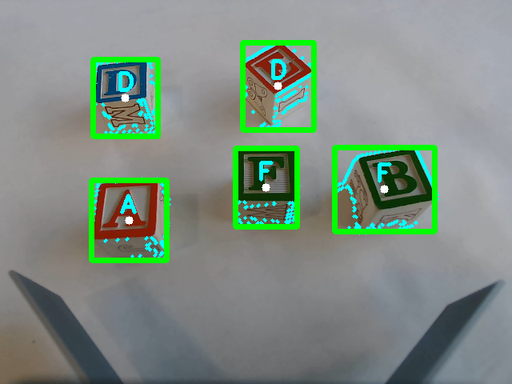
Known Bugs
Non-uniform lighting conditions
Canny edge detection issues
ORB w/ masks issues

Slide 8
Future Work
Use area inside cow catcher
Image masking for black tape boundary
Get an isolated room for uniform lighting
Machine learning models
Haar cascade instead of Canny
PyTesseract instead of ORB w/ masks

Slide 9

Live Demonstration

