Slide 2
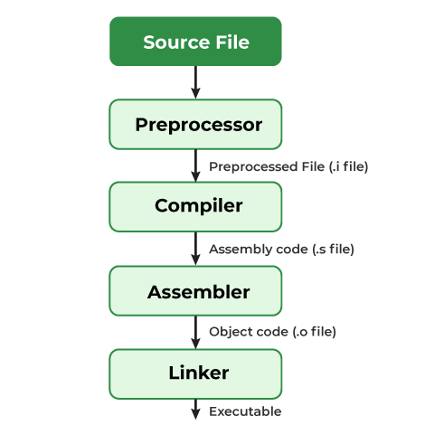
Compiling

Slide 3
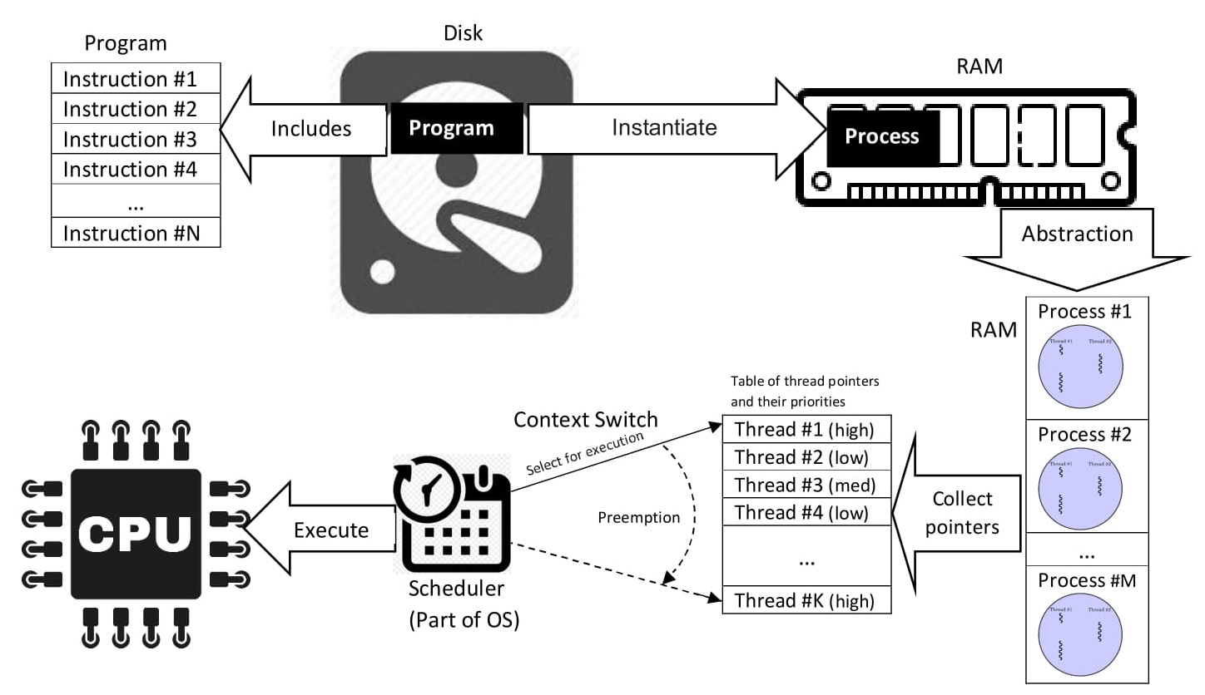
Programs
Program: set of instructions in a programming language for a computer to execute
programs will typically be compiled or interpreted depending on the language used to build them
end result is typically a binary file (machine readable instructions)
programs live in non-volatile memory (ROM) until deleted
Application: program designed to execute a specific task
often used interchangeably with program
Process: an instance of a program being executed
executed within RAM
each process contains its own memory address space
Thread: unit of execution (sub-routine) within a process
each thread within a process shares the process memory/resources
each thread will contain its own stack, but share the heap

Slide 4
Memory Allocation*
Stack
Stack
Heap
Stack
Virtual Memory
BSS
Data
Process
Text
Memory Management Unit
CPU
Stack
Process
Stack
Heap
Stack
Virtual Memory
BSS
Data
Text
* OVER-SIMPLIFIED

Slide 5

Architecture
64bit
can process 8 bytes in one instruction cycle
can address $2^{64}≈16 exabytes$ of memory (limited by RAM)
can run 32bit or 64bit OS
32bit
can process 4 bytes in one instruction cycle
can address $2^{32}≈4 GB$ of memory (limited by CPU)
can only run 32bit OS

Slide 6
Appendix

Slide 7
Program
Process
Thread
Thread
Source Code
Translation Units
Objects Files
Bin/Hex
File
Process
Pre-processing
Compilation
Linking
Thread
Thread

