Slide 1


Introduction to Virtualization on Fedora with KVM
Sept 2012
Fedora Activity Day
RVCE, Bangalore
PRESENTED BY:
Charles Rose
Dell Inc.
This work is licensed under the Creative Commons Attribution 3.0 Unported License.
To view a copy of this license, visit http://creativecommons.org/licenses/by/3.0/

Slide 2
Today's Topics
Jump Start
The Hypervisor
  Hardware-assisted virtualization
  KVM
  I/O Virtualization
  Qemu-kvm
Managing Virtualization
  Libvirt

Slide 3
Jump Start

Slide 4
Jump Start
Prepare System
  Enable virtualization In BIOS
  Install F17
Setup yum repositories
  Enable virtualization on F17
  # yum install @virtualization
  # modprobe kvm-<intel|amd>
  # ls -l /dev/kvm

Slide 5
Jump Start
Create 8GB disk image
  # qemu-img create -f qcow2 vm.img 8G
Install OS on vm.img from F17 ISO image
  # qemu-kvm -cdrom Fedora-17-x86_64-DVD.iso -hda vm.img
Start the VM
  # qemu-kvm vm.img
Thats it!
  But how does it all work?

Slide 6
The Hypervisor

Slide 7
30,000' View
qemu-kvm
qemu-kvm
Virt-*
Gnome-boxes
Ovirt
Guest A
Guest B
App A1
App B1
libvirt
App A2
App B2
OpenStack
Linux Kernel
KVM kernel module

Slide 8
Hardware-Assisted Virtualization
Binary Translation
  Modify in-memory kernel/driver at run-time
CPU Para-virtualization
  Modify guest Kernel/Driver source
Hardware Assisted (Full) - Intel VT-x, AMD-V
  New operating modes: VMX root, VMX non-root
  Transition b/w modes: VM entry, VM exit

Slide 9
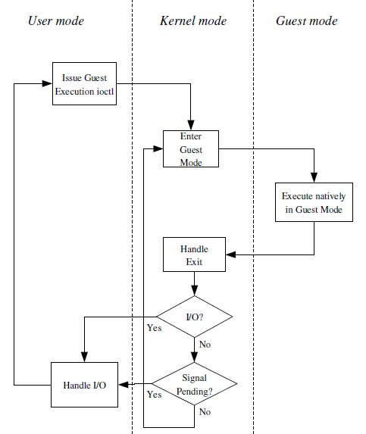
KVM
qemu-kvm
qemu-kvm
App
Kernel Mode
User Mode
Guest Mode
Guest
Guest
VMXON
VMLAUNCH VMRESUME
Kernel
KVM kernel module
UserMode: qemu-kvm
Kernel Mode: kvm.ko
Interface: ioctl /dev/kvm
VMEXIT
'Kvm': Proceedings of the
Linux Symposium, 2007; Avi Kivity, et. al.

Slide 10
I/O Virtualization
qemu-kvm
Para-virt I/O
  Virtio
  Hypervisor Agnostic
  Guest Drivers
    Virtio-blk
    Virtio-net
    Virtio-baloon
    Virtio-serial
Guest Operating System
virtio-blk
virtio-net
virtio-serial
Linux Kernel
KVM kernel module

Slide 11
qemu-kvm
CPU
Miscl
  Serial
  Bluetooth
  RTC
Keyboard Mouse
BIOS
  ACPI Tables
  SMBIOS
  Boot order
Guest Operating System
Drives
  Hard Disk
  CDROM
PCI Devices
  Network
  Storage
  Graphics
Floppy
PCI Pass through
Sound
USB Bus
  USB Devices
Graphics

Slide 12
Qemu-kvm command line
# /usr/bin/qemu-kvm -S -M pc-0.15 -enable-kvm -m 1024 -smp 1,sockets=1,cores=1,threads=1 -name devbox -uuid a073c70f-36bc-08c2-2a65-2cbdc30b95bc -nodefconfig -nodefaults -chardev socket,id=charmonitor,path=/var/lib/libvirt/qemu/devbox.monitor,server,nowait -mon chardev=charmonitor,id=monitor,mode=control -rtc base=utc -no-shutdown -device piix3-usb-uhci,id=usb,bus=pci.0,addr=0x1.0x2 -device virtio-serial-pci,id=virtio-serial0,bus=pci.0,addr=0x5 -drive file=/var/lib/libvirt/images/devbox.img,if=none,id=drive-virtio-disk0,format=raw -device virtio-blk-pci,scsi=off,bus=pci.0,addr=0x6,drive=drive-virtio-disk0,id=virtio-disk0,bootindex=1 -netdev tap,fd=24,id=hostnet0,vhost=on,vhostfd=25 -device virtio-net-pci,netdev=hostnet0,id=net0,mac=52:54:00:3f:33:d3,bus=pci.0,addr=0x3 -chardev pty,id=charserial0 -device isa-serial,chardev=charserial0,id=serial0 -chardev spicevmc,id=charchannel0,name=vdagent -device virtserialport,bus=virtio-serial0.0,nr=1,chardev=charchannel0,id=channel0,name=com.redhat.spice.0 -device usb-tablet,id=input0 -spice port=5900,addr=127.0.0.1,disable-ticketing -vga qxl -global qxl-vga.vram_size=67108864 -device intel-hda,id=sound0,bus=pci.0,addr=0x4 -device hda-duplex,id=sound0-codec0,bus=sound0.0,cad=0 -device virtio-balloon-pci,id=balloon0,bus=pci.0,addr=0x7

Slide 13
Managing
Virtualization

Slide 14
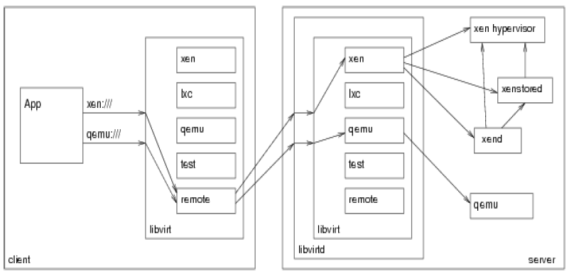
Libvirt – Abstract it all!
# service start libvirtd
# virsh --connect qemu:///system start devbox

Slide 15
Domain Configuration
# virsh dump myvm
<domain type='kvm'>
<name>rhel6.2-ovirt</name>
<uuid>88d10cca-d36a-74a2-cee1-1b714a07919b</uuid>
<memory unit='KiB'>4194304</memory>
<currentMemory unit='KiB'>4194304</currentMemory>
<vcpu>2</vcpu>
<os>
<type arch='x86_64' machine='pc-0.14'>hvm</type>
<boot dev='hd'/>
</os>
<features>
<acpi/>
<apic/>
<pae/>
</features>
<clock offset='utc'/>
<on_poweroff>destroy</on_poweroff>
<on_reboot>restart</on_reboot>
<on_crash>restart</on_crash>
<devices>
<emulator>/usr/bin/qemu-kvm</emulator>
<disk type='file' device='disk'>
<driver name='qemu' type='raw'/>
<source file='/var/lib/libvirt/images/rhel6.2-ovirt.img'/>
<target dev='vda' bus='virtio'/>
<address type='pci' domain='0x0000' bus='0x00' slot='0x04' function='0x0'/>
</disk>

Slide 16
Making it Easy
Through libvirt
virsh
virt-install
virt-manager
virt-viewer
virt-clone
virt-image
virt-convert
guestfs-browser
# service start libvirtd
# virt-install –name myvm --prompt
# virsh shutdown myvm
# virsh start myvm
# virt-viewer myvm
# virt-manager
# gnome-boxes

Slide 17
References
www.linux-kvm.org
wiki.qemu.org/KVM
libvirt.org
Native Linux KVM tool
  github.com/penberg/linux-kvm/tree/master/tools/kvm
Datacenter Management of KVM hypervisors
  www.ovirt.org
Openstack and libvirt
  wiki.openstack.org/LibvirtAPIvirsh

Slide 18
Summary
Qemu-kvm: Get started with KVM based virtualization
KVM: hardware assisted virtualization
  Virtual Machine is a Linux Process
I/O Virtualization: virtio for better performance
Libvirt: Abstraction to qemu-kvm
  Virt-* tools for easy management

Slide 19
Backup
Thin provisioning
Create a thinly provisioned vmthin.img based on vm.img
  # qemu-img –b vm.img –f qcow2 vmthin.img
  # qemu-kvm vm.img
  # qemu-kvm vmthin.img

Slide 20
Backup
Thin provisioning
Create a thinly provisioned vmthin.img based on vm.img
  # qemu-img –b vm.img –f qcow2 vmthin.img
  # qemu-kvm vm.img
  # qemu-kvm vmthin.img

Slide 21
Questions?
CONTACT:
charles_rose@dell.com
This work is licensed under the Creative Commons Attribution 3.0 Unported License.
To view a copy of this license, visit http://creativecommons.org/licenses/by/3.0/

