Slide 1
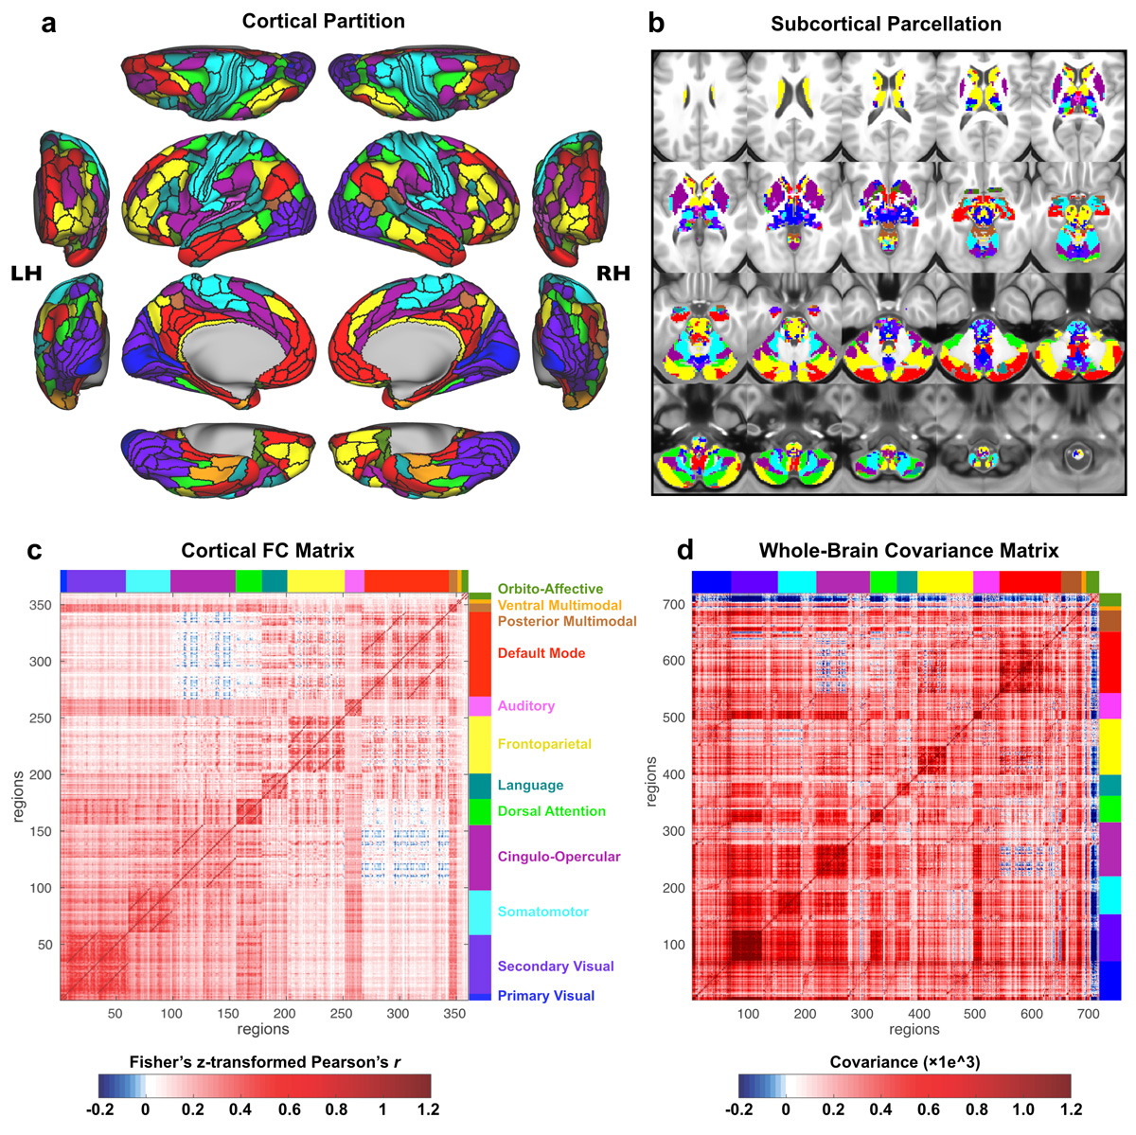
fMRI measures: GBC
functional connectivity between each pair of regions
row averages for full FC matrix, giving one GBC value per region
360 cortical regions (Glasser et al. 2016)
High GBC = more similar
Low GBC = less similar

Slide 2
fMRI measures: LC
Within-region functional connectivity between each vertex
Average within-region connectivity
360 cortical regions
High LC = homogenous signal
Low LC = heterogeneous signal

Slide 3
fMRI measures: BSV
Temporal standard deviation of signal at each vertex
Average within region SD
360 cortical regions
High BSV = large amplitude changes
Low BSV = small amplitude changes

