Slide 1
Field Line Resonance in Two and a Half Dimensions
Charles McEachern
Advisor: Bob Lysak

Slide 2
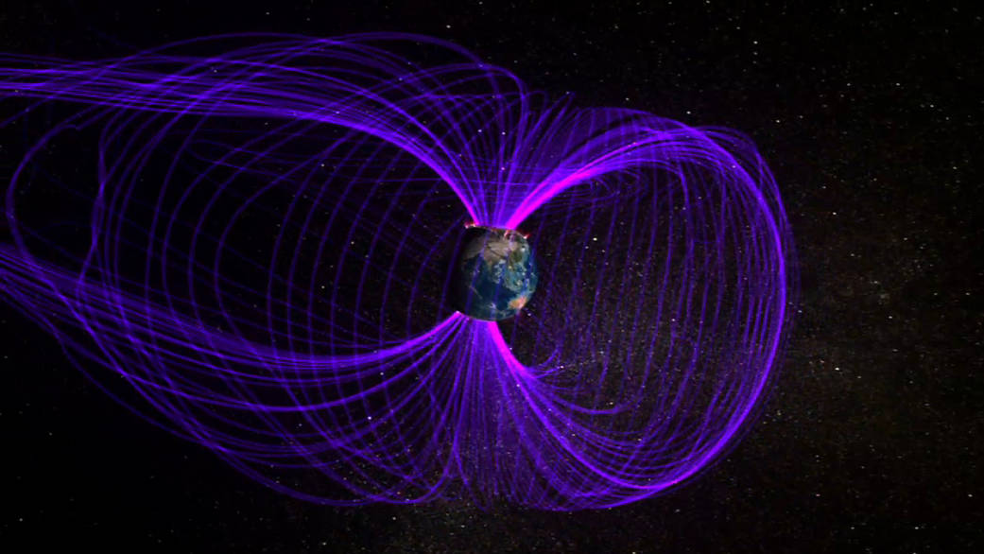

Earth's Magnetic Field
When shaken by the solar wind, etc, Earth's dipole field rattles.
NASA
Flóra Borsi

Slide 3
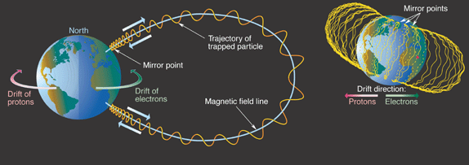
Particles in a Dipole Field
Three fundamental motions: gyro, bounce, drift.
Resonance happens when particle frequency matches wave frequency.
aero.org

Slide 4
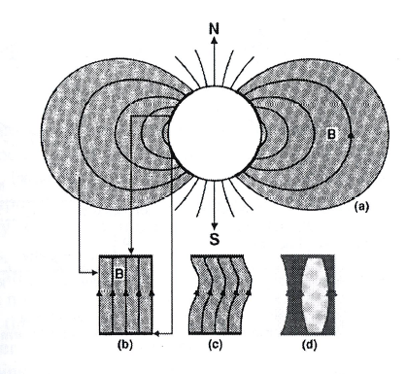
Alfvén Waves
Shear Alfvén waves carry energy along the magnetic field.
Compressional Alfvén waves can carry energy across field lines.

Slide 5
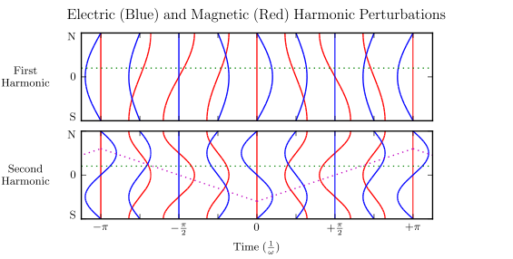
Odd and Even Harmonics

Slide 6
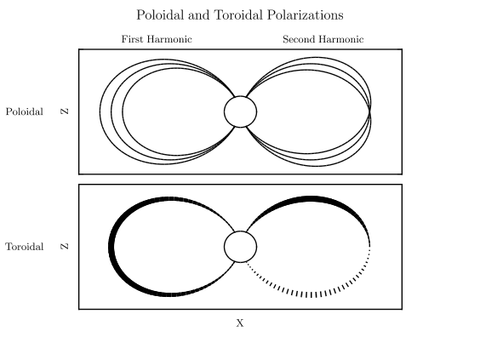

Slide 7
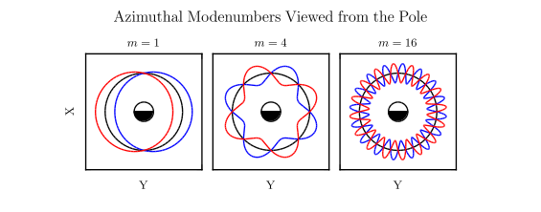
Azimuthal Modenumber
Small m waves tend to be driven externally.
Large m waves are driven internally.

Slide 8
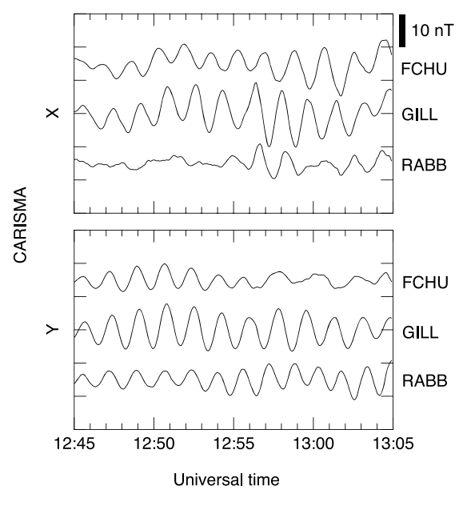
Pc4s and Giant Pulsations
Pc4s:
FLR at 7mHz to 25mHz.
Mostly toroidal.
Peak near noon.
Pg:
Odd poloidal Pc4.
Peak near midnight.
Striking ground signature.
Typically 16 < m < 35.
Takahashi, 2011

Slide 9
Outline
Intro (done!)
Numerical Model
Numerical Results
Van Allen Probe Observations

Slide 10
“Tuna Half” Dimensions
The ionosphere is important to FLRs, but is also computationally demanding.
High-m waves are of particular interest, but are hard to resolve in 3D.
We don't actually need to look at the dayside and nightside at the same time.
Say everything goes as exp(imφ).

Slide 11
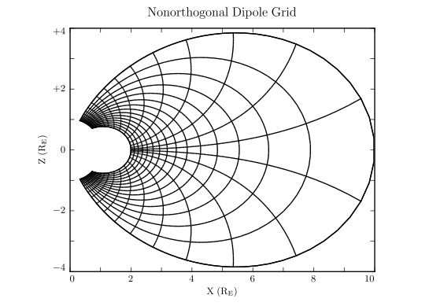

Slide 12
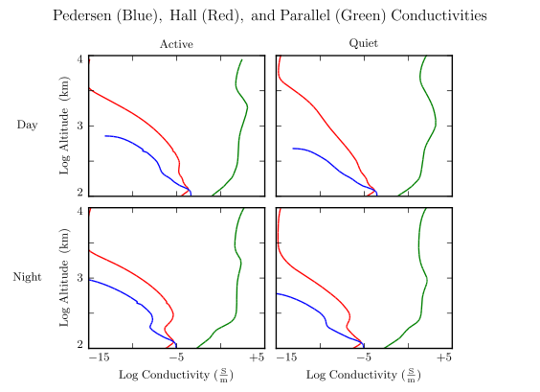
Physical Parameter Profiles
Background dipole magnetic field.
Height-resolved conductivity profiles.
Density profile, including the plasmasphere.
Alfvén speed.

Slide 13
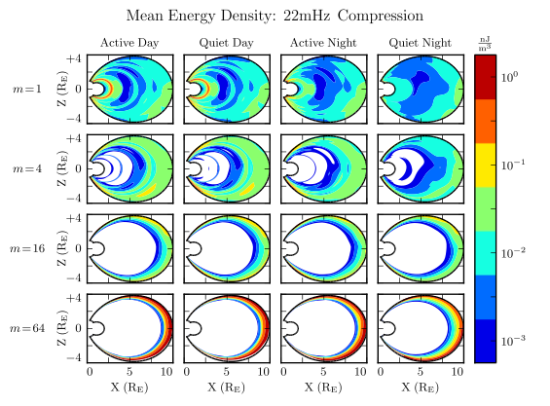
Driving with Compression?

Slide 14
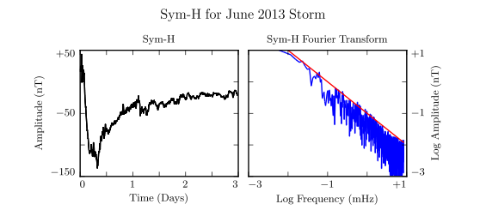
Driving with Current
From Sym-H pink noise, estimate the strength of ring current perturbations at 10 mHz.

Slide 15
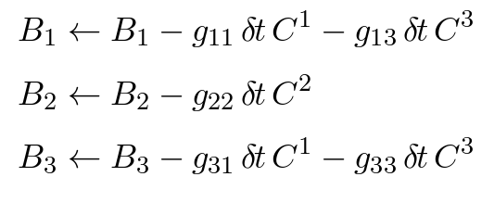
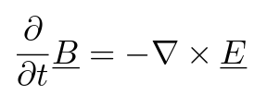

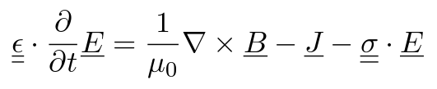

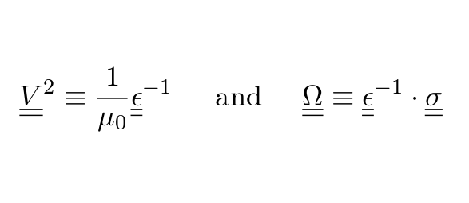
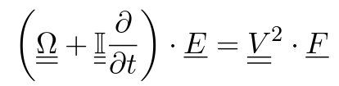
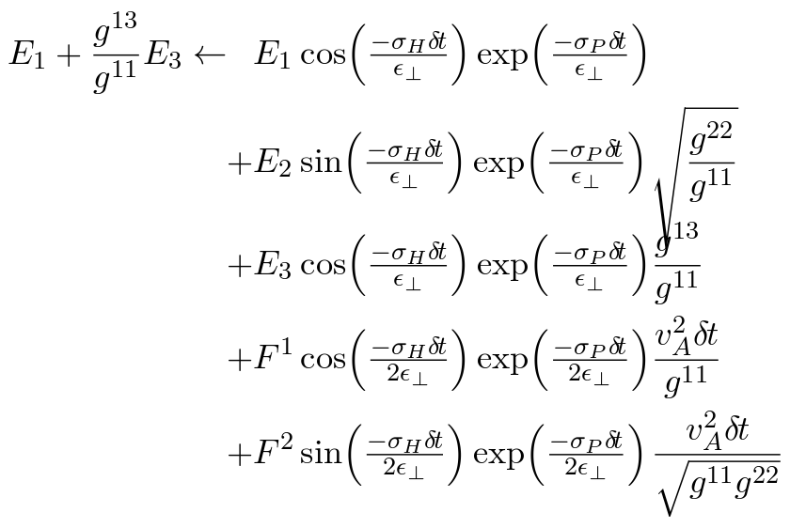
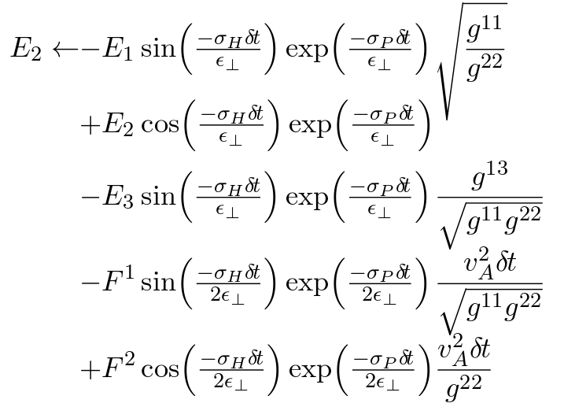

Maxwell's Equations

Slide 16
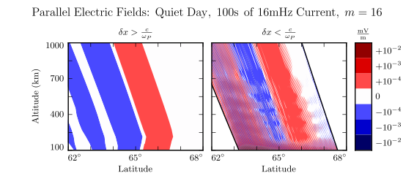
Electron Inertial Effects

Slide 17




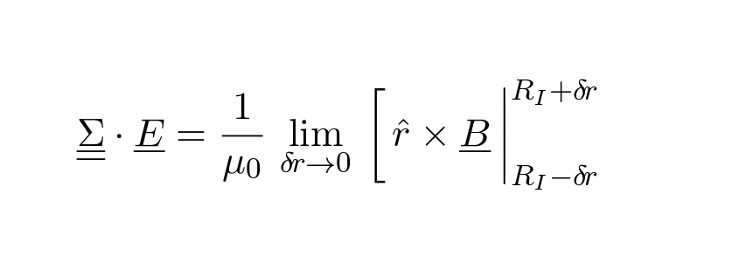
Coupling to the Atmosphere
and
so where

Slide 18
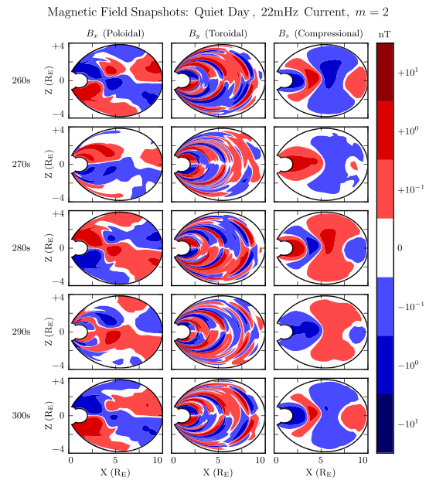

Slide 19
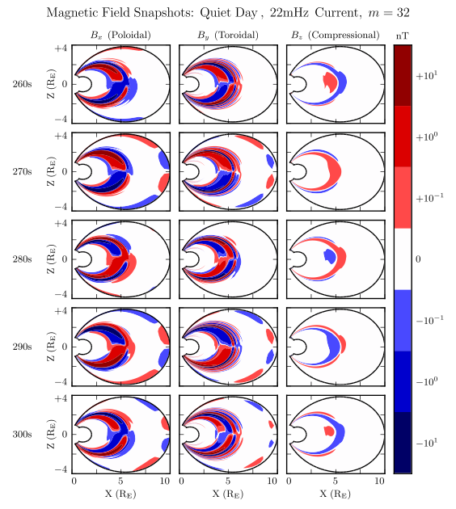

Slide 20
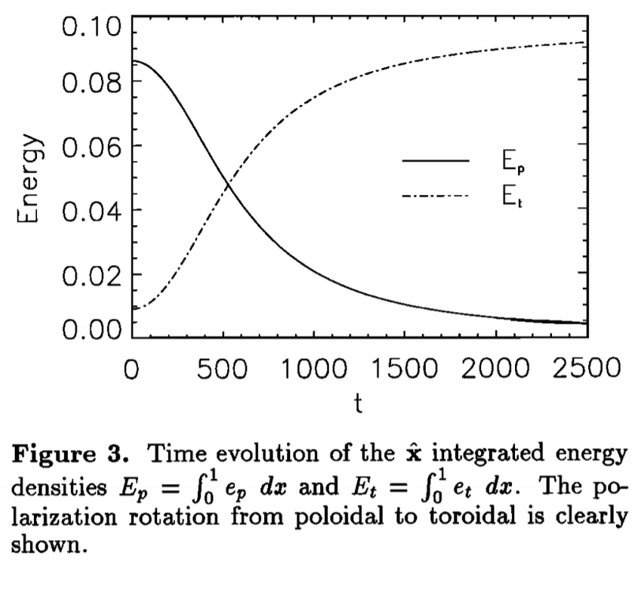
Poloidal-to-Toroidal Rotation
Poloidal waves rotate to the toroidal mode over time.
Low-m waves rotate faster.
Mann and Wright, 1995

Slide 21
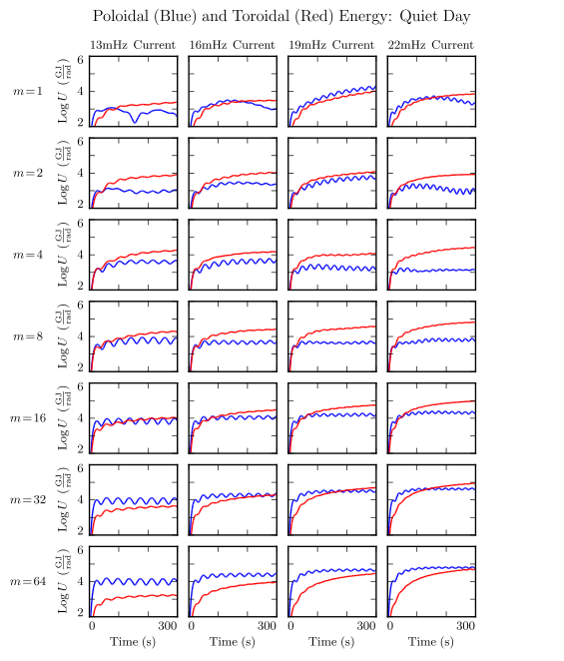
Slowest rotation at high m.
Faster rotation at moderate m.
Low m: ???

Slide 22
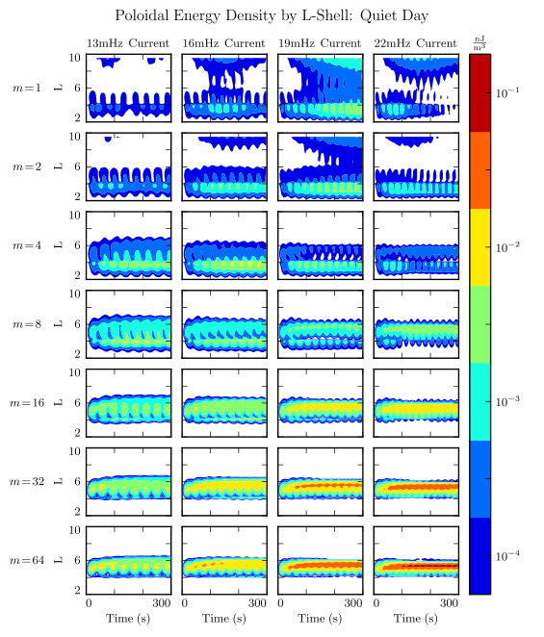
Guided at high m.
Escape at low m.
Buildup near boundary likely nonphysical.

Slide 23
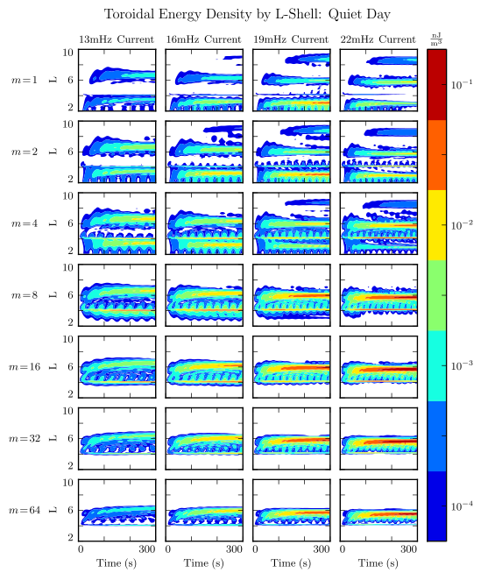
Sharp in L, regardless of m.
Asymptotically exceeds poloidal energy in most runs.

Slide 24
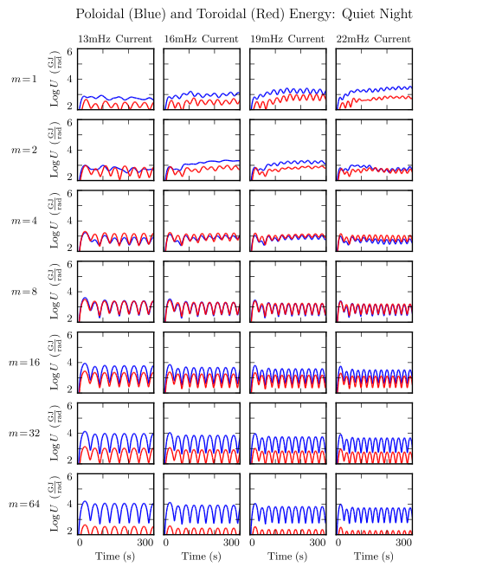
Ionosphere is the only change.
Low m: still weird.
Moderate m: still best for toroidal.
High m: toroidal very weak.

Slide 25
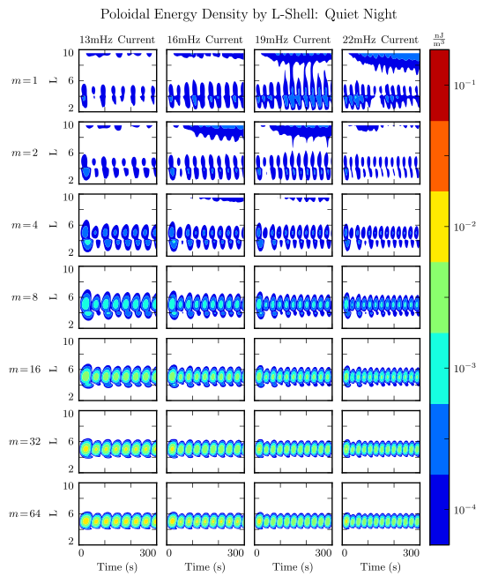
Low m: still escaping.
Higher m → more guided, stronger.
Down 10x from the dayside.

Slide 26
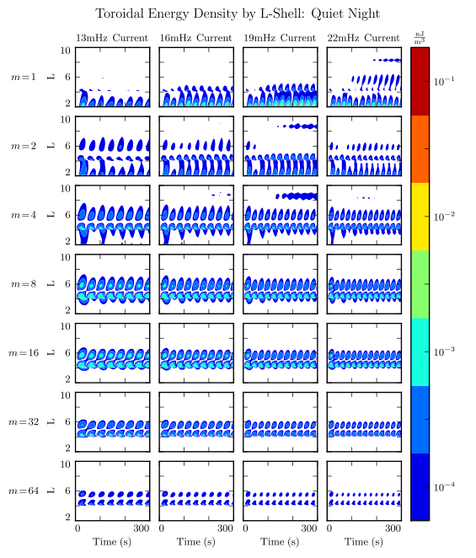
Low to moderate m: weaker than dayside, but qualitatively similar.
High m: barely exists. Rotation slower than Joule dissipation.

Slide 27
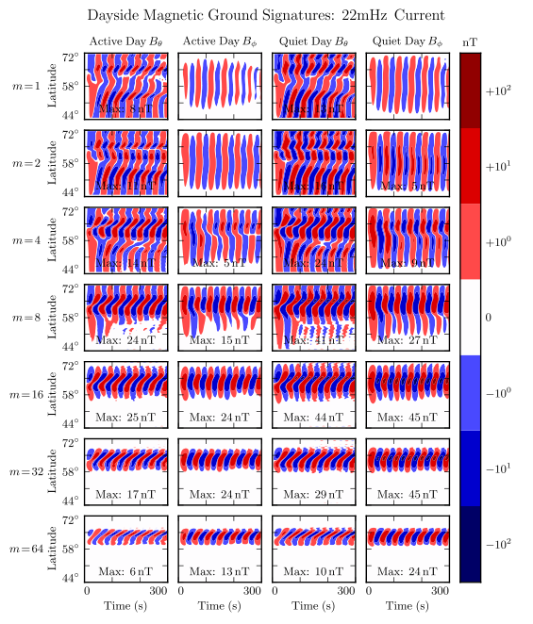
Peak at m=16, 32.
Mostly east-west polarized.
Strongest for quiet profile.
Low latitude CCW, high latitude CW.

Slide 28
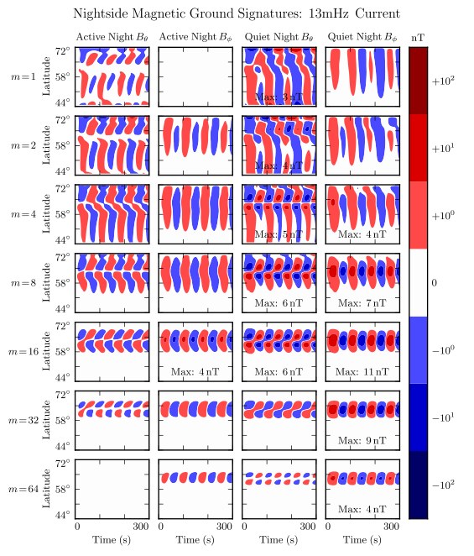
Weaker by a factor of 4.
Pg properties still apparent.

Slide 29
Comparison to Observations?
How does the distribution of Pgs line up with that of odd poloidal Pc4s overall?
Do the distributions of odd poloidal Pc4s and odd toroidal Pc4s look similar – with the toroidal ones skewed dayward?
How about even Pc4s?

Slide 30
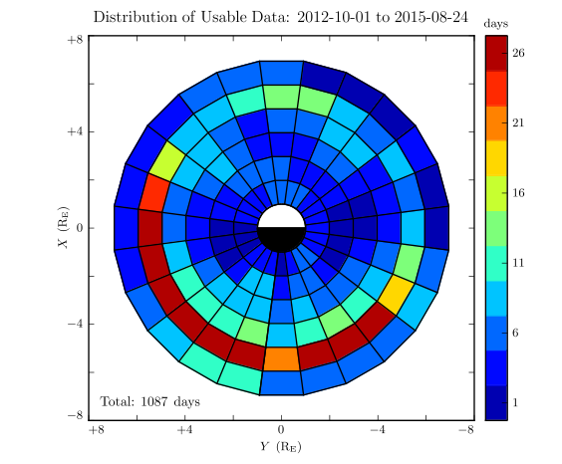

Slide 31
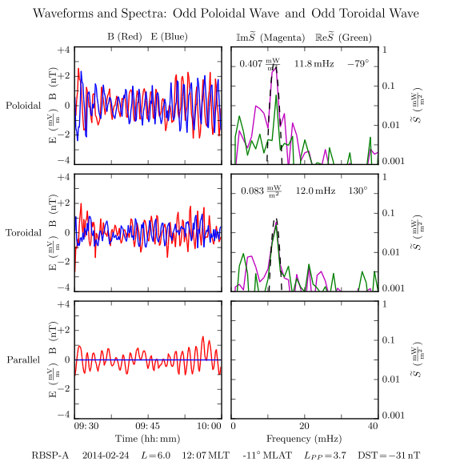
Event Selection
For each channel:
Fit the spectrum.
Check frequency.
Check magnitude.
Check coherence.
Check parity.

Slide 32
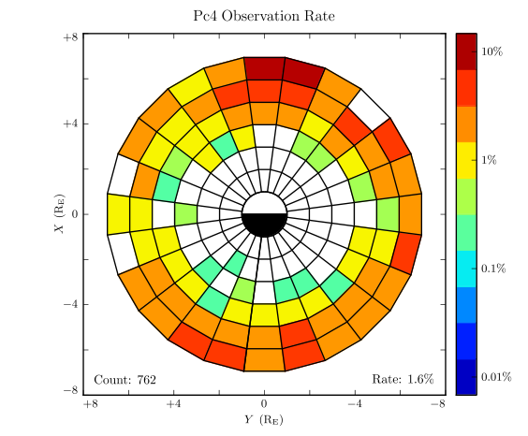

Slide 33
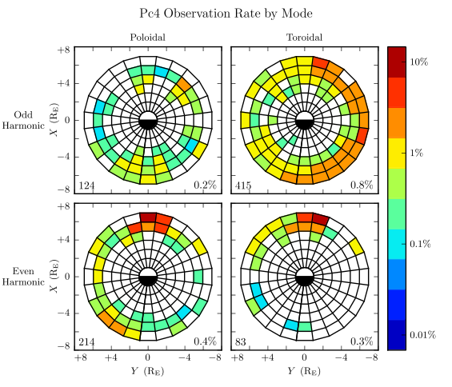

Slide 34
Summary and Conclusions
Past work has described Pc4s in terms of a mishmash of different properties.
Tuna is a code designed to simulate Pc4s effectively, even at high modenumber.
Numerical results suggest novel connections between known Pc4 properties.
In situ survey and numerical results compliment one another.

